Slide 1
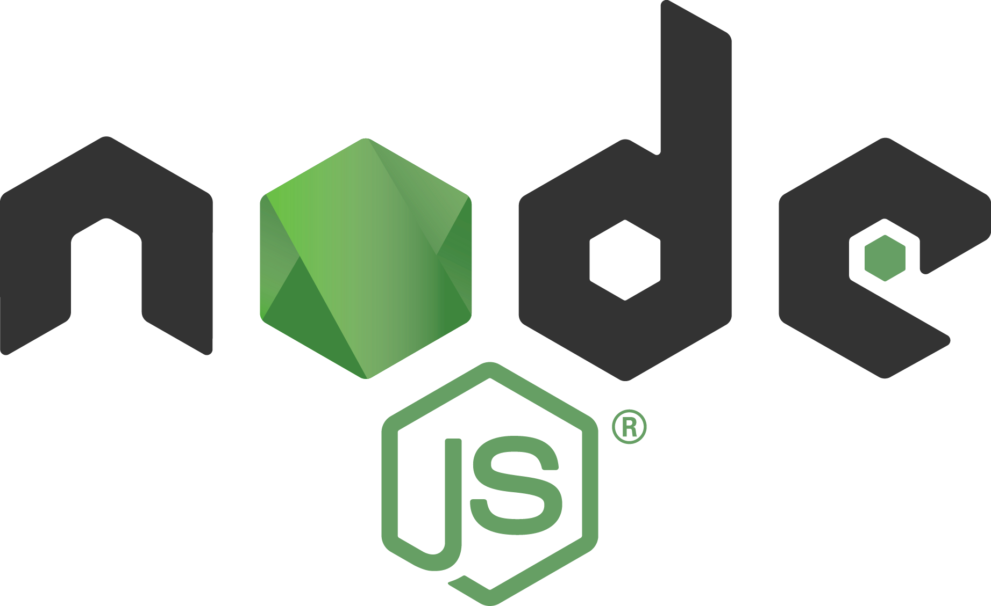

Slide 2

Node’s goal is to provide an easy way to build scalable network programs

Slide 3
Node.JS
Node.js is an open source, cross-platform, JavaScript runtime built on Chrome's V8 JavaScript engine, for developing server and client side applications. Node.js uses an event-driven, non-blocking I/O model that makes it lightweight and efficient.

Slide 4
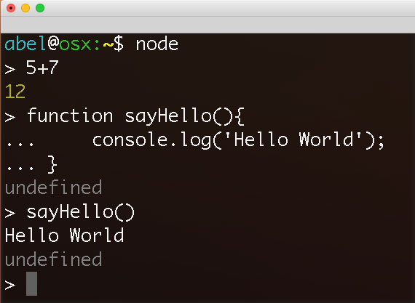
Console Use

Slide 5
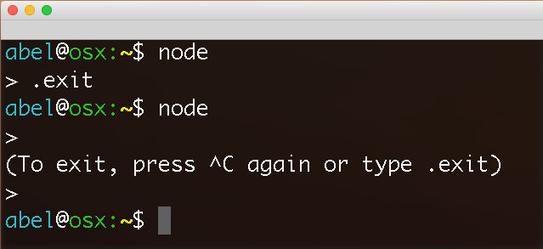
Exit Console

Slide 6
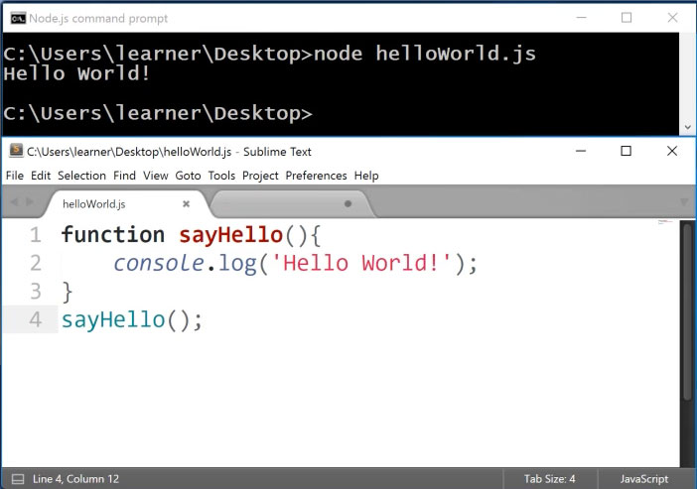
Run File

Slide 7
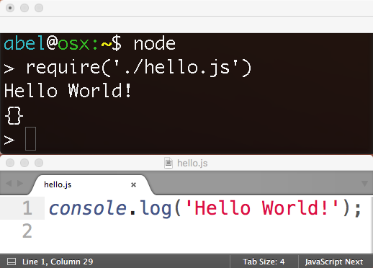
Load File

Slide 8
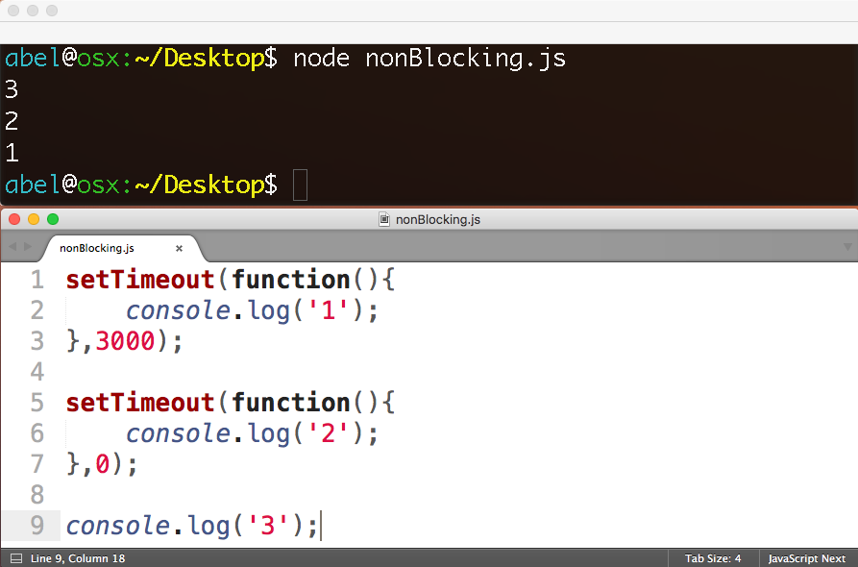
Non-Blocking

Slide 9


Slide 10
trigger callback
register callback
REQUESTS
EXPENSIVE
OPERATION
EVENT LOOP
(single thread)
operation complete
FILE SYSTEM
DATABASE
COMPUTATION

Slide 11
Architectural Shift
1.old) web server with some application logic
1.new) app that can connect and collaborate
2.old) stateful
2.new) stateless

Slide 12
Architectural Shift
1.old) blocking
1.new) non-blocking
2.old) process per request
2.new) single process

Slide 13
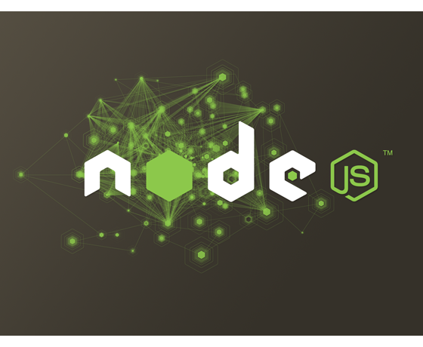
MODULES

Slide 14
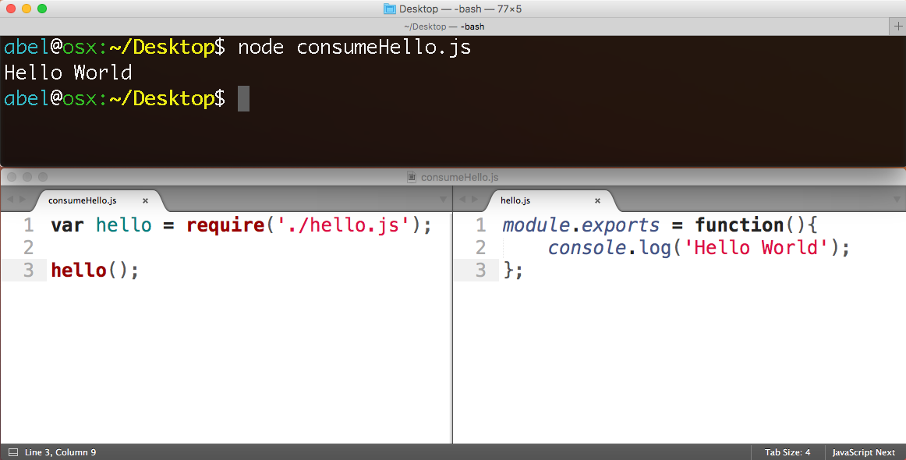
Use module with
“require”
Make module with “module.exports”

Slide 15

What is npm?
https://www.npmjs.com
Package manager. Installs, publishes and manages node programs

Slide 16
What is npm?
400,000+ Modules

Slide 17
What is npm?
261 Million
downloads in the past day

Slide 18
What is npm?
1.9 Billion
downloads in the past week

Slide 19
What is npm?
7.8 Billion
downloads per month

Slide 20
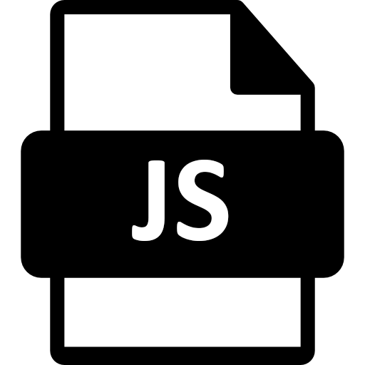

What is a Module?
A Module is some JavaScript paired with a package.json file
+

Slide 21
Advantages
Small pieces, loosely joined
Leverage external packages
Leverage internal packages
Facilitate collaboration
Packages are discoverable in npm

Slide 22
Creating node/npm apps

Slide 23
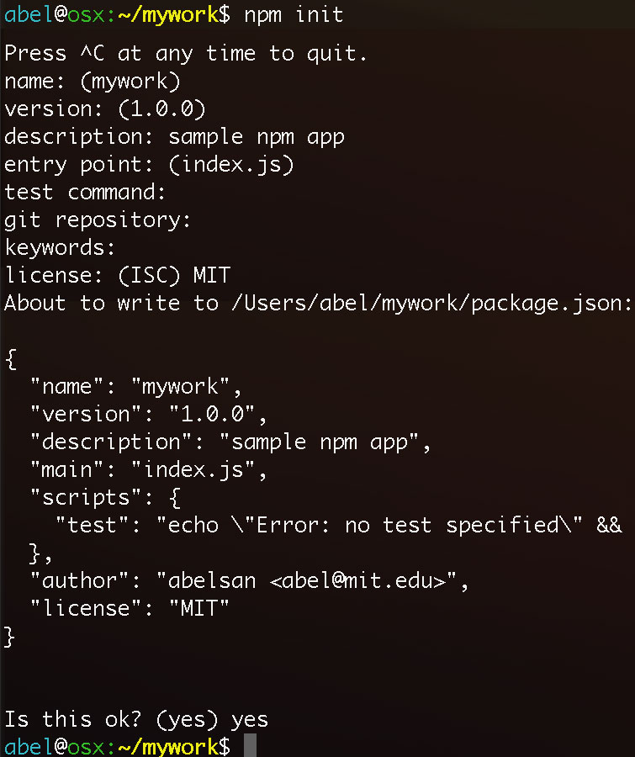
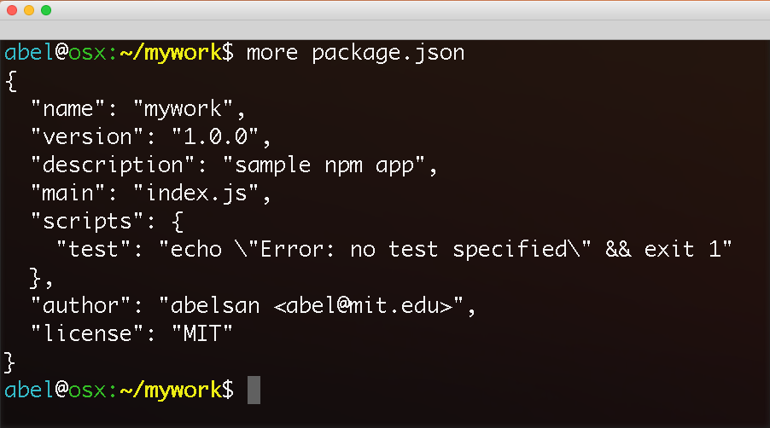
“npm init” generates the configuration file package.json

Slide 24
adding npm packages
to your application

Slide 25
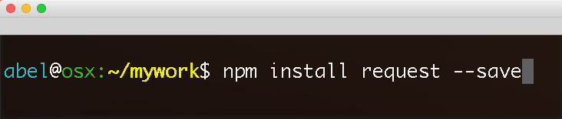
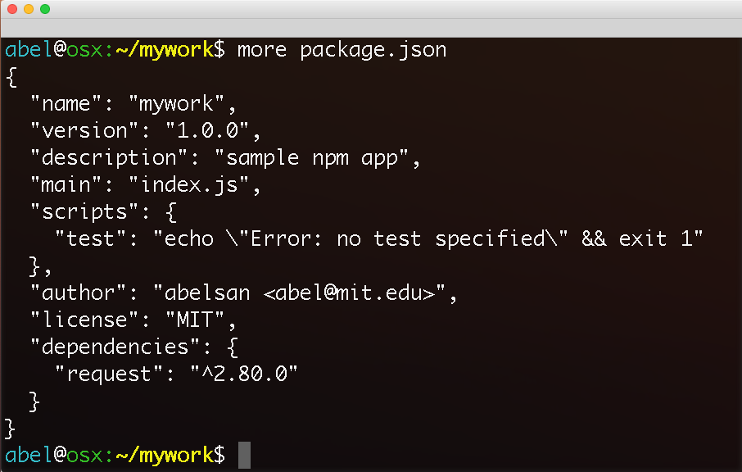
Local installation of request package. Dependency added to package.json

Slide 26
Active Learning
…

Slide 27
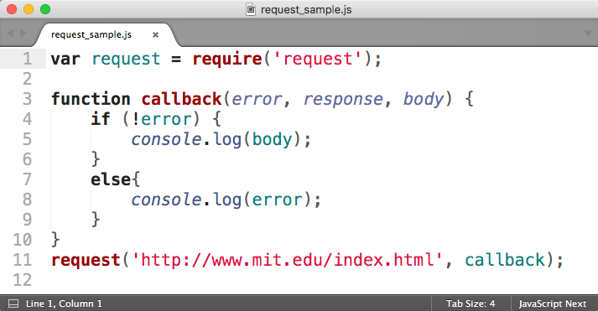
Request Basics

Slide 28
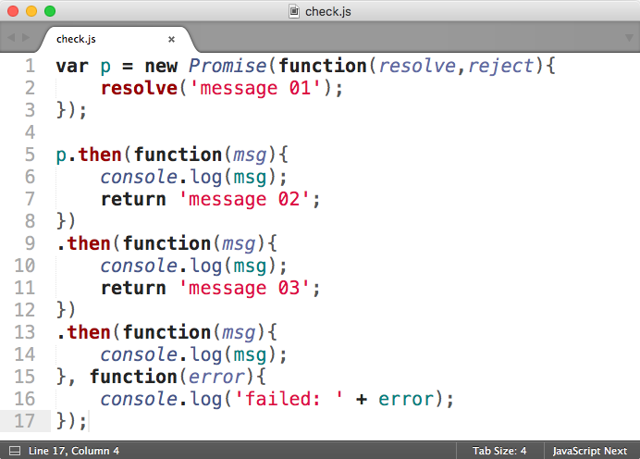
Promises Basics
Basics …

