Slide 1
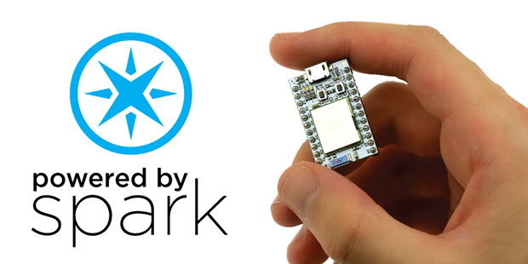

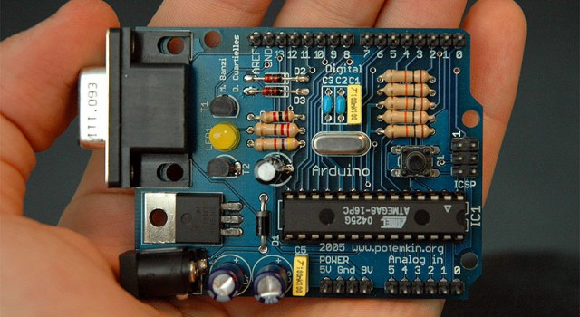
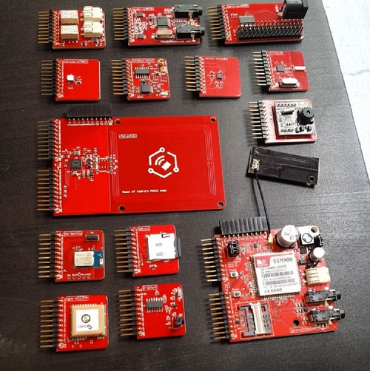
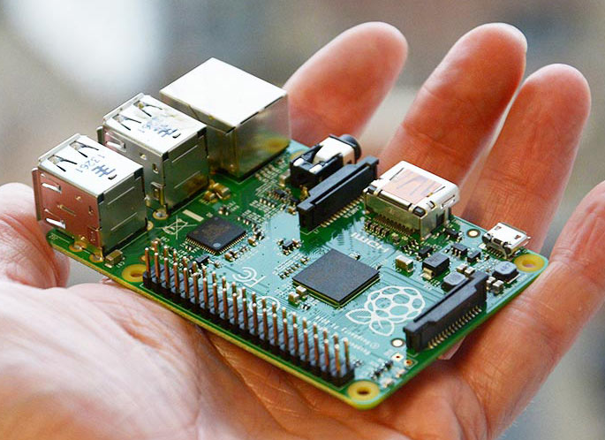
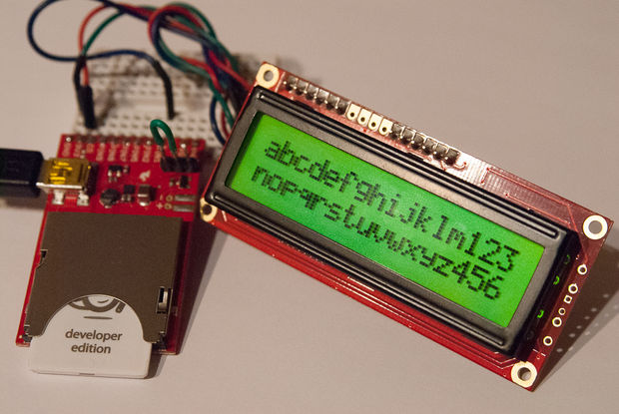




Internet of Things

Slide 2
How do devices communicate?

Slide 3
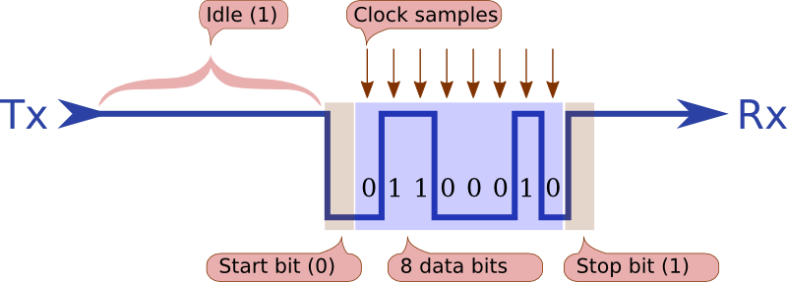
Serial Communication
Send data bit by bit
Format and transfer rate must be agreed at both ends

Slide 4
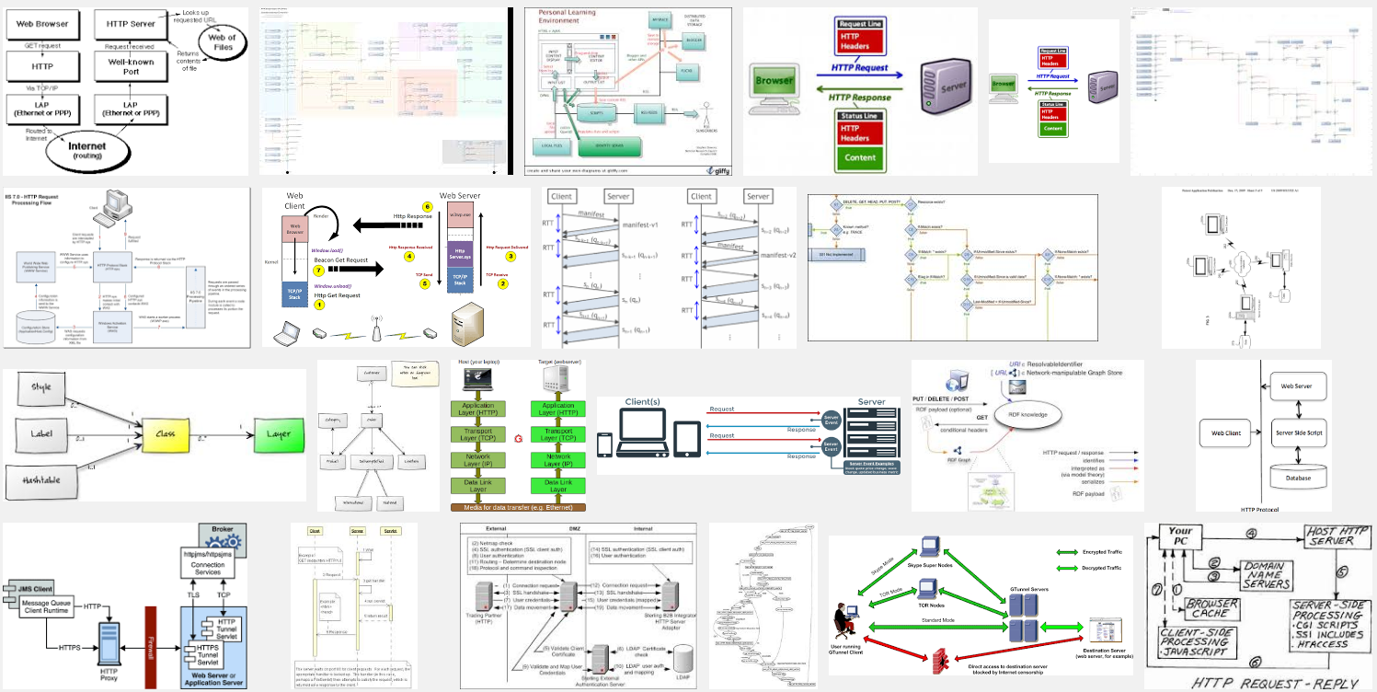
HTTP

Slide 5
HTTP: RESTful
A “request” is sent to a server via URL
Eg. http://api.example.com/resources/user/1036721?name=something
Response is usually text in HTML, XML, or JSON
Great if your asking for something
What about “push”
Eg. Server wants to tell device to do something
Path or variables
variables

Slide 6

HTTP: RESTful Hypothetical Light Switch
Cell Phone
Server
api.example.com/turnoff
api.example.com/shoulditurnoff
WiFi Switch
Should I turn off?
No
Process Response
Yes
Turn off

Slide 7
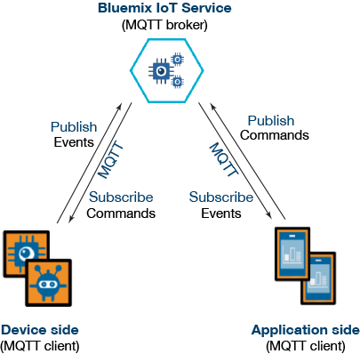
MQTT: Message Queuing Telemetry Transport

Slide 8
MQTT
MQTT was invented by Andy Stanford-Clark (IBM) and Arlen Nipper (Arcom, now Cirrus Link) back in 1999, when their use case was to create a protocol for minimal battery loss and minimal bandwidth connecting oil pipelines over satellite connection. They specified the following goals, which the future protocol should have:
Simple to implement
Provide a Quality of Service Data Delivery
Lightweight and Bandwidth Efficient
Data Agnostic
Continuous Session Awareness

Slide 9
MQTT: Pub/Sub
Clients connect to a “Broker”
Clients subscribe to topics eg,
client.subscribe(‘toggleLight/1’)
client.subscribe(‘toggleLight/2’)
client.subscribe(‘toggleLight/3’)
Clients can publish messages to topics:
client.publish(‘toggleLight/1’, ‘toggle’);
client.publish(‘toggleLight/2’, ‘toggle’);
All clients receive all messages published to topics they subscribe to
Messages can be anything
Text
Images
etc

Slide 10
MQTT Hypothetical Light Switch
Cell Phone
Broker
client.publish(‘lightSwitch/1’, ‘toggle’)
‘toggle’
WiFi Switch
Toggle Switch

Slide 11

Websockets
Chrome supports HTTP, HTTPS, FILE, FTP, WS (websockets).
Chrome does not support MQTT
But you can do MQTT over websockets!
What is websockets?

Slide 12
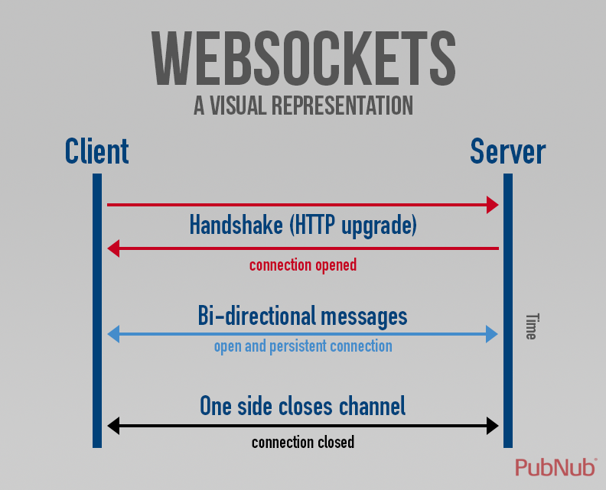
Websockets

Slide 13
Websockets
client.js
var webSocketClient = require('ws');
var ws = new webSocketClient('ws://localhost:8080');
var id = Math.floor(Math.random()*10000);
ws.on('message', function(message) {
console.log('received from %s', message);
});
function sendMessage(){
var timeStamp = Date.now();
var message = 'clientId:' + id + ', '
+ 'timeStamp:' + timeStamp;
ws.send(message);
}
function timer(){
sendMessage();
setTimeout(timer, 3000);
}
ws.on('open', function() {
timer();
});
server.js
var webSocketServer = require('ws').Server;
var wss = new webSocketServer({port: 8080});
// broadcast client message to all
wss.broadcast = function broadcast(data) {
wss.clients.forEach(function each(client) {
client.send(data);
});
};
// catch client messages
wss.on('connection', function connection(ws) {
ws.on('message', function incoming(message) {
console.log('received from %s', message);
wss.broadcast(message);
});
});

Slide 14
MQTT Over Websockets
We can still use MQTT in a browser
The connection is handled via Websockets
This eliminates a lot of the “housekeeping” required by Websockets
Many to many communication much easier

Slide 15
MQTT
var mqtt = require('mqtt')
client = mqtt.connect('mqtt://162.243.219.88',1883)
client.on('message', function (topic, message) {
console.log(message)
});
client.on('connect', function () {
client.subscribe('tesselData');
client.publish('tesselData','Hello from <someone>')
});

Slide 16



MQTT in the wild

Slide 17

The Broker
IP Address: 162.243.219.88
MQTT Port: 1883 (For running in NodeJS)
Websocket Port: 9001 (For running in a web browser)
Broker is running on DigitalOcean
https://www.digitalocean.com/
Broker is Mosquitto
https://mosquitto.org/

Slide 18
Active Learning
mqtt-formatting
Connect to an MQTT server
Send and receive messages

Slide 19
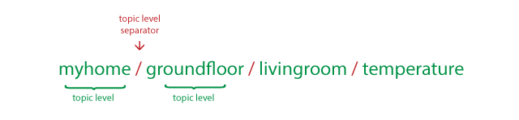
Channels in MQTT
Channels/topics in MQTT work like file paths
When subscribing to a channel we have to specify the whole path
Or use a wildcard
+
#

Slide 20

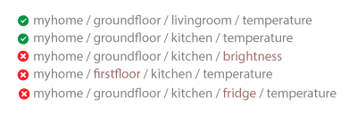
+ Wildcard

Slide 21

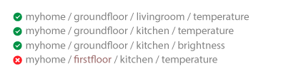
# Wildcard

Slide 22
Active Learning
mqtt-channels
Understand how channel paths work

Slide 23
MQTT Light Switch
browser-hardware-matrix.zip
Use MQTT to send a message to the device to toggle an LED
Format as JSON string
{id:”YourID”, state:true/false}
Your ID is the day of your birthday plus by 0 (male) or 32 (female)
John was born on the 27th February, his ID is 27.
Elizabeth was born on 11th May, her ID is 43
Add your code to ledMatrix.html to send the message
serverTessel.js is the code running on the device

Slide 24
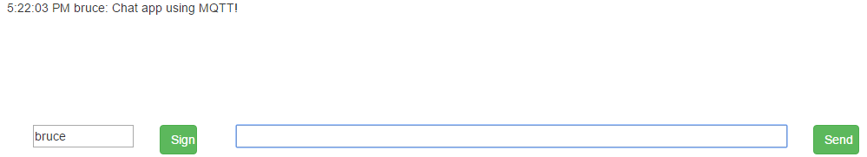
Chat with MQTT
chat.zip on stellar

Slide 25
Plotting Ambient Sensor Data
Browser-hardware-sensors.zip
Add your code to sensors.html
Receive sensor data via MQTT
Format as a JSON string:
{date, lightLevel:data, soundLevel:data}
Plot the data live with google charts
serverTessel.js is the code running on the device

Slide 26
Timestamps
How do we know the order in which events occurred?
Messages might be timestamped
Were the clocks synced across machines?
Ultimate solution:
https://en.wikipedia.org/wiki/Spanner_(database)

