Slide 1
Naive Bayesian Classification
Abel Sanchez, John R Williams

Slide 2
Stunningly Simple
The mathematics of Bayes Theorem are stunningly simple. In its most basic form, it is just an equation with three known variables and one unknown one.
This simple formula can lead to surprising predictive insights.

Slide 3
Bayes and Laplace
The intimate connection between probability, prediction, and scientific progress was thus well understood by Bayes and Laplace in the eighteenth century—the period when human societies were beginning to take the explosion of information that had become available with the invention of the printing press several centuries earlier, and finally translate it into sustained scientific, technological, and economic progress.

Slide 4
Conditional Probability
Bayes’s theorem is concerned with conditional probability. That is, it tells us the probability that a hypothesis is true if some event has happened.

Slide 5
Bayes Theorem
P(A) and P(B) | are the probabilities of A and B independent of each other
P(A|B) | a conditional probability, is the probability of A given that B is true
P(B|A) | is the probability of B given that A is true

Slide 6

Example

Slide 7
Probability that your partner is cheating on you, given an event
Event: you come home from a business trip to discover a strange pair of underwear.
Condition: you have found the underwear
Hypothesis: probability that you are being cheated on

Slide 8
p(u/c) - The probability of underwear u given cheating c
Probability of underwear appearing, conditional on his cheating
50%

Slide 9
p(u) - The probability of the underwear u appearing if NO cheating
Probability of the underwear’s appearing conditional on the hypothesis being false.
5%

Slide 10
p(u) - The probability of cheating c
What is the probability you would have assigned to him cheating on you before you found the underwear?
4%

Slide 11
Underwear Example*
 | The probability of cheating c given underwear u
 | The probability of underwear u given cheating c
 | The probability of the cheating c
 | The probability of the underwear u
* The Signal and the Noise: Why So Many Predictions Fail--but Some Don't, Nate Silver, 2012

Slide 12
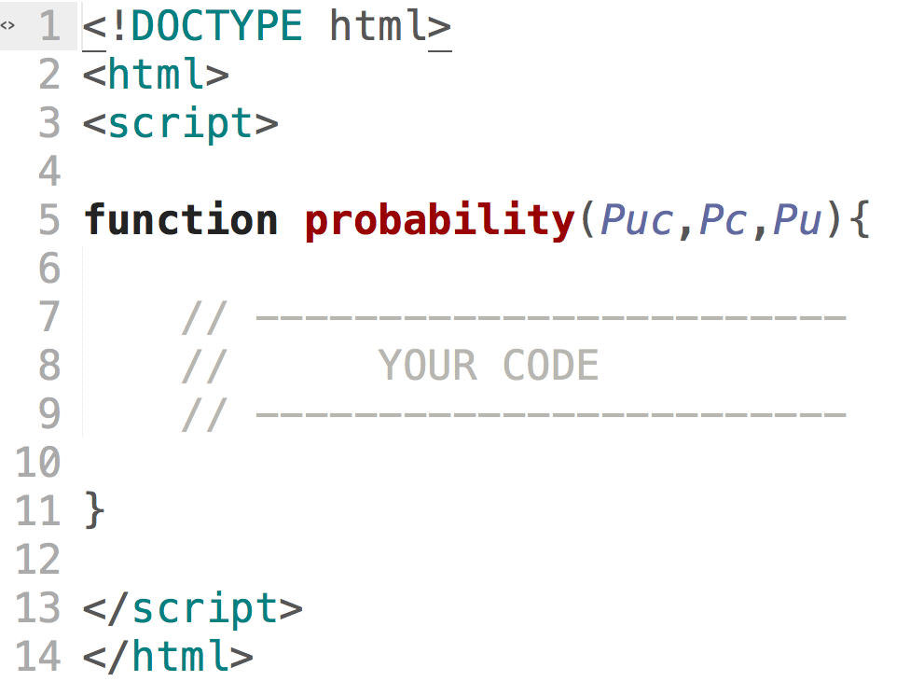
Active Learning

Slide 13
Active Learning – Calculate Cheating Probability
 | The probability of cheating c given underwear u
 | The probability of underwear u given cheating c | 50
 | The probability of the cheating c | 4
 | The probability of the underwear u appearing if NO cheating | 5

Slide 14
Classification of Drew

Slide 15
Example: classification of Drew
We have two classes:
c₁=male, and c₂=female
Classifying drew as male or female is equivalent to asking
is it more probable that drew is male or female.
probability of being called “drew” given that you are a male?
Probability of being a male?
probability of being named “drew”?

Slide 16
Using Data
probability of being called “drew” given that you are a male?
Probability of being a male?
probability of being named “drew”?
Name | Gender
Drew | Male
Claudia | Female
Drew | Female
Drew | Female
Alberto | Male
Karin | Female
Nina | Female
Sergio | Male
p(male|drew) | = | 1/3 x 3/8 | = | 0.125
 |  | 3/8 |  | 3/8
p(female|drew) | = | 2/5 x 5/8 | = | 0.250
 |  | 3/8 |  | 3/8

Slide 17
Bayesian Approach
Posterior probability based on prior probability plus a new event

Slide 18
Classification of Documents

Slide 19
Questions We Can Answer
Is this spam?
Who wrote which Federalist papers?
Positive or negative movie review?
What is the subject of this article?

Slide 20
Text Classification
Assigning subject categories, topics, or genres
Authorship identification
Age/gender identification
Language Identification
Sentiment analysis
…

Slide 21
Bayes Theorem
For a document d and a class c
 | a conditional probability, is the probability of class c given document d
 | is the probability of document d given class c
 | the probability of the class c
 | the probability of the document d

Slide 22
 | The probability of a word given a class
 | Count of the word occurring in that class
 | Count of all words in that class
 | Vocabulary – unique instances of words
 | The probability of the class
 | Number of documents with that class
 | Total number of documents

Slide 23
Data | Doc | Words | Class
Training | 1 | chinese beijing chinese | c
Training | 2 | chinese chinese shanghai | c
Training | 3 | chinese macao | c
Training | 4 | tokyo japan chinese | j
Test | 5 | chinese chinese chinese tokyo japan | ?
Priors
p(c) | = | 3/4
p(j) | = | 1/4
Conditional Probabilities
p(chinese|c) | = | (5+1)/(8+6) | = | 6/14
p(tokyo|c) | = | (0+1)/(8+6) | = | 1/14
p(japan|c) | = | (0+1)/(8+6) | = | 1/14
p(chinese|j) | = | (1+1)/(3+6) | = | 2/9
p(tokyo|j) | = | (1+1)/(3+6) | = | 2/9
p(japan|j) | = | (1+1)/(3+6) | = | 2/9
Choosing a class (category)
p(c|d5) | = | (3/4)*(3/7)*(3/7)*(3/7)*(1/14)*(1/14)
 | ≈ | 0.0003
p(j|d5) | = | (1/4)*(2/9)*(2/9)*(2/9)*(2/9)*(2/9)
 | ≈ | 0.0001

Slide 24
For homework we will use*:
 | probability of language given word
 | Probability that word is in language
 | Probability that word is not in language
* http://en.wikipedia.org/wiki/Naive_Bayes_spam_filtering

Slide 25
Calculating Probabilities
// probability that word shows up in a language
// probability that word is not in language

Slide 26
Underflow Prevention
Multiplying lots of probabilities can result in floating-point underflow. Since log(xy) = log(x) + log(y); better to sum logs of probabilities instead of multiplying probabilities.
Add probability of words (per language) using:
In JavaScript ln is Math.log, and e is Math.exp
At completion of each language:

