Slide 1











Github Cycle
1
2
3
4
client repository git cli keys
5
6
7
8
account clone add file push

Slide 2

Create a github account

Slide 3
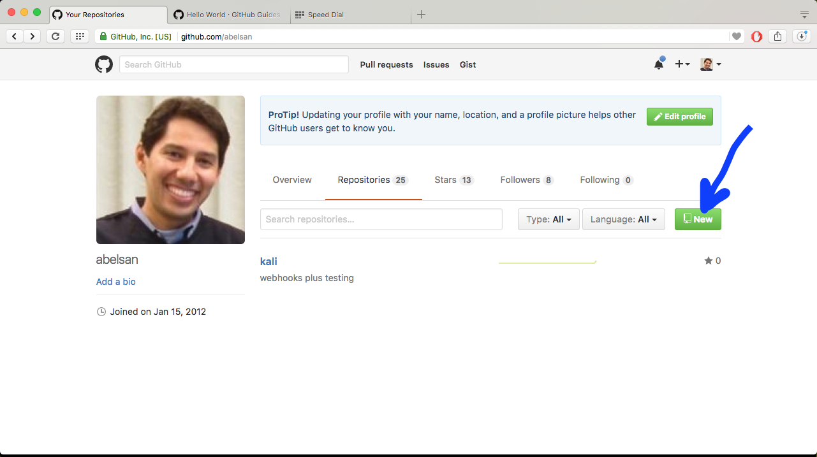
Create new repository

Slide 4
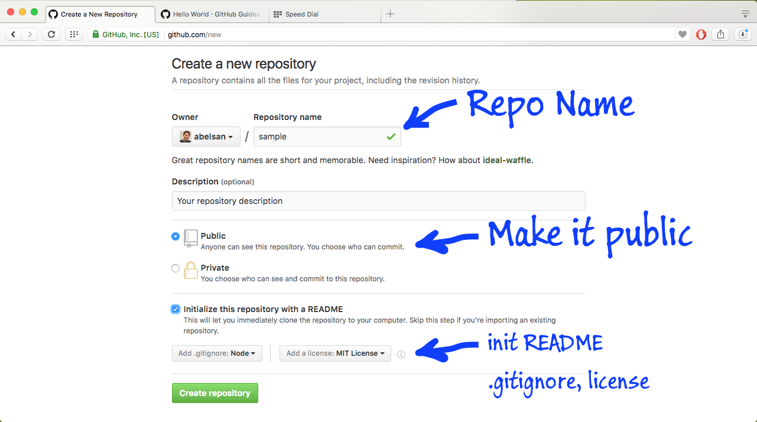

Slide 5
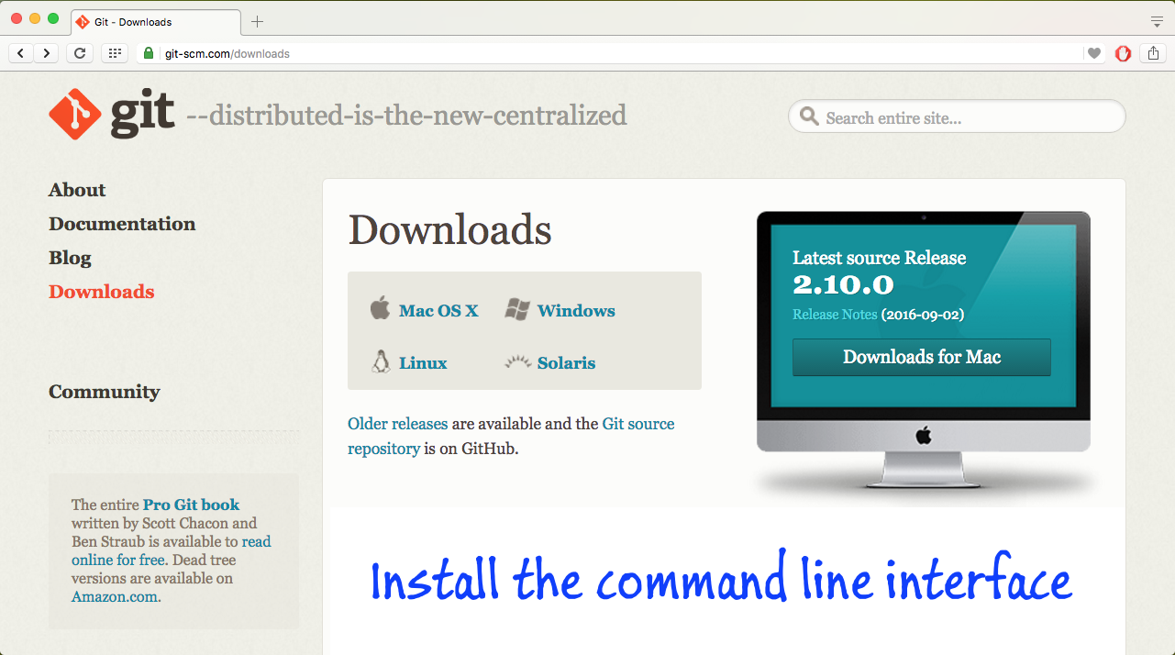

Slide 6
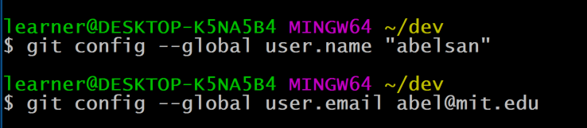
Config User

Slide 7
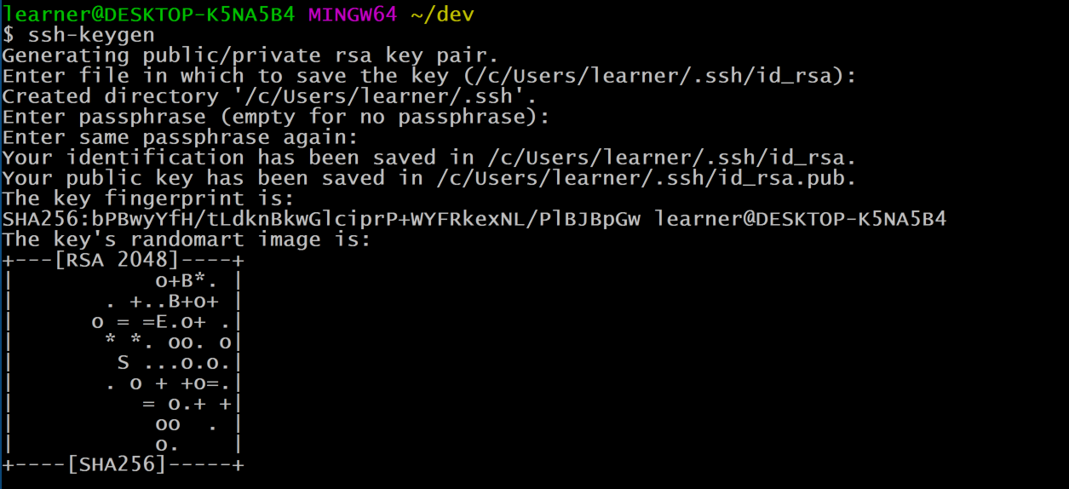
Create Key (ssh-keygen)

Slide 8
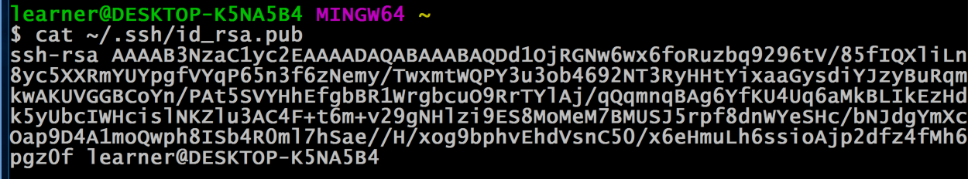
Copy Key

Slide 9
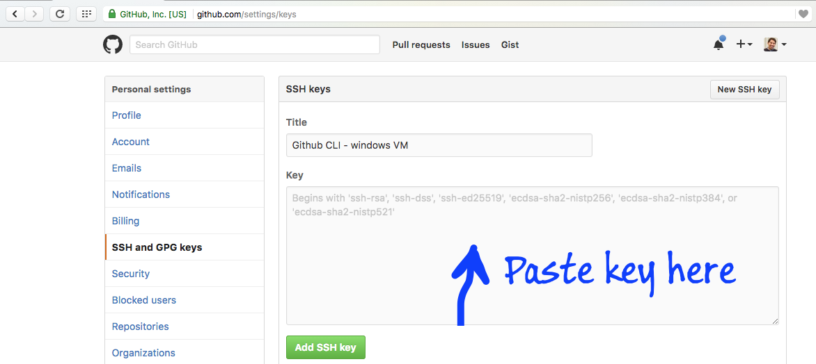
Copy Key To Github

Slide 10
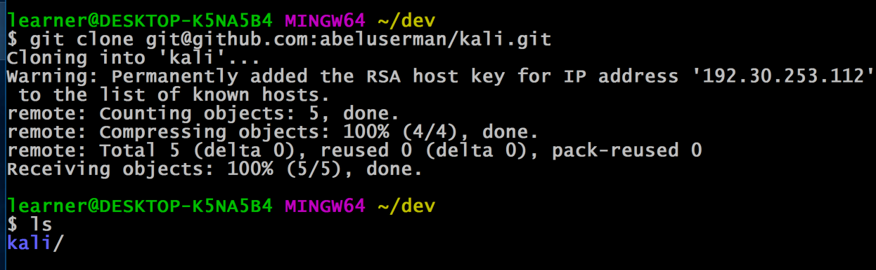
Clone Repository

Slide 11
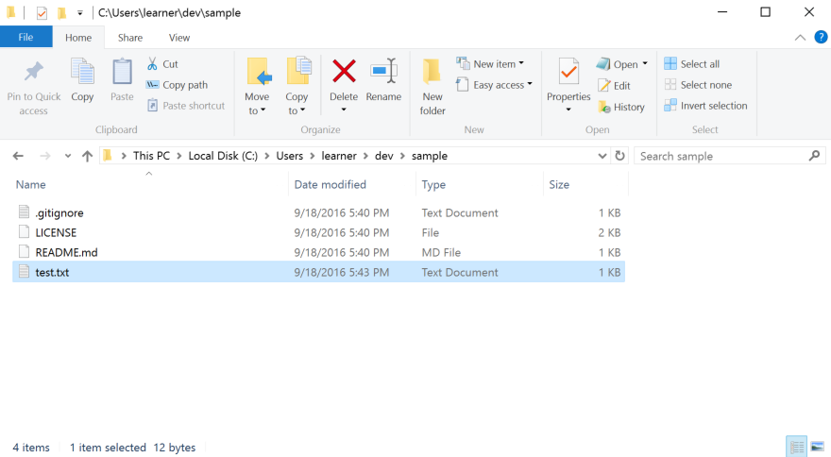
Add File (test.txt)

Slide 12
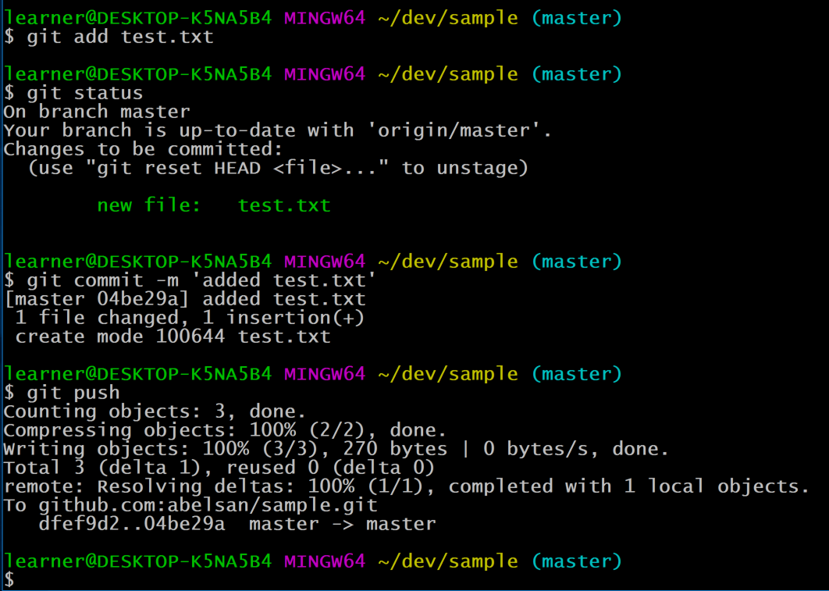
git add
git status
git commit
git push

