Slide 1
Machine Learning
Abel Sanchez, John Williams

Slide 2
Machine Learning (Practical Definition)
Start with data
Learn a model from data, identify a pattern in data
Use pattern to gain insight

Slide 3
Examples
Prediction – e.g. Is this transaction fraudulent?
Prediction – e.g. Will user click on link?
Exploration – e.g. Processing larger numbers of documents
Exploration – e.g. Visualization patterns

Slide 4
Your Life is Impacted by ML
What adds you are shown
What news articles you are offered
Other shoppers like you bought …
E-dating
Security screening
...

Slide 5
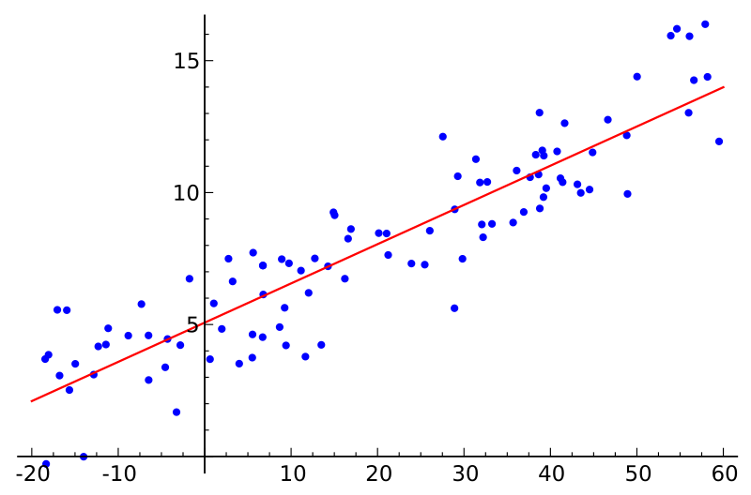
Linear Regression

Slide 6
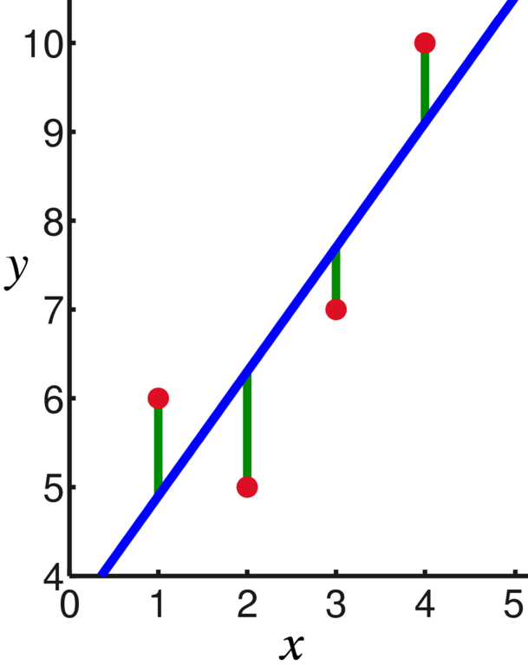
Least Squares
d4
D = (d1)² + (d2)² + (d3)² + (d4)²
Best linear model will have
the smallest sum of distances squared (D)
d3
d2
d1

Slide 7
Linear Regression
Error
where
For minimum
and
http://isites.harvard.edu/fs/docs/icb.topic515975.files/OLSDerivation.pdf

Slide 8
Linear Regression
Error
where
For minimum
and

Slide 9
In Class - Show
Intercept
Slope
Regression
Equation
Line

Slide 10
Active Learning
Write a function to create the linear regression equation …

Slide 11
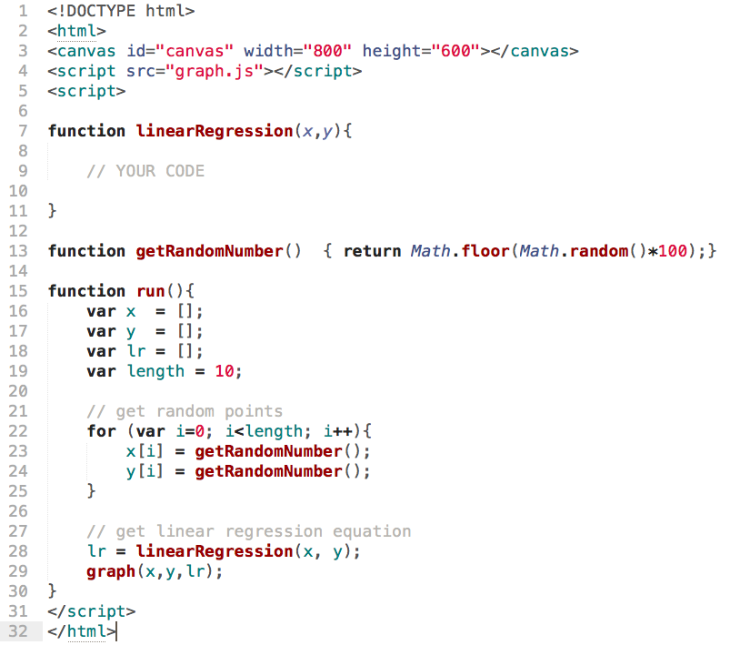

Slide 12
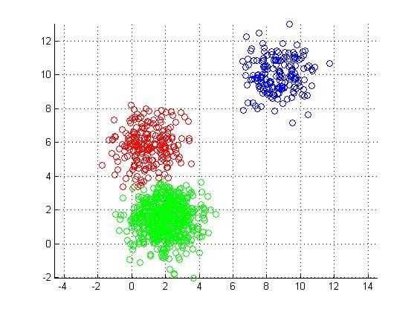
K-Means

Slide 13
Algorithm
Place K points into the space represented by the objects. These points represent initial group centroids.
Assign each object to the group that has the closest centroid.
When all objects have been assigned, recalculate the positions of the K centroids.
Repeat Steps 2 and 3 until the centroids no longer move.

Slide 14
K-Means Algorithm
start
add k points
(initial centroids)
Assign each point to closest centroid
yes
no
Centroid movement
end
Group based
on assigned centroid
Recalculate k centroids

Slide 15
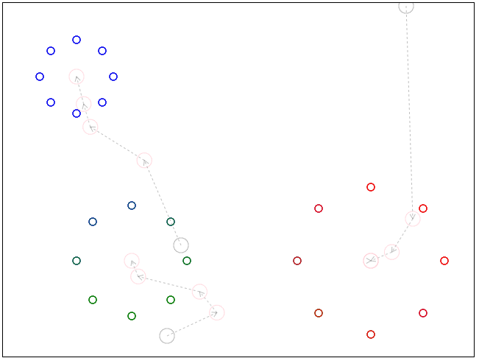
Visualization

Slide 16
Start
progress values 0 – to – 1
x₁, y₁
x_{i} = x₁ + (x₂ – x₁)•progress
y_{i} = y₁ + (y₂ – y₁)•progress
x_{i}, y_{i}
y₂ – y₁
x₂, y₂
End
progress
x₂ – x₁

Slide 17
You have x₁, y₁ and x₂, y₂ - Find y_{i} given x_{i}
Slope, m = (y₂ – y₁)/(x₂ – x₁)
Substitute x_{i}, y_{i} for x₂, y₂
The equation is:
y = y₁ + m(x – x₁)
Start
x₁, y₁
y₂ – y₁
y_{i}
x₂, y₂
x_{i}
End
progress
x₂ – x₁

Slide 18
Active Learning
Write an implementation of K-Means …

Slide 19
