Slide 1
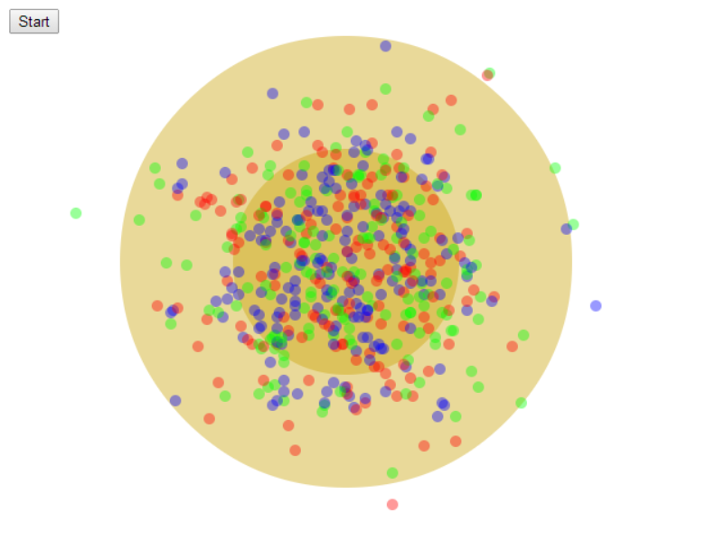
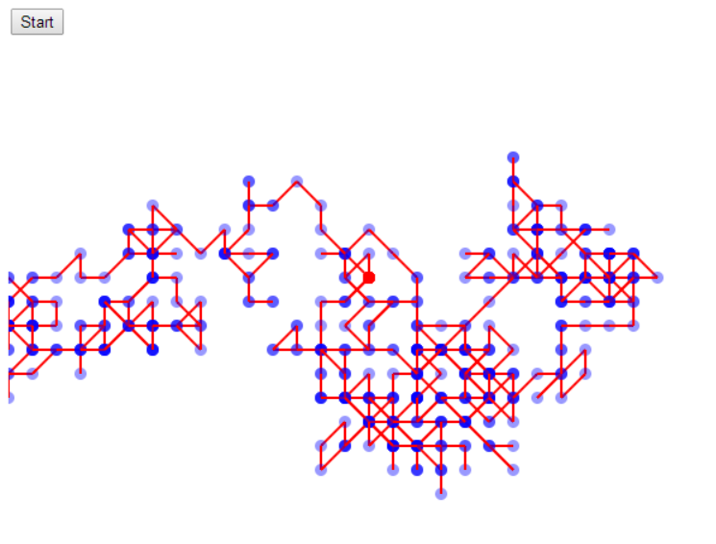
1.00 Lecture 27 – Random Walk From Physics to Finance
John R Williams
Abel Sanchez

Slide 2
1-D Random Walk
Flip coin so that Heads moves the ball to the right and Tails moves left. Below shows H,H,T,T,T
0
On average how far will it move from its starting position after N steps ?

Slide 3
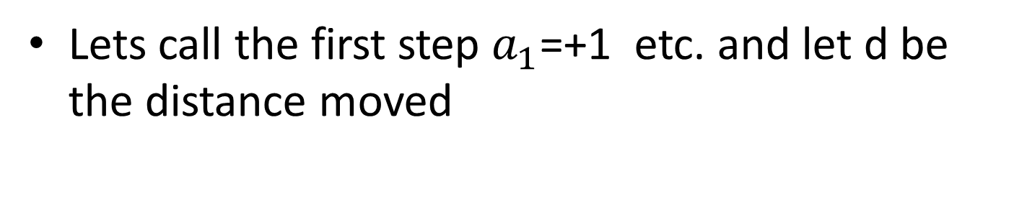
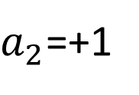
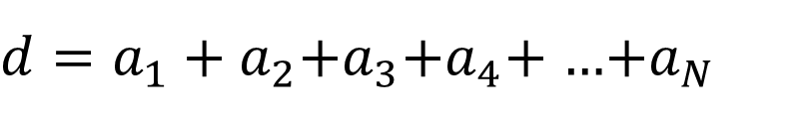
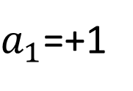
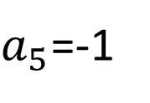
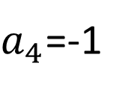
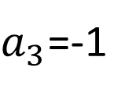
1-D Random Walk
Lets call the first step $a_{1}$=+1 etc. and let d be the distance moved
$a_{5}$=-1
$a_{4}$=-1
$a_{3}$=-1
0
$a_{1}$=+1
$a_{2}$=+1
${d=a}_{1}+a_{2}$+$a_{3}$+$a_{4}$+ …+$a_{N}$
Component 1

Slide 4
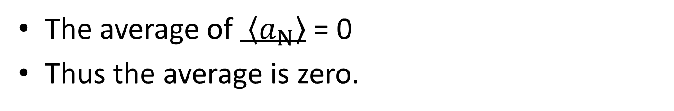
1-D Random Walk
We actually want the average distance.
$${\left\langle d\right\rangle =\left\langle a_{1}\right\rangle +\left\langle a_{2}\right\rangle +\left\langle a_{3}\right\rangle +\left\langle a_{4}\right\rangle …+\left\langle a_{N}\right\rangle }_{}$$
The average of $\left\langle a_{N}\right\rangle$ = 0
Thus the average is zero.
Component 1

Slide 5
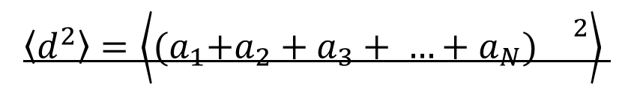
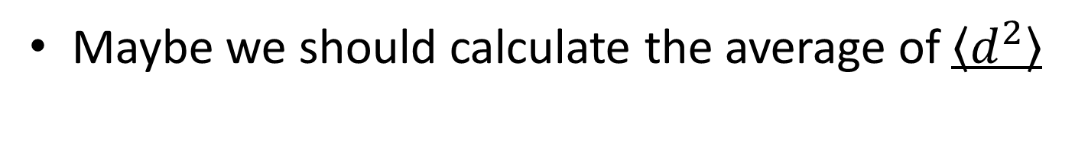
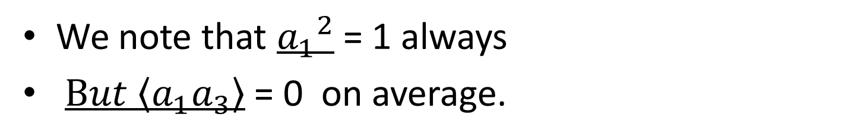
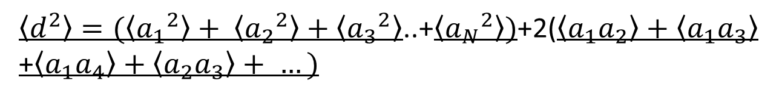
1-D Random Walk
Maybe we should calculate the average of $\left\langle d^{2}\right\rangle$
$$\left\langle d^{2}\right\rangle =\left\langle {(a}_{1}+a_{2}+a_{3}+ …+a_{N}){}^{2}\right\rangle$$
$$\left\langle d^{2}\right\rangle =\left\langle {(a}_{1}+a_{2}+a_{3}+ …+a_{N}){(a}_{1}+a_{2}+a_{3}+ …+a_{N}) \right\rangle$$
$\left\langle d^{2}\right\rangle =(\left\langle {a_{1}}^{2}\right\rangle + \left\langle {a_{2}}^{2}\right\rangle +\left\langle {a_{3}}^{2}\right\rangle$..+$\left\langle {a_{N}}^{2}\right\rangle )$+2($\left\langle a_{1}a_{2}\right\rangle +\left\langle a_{1}a_{3}\right\rangle$
+$\left\langle a_{1}a_{4}\right\rangle +\left\langle a_{2}a_{3}\right\rangle + …)$
We note that ${a_{1}}^{2}$ = 1 always
$But \left\langle a_{1}a_{3}\right\rangle$ = 0 on average.

Slide 6
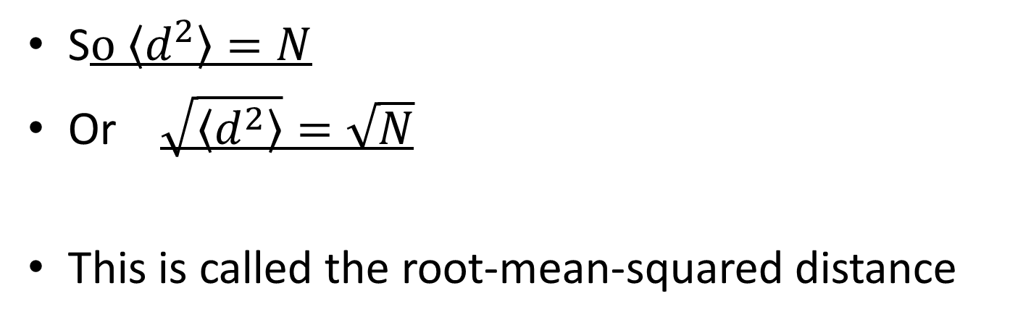
1-D Random Walk
S$o \left\langle d^{2}\right\rangle =N$
Or $\sqrt{\left\langle d^{2}\right\rangle }=\sqrt{N}$
This is called the root-mean-squared distance

Slide 7
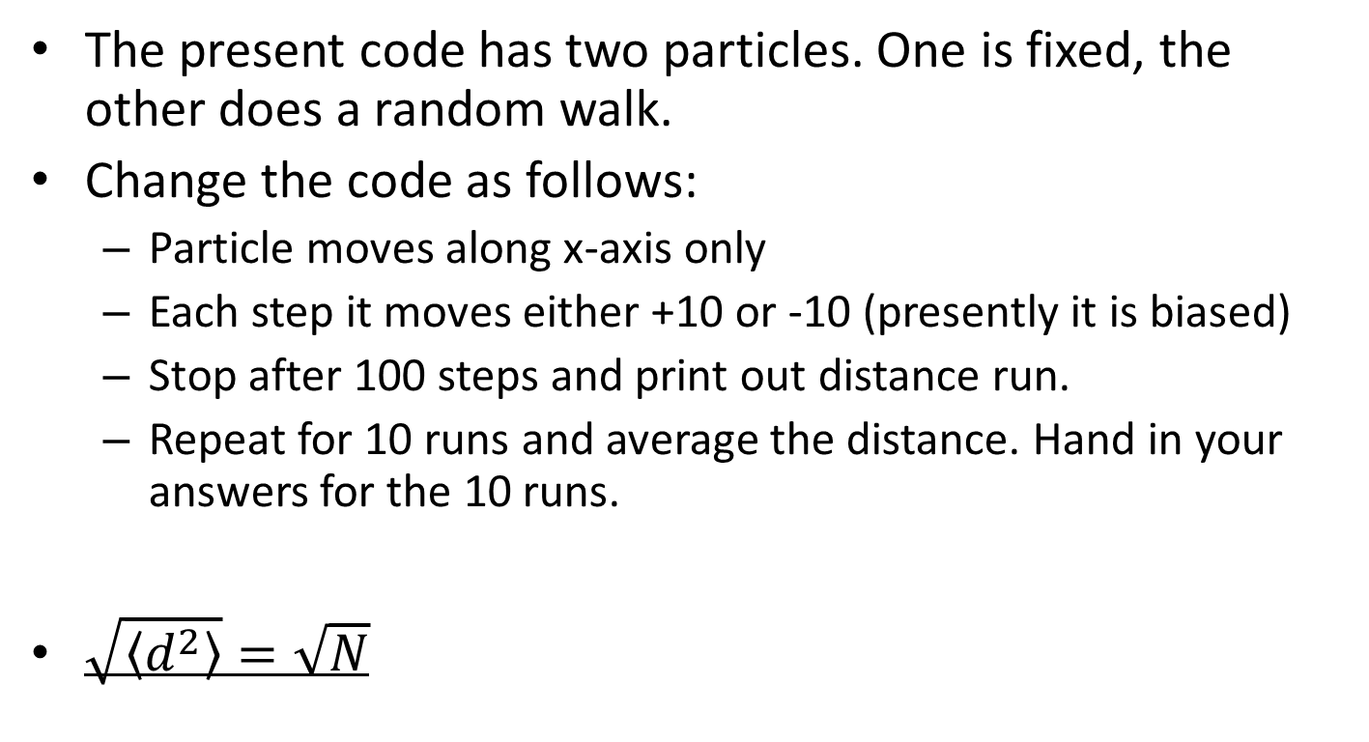
In Class Experiment
The present code has two particles. One is fixed, the other does a random walk.
Change the code as follows:
Particle moves along x-axis only
Each step it moves either +10 or -10 (presently it is biased)
Stop after 100 steps and print out distance run.
Repeat for 10 runs and average the distance. Hand in your answers for the 10 runs.
$\sqrt{\left\langle d^{2}\right\rangle }=\sqrt{N}$

Slide 8
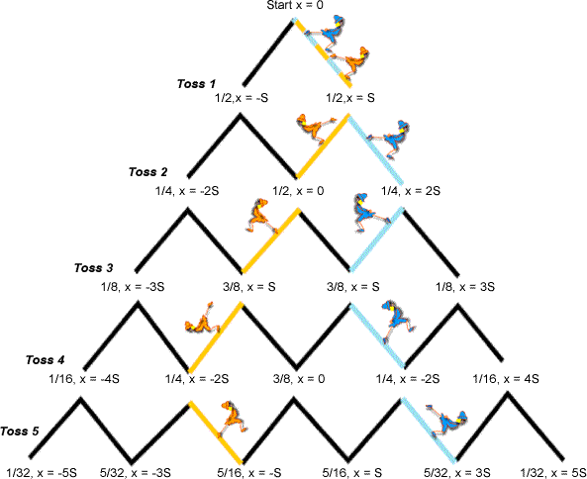
Random Walk as a Tree
We can calculate the probability of a particle being at a given distance from the start point.

Slide 9
Molecule Diffusion
dx
dx
Consentration C1
Consentration C2
Each particle moves distance dx either + or -
Area of Interface
A

Slide 10
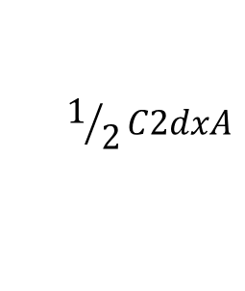
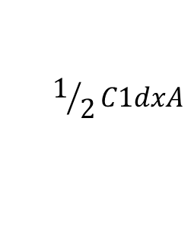
Molecule Diffusion
dx
dx
Consentration C1
Consentration C2
$$1/2C1dxA$$
$$1/2C2dxA$$

Slide 11
Diffusion – Fick’s Law
If C(X) is continuous, then
.
D is diffusion coefficient

Slide 12
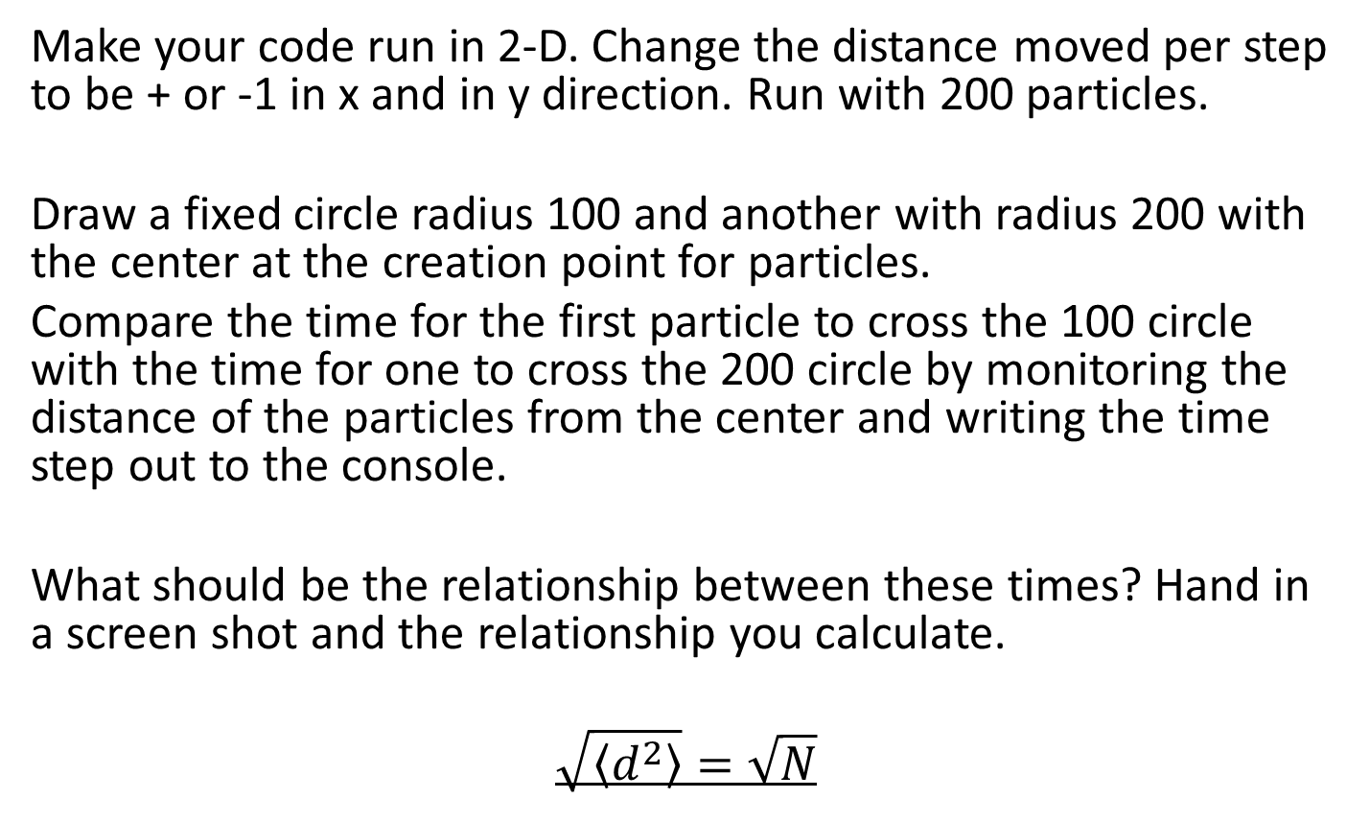
In Class Experiment
Make your code run in 2-D. Change the distance moved per step to be + or -1 in x and in y direction. Run with 200 particles.
Draw a fixed circle radius 100 and another with radius 200 with the center at the creation point for particles.
Compare the time for the first particle to cross the 100 circle with the time for one to cross the 200 circle by monitoring the distance of the particles from the center and writing the time step out to the console.
What should be the relationship between these times? Hand in a screen shot and the relationship you calculate.
$$\sqrt{\left\langle d^{2}\right\rangle }=\sqrt{N}$$

Slide 14
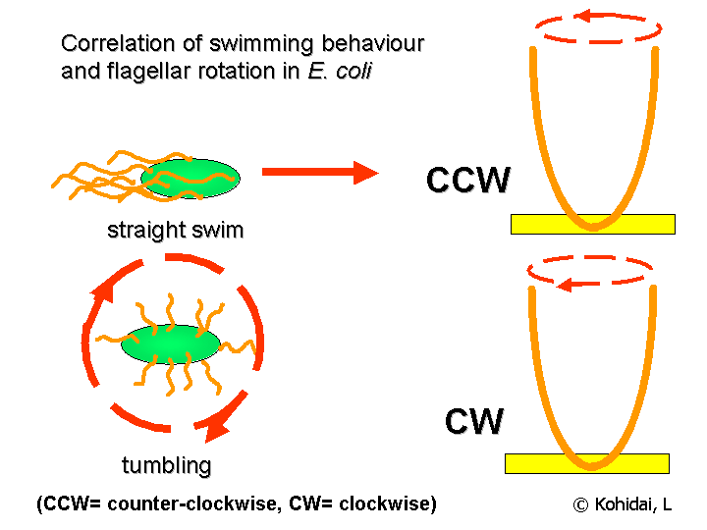
Random Walk of E.Coli
The movement looks like a random walk with relatively straight swims interrupted by random tumbles that reorient the bacterium. In the presence of a chemical gradient bacteria will chemotax, or direct their overall motion based on the gradient. http://en.wikipedia.org/wiki/Chemotaxis

Slide 15


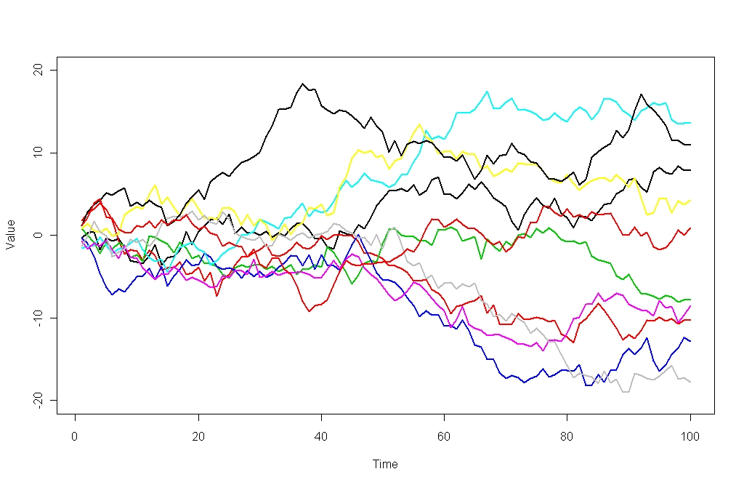
Random Walk in Finance (don’t bet on it)

Slide 16
In Class Exercise 3
Take the starter code for a small radioactive release near MIT. This is the same as the starter code for Problem Set 8. Start by making the random walk symmetric about the start point.
Then add in the wind Vector(1,-1) - I’m assuming canvas cords so this is blowing towards the North East.

Slide 17
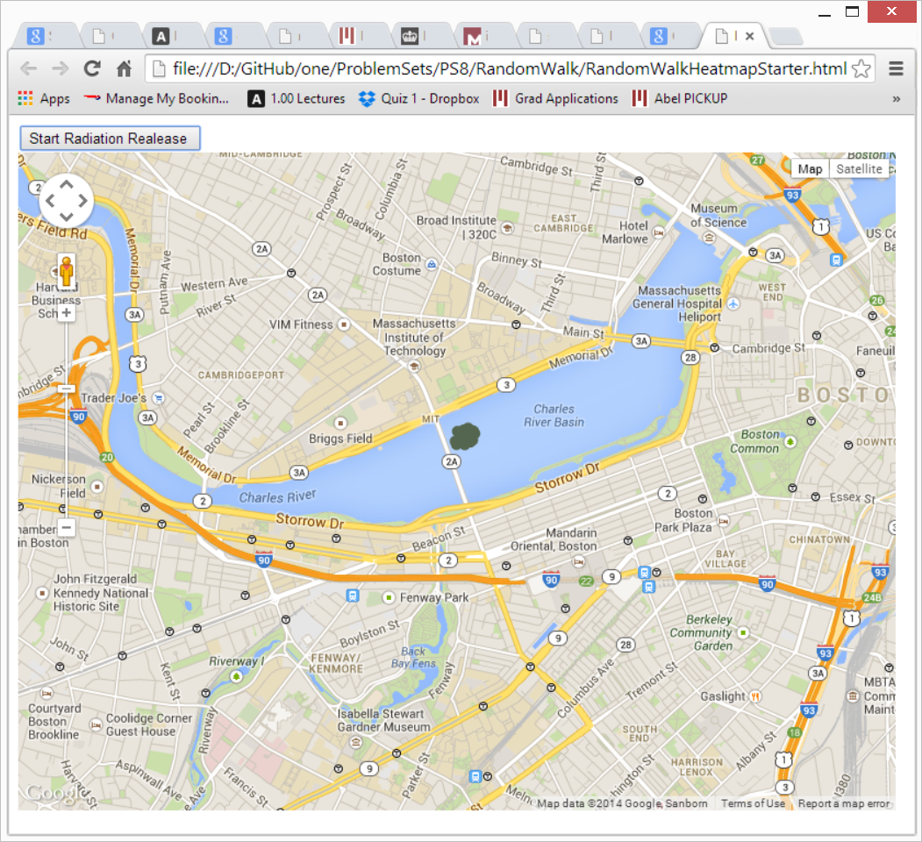
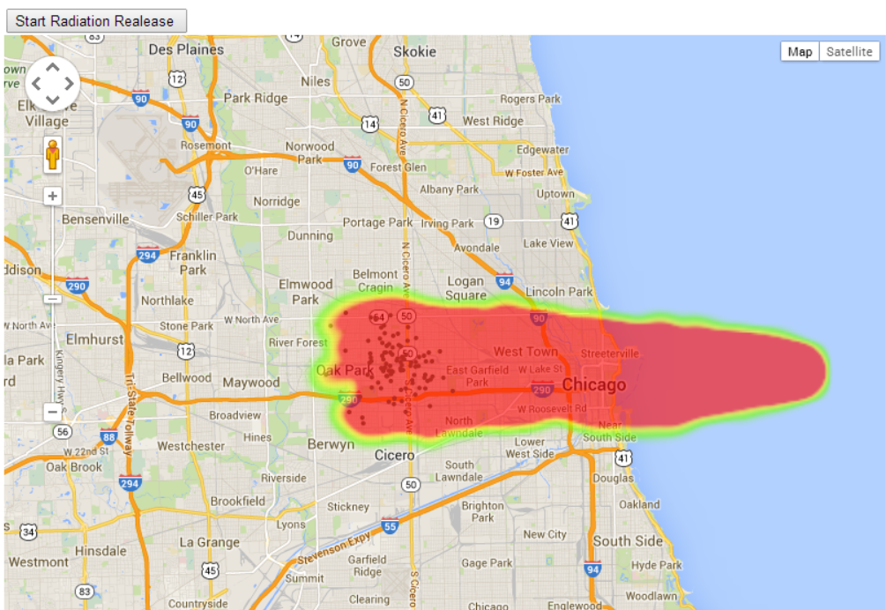

Slide 18
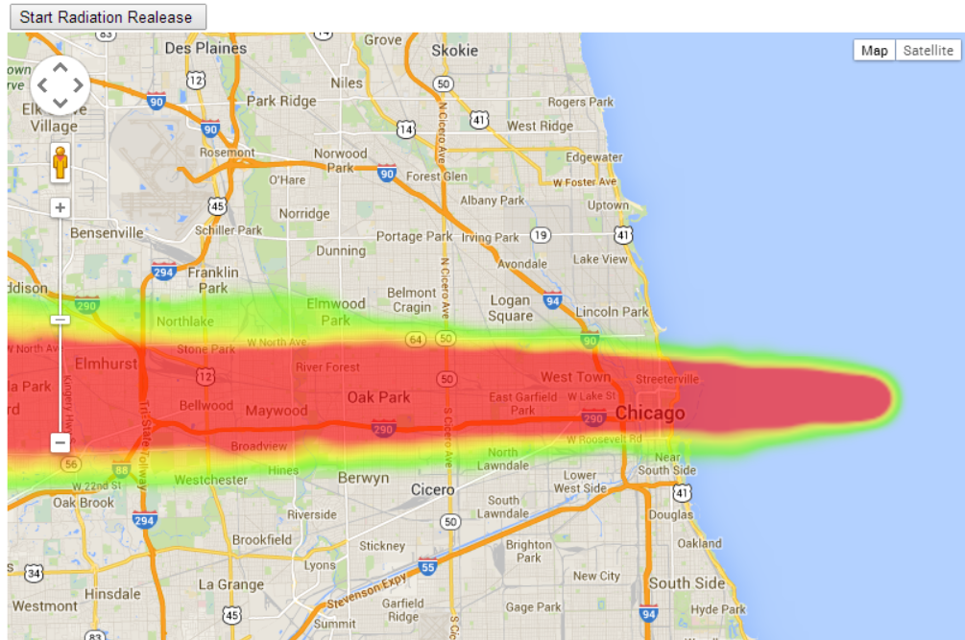
Chicago Gas Release from Ship

