Slide 1
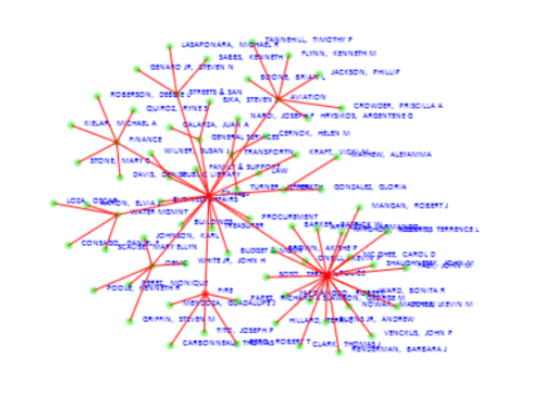
Lecture 28 - Networks, Graphs and Trees (part 1) John R. Williams and Abel Sanchez, MIT

Slide 2
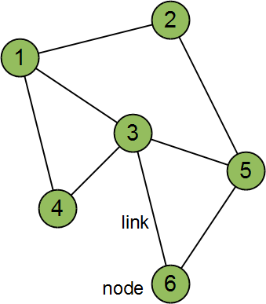
Networks
Collection of nodes (vertices) that is connected via links (edges).
Also referred to as a graph i.e. graph theory
Naming conventions differ between fields
Also named vertices and edges
In physics, sites and bonds
In sociology, actors and ties
Number of nodes = n
Number of links = m

Slide 3
Networks and Graphs
The links may be directed or undirected, weighted or un-weighted. For weighted links think of multi-lane highways where the weight corresponds to the number of lanes.

Slide 4
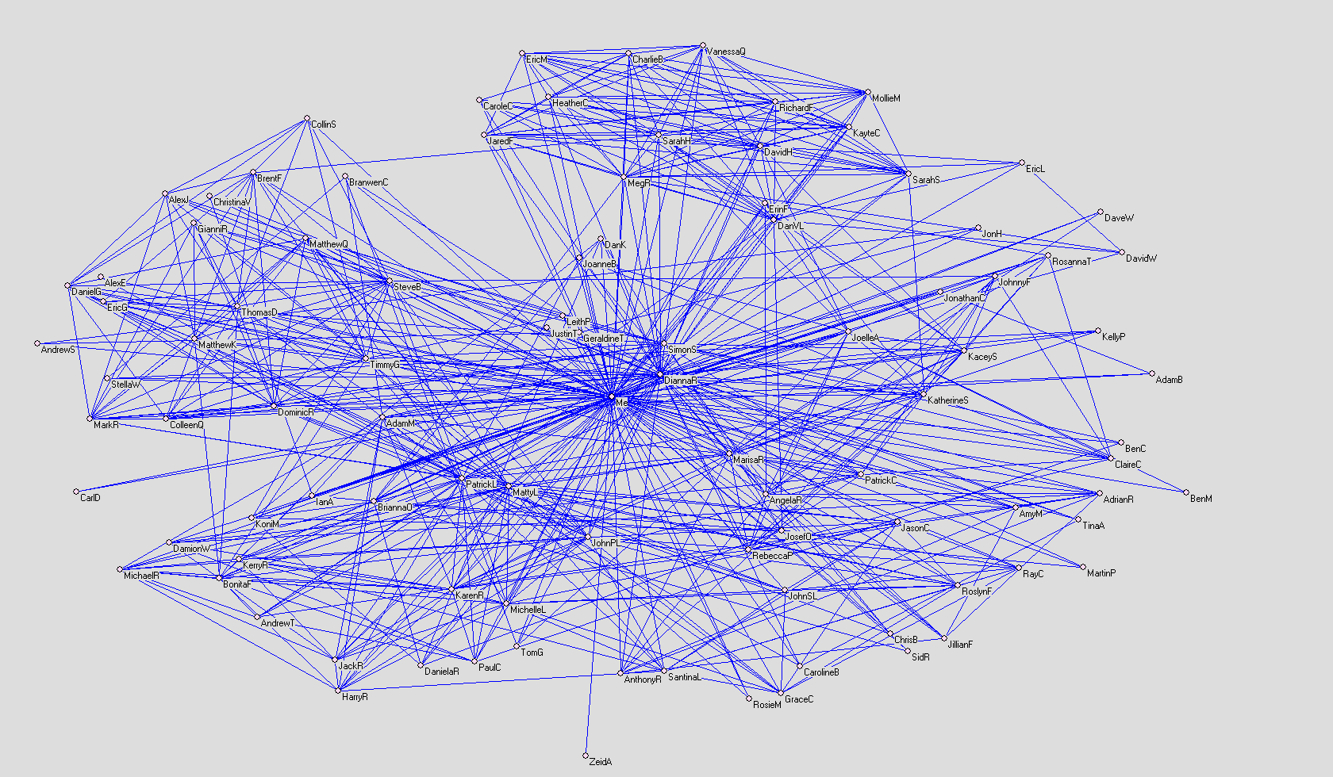
Networks and Connection Science
A Facebook network of 100 people
Notes:
4

Slide 5
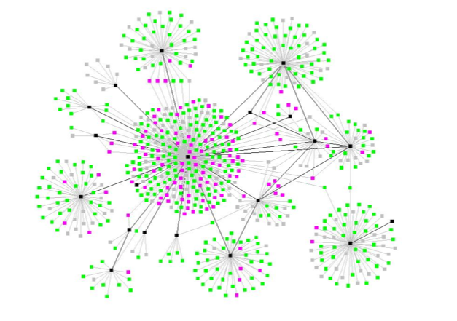
Networks and Connection Science
A tuberculosis epidemic is a form of network
Andre et. al.
Notes:
5

Slide 6
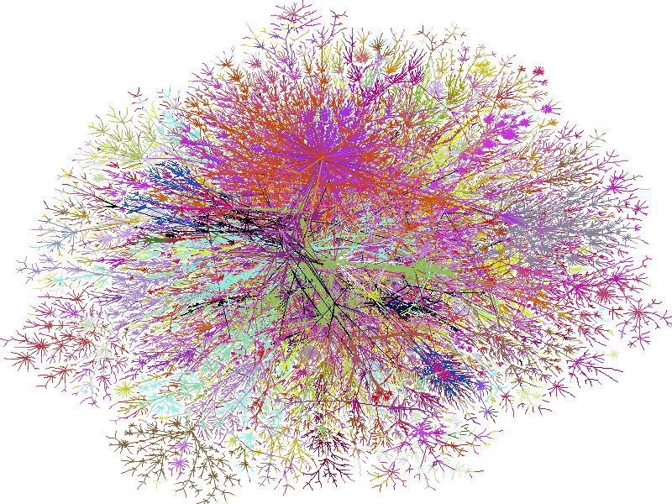
Networks and Connection Science
A map of the internet, colored by IP address
W.R. Cheswick
Notes:
6

Slide 7
Networks and Connection Science
Email communication pattern between 436 employees of HP research labs
http://www-personal.umich.edu/ladamic/img/hplabsemailhierarchy.jpg
Notes:
7

Slide 8
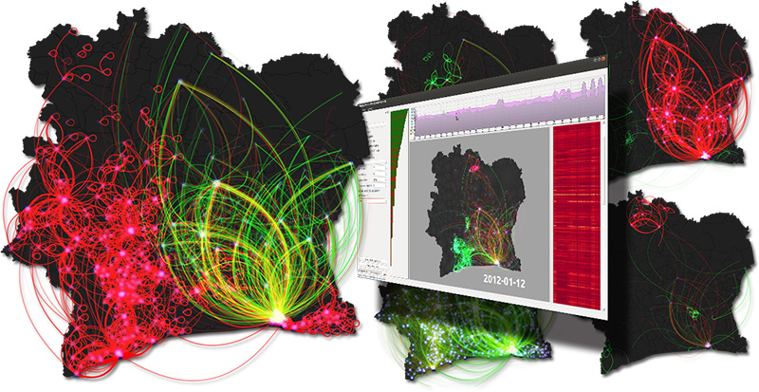
Layered Visualization –D4D Competition
http://www.orange.com/en/about/Group/our-features/2013/D4D/Folder/best-visualization

Slide 9
Degree of a node
The goal of network theory is to give us insight into the properties of networks.
An example of a property is the degree of a node. The degree is the number of links attached to the node. In the network below node 1 has degree 3, node 2 degree 2, node 3 degree 2 and node 4 degree 1. Often k is used to represent the degree.
1
2
4
3

Slide 10
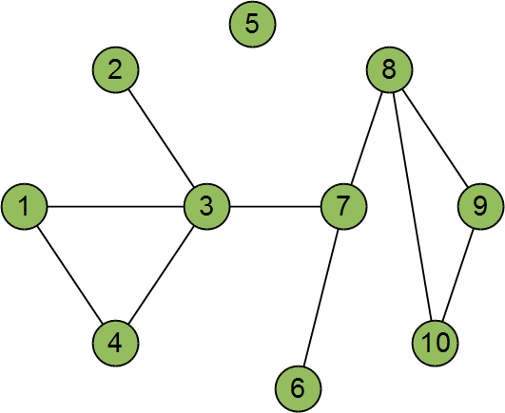
Concepts: Degree Distribution
A defining characteristic of network structure
Define p_{k} to be fraction of nodes in a network that have degree, k
In this example: p₀ = 1/10, p₁ = 2/10, p₂ = 4/10, p₃ = 2/10, p₄ = 1/10
Can you see why?
Can also be thought of as the probability that a chosen node has degree, k

Slide 11
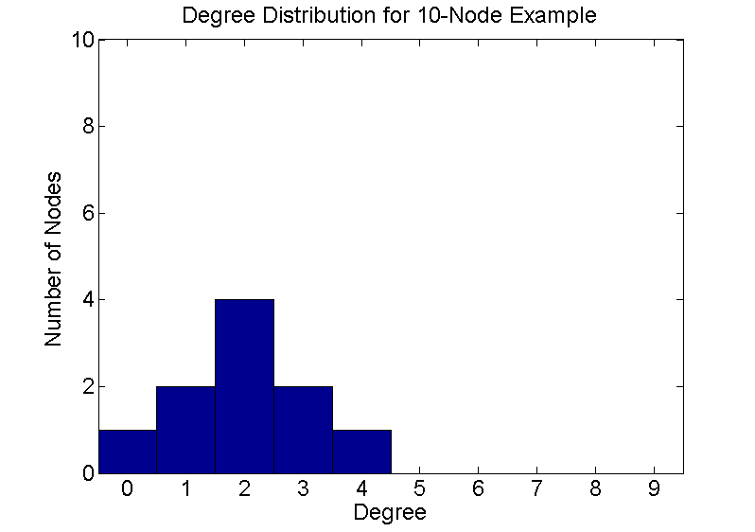
Concepts: Degree Distribution
Extending the probability concept of degree distribution, it can be plotted as a histogram
p = [2 1 4 2 0 1 3 3 2 2];
links = 0:9;
hist(p,links)
set(gca, 'FontSize', 18, 'XLim',[-0.5 9.5], 'YLim', [0 10]);
xlabel('Degree', 'FontSize', 18)
ylabel('Number of Nodes', 'FontSize', 18)
title('Degree Distribution for 10-Node Example', 'FontSize', 18)

Slide 12
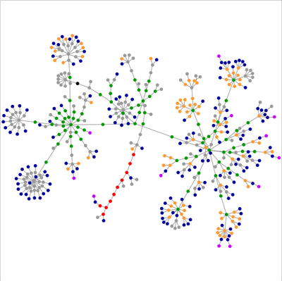
Hubs are often most important nodes in a network.

Slide 13
Back to Computing – Starting with Trees
Lets look now at how we represent trees, which are a sub-set of graphs, in the computer. Lets consider a node such as node 1. The data structure needs to capture that its connect to nodes 2 and 3.
1
2
3
node ={
id: id,
children: [{node2}, {node3} ]
}

Slide 14
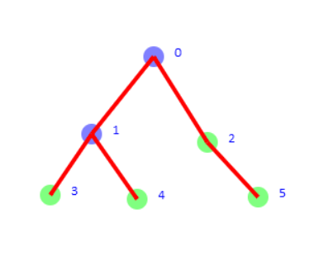
In Class Exercise 1
The present code generates two nodes with a link between them. It also writes out JSON for the network assuming node 1 is the “root” and all others are children of this node ie we are dealing with a ‘tree’. Create the following nodes as shown below. Hand in the screen shot and the JSON data structure written to the console.
Steps: Create Node(position, radius), give it ‘id’, save it in sim.nodes[ ], Create Link(parent, newNod), add newNod to parent.children [ ]

Slide 15
City of Chicago Data
One of the data sets is the salary data for all city employees.
We want to plot out the data to understand it better.
The data looks like this.
var data = [ [ 1, "26B361A2-F674-467D-9374-1208DBAFFBE0", 1, 1389641641, "700397", 1389641641, "700397", "{\n}", "AARON, ELVIA J", "WATER RATE TAKER", "WATER MGMNT", "87228.00" ]
, [ 2, "2FDAC83E-C605-4DAF-8673-36916BD1C5D3", 2, 1389641641, "700397", 1389641641, "700397", "{\n}", "AARON, JEFFERY M", "POLICE OFFICER", "POLICE", "85372.00" ]

Slide 16
Data structure
[[ […… name, x, department, salary ], […. name, x, department, salary ]….]
Its basically an array of arrays and within each array we need to pull out locations 8,10,11.
Since the data is not in a tree structure we’ll need to first decide on the structure we want to create in terms of node hierarchy.
397", 1389641641, "700397", "{\n}", "AARON, ELVIA J", "WATER RATE TAKER", "WATER MGMNT", "87228.00" ]
, [ 2, "2FDAC83E-C605-4DAF-8673-36916BD1C5D3", 2, 1389641641, "700397", 1389641641, "700397", "{\n}", "AARON, JEFFERY M", "POLICE OFFICER", "POLICE", "85372.00" ]
, [ 3, "A1FD838F-BA4A-4B32-B545-51B5919E0475", 3, 1389641641, "700397", 1389641641, "700397", "{\n}", "AARON, KIMBERLEI R", "CHIEF CONTRACT EXPEDITER", "GENERAL SERVICES", "80916.00" ]
, [ 4, "96EE71F1-C345-43AE-8874-8F0C5E9A307F", 4, 1389641641, "700397", 1389641641, "700397", "{\n}", "ABAD JR, VICENTE M", "CIVIL ENGINEER IV", "WATER MGMNT", "99648.00" ]
, [ 5, "7D92EF6A-A7AB-418C-8649-F7B06FAE0BFD", 5, 1389641641, "700397", 1389641641, "700397", "{\n}", "ABARCA, ANABEL", "LEGISLATIVE AIDE", "CITY COUNCIL", "81000.00" ]
];
Chicago
Fire
Police
Julia
Child
Fred Blogs
Mary Poppins

Slide 17
In Class Exercise 2
In the 2nd starter code I’ve added the capability to rip through the Chicago salary data and create 3 levels of nodes. However, I haven’t quite got it right. The 2nd level seems to repeat WATER MGMNT twice. Also the layout is not very good.
First correct the problem with the Water Management.
Next think about how we might lay out the nodes in a better way.

Slide 18
Searching the Tree Structure
Now we have a tree structure we want to “walk” the tree starting at the “root”.
We’ll apply what is called Breadth First Search which starts at the root node then goes layer by layer downwards, visiting all the nodes in layer 2 before proceeding to those at layer 3.
Lets see how it works.

Slide 19
Basic Data Structure – Leaving a Trail
node = { children : children [ ] }
If we want to keep track of a node we store a reference to it in an array. Eg [ 0, 1 ] might indicate we have moved from node 0 to 1. Sometimes these are called ‘bread crumbs’ because they allow us to retrace our steps.
0
Array
1
0
1
3
4

Slide 20
Basic Data Structure – Flagging nodes visited
node = {children : children [ ], color:’Red’ }
A mechanism we use is to color nodes we have ‘visited’ so that we don’t repeat our steps. Here I’m going to color nodes I’ve visited ‘Red’
0
Stack
1
0
1
3
4
Now we are ready to systematically explore the tree using the array to retrace our steps and the color to flag that we’ve already explored part of the tree. Depending on the way we explore the tree we use the array as a Stack or a Queue.

Slide 21
Trees- Basic Data Structure
A node may have at most one parent but many children. Eg node 1 has parent 0 and children [3, 4]. Thus, the minimum data structure for any node is as below
node = {children : children [ ] }
0
1
3
4

Slide 22
Breadth First Search
Queue
0
1
2
3
4

Slide 23
Breadth First Search
Queue
0
1
1
2
3
4

Slide 24
Breadth First Search
Queue
0
1
2
1
2
3
4

Slide 25
Breadth First Search
Queue
0
2
1
2
3
4

Slide 26
Breadth First Search
Queue
0
2
3
4
1
2
3
4

Slide 27
Breadth First Search
Queue
0
3
4
1
2
3
4

Slide 28
Breadth First Search
Queue
0
4
1
2
3
4

Slide 29
Breadth First Search
Queue
0
1
2
3
4

Slide 30
In Class Exercise 3
The starter code implements Breadth First Search. I want you now to understand of Breadth First Search works.
Part 1- Print out the state of the Queue after any change to the length of the Queue. ie when something is added or something taken out. Use ‘printArray(xxx)’ to do this.
Hand in a screen shot of the history of the Queue.
Part 2- I want to calculate the “degree k” of every node. Modify the code to print this to the console.

Slide 31
Depth First Search
Stack
0
1
2
3
4

Slide 32
Depth First Search
Stack
0
0
1
2
3
4

Slide 33
Depth First Search
Stack
0
0
1
1
2
3
4

Slide 34
Depth First Search
Stack
0
0
1
3
1
2
3
4

Slide 35
Depth First Search
Stack
0
0
1
1
2
3
4

Slide 36
Depth First Search
Stack
0
0
1
4
1
2
3
4

Slide 37
Depth First Search
Stack
0
0
1
1
2
3
4

Slide 38
Depth First Search
Stack
0
0
1
2
3
4

Slide 39
Depth First Search
Stack
0
0
2
1
2
3
4

Slide 40
Depth First Search
Stack
0
0
1
2
3
4

Slide 41
Depth First Search
Stack
0
1
2
3
4

