Slide 1
Flow in Networks Incidence Matrix Approach
Prof. John R. Williams
MIT

Slide 2
Flow in a Network
We often want to calculate how a network behaves. Here we consider flow in a network. The flow could be flow of cars in a road network or flow of electricity through a power grid. Usually the flow will be moderated by the conductance (capacity) of the links or the resistance of the links. We will deal in conductance.
First we need to understand how best to represent the network.
1
2
3
4

Slide 3
Incidence Matrix Representation
Node
The incidence matrix contain information about both Nodes and Edges
Edge
1
1
2
2
3
3
4
5
4

Slide 4
Apply Ohm’s Law To Flow on Edges
Here we set up a flow problem where the Conductance C is defined for each edge.
We apply Ohm’s law in the form
Where w are the currents and e the voltage drops (differences).

Slide 5
Apply Ohm’s Law To Flow on Edges
1
2
3
Here we set up a flow problem where the Conductance C is defined for each edge.
We apply Ohm’s law in the form
Where w are the currents and e the voltage drops (differences).
4

Slide 6
Kirchhoff’s Current Law Conservation of Mass
At the nodes there is conservation of current. What flows in must flow out. Here we add in the external flows
1
2
3
4

Slide 7
Combining Equations
Eq. 1
Eq. 2
This is equivalent to the “Displacement FEM Method”

Slide 8
Observations
This is singular so to solve we
need to “ground” some node
2
3
Here we see that the diagonal matrix D tells us about the degree of the node (how many links it has) and the Adjacency Matrix tells us which nodes are connected.
is called the Graph Laplacian

Slide 9
Solving the Equations
Ground a node
Removing this unknown will reduce the matrix to a 3x3
2
3

Slide 10
First the Simple Case C=1
Lets make
If there are no inflows then we can easily solve this

Slide 11
Now lets do the Full Case
Note this is Symmetric
All rows and columns sum to zero

Slide 12
Setting the Boundary Conditions
Let

Slide 13
Assign C=1 everywhere

Slide 14
Now Calculate Flows

Slide 15
Exercise in Class Assign the Cs

Slide 16
Now Calculate Flows

Slide 17
Assign the Cs

Slide 18
Static Equation for Network
Sometimes we are interested in the dynamic behavior of quantities in a network. For example, the spread of a disease, which starts at one place and spreads (diffuses) over time.
Lets now look at the dynamic equations.

Slide 19
Diffusion- A Dynamic Process
Suppose there is some substance at node i at time t, whose concentration potential is given by

Slide 20
Rate of Change at a Node
The rate of change at a node is given by
1
2
3
4

Slide 21
Diffusion
Flow from j to i
Rate of Change Equation
In Matrix Form
Substitute for w
If all the external fluxes are zero
L is called the Laplacian

Slide 22
Relationship to the Laplacian
For a continuum we remember the diffusion equation is given by

Slide 23
Solution Using Eigenvectors of L
Eigenvectors of L
The eigenvectors are orthonormal
And

Slide 24
Solution Using Eigenvectors of L
Substitute the linear expansion of the eigenvectors
Multiply by

Slide 25
Solution Using Eigenvectors of L
But the eigenvectors are orthonormal
And

Slide 26
Solving Analytically
We can solve this analytically
Since the eigenvalues are real and positive then this is a decaying solution over time.

Slide 27
Diffusion on Lattice
The easiest way to generate the Laplacian is to use
retlationship below
1
2
3
4

Slide 28
Difference Relationship for Laplacian
1
2
3
4
Note the similarity

Slide 29
Diffusion on Lattice
Eigenvectors of L are the columns
-0.5000 0.6533 0.5000 -0.2706
-0.5000 0.2706 -0.5000 0.6533
-0.5000 -0.2706 -0.5000 -0.6533
-0.5000 -0.6533 0.5000 0.2706
Eigenvalues
1
2
3
4
-0.0000 0 0 0
0 0.5858 0 0
0 0 2.0000 0
0 0 0 3.4142

Slide 30
Initial Condition
-0.5000 0.6533 0.5000 -0.2706
-0.5000 0.2706 -0.5000 0.6533
-0.5000 -0.2706 -0.5000 -0.6533
-0.5000 -0.6533 0.5000 0.2706
1
2
3
4

Slide 31
Matlab Code to Plot Solution
t=0.1:0.1:10;
phi(1,:)=-0.5*exp(-0*t);
phi(2,:)= 0.65*exp(-0.58*t);
phi(3,:)= 0.5*exp(-2*t);
phi(4,:)= -0.27*exp(-3.41*t);
psi=V*phi;
plot(psi(1,:));
hold on
plot(psi(2,:));
plot(psi(3,:));
plot(psi(4,:));
V Matrix

Slide 32
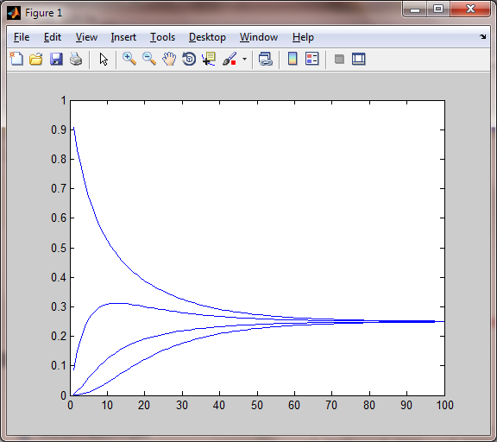
Phi vs Time

Slide 33
Exercise for Later in Term

Slide 34
Diffusion on Lattice
The easiest way to generate the Laplacian is to use
retlationship below
1
2
3
4
5
6
7
8
9

Slide 35
Laplacian
1
2
3
4
5
6
7
8
9
[V, D]=eig(AJJ);

Slide 36
Laplacian
Eigenvalues Lambda = [0, 1, 1, 2, 3, 3, 4, 4, 6]
We need to find the initial alphas
1
2
3
4
5
6
7
8
9

Slide 37
Initial Conditions
Using the orthonormality to find initial condition
1
2
3
4
5
6
7
8
9

Slide 38
Least Squares
In general there will be more equations than unknowns and unless we are lucky there is no solution. We want to get the “best” approximation.
(1,2)
(3,3)
(0,1)
http://www.youtube.com/watch?v=V5EjSvx1vw0&feature=relmfu

Slide 39
Fit a line through the points
In general there will be more equations than unknowns and unless we are lucky there is no solution. We want to get the “best” approximation.
(1,2)
(3,3)
(0,1)

Slide 40
Fit a line through the points
(1,2)
(3,3)
(0,1)

Slide 41
Changing Notation
(1,2)
(3,3)
(0,1)

Slide 42
Changing Notation
Column Vectors
The solution is some combination of the column vectors. The column vectors form a plane. The plane however does not contact the RHS vector.
The best we can do is find a projection onto the plane.

Slide 43
Changing Notation

Slide 44
Least Squares
The minimum least squares error will be when this equation holds

Slide 45
Least Squares
We seek to minimize the error in a least squares sense. Minimize

Slide 46
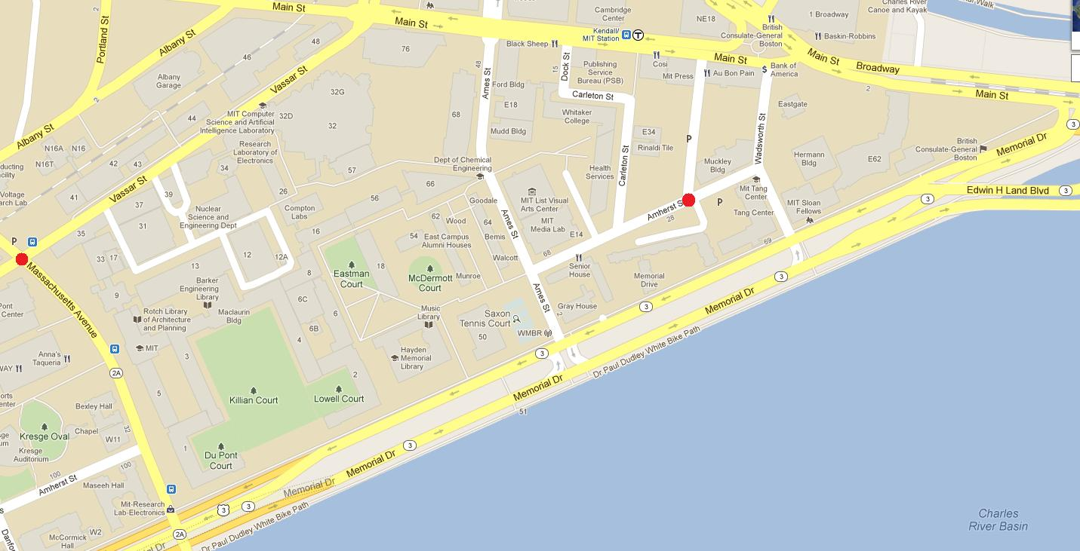
4
11
5
9
13
16
19
18
17
6
14
12
1
10
15
7
2
8
3

