Slide 1
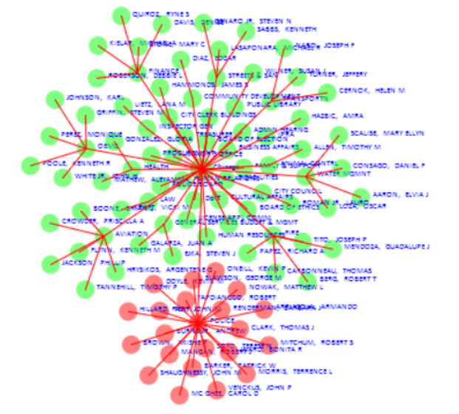
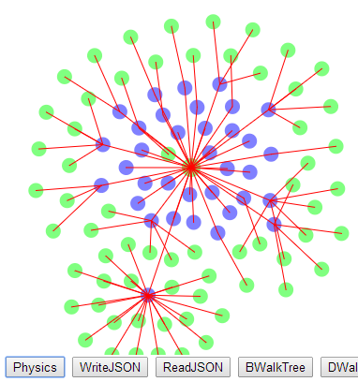
Lecture 29 – Graph Physics (Graphs part 2) John R. Williams and Abel Sanchez, MIT

Slide 2
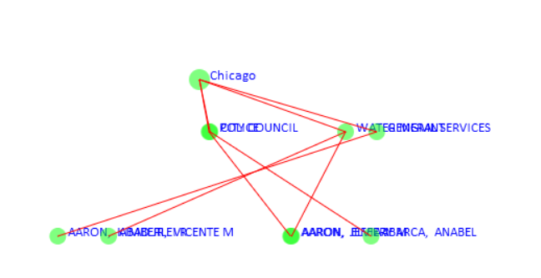
Review of Network Layout Issues
At present we are laying out our nodes in a rather random pattern. Typical strategies might be to lay out in layers as we have done (but with better structure) or on concentric circles.
Layer 1
Layer 2
Layer 3

Slide 3
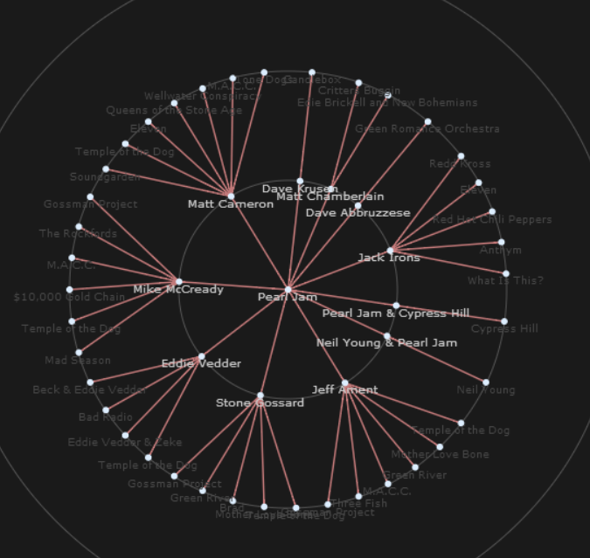
Concentric Circle Layout

Slide 4
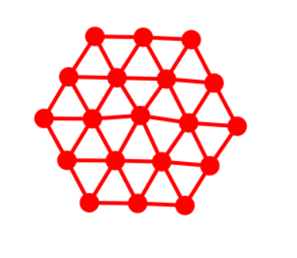
Remember Particle Mechanics
Remember in particle mechanics when we automatically put springs between particles and the result was the particles “self organized” themselves into structures such as below.
The effect of the springs was to keep particles apart and it was controlled by the ‘originalLength’ of the spring.
In our graphs we want to plot the ‘links’ so we might make each link a spring, which we plot.
However, we also want to put in ‘hidden-springs’ that keep particles separate just like the real springs. Lets call these a “repulsive-force”.

Slide 5
Red and Blue Spring Behavior
Tension and compression
originalLength = a*x
Acts in Compression only
originalLength = x
interactionDistance = y

Slide 6
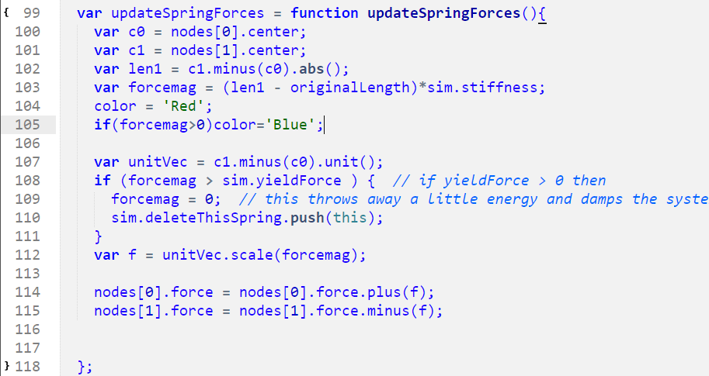
Look in Link for this

Slide 7
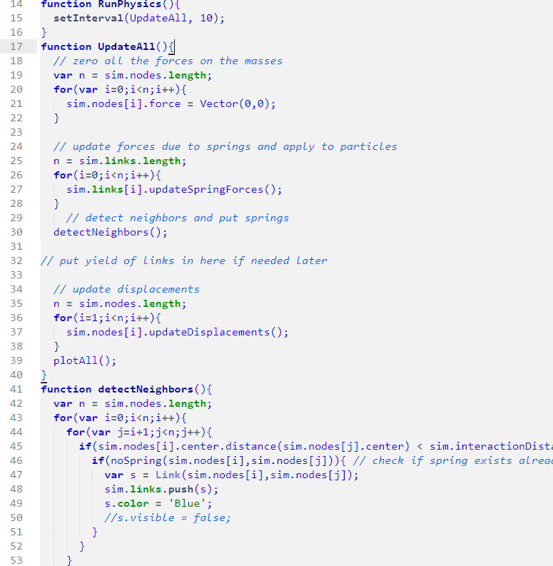
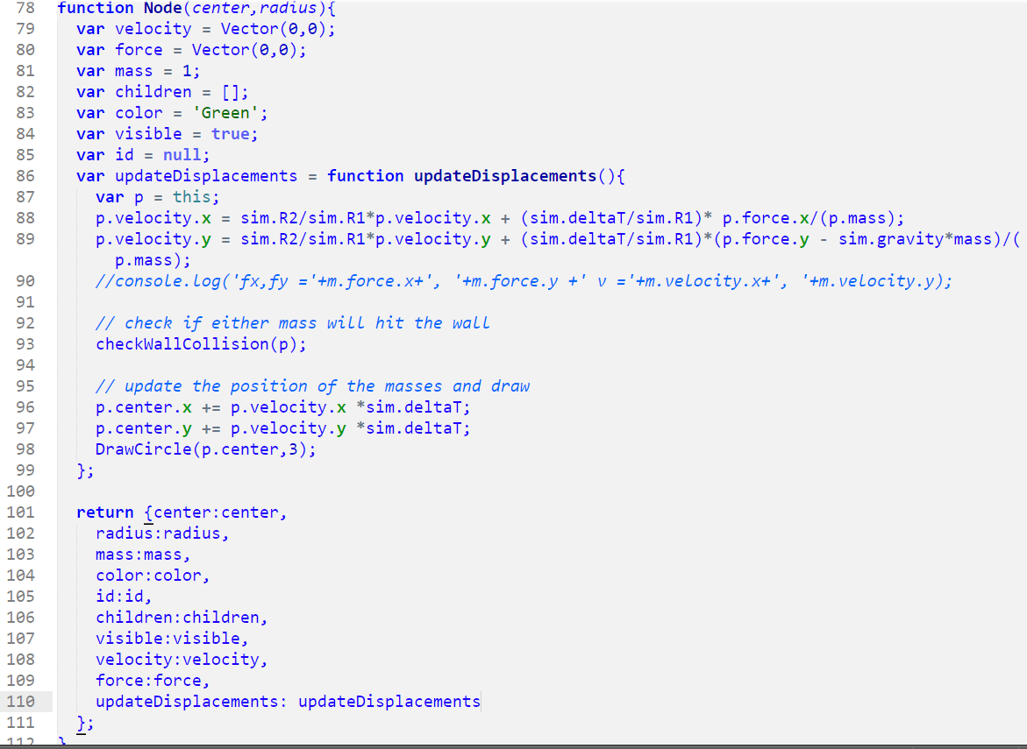
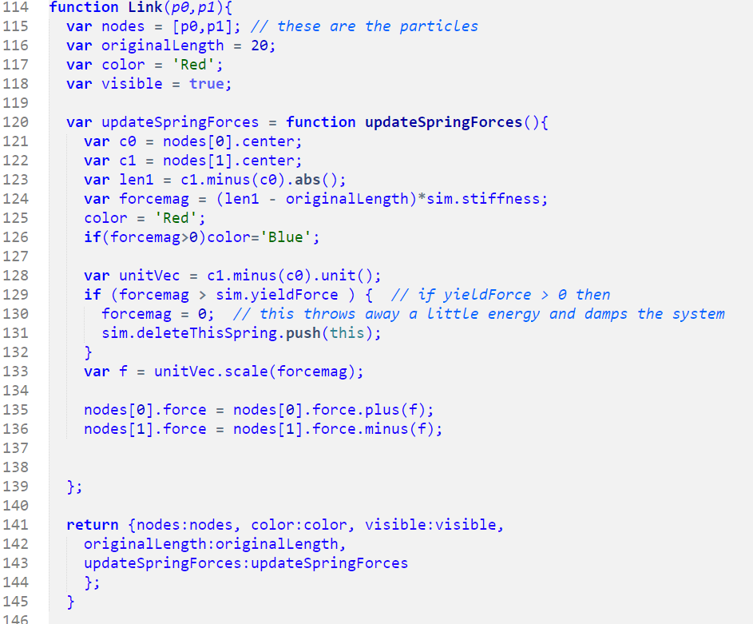
In Class Exercise 1
I’ve provided some code from our Particle Mechanics days so that you can use pieces to put physics into the starter code.
InClassGraphPhysicsEx1 – the starter code (same as we ended up with in last lesson.
Physics Bits - You need to use these to put physics into the starter code. They are taken from our Particle Mechanics days. Here are a few of the bits

Slide 8
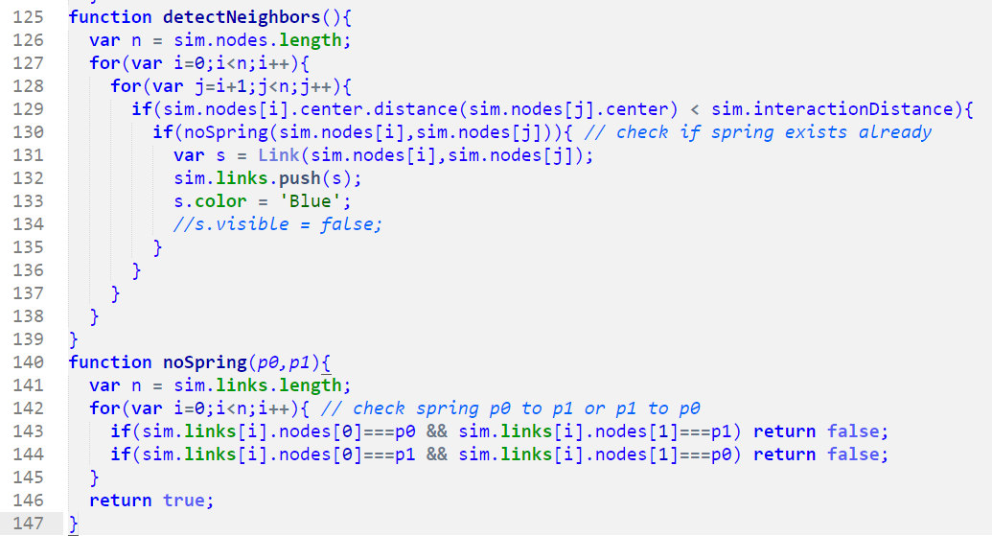
List of things you need.

Slide 9
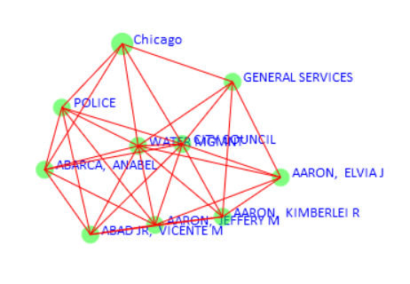
Running physics
If you plot all the ‘new’ springs and the ‘Links’ you get a get something like below when you run physics.
Its not bad but its not great either.

Slide 10
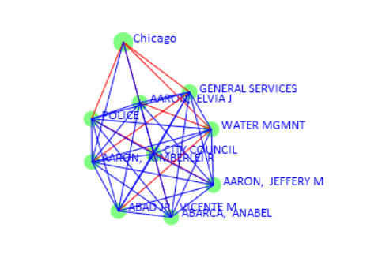
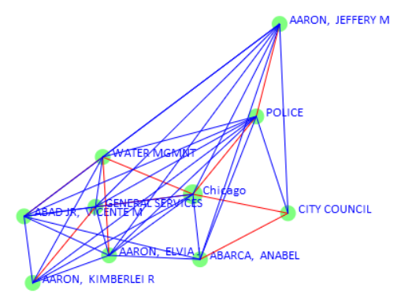
In Class Exercise 2a
Change the color of the ‘new’ springs added by physics to ‘Blue’, leaving the ‘old’ graph links in red. You should get something like this. This now makes two categories of springs red ones and blue ones.
Its still not great.

Slide 11
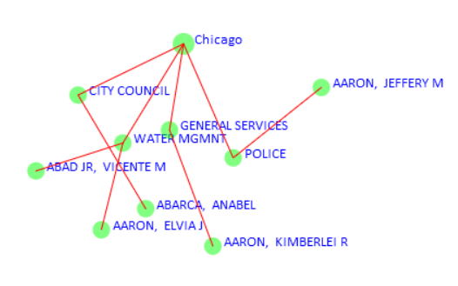
In Class Exercise 2b
Instead of blue just make the ‘new’ springs invisible by turning visible = false; for the new springs.

Slide 12
Red and Blue Spring Behavior
Tension and compression
originalLength = a*x
Compression only
originalLength = x
interactionDistance = y

Slide 13
In Class Exercise 3
The springs work well to keep the particles apart but they also tend to pull the particles together when they go into tension. What might work better is springs that only work when pushing particles apart but then don’t go into tension.
Modify the code so that the behavior of ‘Red’ springs is unchanged but ‘Blue’ springs exert zero force once they go into tension.
Once the code is working on the small data set try the larger data set. Change the code in SalaryRipDataLayer.js so that only 1 in 500 employees is read from the data set. (See next slide ) Also turn off writing out the names on the nodes so you can see more clearly the overall layout.
Hand in your final code and a screen shots for both data sets.

Slide 14
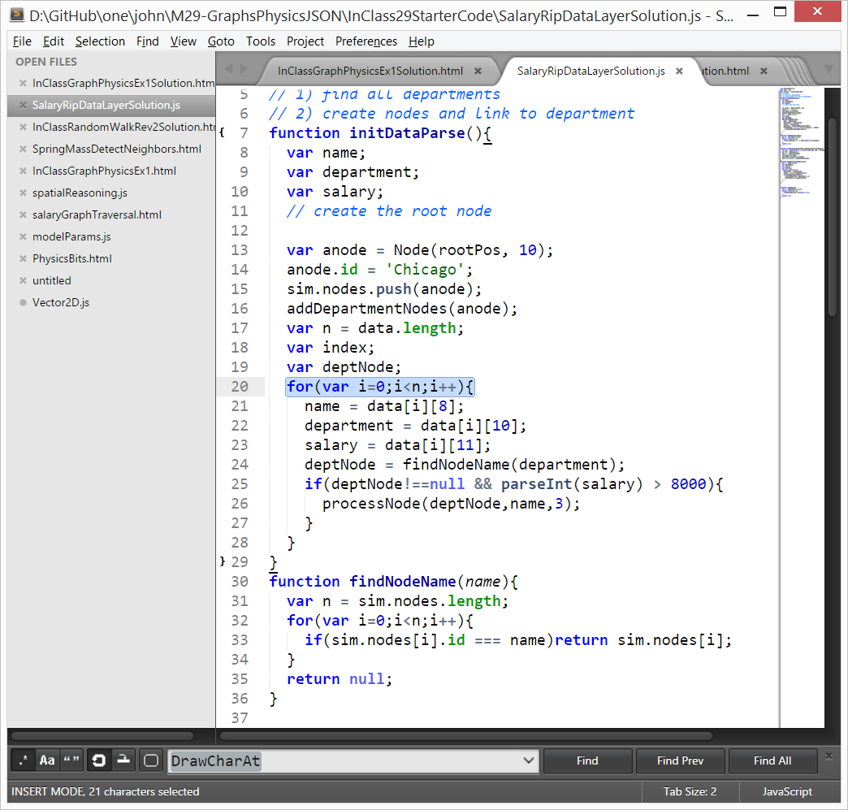

Slide 15
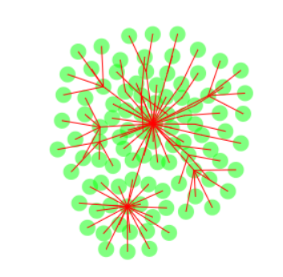
Result
You should get something like this.

