Slide 1
Stress-Strain in Networks Incidence Matrix Approach
Prof. John R. Williams
MIT

Slide 2

Defining Stress
One simple form is just to resolve the Force along the direction of the axis

Slide 3
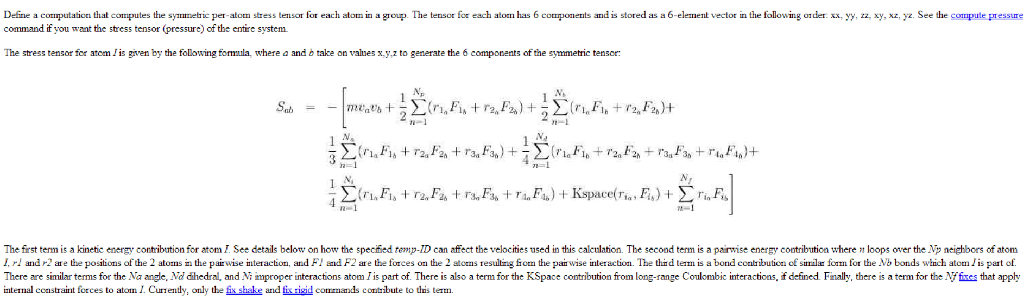
LAMMPS Stress

Slide 4
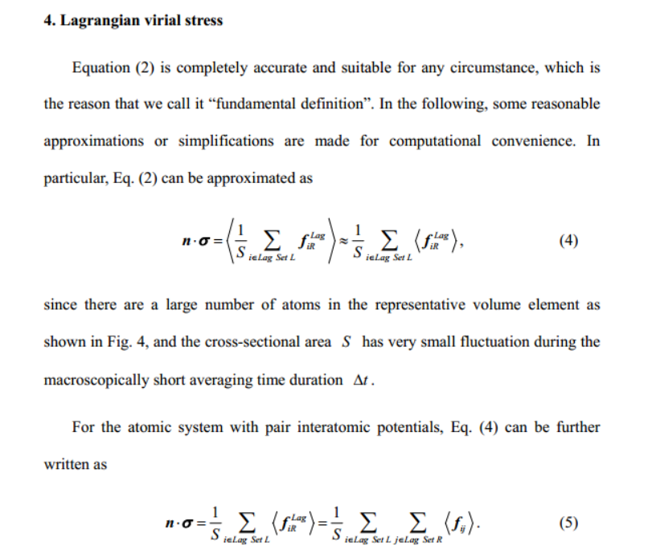
Time Averaged

Slide 5
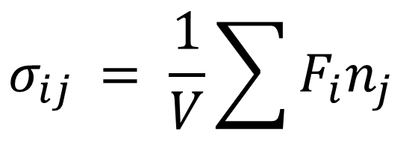
Stress
1
2
$$σ_{ij }= \frac{1}{V}\sum{F_{i}n_{j}}$$
3

Slide 6
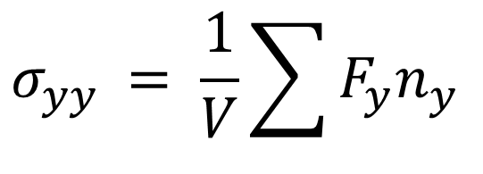
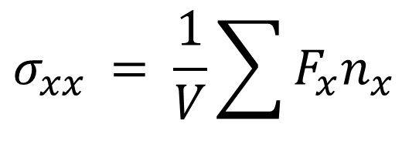


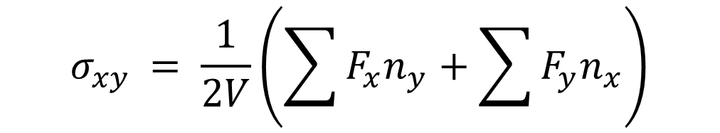
Stress
$$n_{y }$$
1
$$σ_{xx }= \frac{1}{V}\sum{F_{x}n_{x}}$$
2
$$n_{x }$$
$$σ_{yy }= \frac{1}{V}\sum{F_{y}n_{y}}$$
3
$$σ_{xy }= \frac{1}{2V}\left(\sum{F_{x}n_{y}}+\sum{F_{y}n_{x}}\right)$$

Slide 7
Stress
$$n_{y }$$
$$σ_{xx }= \frac{1}{V}\sum{F_{x}n_{x}}$$
$$n_{x }$$
$$σ_{yy }= \frac{1}{V}\sum{F_{y}n_{y}}$$
$$σ_{xy }= \frac{1}{2V}\left(\sum{F_{x}n_{y}}+\sum{F_{y}n_{x}}\right)$$

Slide 8
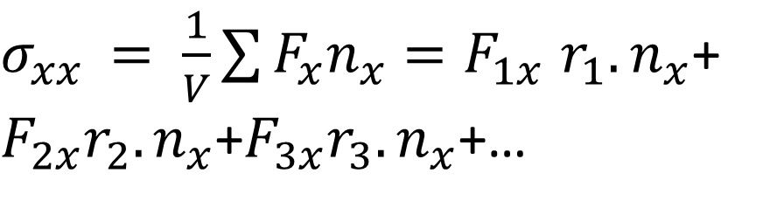
Stress
$$n_{y }$$
2
1
$$n_{x }$$
3
Lets suppose all Forces are tensile = +
$σ_{xx }= \frac{1}{V}\sum{F_{x}n_{x}}{=F}_{1x}{r_{1}.n}_{x}$+ $F_{2x}{r_{2}.n}_{x}$+$F_{3x}{r_{3}.n}_{x}$+…

Slide 9
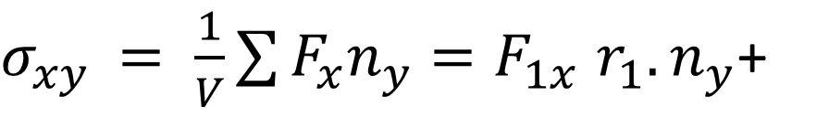
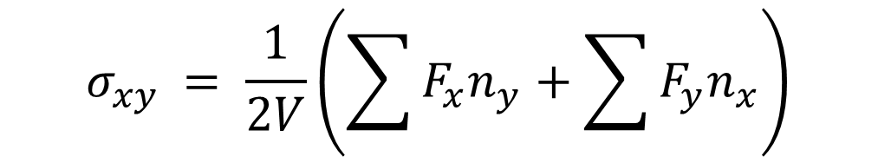
Stress
$$n_{y }$$
$$σ_{xy }= \frac{1}{2V}\left(\sum{F_{x}n_{y}}+\sum{F_{y}n_{x}}\right)$$
2
1
$$n_{x }$$
3
Lets suppose all Forces are tensile = +
$σ_{xy }= \frac{1}{V}\sum{F_{x}n_{y}}{=F}_{1x}{r_{1}.n}_{y}$+

Slide 10
Incidence Matrix Representation
Node
The incidence matrix contain information about both Nodes and Edges
Edge
1
1
2
2
3
3
4
5
4

Slide 11
Apply Hook’s Law To Force on Edges
Here we set up a force problem where the Stiffness K is defined for each spring.
We apply Ohm’s law in the form
Where w are the currents and e the voltage drops (differences).

Slide 12
Apply Hook’s Law To Force in Edge Springs
1
2
3
4

Slide 13
Equilibrium
If a node is in equilibrium the external and internal forces must balance.
1
2
3
4

Slide 14
Combining Equations
Eq. 1
Eq. 2
This is equivalent to the “Displacement FEM Method”

Slide 15
Dynamic Equations
This is equivalent to the “Displacement FEM Method”

Slide 16
Observations
This is singular so to solve we
need to “ground” some node
2
3
Here we see that the diagonal matrix D tells us about the degree of the node (how many links it has) and the Adjacency Matrix tells us which nodes are connected.
is called the Graph Laplacian

Slide 17
Solving the Equations
Ground a node
Removing this unknown will reduce the matrix to a 3x3
2
3

Slide 18
First the Simple Case C=1
Lets make
If there are no inflows then we can easily solve this

Slide 19
Now lets do the Full Case
Note this is Symmetric
All rows and columns sum to zero

Slide 20
Setting the Boundary Conditions
Let

Slide 21
Assign C=1 everywhere

Slide 22
Now Calculate Flows

Slide 23
Exercise in Class Assign the Cs

Slide 24
Now Calculate Flows

Slide 25
Assign the Cs

Slide 26
Static Equation for Network
Sometimes we are interested in the dynamic behavior of quantities in a network. For example, the spread of a disease, which starts at one place and spreads (diffuses) over time.
Lets now look at the dynamic equations.

Slide 27
Diffusion- A Dynamic Process
Suppose there is some substance at node i at time t, whose concentration potential is given by

Slide 28
Rate of Change at a Node
The rate of change at a node is given by
1
2
3
4

Slide 29
Diffusion
Flow from j to i
Rate of Change Equation
In Matrix Form
Substitute for w
If all the external fluxes are zero
L is called the Laplacian

Slide 30
Relationship to the Laplacian
For a continuum we remember the diffusion equation is given by

Slide 31
Solution Using Eigenvectors of L
Eigenvectors of L
The eigenvectors are orthonormal
And

Slide 32
Solution Using Eigenvectors of L
Substitute the linear expansion of the eigenvectors
Multiply by

Slide 33
Solution Using Eigenvectors of L
But the eigenvectors are orthonormal
And

Slide 34
Solving Analytically
We can solve this analytically
Since the eigenvalues are real and positive then this is a decaying solution over time.

Slide 35
Diffusion on Lattice
The easiest way to generate the Laplacian is to use
retlationship below
1
2
3
4

Slide 36
Difference Relationship for Laplacian
1
2
3
4
Note the similarity

Slide 37
Diffusion on Lattice
Eigenvectors of L are the columns
-0.5000 0.6533 0.5000 -0.2706
-0.5000 0.2706 -0.5000 0.6533
-0.5000 -0.2706 -0.5000 -0.6533
-0.5000 -0.6533 0.5000 0.2706
Eigenvalues
1
2
3
4
-0.0000 0 0 0
0 0.5858 0 0
0 0 2.0000 0
0 0 0 3.4142

Slide 38
Initial Condition
-0.5000 0.6533 0.5000 -0.2706
-0.5000 0.2706 -0.5000 0.6533
-0.5000 -0.2706 -0.5000 -0.6533
-0.5000 -0.6533 0.5000 0.2706
1
2
3
4

Slide 39
Matlab Code to Plot Solution
t=0.1:0.1:10;
phi(1,:)=-0.5*exp(-0*t);
phi(2,:)= 0.65*exp(-0.58*t);
phi(3,:)= 0.5*exp(-2*t);
phi(4,:)= -0.27*exp(-3.41*t);
psi=V*phi;
plot(psi(1,:));
hold on
plot(psi(2,:));
plot(psi(3,:));
plot(psi(4,:));
V Matrix

Slide 40
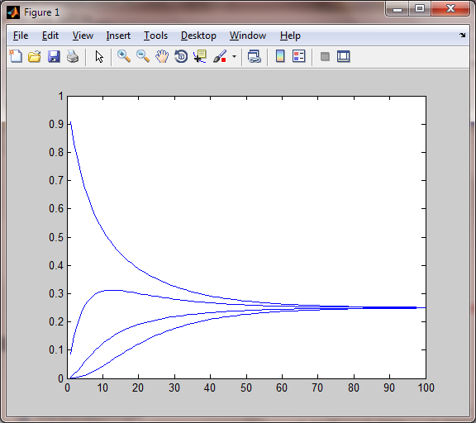
Phi vs Time

Slide 41
Exercise for Later in Term

Slide 42
Diffusion on Lattice
The easiest way to generate the Laplacian is to use
retlationship below
1
2
3
4
5
6
7
8
9

Slide 43
Laplacian
1
2
3
4
5
6
7
8
9
[V, D]=eig(AJJ);

Slide 44
Laplacian
Eigenvalues Lambda = [0, 1, 1, 2, 3, 3, 4, 4, 6]
We need to find the initial alphas
1
2
3
4
5
6
7
8
9

Slide 45
Initial Conditions
Using the orthonormality to find initial condition
1
2
3
4
5
6
7
8
9

Slide 46
Least Squares
In general there will be more equations than unknowns and unless we are lucky there is no solution. We want to get the “best” approximation.
(1,2)
(3,3)
(0,1)
http://www.youtube.com/watch?v=V5EjSvx1vw0&feature=relmfu

Slide 47
Fit a line through the points
In general there will be more equations than unknowns and unless we are lucky there is no solution. We want to get the “best” approximation.
(1,2)
(3,3)
(0,1)

Slide 48
Fit a line through the points
(1,2)
(3,3)
(0,1)

Slide 49
Changing Notation
(1,2)
(3,3)
(0,1)

Slide 50
Changing Notation
Column Vectors
The solution is some combination of the column vectors. The column vectors form a plane. The plane however does not contact the RHS vector.
The best we can do is find a projection onto the plane.

Slide 51
Changing Notation

Slide 52
Least Squares
The minimum least squares error will be when this equation holds

Slide 53
Least Squares
We seek to minimize the error in a least squares sense. Minimize

Slide 54
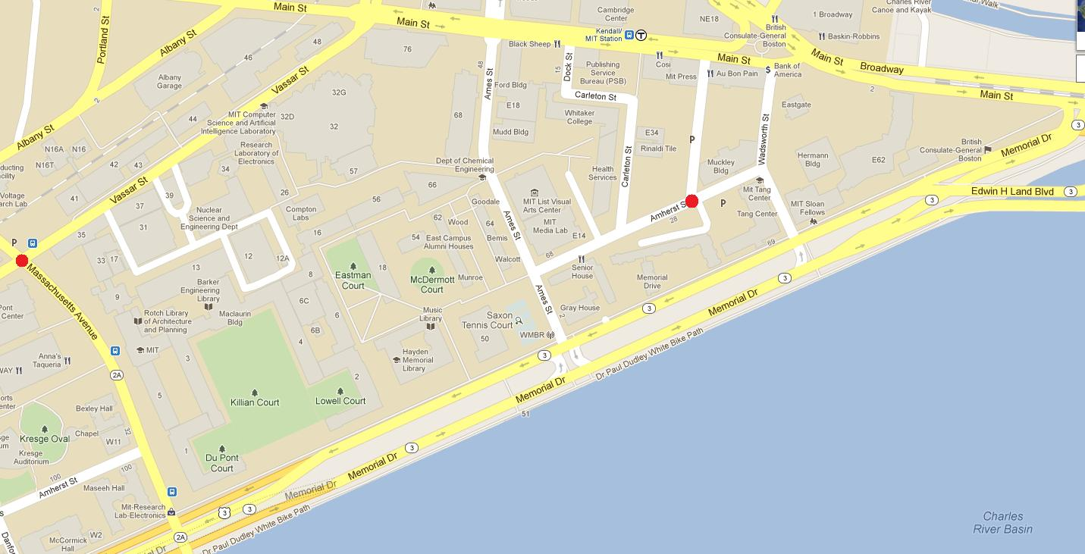
4
11
5
9
13
16
19
18
17
6
14
12
1
10
15
7
2
8
3

