Slide 1
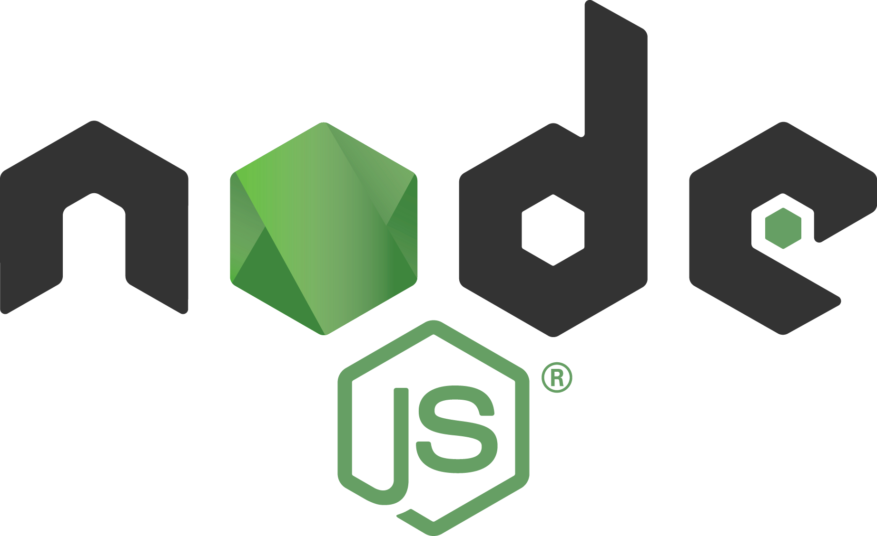

Slide 2
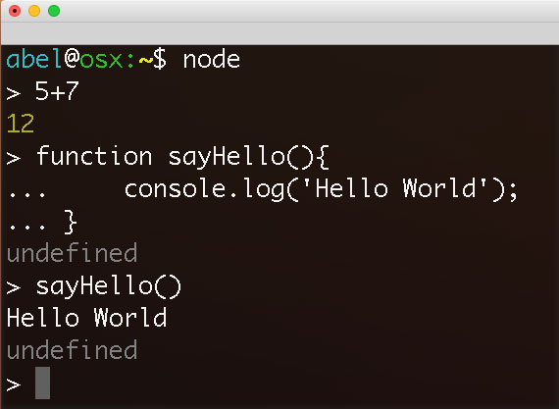
Console Use

Slide 3
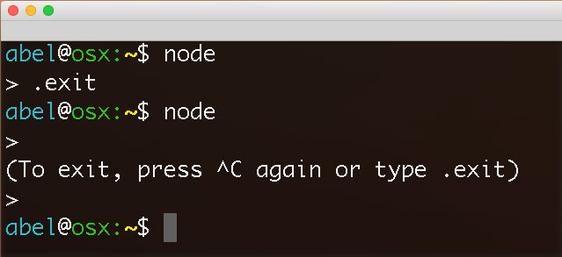
Exit Console

Slide 4
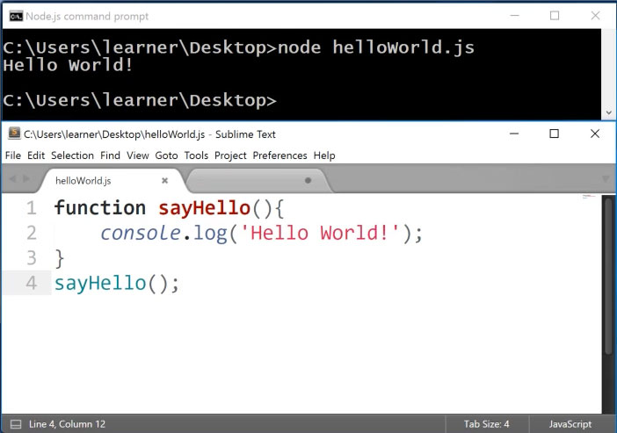
Run File

Slide 5
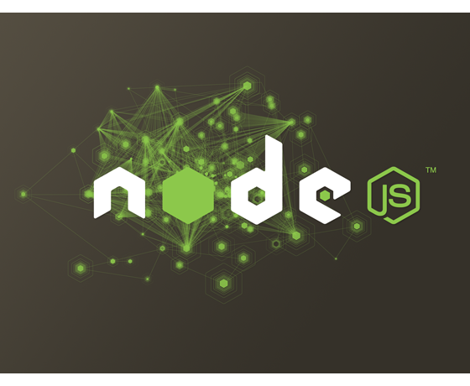
MODULES

Slide 6
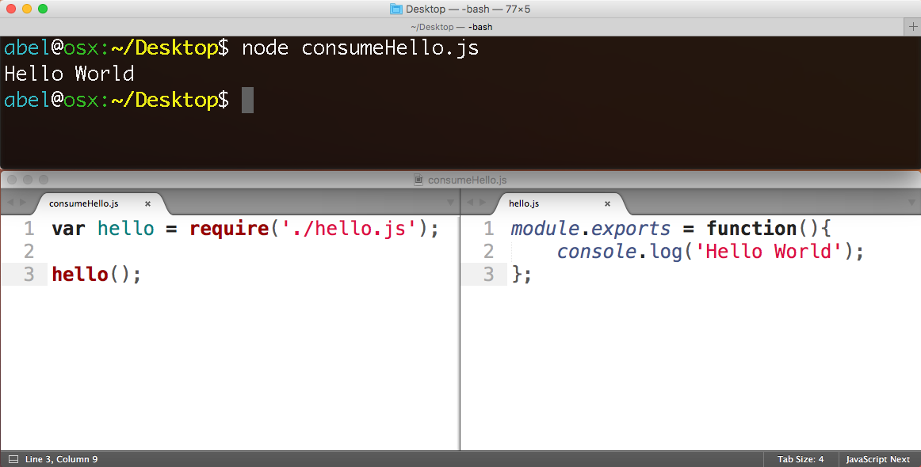
Use module with
“require”
Make module with “module.exports”

Slide 7

What is npm?
https://www.npmjs.com
Package manager. Installs, publishes and manages node programs

Slide 8
What is npm?
475,000+ Modules

Slide 9
What is npm?
4.2 Billion
downloads/week

Slide 10
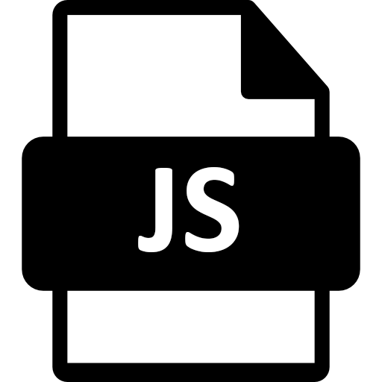

What is a Module?
A Module is some JavaScript paired with a package.json file
+

Slide 11
Advantages
Small pieces, loosely joined
Leverage external packages
Leverage internal packages
Facilitate collaboration
Packages are discoverable in npm

Slide 12
Creating node/npm apps

Slide 13
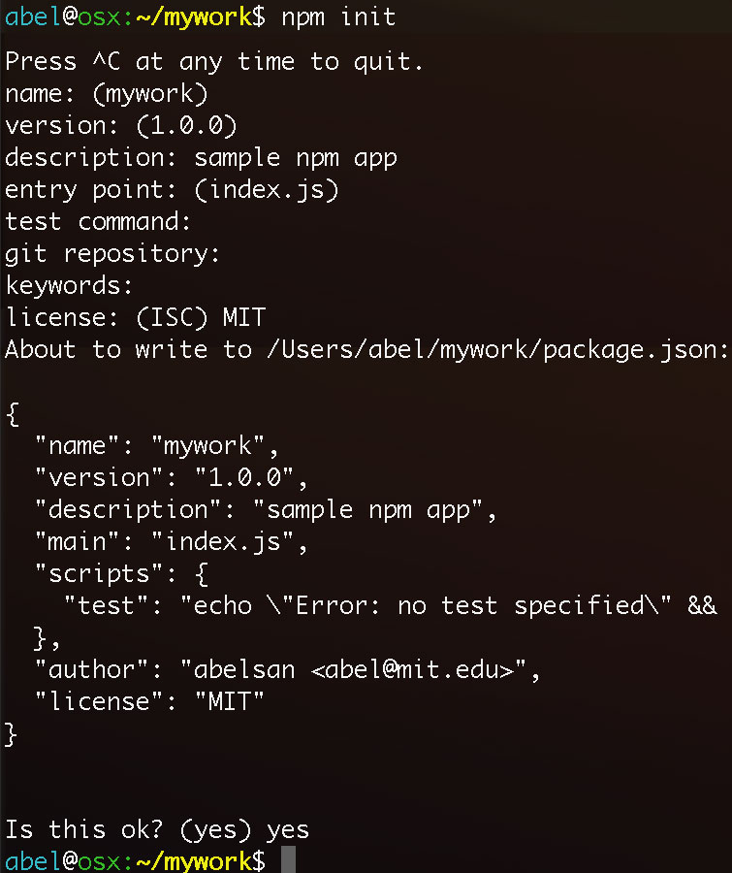
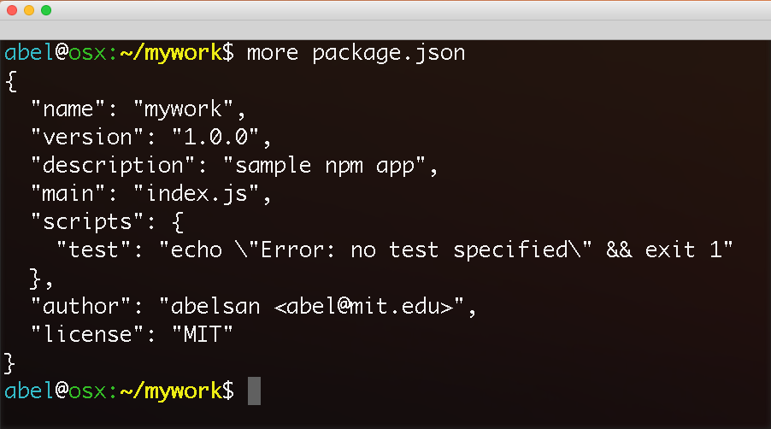
“npm init” generates the configuration file package.json

Slide 14
adding npm packages
to your application

Slide 15
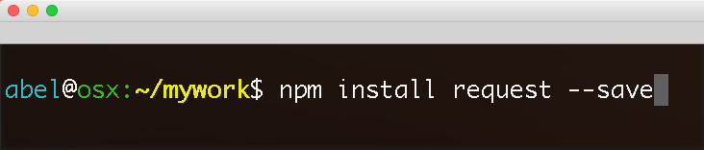
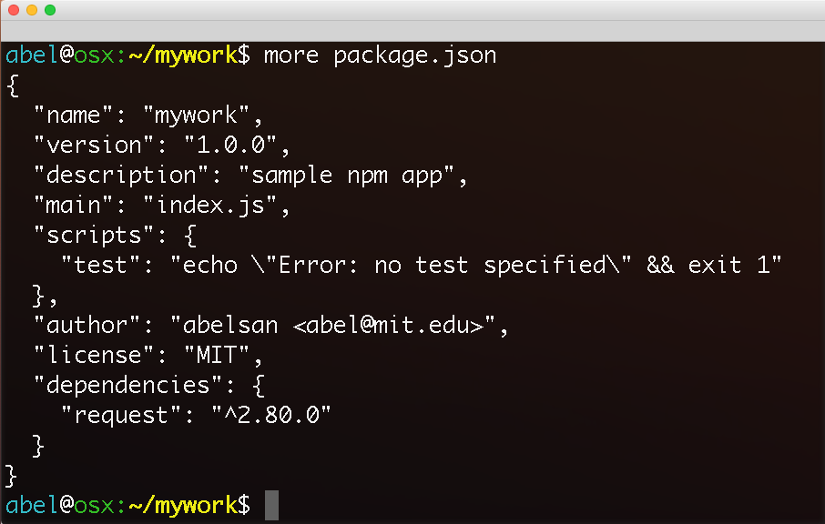
Local installation of request package. Dependency added to package.json

Slide 16
Active Learning
…

Slide 17
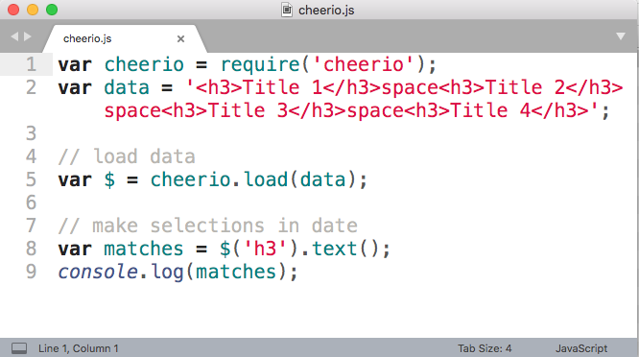
DOM selections with cheerio

Slide 18
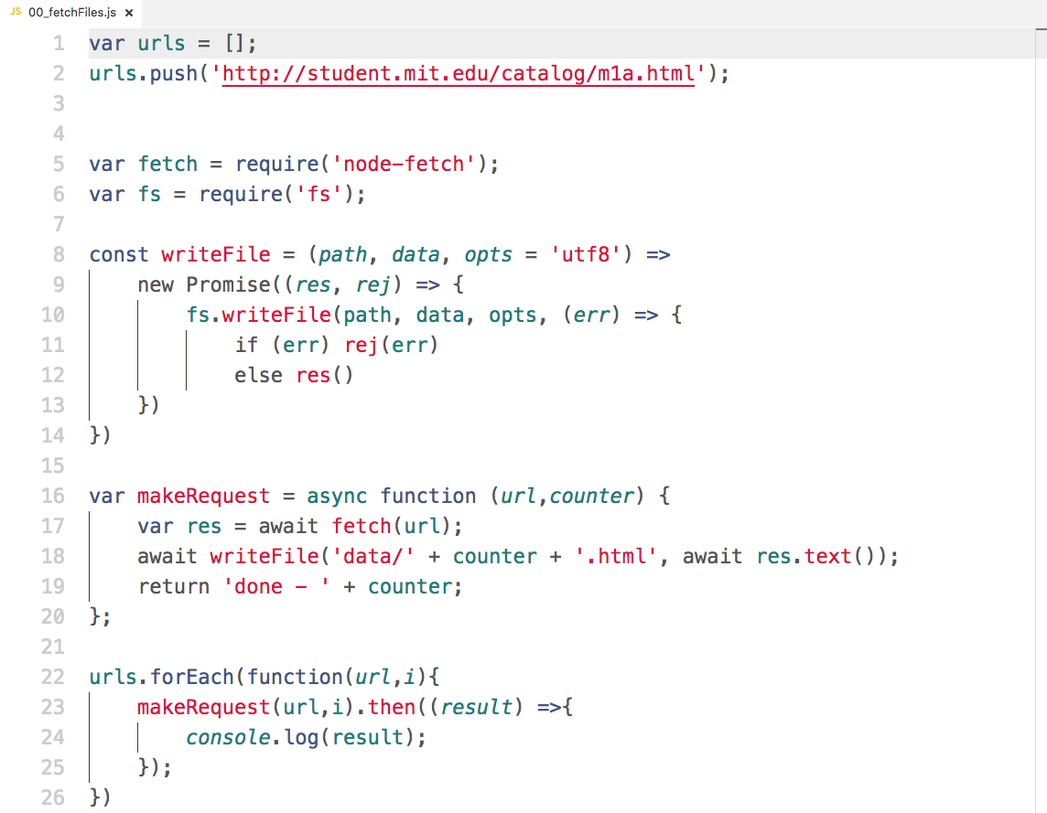
Download HTML
files using
node-fetch

