Slide 1

Sensemaking
Course Catalog

Slide 2

MIT Course Catalog
We will scrape the MIT course catalog

Slide 3




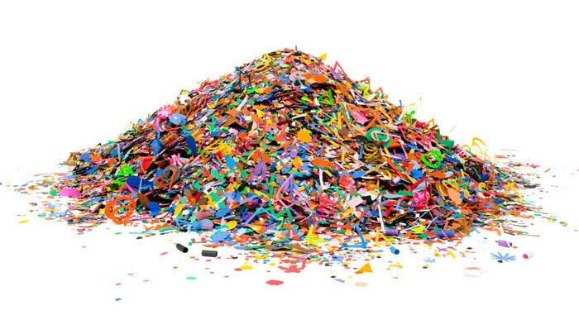
Curl or Request
Course
Catalog

Slide 4
What do you do?

Slide 5
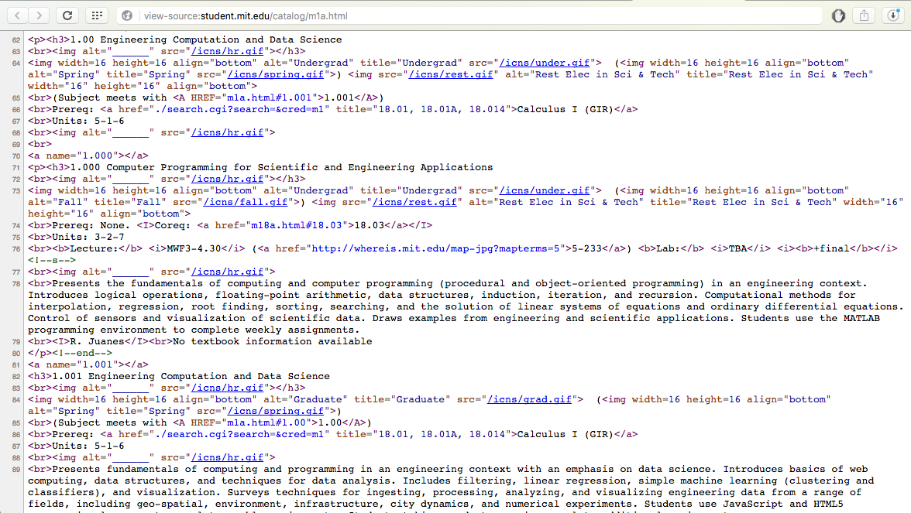

Slide 6
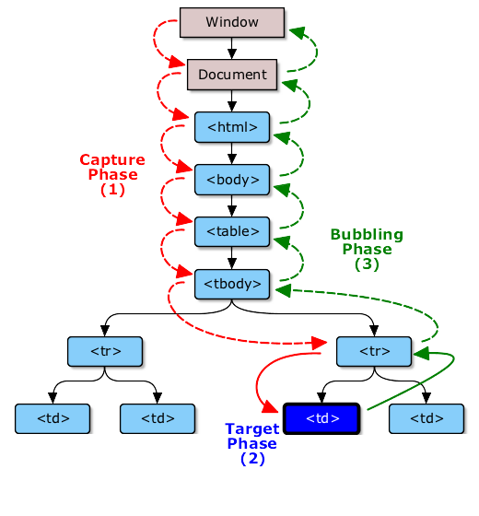
DOM

Slide 7
10 Steps
1.- Curl or Request
6.- Get Titles
2.- Remove Whitespace
7.- Scrub Titles
3.- Additional Cleaning
8.- Word Arrays
4.- Parse
9.- Flatten Arrays
5.- Get Courses
10.- Word Frequency

Slide 8
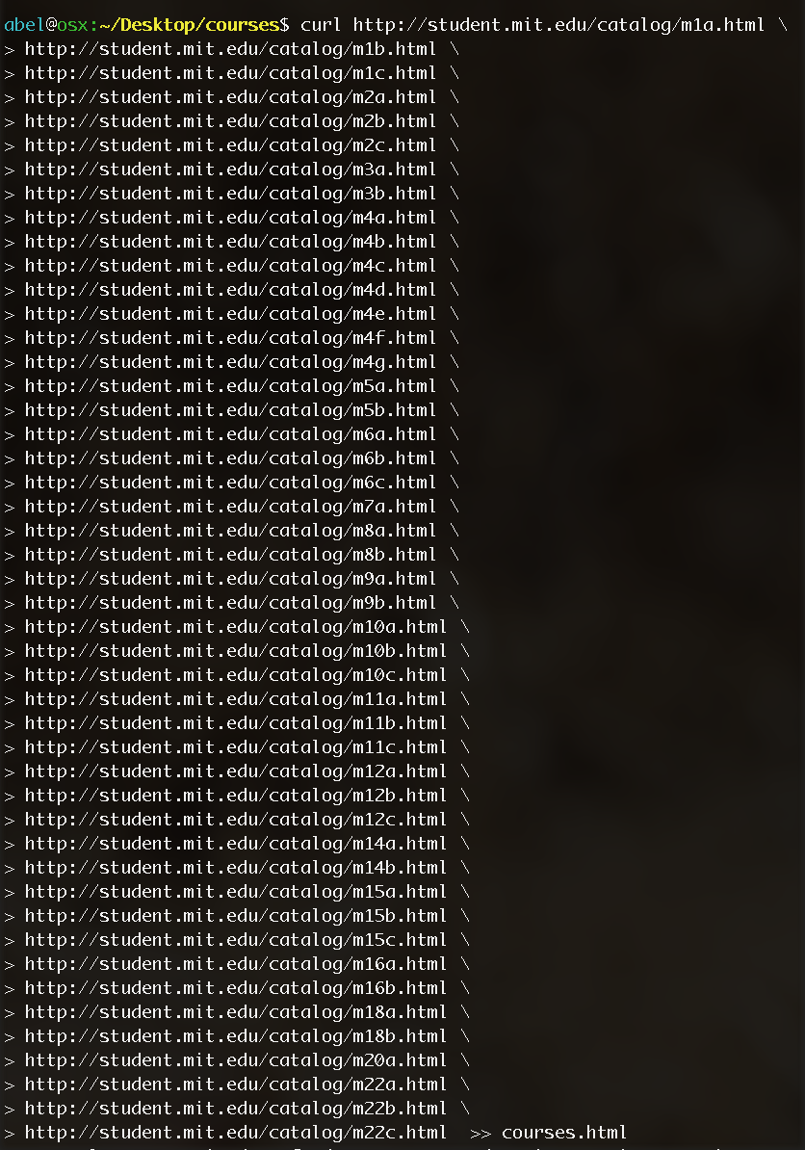
Download
course
catalog

Slide 9
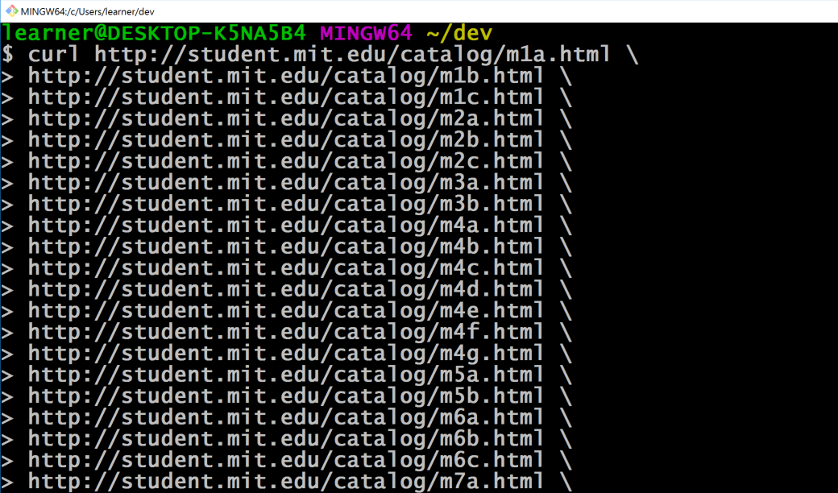
If you are on windows
Use the git bash

Slide 10
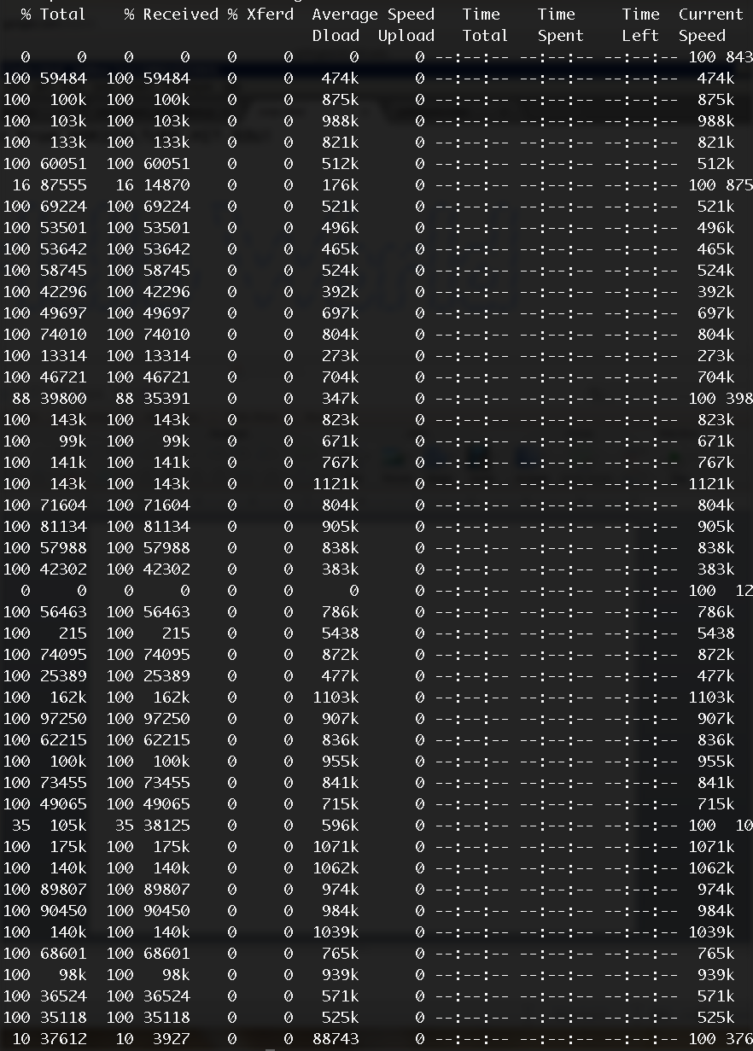
You
should
see

Slide 11
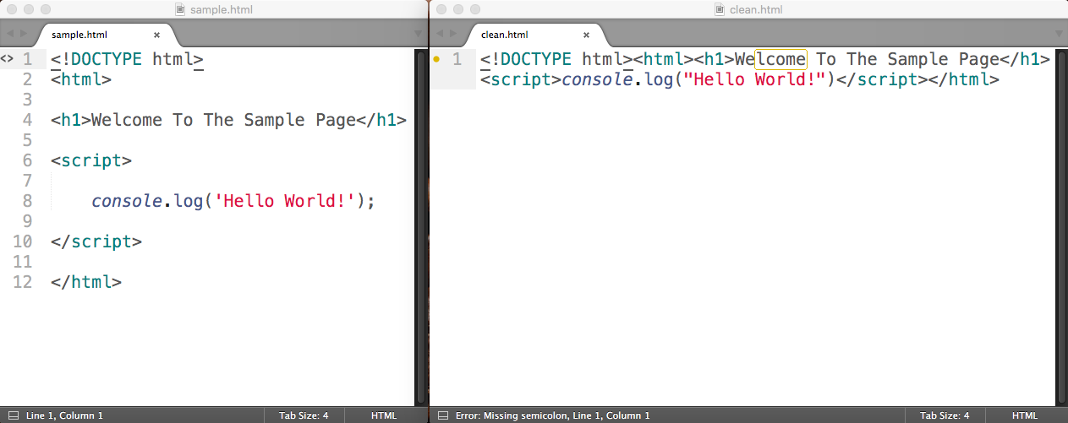
You need to remove whitespace
You can use NPM package html-minifier
To install enter
npm install html-minifier –g
Sample use
html-minifier whitespace_sample.html --collapse-whitespace --minify-js --minify-css -o clean.html

Slide 12
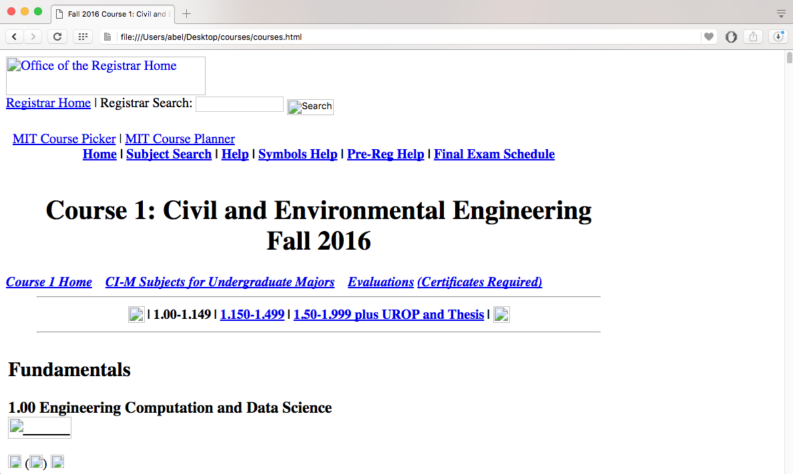
Load the file into your browser
You should see

Slide 13
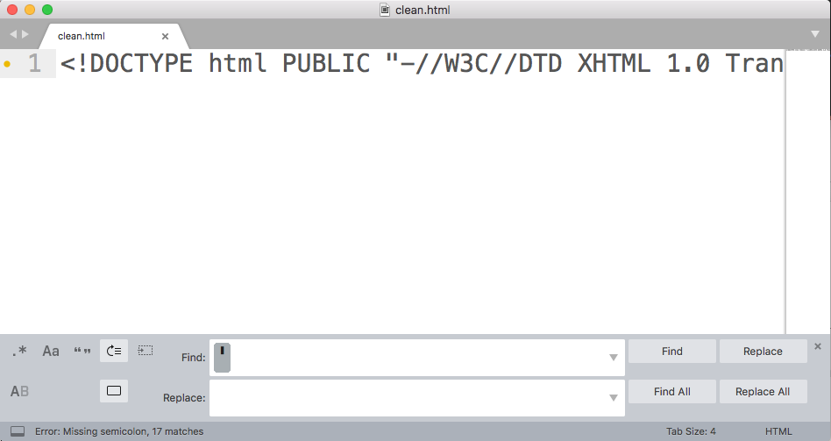
Create one continuous string
Remove all other single quotes – to avoid breaking string

