Slide 1

REST: Web Services
Abel Sanchez

Slide 2
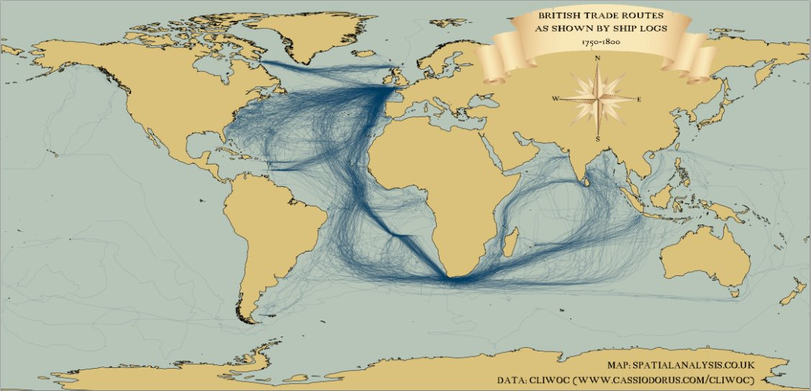
Work Requires Connections
Shipping Routes

Slide 3
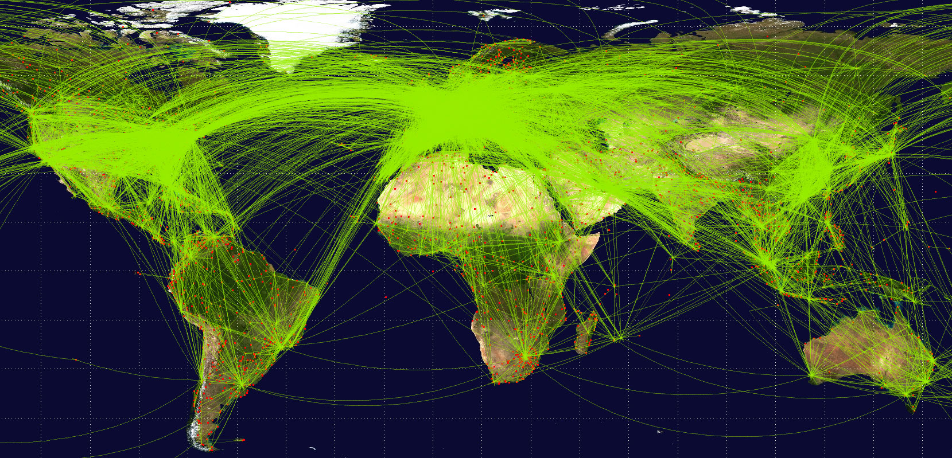
Work Requires Connections
Flight Routes

Slide 4
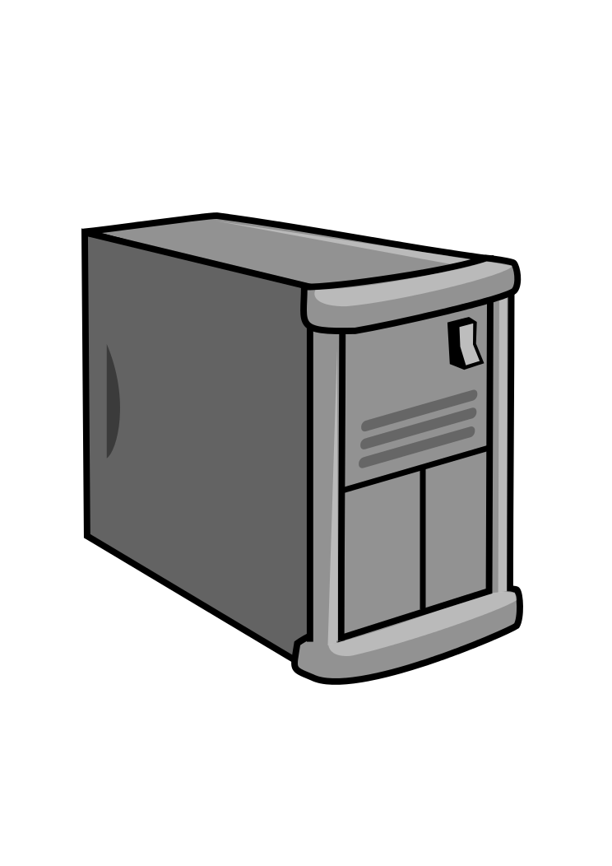
Connecting
1980s “Internetworking Protocols”
1995, Web 1.0
Document linking
Connecting Computers
The Internet
1960s Licklider
Man-Computer Symbiosis
The Computer as a Communication Device
2005, Web 2.0
Connecting software/data:
Databases
Computational resources
Simulation and visualization tools
Number crunching power of computers

Slide 5
Modern Application landscape

Slide 6
Browser UI Components

Slide 7
Browser
Browser HTML5
<JavaScript>
<JSON>
<div id=“map”>
eg MAP
UI
Handle
Analyze, Query, Share, Edit
Custom
Overlays
Visualization Data
Custom
Tools
Web Sockets
Custom
Applications
Web Workers (threads)
applications
Browser storage

Slide 8
Server
POJ, WS, REST
Analysis
APIs
Local Services
External Services
Notifications
Subscriptions
Real Time Data
Visualization Data
Data Services

Slide 9
Storage
JOX, WS, REST
CRUD
Environmental
Health
Energy
Water
Custom
CRUD
Extend
Version
Share

Slide 10
Lets think about data

Slide 11
Public Facades?
Web services and web sites are merely public facades to your internal databases.

Slide 12
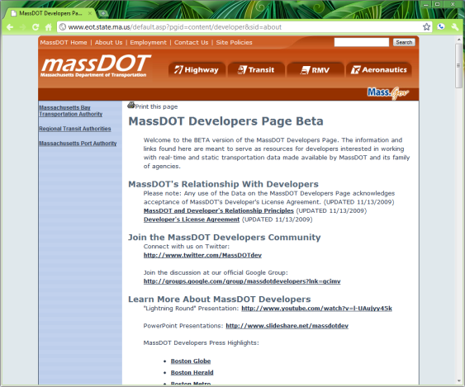
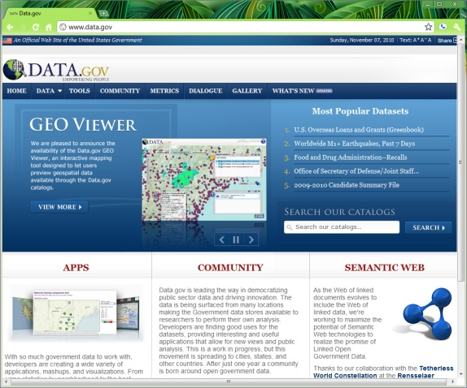
Web Sites
Web sites expose your database rendered as HTML
HTML
(data + layout)

Slide 13
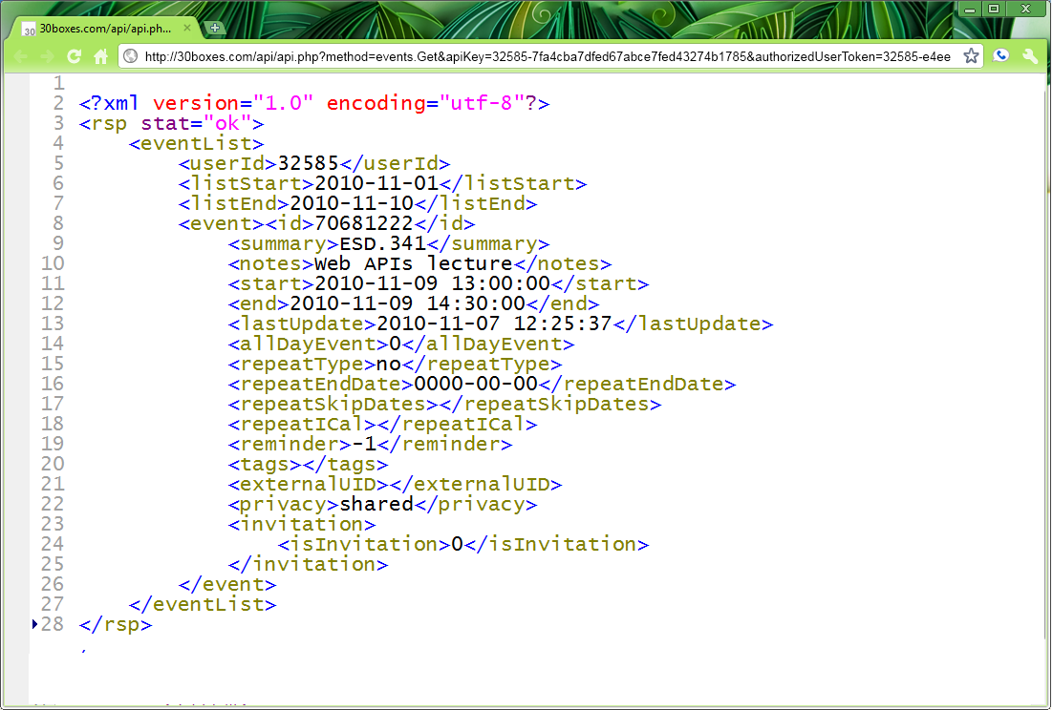
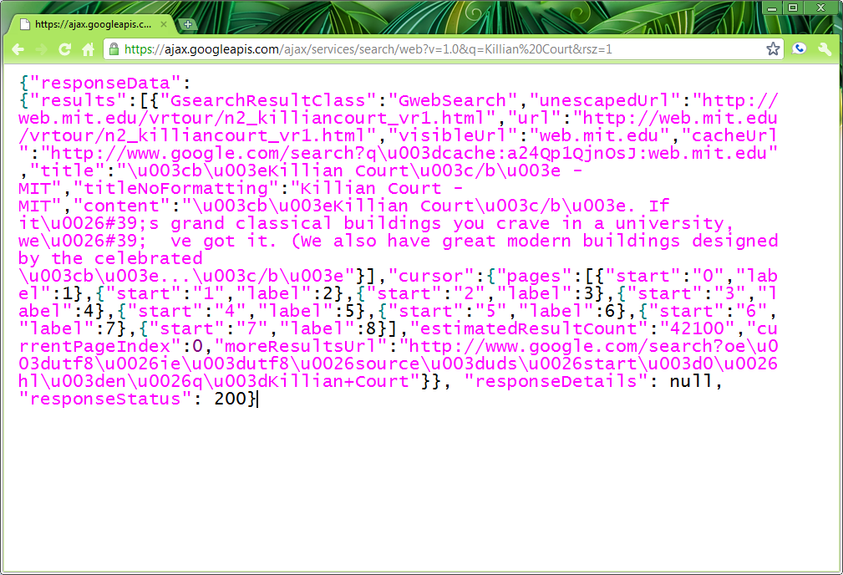
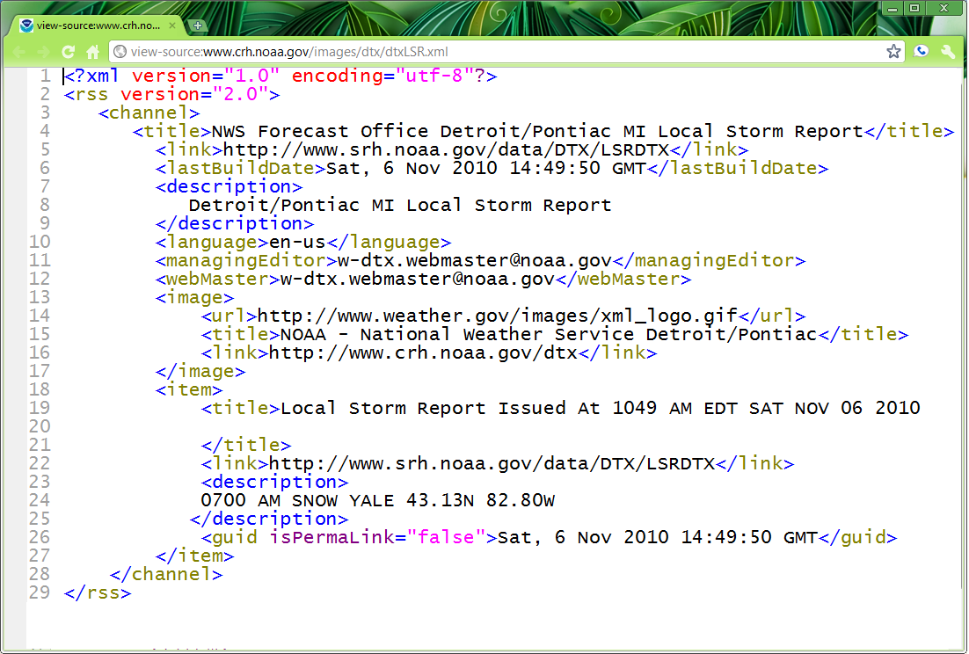
Web Services
Web services expose your database in some data format, defined on a case-by-case basis.
Your Data Format
Your Schema

Slide 14



Web Services
You need to anticipate what bits of information should be exposed and how to expose them
How much do
you expose?
What methods
do you create?
What data formats
do you offer?
What schema
do you use?

Slide 15

Do you have the time and can you anticipate every possible use?

Slide 16
Would be Great to
Read
Query
Edit
Version
Share (with friends)
Share (with programs)
Discover

Slide 17
architectures

Slide 18
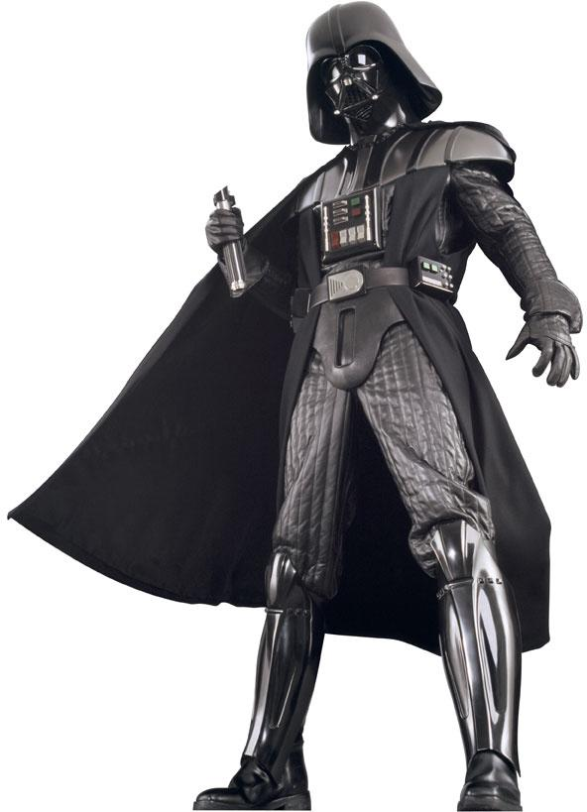
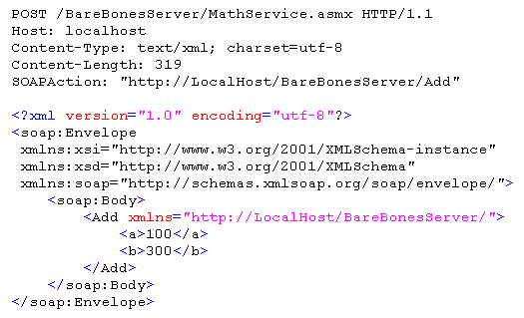
Simple Object Access Protocol (SOAP)
SOAP
Post Standard SOAP
HTTP Server
Response Standard SOAP

Slide 19

Forget the Standard
Just use HTTP
Roll your own

Slide 20
POJ
Plain Old JSON
Post JSON
HTTP Server
JSON Response

Slide 21
POX
Plain Old XML
Post XML
HTTP Server
XML Response

Slide 22
REST
Representational State Transfer (Roy Fielding)
An architectural style (no a protocol)
Web centric
Simple (a different way of thinking)

Slide 23
REST Principles
Everything is a Resource
Resources have Names
Resources are addressable via URIs
Resources are self descriptive
content types (“application/xml”)
Resources are stateless
Resources are manipulated via verbs

Slide 24
REST
URL in, JSON out
URL Message Bus
HTTP Server
JSON Response

Slide 25
HTTP Methods
To create a resource, use POST
To retrieve a resource, use GET
To change the state/update, use PUT
To delete a resource, use DELETE

Slide 26
Directory structure-like URIs
http://myservice.edu/university/course/{number}
http://myservice.edu/mit/1/100
http://myservice.edu/university/{number}/{semester}/{year}

