Slide 1

Video - Deliverable #0

Slide 2

10 seconds – Introduce Yourself
Put yourself on camera
Team name
Team members
Department, Year
Where are you from

Slide 3

30 seconds – The pitch
Make your case
Why do we care?

Slide 4

30 seconds – Support your pitch
Tell us more

Slide 5
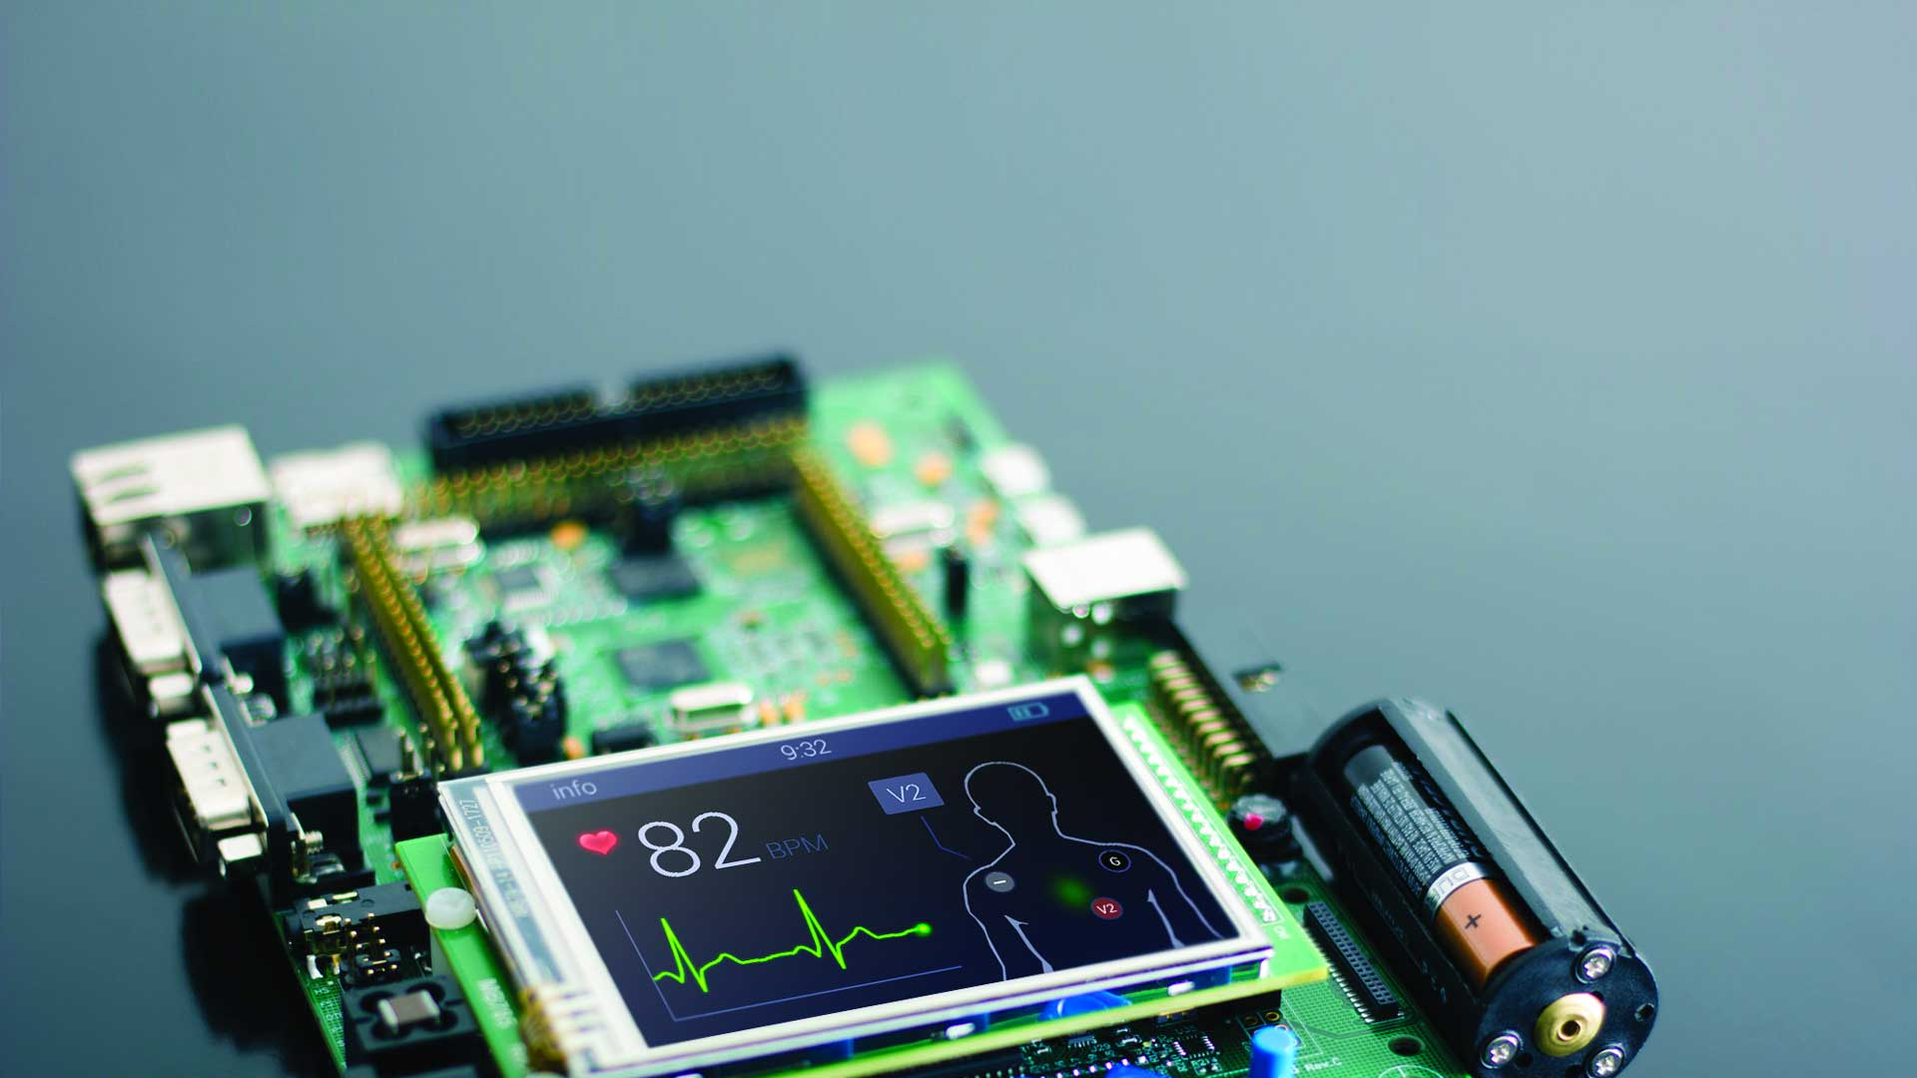
30 seconds – The technology
Hardware/software
Components
APIs Packages/Modules you will use
Cloud services you will use
Others?

Slide 6

30 seconds - Risk Management
Identify
Assess
Monitor
Control
Mitigate

Slide 7

30 seconds – Next steps

