Slide 1

Video - Deliverable #1

Slide 2
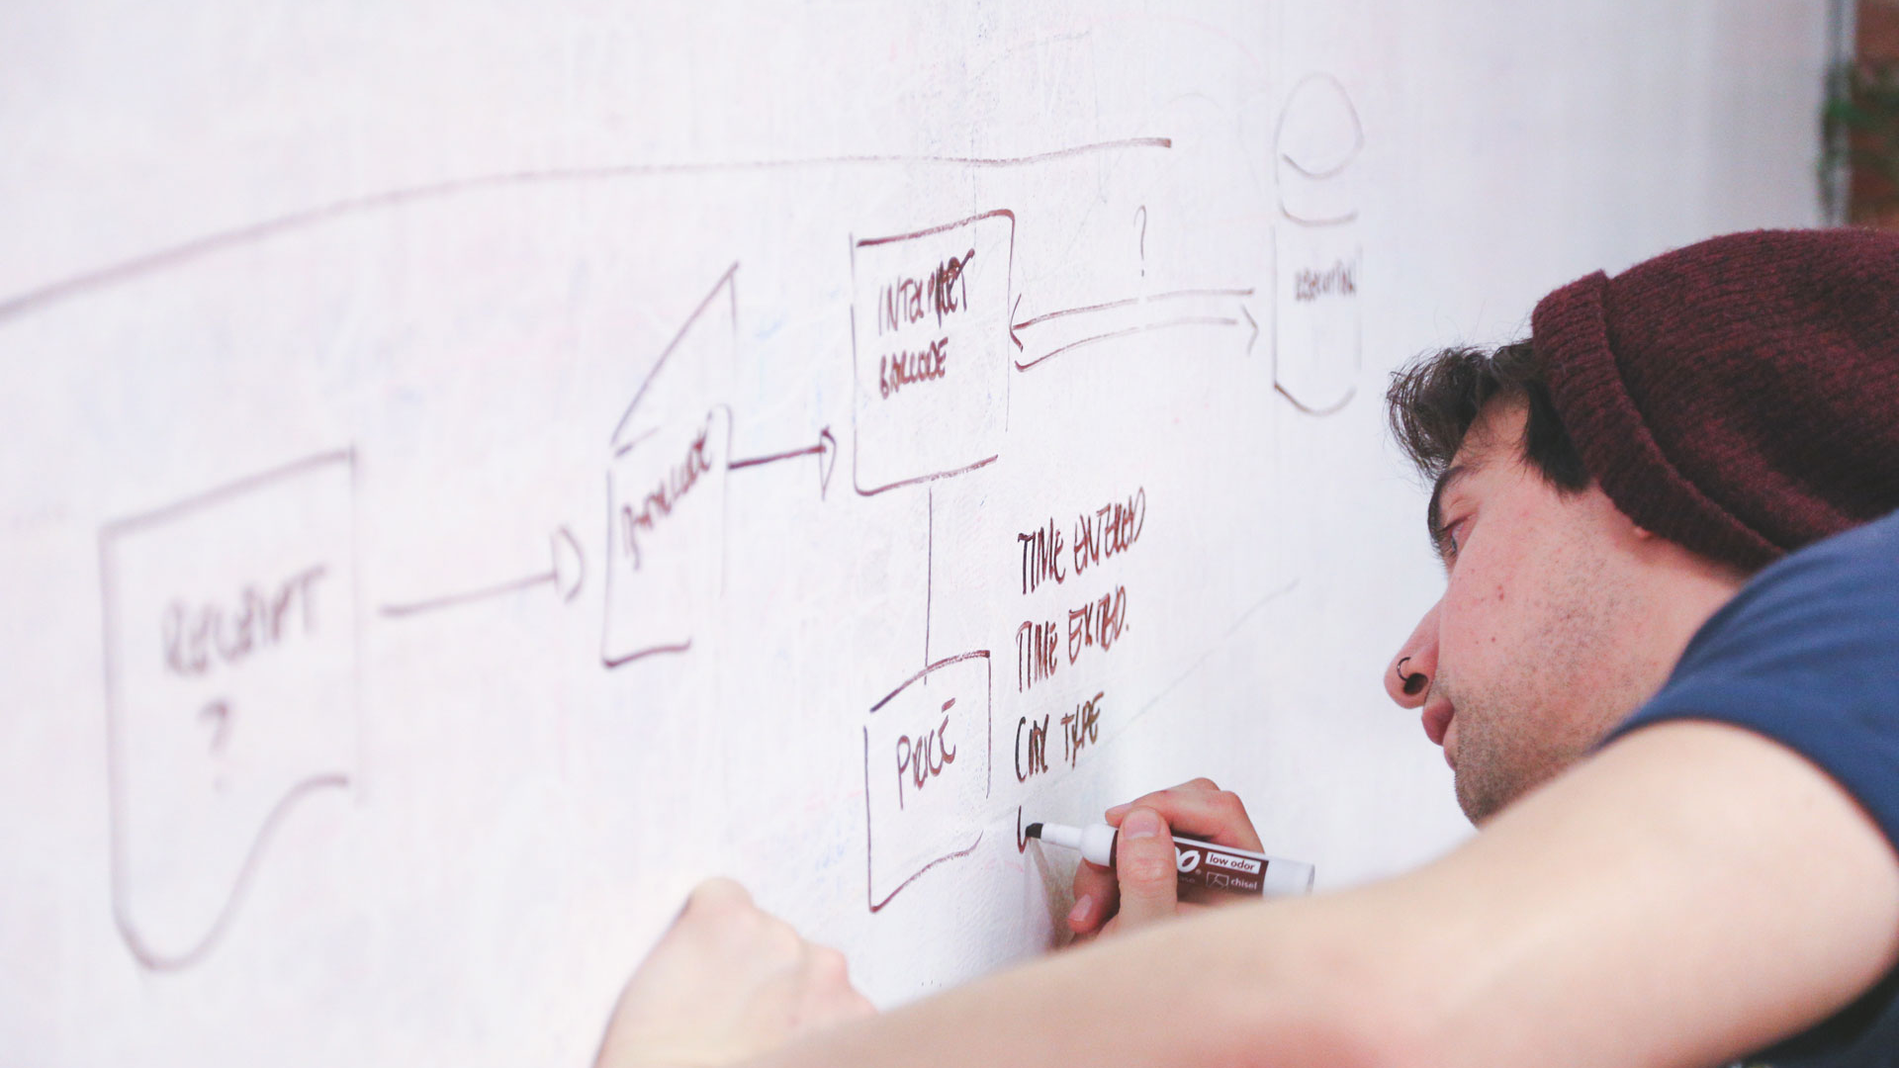
10 seconds – High Level Updates

Slide 3

10 seconds – Introduction Updates

Slide 4

30 seconds – Pitch Updates

Slide 5
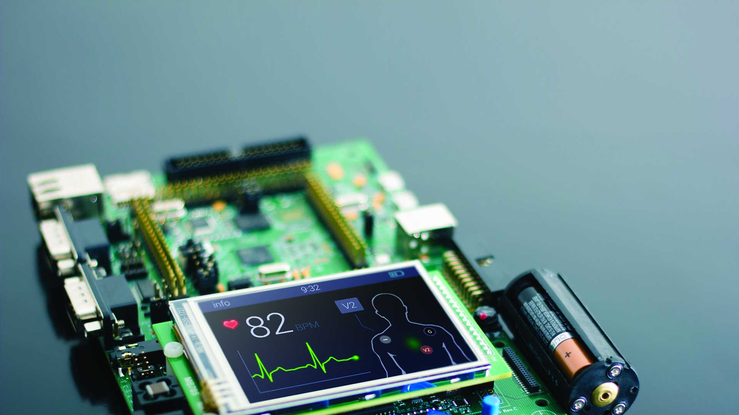
30 seconds – Technology Updates

Slide 6

1 minute – Code Overview
Tell us about your code:
Architecture diagram (layered)
Major software artifacts
Organization
What you wrote and what you did not

Slide 7

1 minute – Early (Crude) Demo
Demonstrate the concept

Slide 8

30 seconds – Risk Updates

Slide 9

30 seconds – Next steps

