Slide 1

Video - Deliverable #2

Slide 2

10 seconds – High Level Updates

Slide 3

10 seconds – Introduction Updates

Slide 4

30 seconds – Pitch Updates

Slide 5
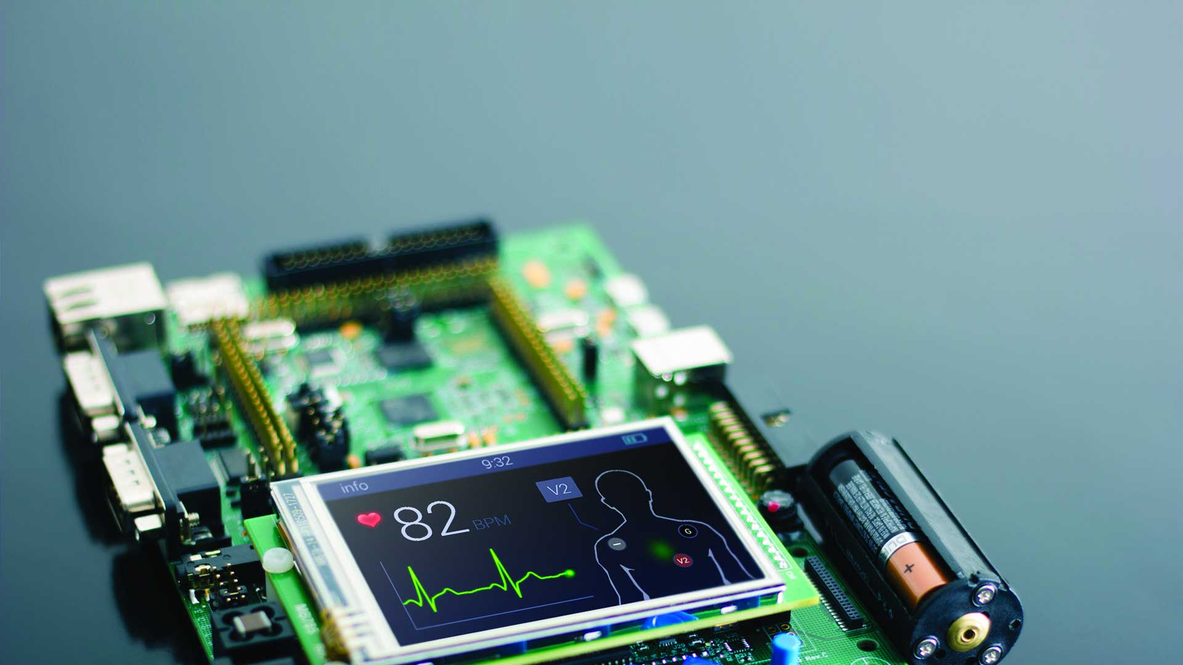
30 seconds – Technology Updates

Slide 6

1 minute - Code Updates

Slide 7

1 minute – Demo
Demonstrate working prototype

Slide 8
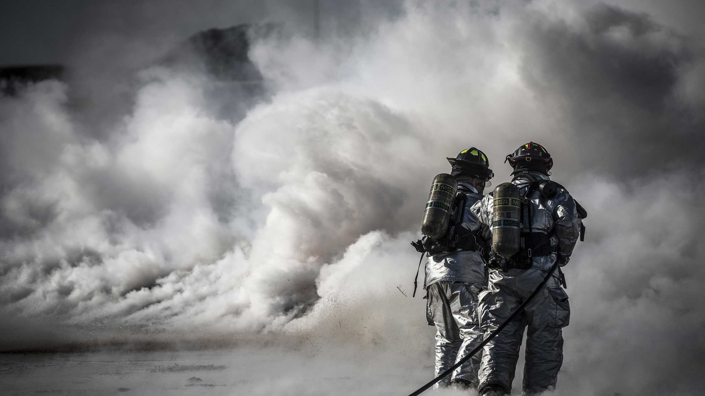
30 seconds – Risk Updates

Slide 9

30 seconds – Next steps

