Slide 1







Active Learning & HW Workflow
fork
clone
add
push
pull
request

Slide 2
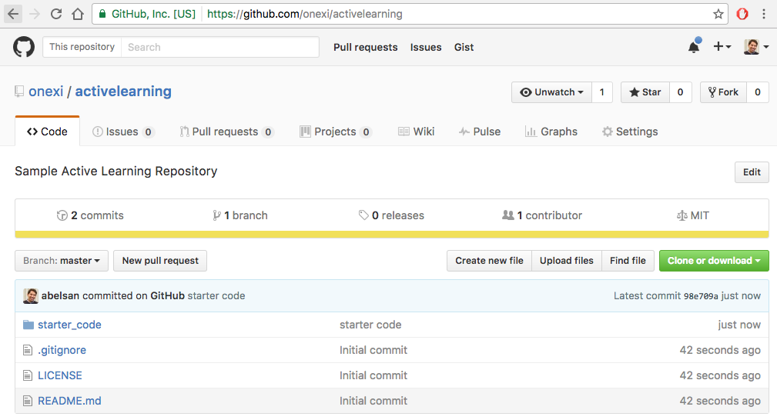
Go To Github
https://github.com/onexi/activelearning

Slide 3
Fork Repository

Slide 4
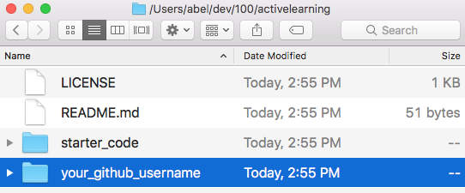
Add directory with your username
Add directory with your github username

Slide 5


Upload Changes
add
commit
push

Slide 6
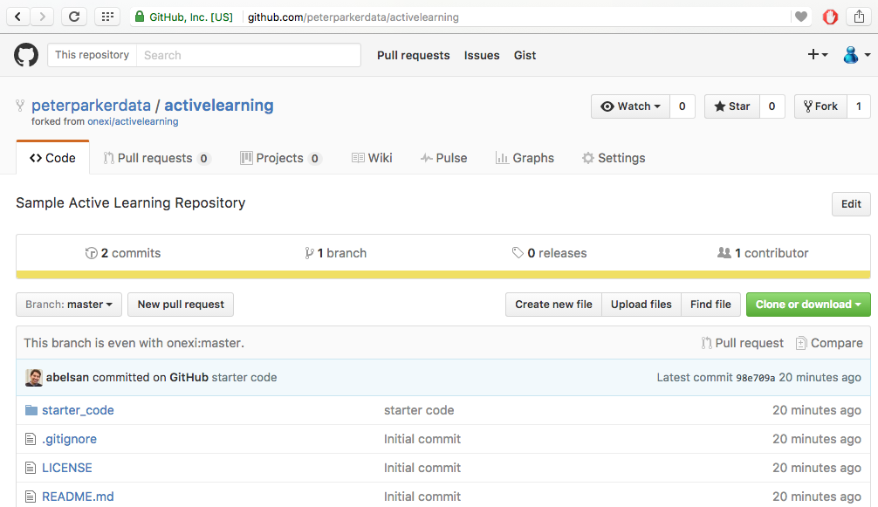
Confirm Changes in Repository
https://github.com/YourUsername/activelearning
Look for your changes

Slide 7
Pull Request
https://github.com/YourUsername/activelearning
Create pull request

