Slide 1

7 BILLION PEOPLE
200 COUNTRIES
ALL PRODUCING DATA
Engineering Computation
& Data Science
Abel Sanchez, abel@mit.edu, John R Williams, jrw@mit.edu
Massachusetts Institute of Technology

Slide 2

Rise of Systems & Data

Slide 3
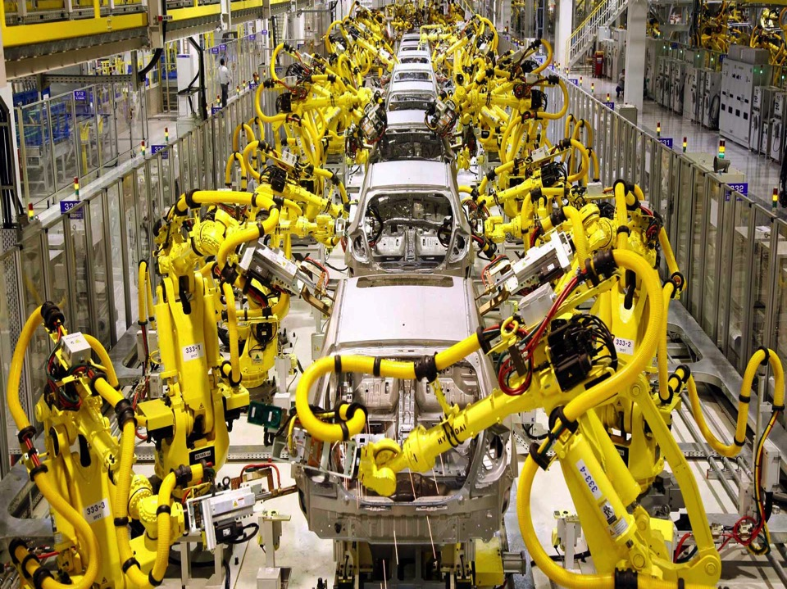
More Systems & More Data

Slide 4




Everywhere

Slide 5

Abstractions for Building
Software Systems Have Risen

Slide 6

New normal: A Single Person can
Build a Complex Software System

Slide 7

New normal: A Small Team can
Challenge an Industry

Slide 8
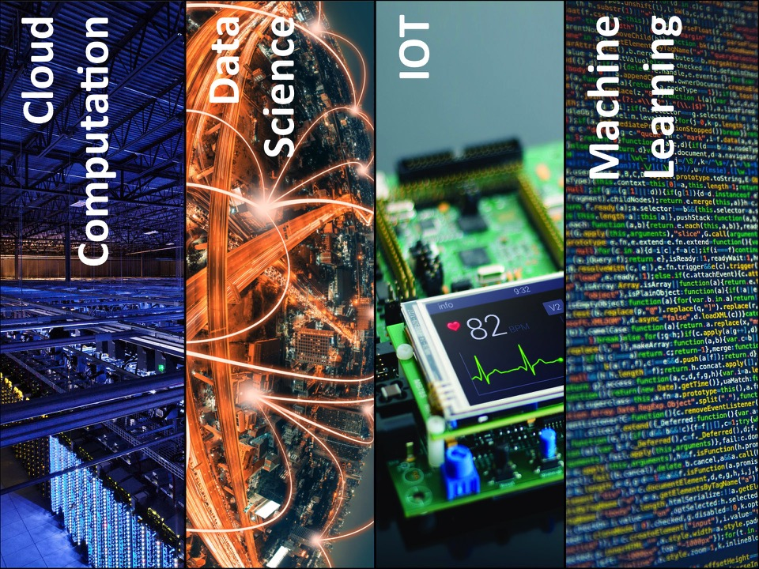
PILLARS

Slide 9








WEB
DEVICES
DATA SCIENCE
SECURITY
COMPUTATION
VISUALIZATION
MACHINE LEARNING
CLOUD
1.00 Engineering Computation
& Data Science
John R. Williams, Abel Sanchez, Lecture: MWF 9:30-11 (1-390)

Slide 10
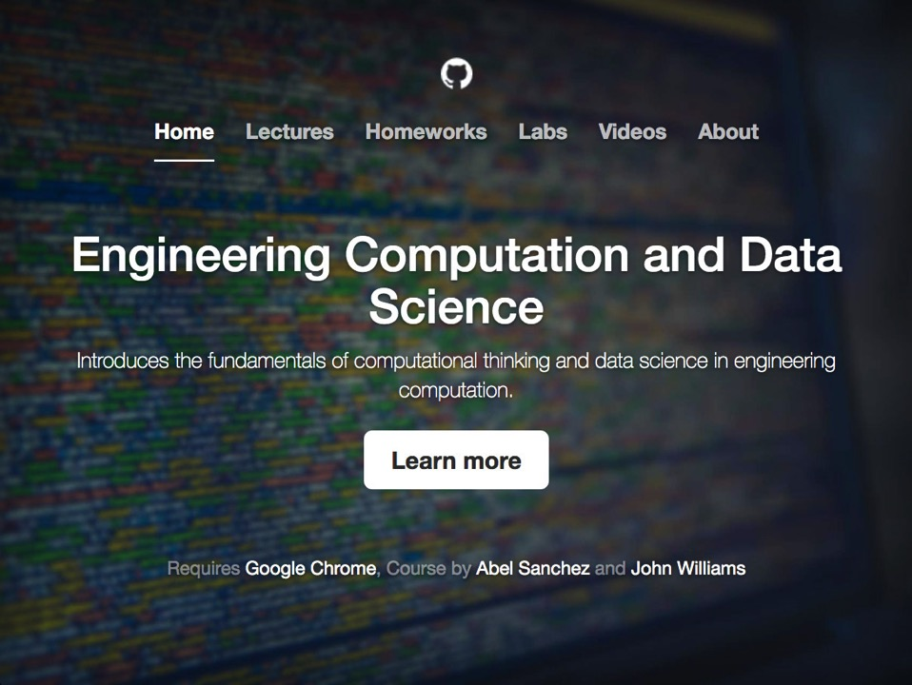
http://onexi.org

Slide 11
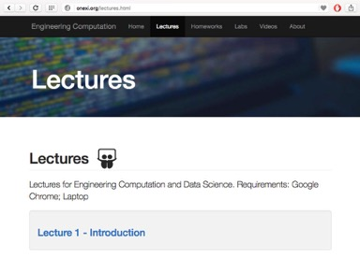
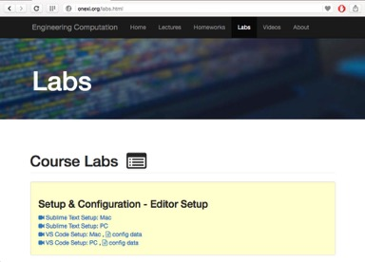
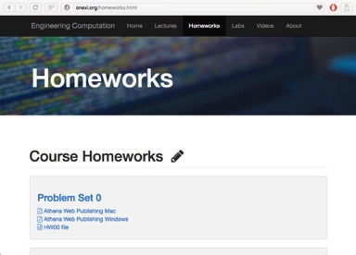

All Content Online, http://onexi.org

Slide 12



Class Template
Class Prep
Mini Lectures
Active Learning

Slide 13


Abel Sanchez
abel@mit.edu
John R. Williams
jrw@mit.edu

