Slide 1

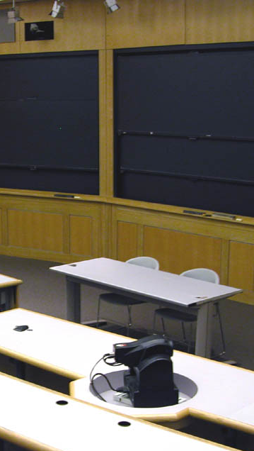

Class Template
Class Prep
Mini Lectures
Active Learning

Slide 2
Class Prep Material – Before Lecture
Material
Content for students – content needed to prepare for lecture and active learning:
Slides
Videos
Exercises
Recommended reading

Slide 3
Mini Lectures – During Class Period
Lecture
Two options:
Two 15 mins lectures
OR
Three 10 mins lectures
Lecture posting:
Lectures need to be recorded and uploaded to YouTube before class

Slide 4
Active Learning – During Class Period
Exercises
Two options:
Two 30 mins exercises
OR
Three 20 mins exercises
Exercise posting:
Exercises need to be uploaded to Github before class

Slide 5

Recitation – Template
Review
Work through week’s active learning exercises:
4-to-6 exercises
No new exercises
No new material
No lecture

