Slide 1
Machine Learning
Abel Sanchez, John Williams

Slide 2
Machine Learning (Practical Definition)
Start with data
Learn a model from data, identify a pattern in data
Use pattern to gain insight

Slide 3
Examples
Prediction – e.g. Is this transaction fraudulent?
Prediction – e.g. Will user click on link?
Exploration – e.g. Processing larger numbers of documents
Exploration – e.g. Visualization patterns

Slide 4
Your Life is Impacted by ML
What adds you are shown
What news articles you are offered
Other shoppers like you bought …
E-dating
Security screening
...

Slide 5
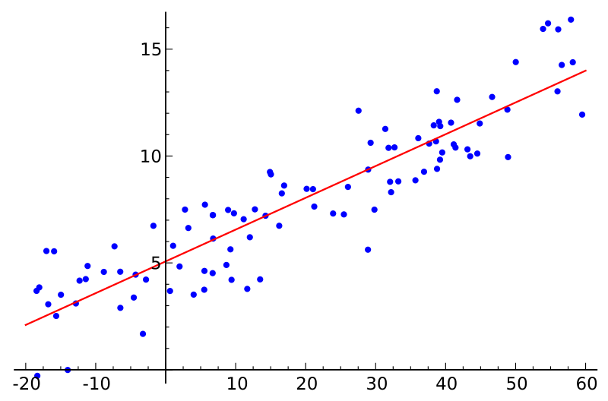
Linear Regression

Slide 6
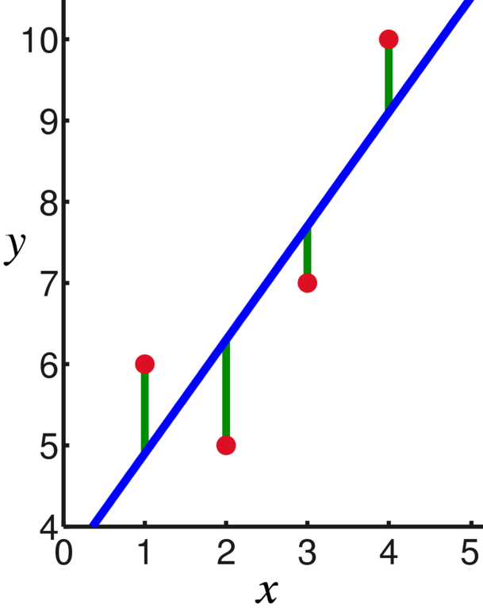
Least Squares
d4
D = (d1)² + (d2)² + (d3)² + (d4)²
Best linear model will have
the smallest sum of distances squared (D)
d3
d2
d1

Slide 7
Linear Regression
Slope
Intercept
Regression
Equation
Line

Slide 8
Active Learning
Write a function to create the linear regression equation …

Slide 9
