Slide 1
Intro to Vue.js
JavaScript Front End Frameworks

Slide 2
Vue.js
Pronounced "View"
A front-end JavaScript framework
Runs in the browser
Trend in recent years – web pages are getting more and more complex; more functionality, more user interaction
Move functionality from the server to the client (browser)
  Less work for server
  More responsive web pages for client
Front end frameworks (in general) are for creating structure in complex JavaScript

Slide 3
Vue.js
Reactive – page updates automatically in response to changes in data
Data binding – data is associated with an element on the page
MVVM – Model, View, ViewModel architecture
View = the web page – what the user sees, displays data, handles events
ViewModel = an object that stores data that the web page displays, contains application logic
Model = persistent data, probably in a database, interact with via API calls
Data binder = connects data in the view to data in the view model
Let's write a Vue app and come back to these concepts

Slide 4
Code examples
https://github.com/claraj/vue-week-1-examples

Slide 5
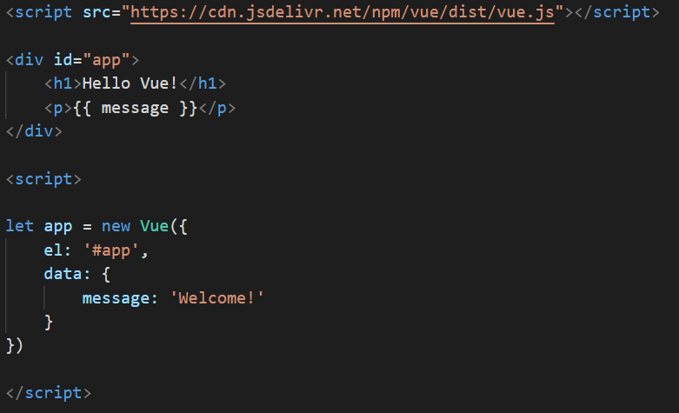
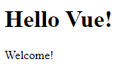
First Vue page
Create a new file hello_vue.html
Open in your browser
<script src="https://cdn.jsdelivr.net/npm/vue/dist/vue.js"></script>

Slide 6
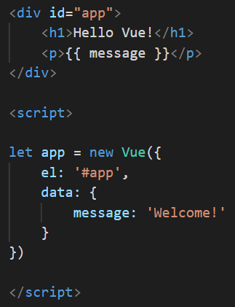
First Vue page
Create a Vue instance
Associate it with an element on the page, by convention div#app
The Vue instance will manage the view – the HTML/content inside the #app div
Everything inside the div#app is the template
Data binding: Vue has a data attribute contains a list of properties which are bound to the view - so message is bound to the view
If the viewmodel changes message, the view will update
{{ message }} in double curly braces, otherwise known as mustache syntax

Slide 7
Reminder: dev tools
Open dev tools in your browser, you'll need it for debugging
PCs: F12
Macs: Option + Command + I

Slide 8
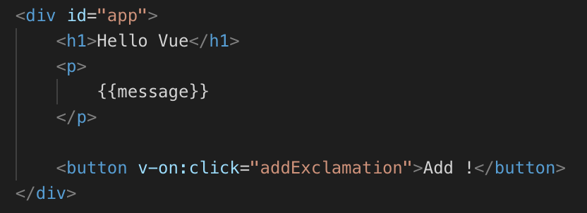
Vue events
Modify your template to add a button
  All the HTML that the Vue instance manages is the template
Bind the click event to an addExclamation method (next slide)

Slide 9
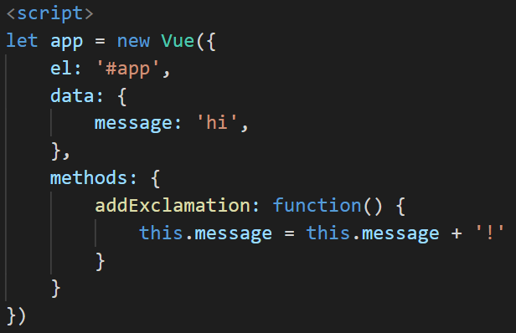
Vue Events
In your Vue instance, add a methods attribute
methods contains a list of function definitions
Add a function called addExclamation
This function modifies the message property
Note that data properties have to be referenced with this.propName

Slide 10
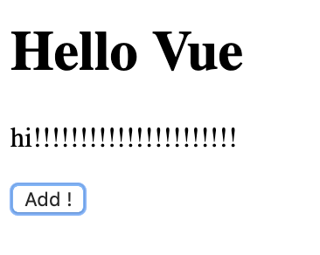
Test
Click the button
Message changes
Doesn't change? Check in the dev tools console for errors

Slide 11
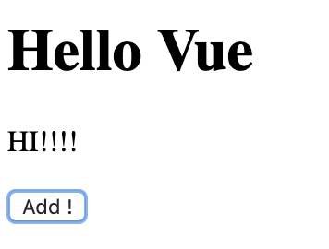
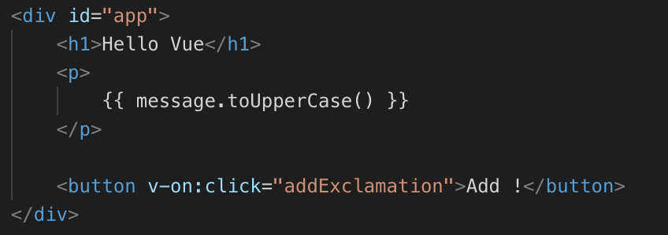
Can use JavaScript statements in {{ }}
Display message in uppercase
Can write one line of JS in {{ }}
Keep it simple – logic doesn't really belong in HTML

Slide 12
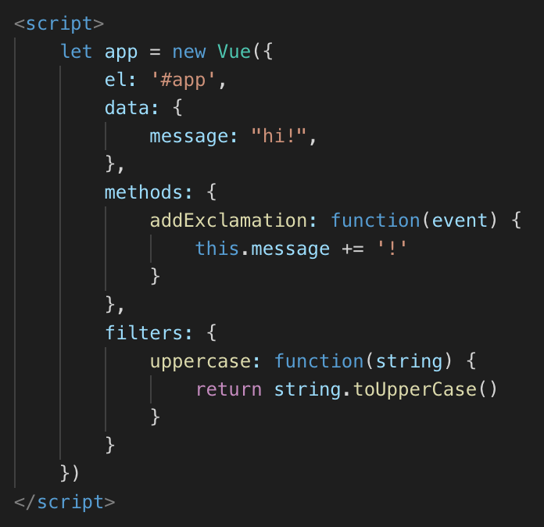
Write a filter
Add filters to Vue instance
Add an uppercase filter function
Better than previous slide – app logic in the Vue instance, not the template

Slide 13
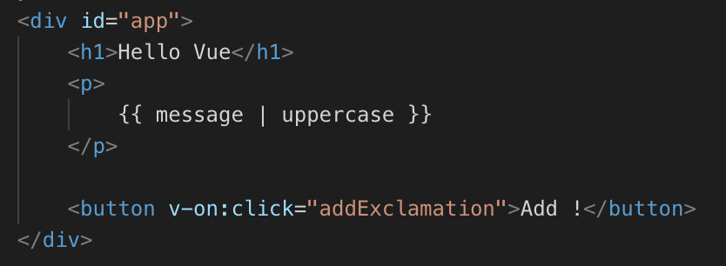
Template
Apply filter to the message, page should look the same as before

Slide 14
Your Turn
Can you limit the number of exclamation points to 10?
Hint: you can declare more variables in the Vue data object

Slide 15
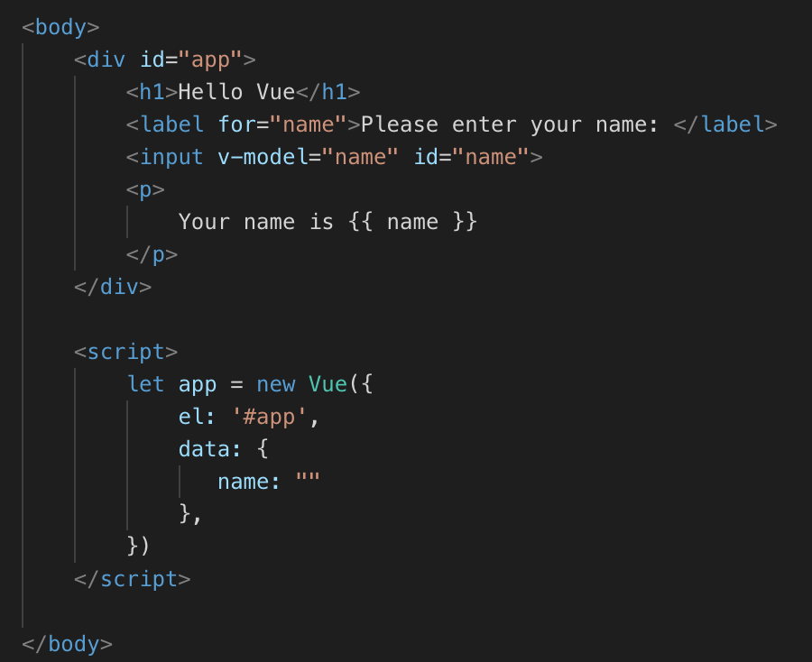
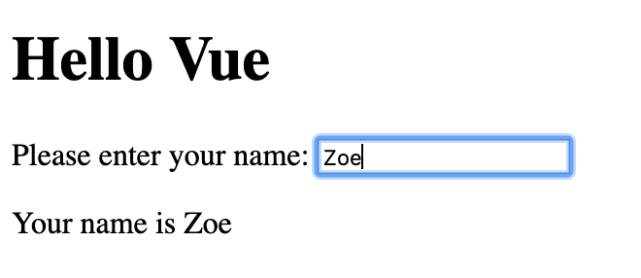
User input with the v-model directive
Create a new page
Copy head, Vue script tag from the previous webpage
Empty string

Slide 16
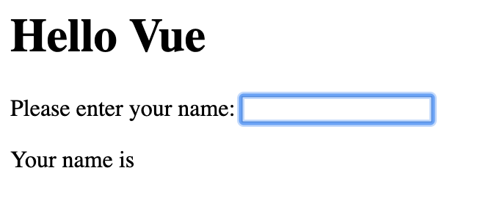
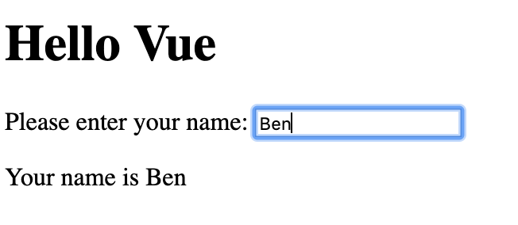
Test out your app
When you type, the text entered is displayed in the p element
v-model instructs Vue to bind the contents of the input to the data property name
And, v-model adds a input event listener to update the name property as the user types
Result: text updated as you type
2-way data binding – if your app was to update name, the value in the input would change too

Slide 17
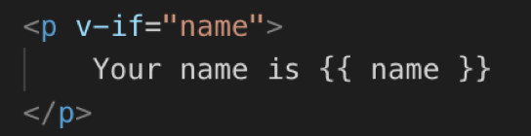
Conditional rendering with v-if
Page looks messy when the user hasn't entered their name yet
Use v-if to only render the paragraph if there is a name entered
  Check the dev tools – there's no p tag until a name is entered
Can use a string in a JS condition – empty strings are false, any other string is true

Slide 18
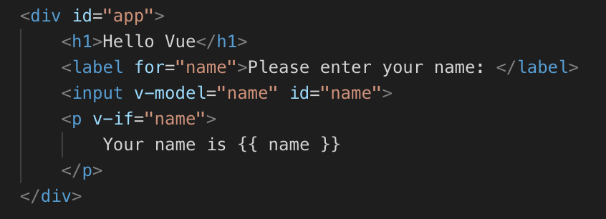
Conditional rendering with v-if
Use v-if to only render the paragraph if there is a name entered
  Check the dev tools – there's no p tag until a name is entered

Slide 19
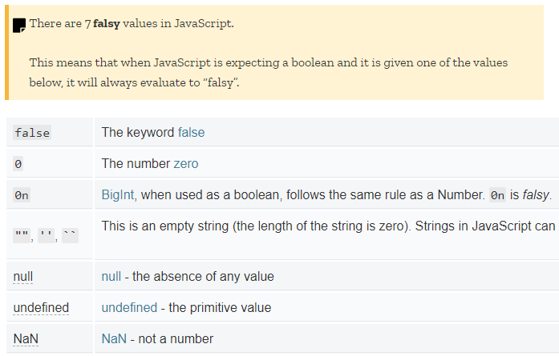
Empty string is false?
Seven values in JavaScript evaluate to false when used in an if statement – these are falsy values
false, 0, null, undefined, NaN and empty strings
Everything else is true (or truthy)

Slide 20
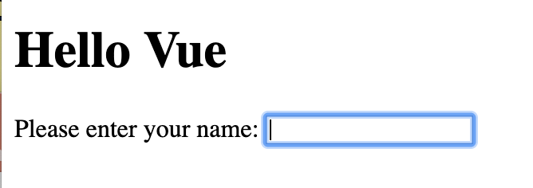
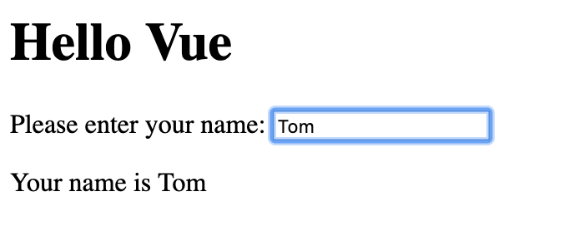
Test
Before entering a name, once a name is entered
Delete the name – does the p element stay on the page, or disappear?

Slide 21
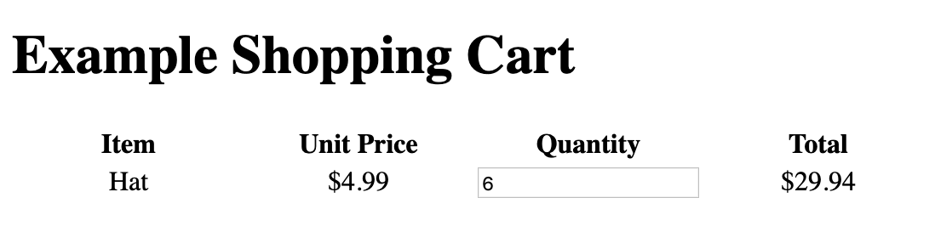
Vue Shopping Cart
Product data from Vue instance
Vue will calculate the total price and ensure it's always up to date when the quantity changes

Slide 22
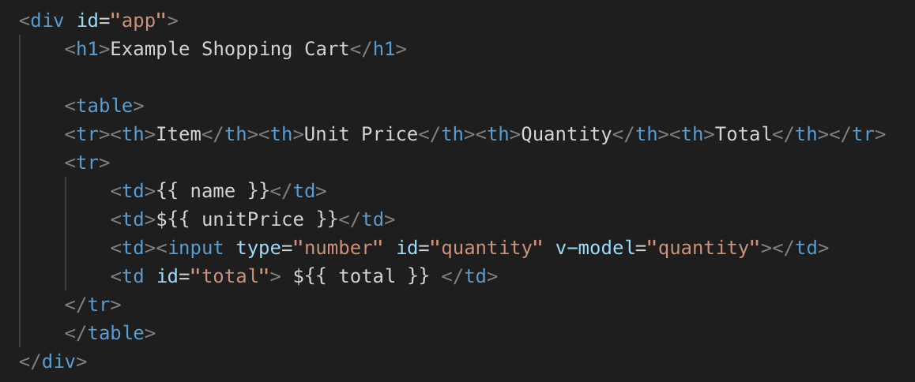
Template

Slide 23
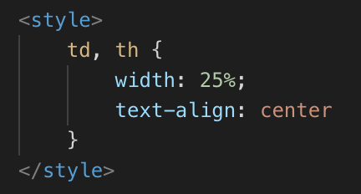
Style – put in head
Sets the table column width and aligns text

Slide 24
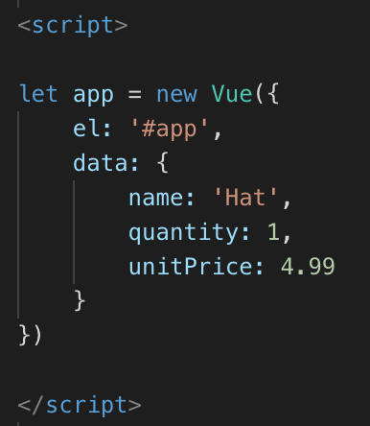
Script
Example product, price

Slide 25
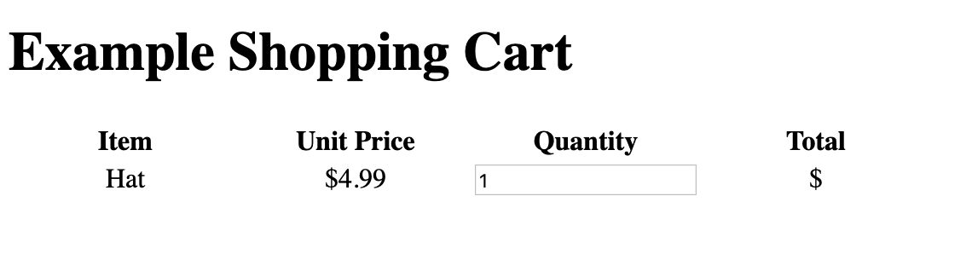
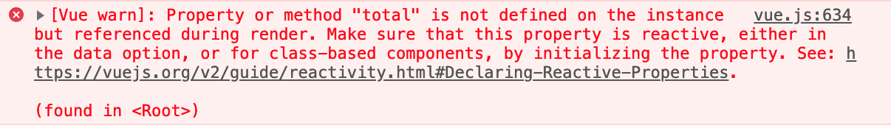
Page
Name, unit price, quantity from Vue instance
And a warning in the console about the total property

Slide 26
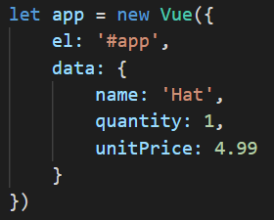
Property or method "total" is not defined on the instance but is referenced during render
This means that you are using a variable in the template that doesn’t exist in the Vue data
Fix: define the variable – or check your spelling if you’ve already defined it.
To fix this, we need to define a total variable
No total property defined in the Vue data, or anywhere else in the Vue object

Slide 27
total
The shopping cart total will change based on the unit price and the quantity ordered
So we can’t define total as part of the Vue data
Solution: use a computed property to calculate the total, based on the values of unitPrice and quantity
Computed properties re-calculate if any of the Vue data used to calculate them, changes

Slide 28
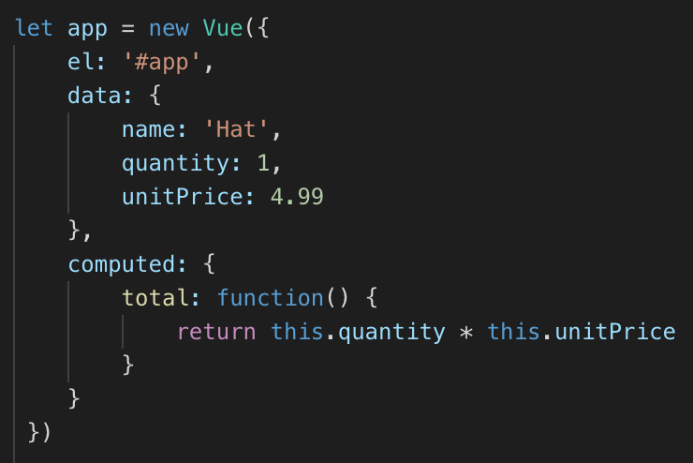
Calculating total using a computed property
Computed properties are calculated from data in the Vue instance
If the data changes, the computed property is recalculated
Notice you have to use this.quantity, this.unitPrice
this is the Vue instance (usually)

Slide 29
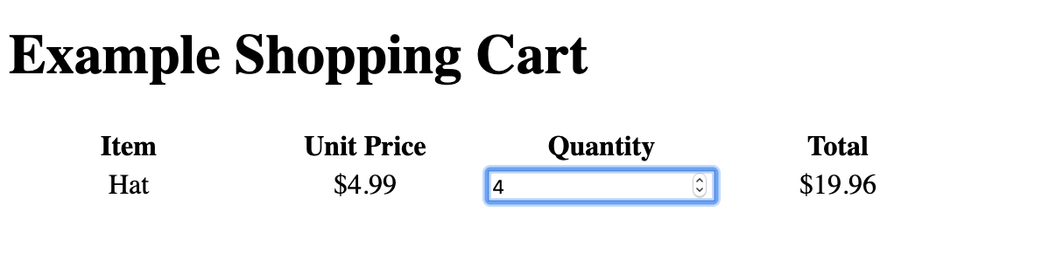
Test – total updates as the quantity changes
Console warning should be gone

Slide 30
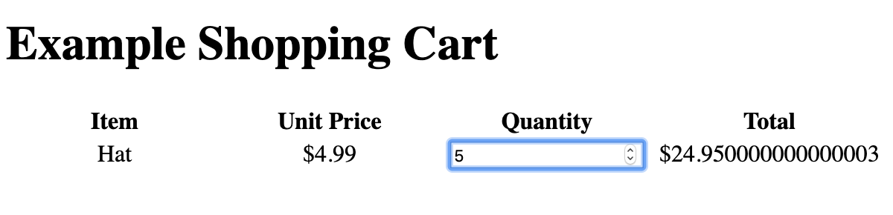
What about 5 hats?
That doesn't look good

Slide 31
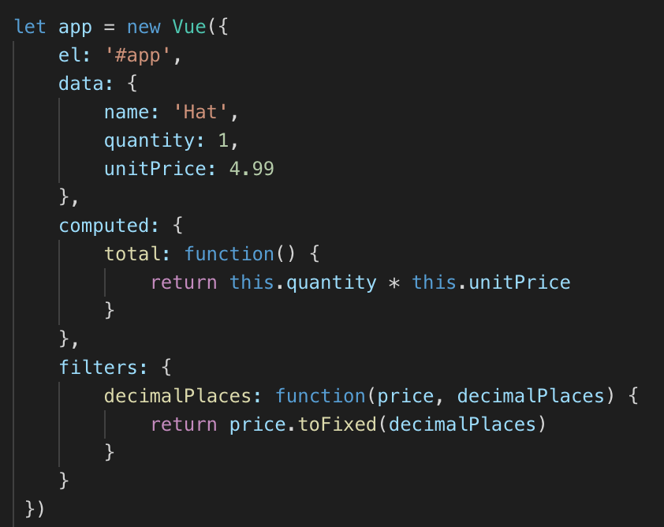
Filter
Add a filter to make all prices display to 2 decimal places

Slide 32
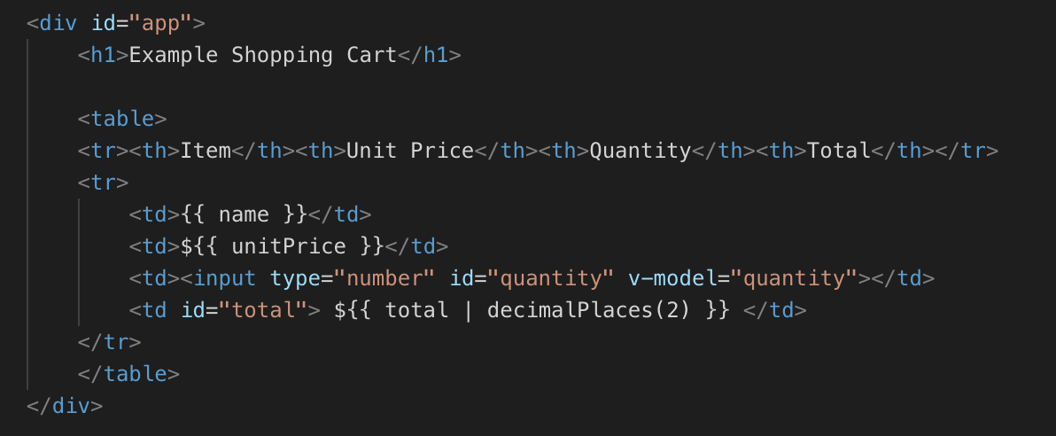
Template – use filter
Filters can have arguments

Slide 33
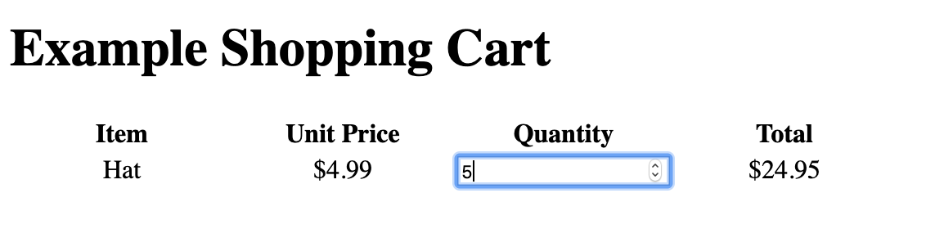
Test
Neater output

Slide 34
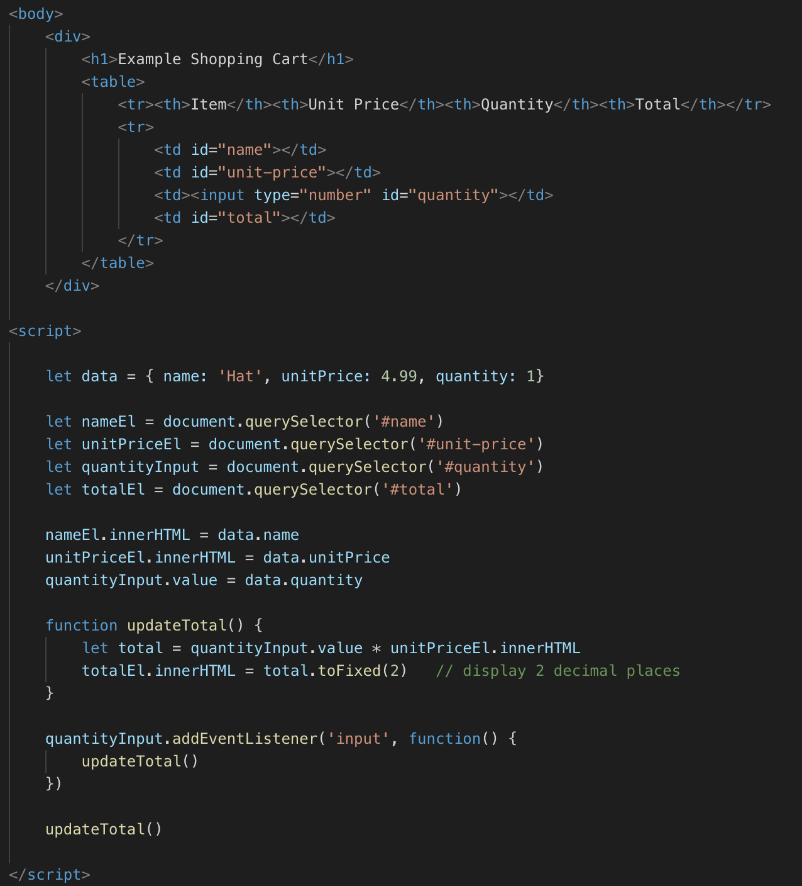
Vue.js vs plain JavaScript
Just for comparison, here’s the cart app, in plain JavaScript
  JavaScript with no frameworks is sometimes called “Vanilla JavaScript”
Same functionality
What's different?
Which does more work keeping the view in sync with data?

Slide 35
Virtual DOM
Under the hood, the Vue instance creates a copy of the DOM – the virtual DOM
  What's the DOM?
When data changes, Vue updates the Virtual DOM, and then changes are propagated to the real DOM
Much faster than manipulating the real DOM
https://medium.com/js-dojo/whats-the-deal-with-vue-s-virtual-dom-3ed4fc0dbb20

Slide 36
Lab
Make sure the Vue apps we built are working as expected
Install Vue devtools for Chrome or Firefox
More Vue apps next week
Lab should not take much time, spend this week working on your midterm project

