Slide 1



DBM1: Databases The 2020 Paralympics
João Marques
Katharina Alefs

Slide 2

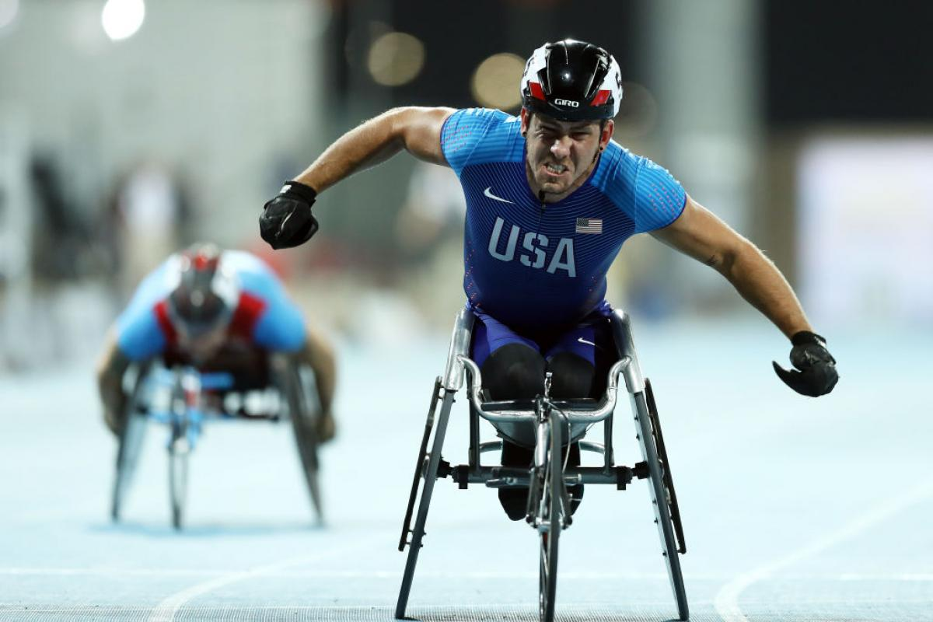
The 2020 Paralympics Dataset
4426 athletes, 212 teams from 162 countries are are competing for 2141 medals
Preprocessing steps: split names, replace gender column with char
Generated mock data for other editions using Mockaroo

Slide 3
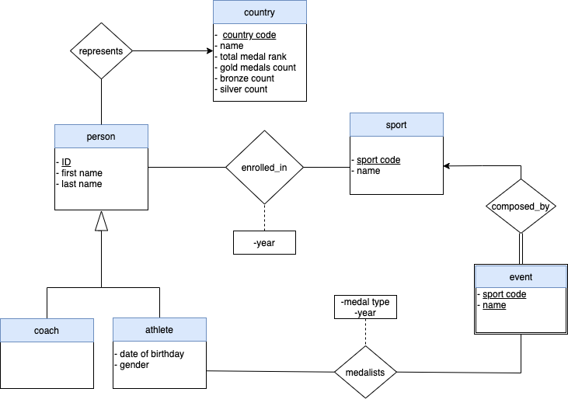
ER Diagram
Entities and design choices

Slide 4
Natural Language Queries
Number of athletes that where enrolled per discipline?
Which first name was the 2nd most popular among the athletes?
How many gold, silver and bronze medals did each country win? (medal tally)
For each year (1980 - 1990), how many athletes were born then and what are their names (sorted alphabetically)?
The birth year of athletes that won exactly 1 gold and 1 silver and 1 bronze medal?
From all winning teams across all events, which team has the most members and what are their names?
Is there a female athlete that won a medal in two different disciplines in two different editions?
Is there any athlete that skipped one edition but then performed better then his/her former participation?

Slide 5
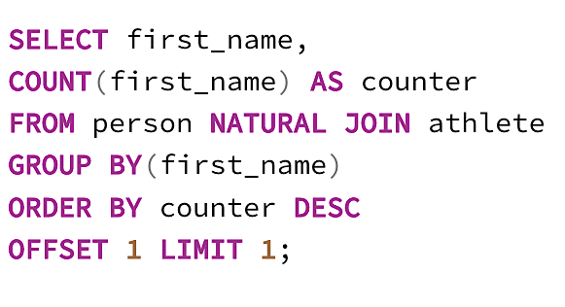
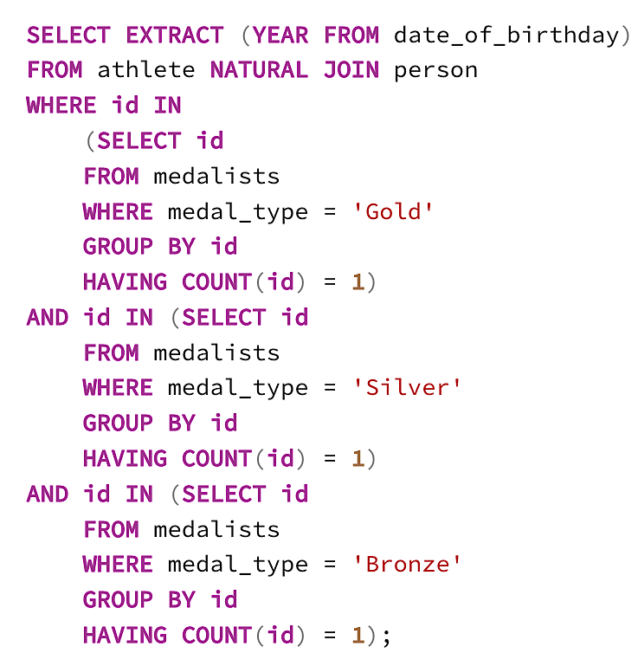
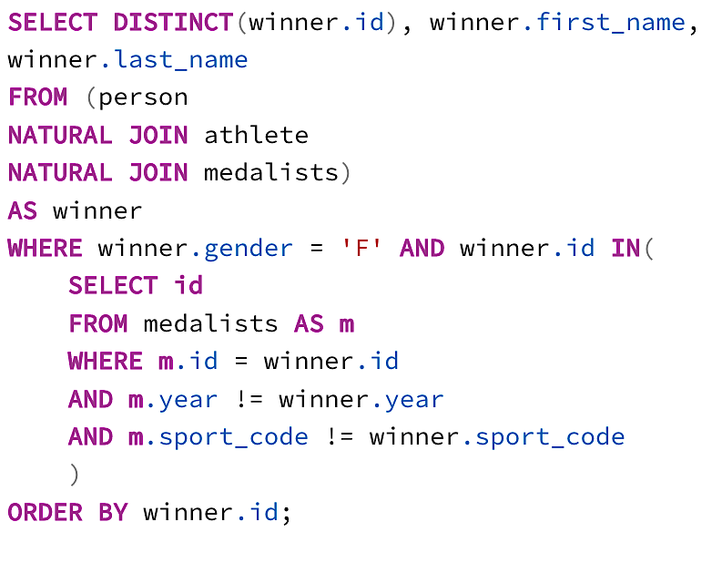
Number of athletes that where enrolled per discipline?
The birth year of athletes that won exactly 1 gold, 1 silver and 1 bronze medal?
A female athlete that won a medal in two different disciplines in different editions?

Slide 6
Relational Algebra
First name of all athletes that won a medal in 2020, but did not win a medal in 2024
All the people (coaches and athletes) who represent Portugal in sport Judo

Slide 7
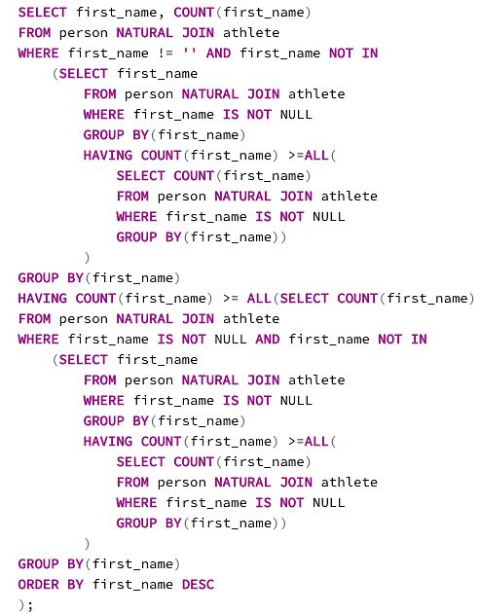

Complications
“Which first name was the 2nd most popular among the athletes?”

Slide 8
Thanks!
Any questions ?
Quick Results

