Slide 1

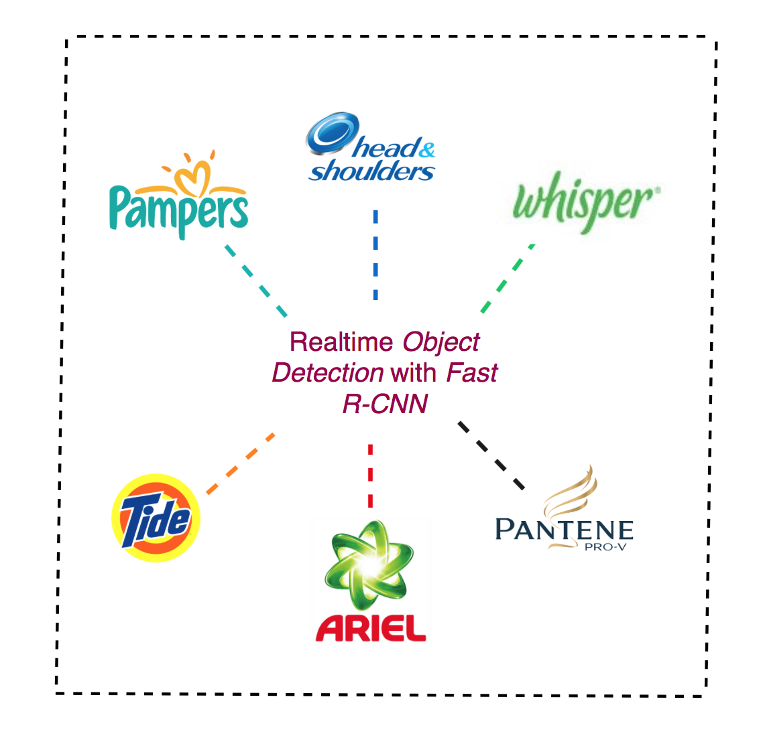

Slide 2
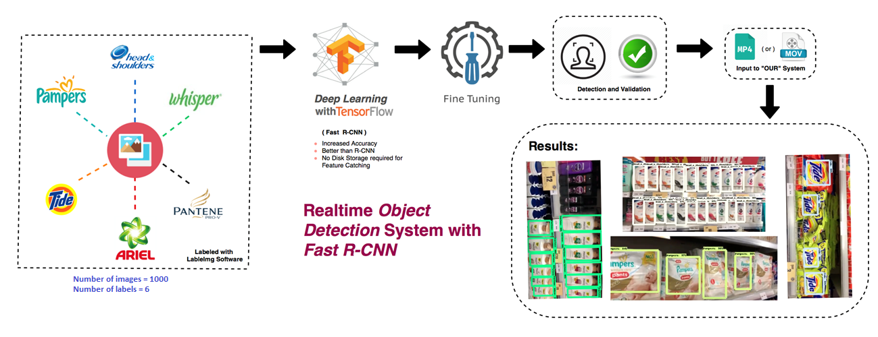
The Architecture

Slide 3
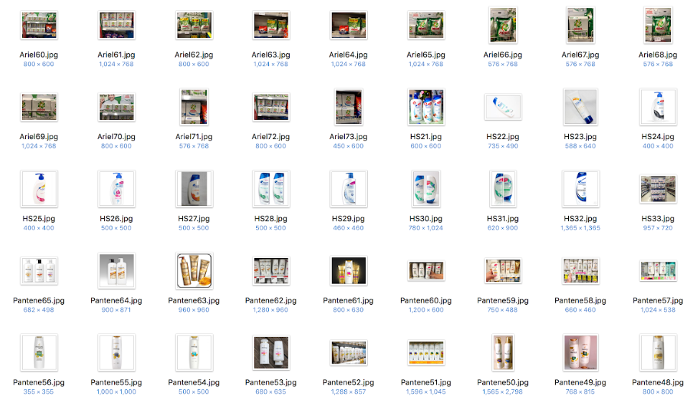
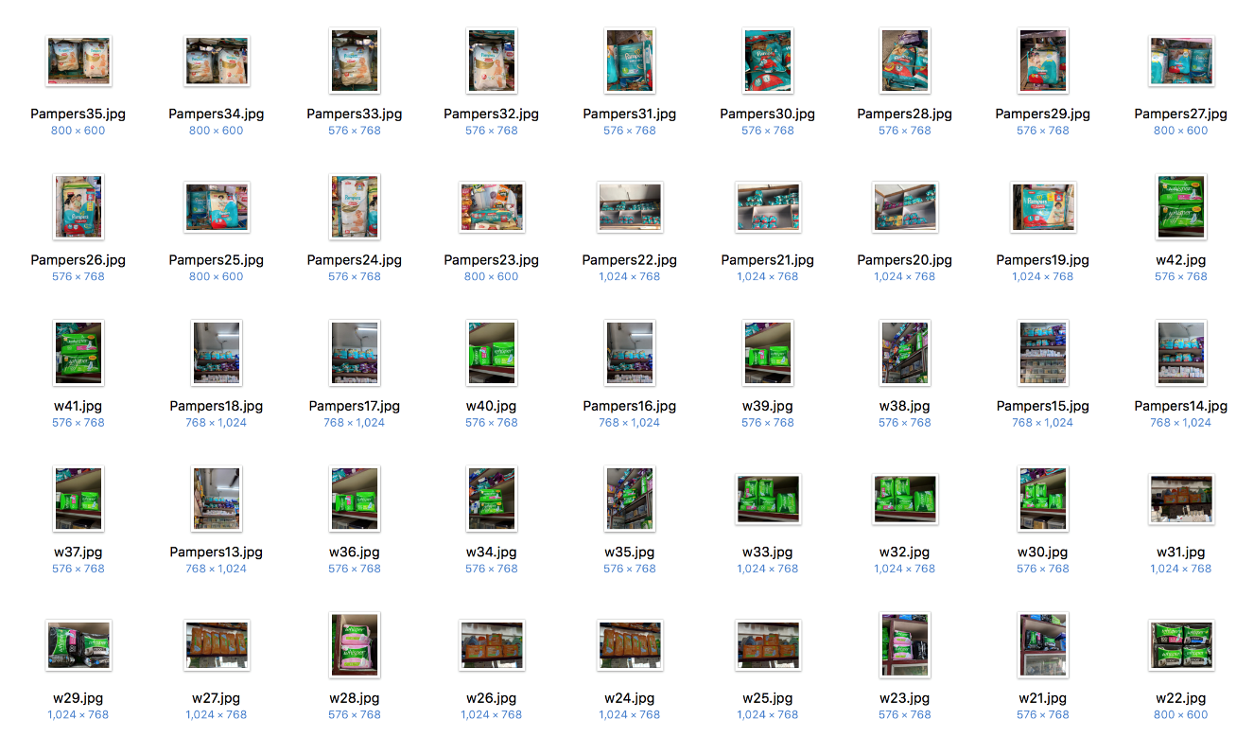
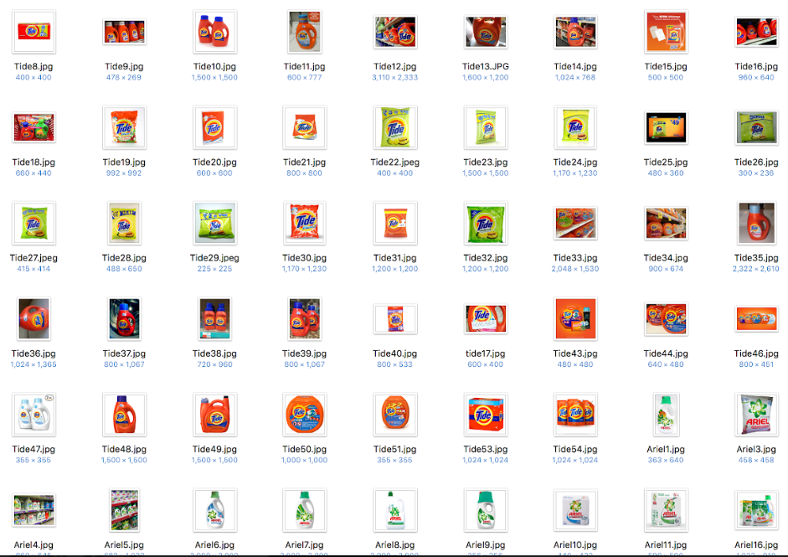
Dataset collected – A Quick view

Slide 4
The Demo Video
YouTube link: https://youtu.be/l8GDmGLfAfM

Slide 5
Summary
Accomplished:
1000 Plus images in the dataset
Collected + Hackerearth given.
Labelled.
Used Fast R – CNN
Improved accuracy
Consistent 95% and above.
Used Tensorflow
Real time object detection
Tested with real time input.
Found stable & Consistent
To do:
Much more heavier dataset to cover all scenarios.
An application for mobile can be developed.
P & G to give more use cases to customize the application developed.

Slide 6


