Slide 1
RECOMMENDATION ENGINE CHALLENGE
A recommendation engine is a system that suggests products, services, information to users based on analysis of data. Notwithstanding, the recommendation can derive from a variety of factors such as the history of the user and the behaviour of similar users.
Now based on certain features you have to cluster the customers into two different groups so that you can recommend the correct products based on the customer’s cluster.

Slide 2
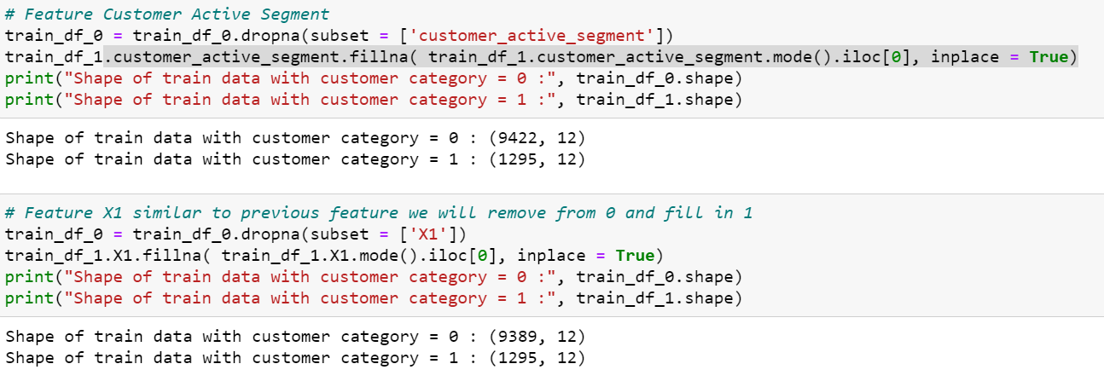
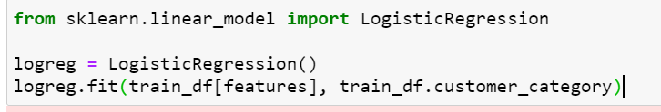
PROS OF THE APPROACH
In this the missing values for the categorical data are taken care based on the customer category as the ratio of count of the two classes in the target column is 5:1 (class0:class1) so to reduce(a bit) this range the rows with missing categorical values having the class0 category is removed while for class1 its filled with the mode of the particular class1 data.
We have used simple Logistic Regression and no extra algorithms so in future if any new columns feels relevant can be added directly to the dataset and based on kind of data and correlation we can fit directly to model along with other features

Slide 3
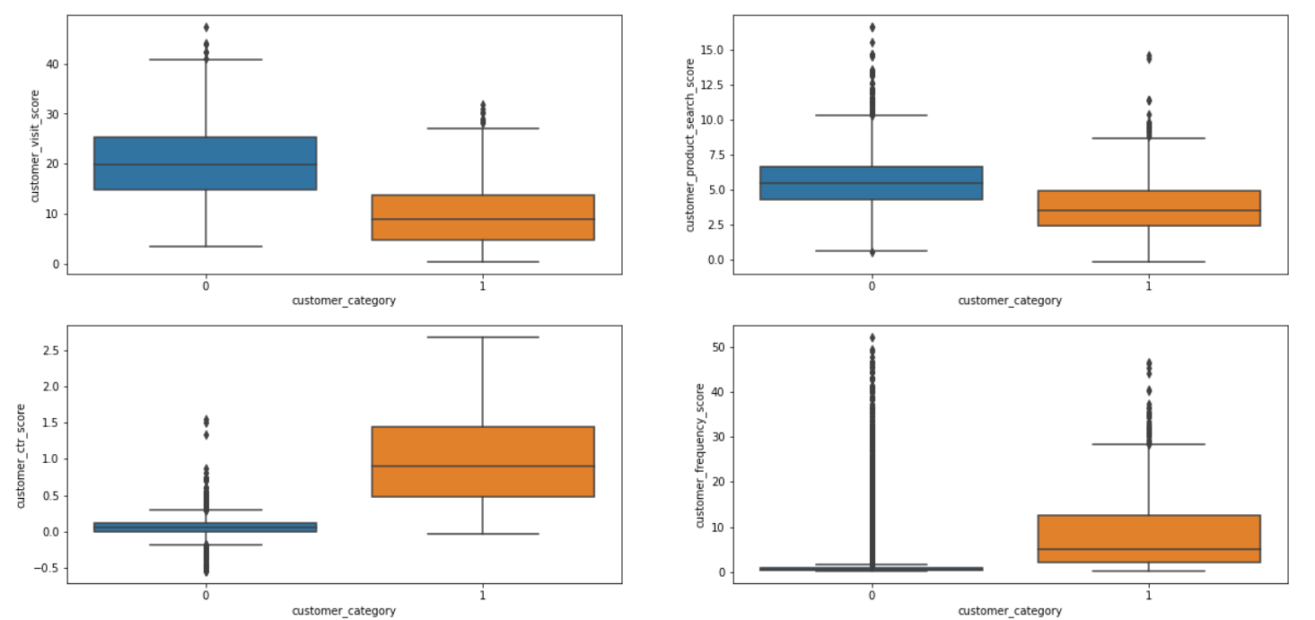
CONS OF THE APPROACH
We could have implemented outliers removal code in the code and removed some outliers as there may be some amount of chances that model could perform better.
Since the correlation was high among few pairs of the columns so for better or faster performance of columns we could have used PCA in data analysis against the train dataset and test dataset

Slide 4
ARCHIETECTURE TO IMPROVE
RECOMMENDATION ENGINE
LSTM can be implemented to keep the memory of past data and update the behaviour accordingly with the current and past data (as it is a feedforward neural network)
Each neural network in LSTM can have Logistic regression algo implemented and data fed into these neurons should be via preprocessed by PCA algo (after data cleaning)

