Slide 1
CSE 482 PROJECT Presentation
SARHAN OSMAN BHUIYA ID-1611008042

Slide 2

HEADER
SLIDER
DESCRIPTION

Slide 3
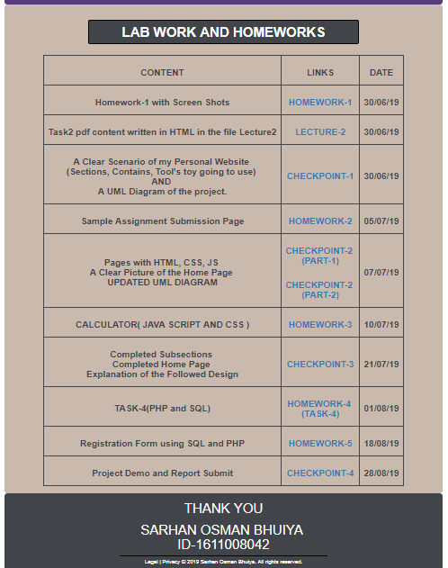
COURSE TASKS AND HOMEWORK TABLE
FOOTER

Slide 4
Project analysis slide 2
Overview
ANALYSIS
SPECIFICATION
PROJECT
IMPLEMENT
DESIGN
TESTING
DEVELOP

Slide 5
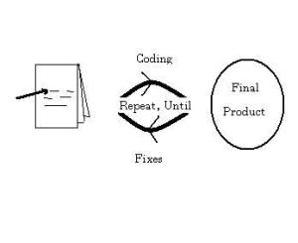
Project analysis slide 3
Project Analysis
The code and fix model probably is the most frequently used development methodology in software engineering.
It starts with little or no initial planning. The code and fix model is appropriate only for small projects that are not intended to serve as the basis for future development.
SE ANALYSIS
CODE AND
FIX
MODEL.

Slide 6
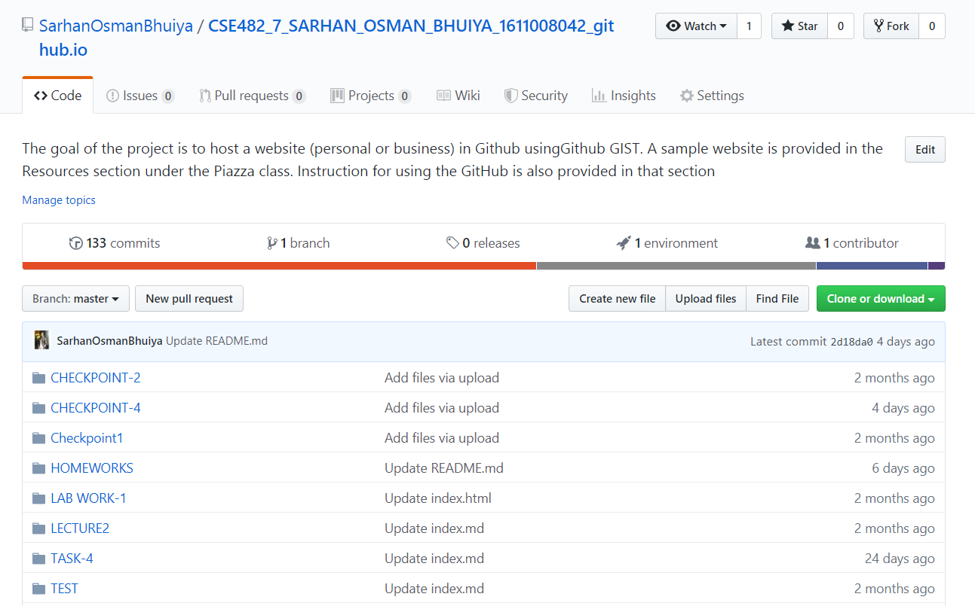
Project analysis slide 3
Project Analysis
GitHub is a Git repository hosting service, but it adds many of its own features.
After creating a repository in GitHub we can host it by using GIST.
https://sarhanosmanbhuiya.github.io/CSE482_7_SARHAN_OSMAN_BHUIYA_1611008042_github.io/
Technical ANALYSIS
GITHUB

Slide 7
Project analysis slide 3
Project Analysis
HTML-5--HTML 5 is a software solution stack that defines the properties and behaviors of web page content by implementing a markup based pattern to it.
CSS-3--Cascading Style Sheets is a style sheet language used for describing the presentation of a document written in a markup language like HTML.
BOOTSTRAP--Bootstrap is a free and open-source CSS framework directed at responsive, mobile-first front-end web development.
PHP-Hypertext Preprocessor is a general-purpose programming language originally designed for web development.
SQL--SQL is a domain-specific language used in programming and designed for managing data held in a relational database management system, or for stream processing in a relational data stream management system.
Language
ANALYSIS

Slide 8
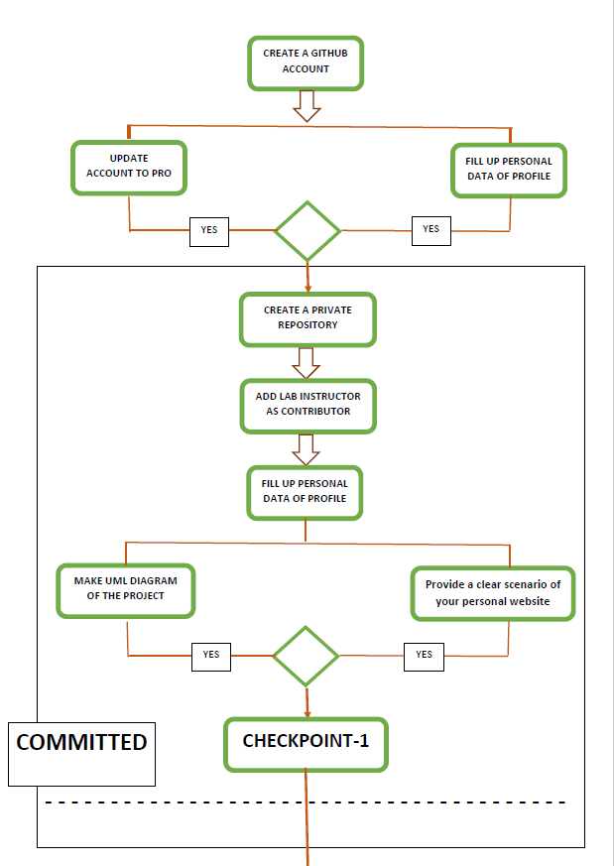
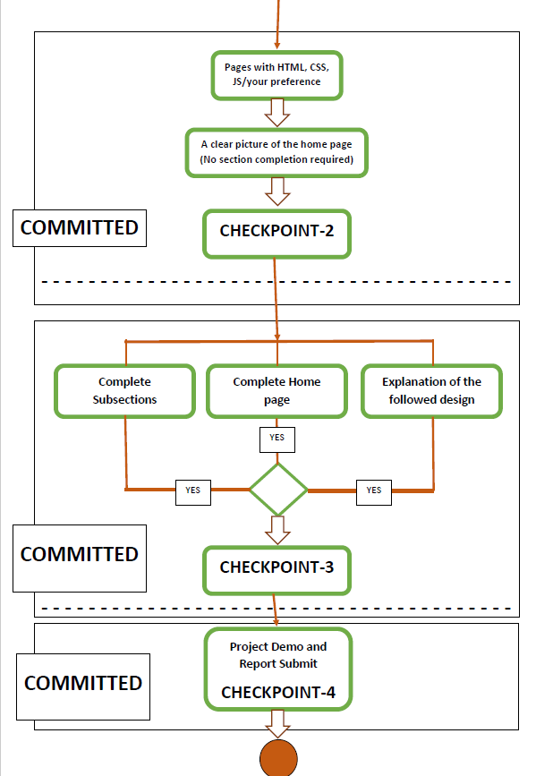
Project analysis slide 3
Project Analysis
Technical ANALYSIS
Project Timeline ANALYSIS

Slide 9
Project analysis slide 3
Project Analysis
The languages used to make my portfolio can be used to make all kinds of website.
Brochure-the simplest type of website
eCommerce-pay for a product or service online.
Portal-brings together information from lots of different sources
Wiki-allows people to collaborate online and write content together
Social media- sharing of images or ideas.
Landing Pages
APPLICATIONS

Slide 10
Thank You

