Slide 1
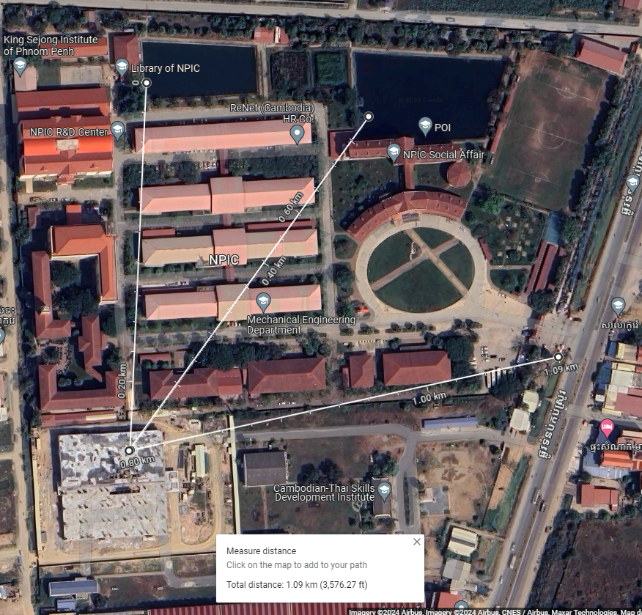
Distance from Gateway to each Node 1:
Node 1 --> Gateway = 0.2km
Node 2 --> Gateway = 0.6km
Node 3 --> Gateway = 1.09km
Node 1
Node 2
Node 3
Gateway
Partial deployment diagram of the experiment

