Slide 1
https://Phishing_URL_Classification
By Simcha (323104562) & Sary (324832914)

Slide 2
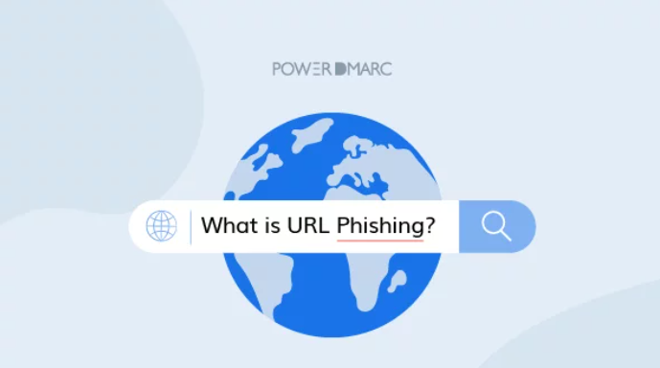

Slide 3
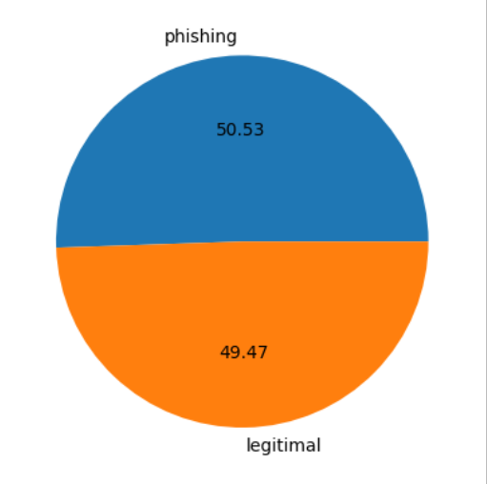
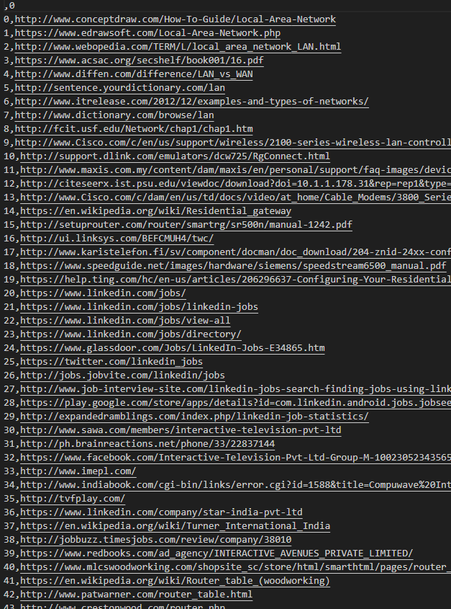
Dataset
37,175 Phishing + 36400 Legitimate = 75535 URLs

Slide 4
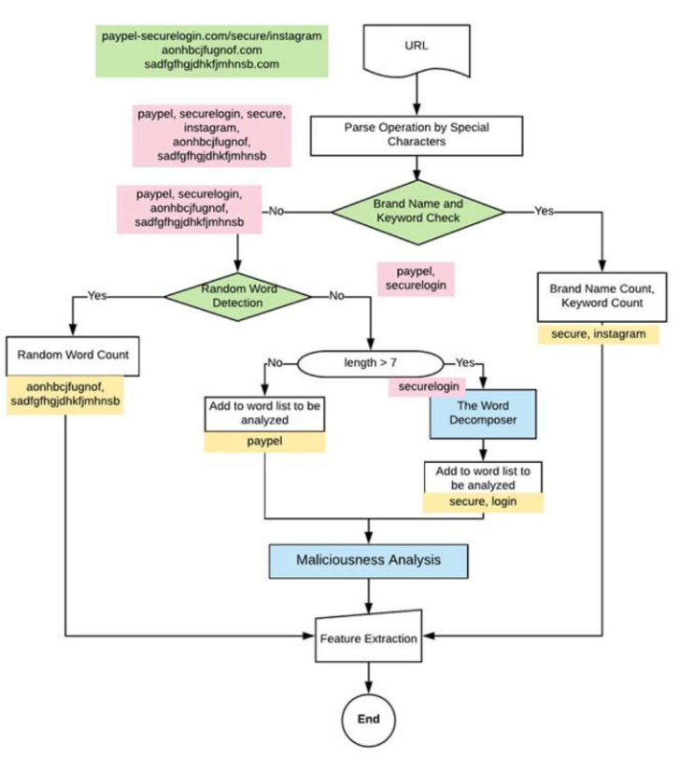
Solution
Pre-procesing

Slide 5
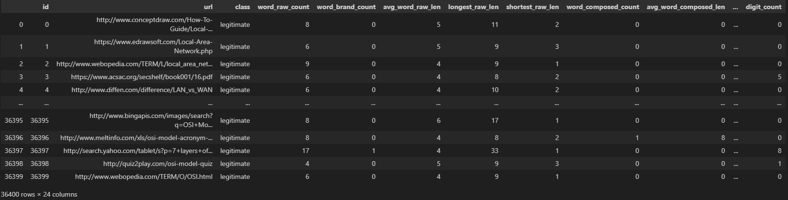
Solution
Feature extraction

Slide 6
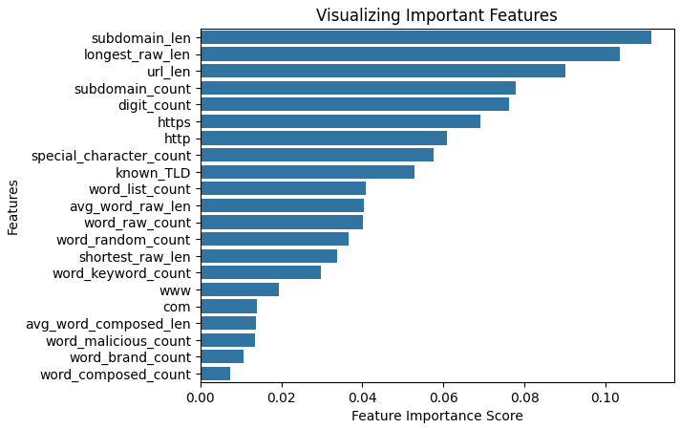
Solution
Model

Slide 7
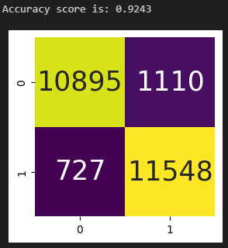
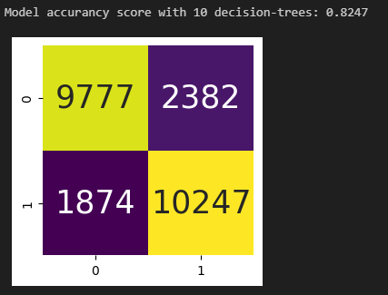
Solution
Results

Slide 8
Demo

