Slide 1

Cleo Telecom DBMS
Sari Itani
Roxane Mezher
Reina Al Hariri

Slide 2
Cleo Telecom DBMS
Outline
Introduction
ER Diagram
SQL
Website Features

Slide 3

Cleo Telecom DBMS
Introduction
We implement a telecom database management system for a company like Touch and Alfa.

Slide 4
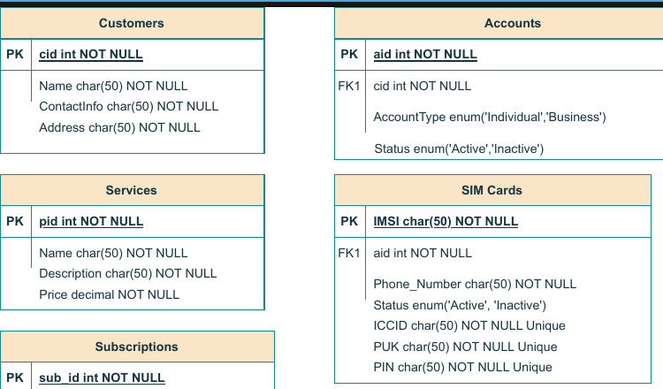
Cleo Telecom DBMS
ER Diagram

Slide 5
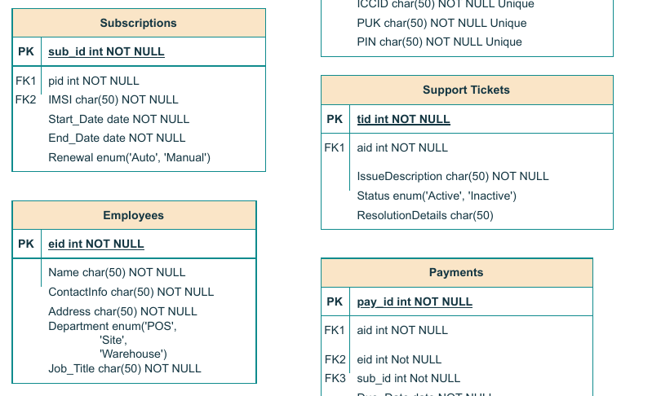
Cleo Telecom DBMS
ER Diagram

Slide 6
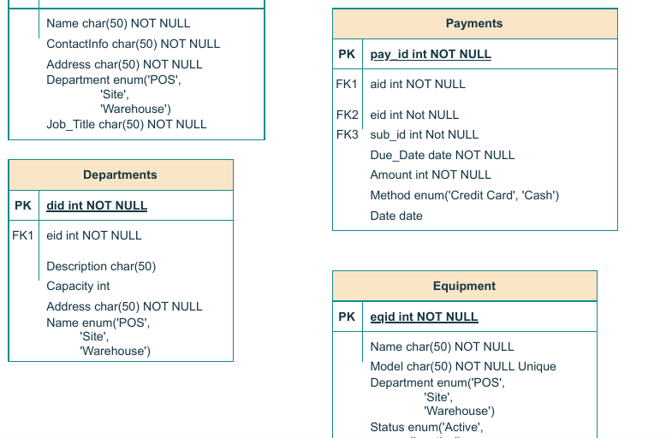
Cleo Telecom DBMS
ER Diagram

Slide 7
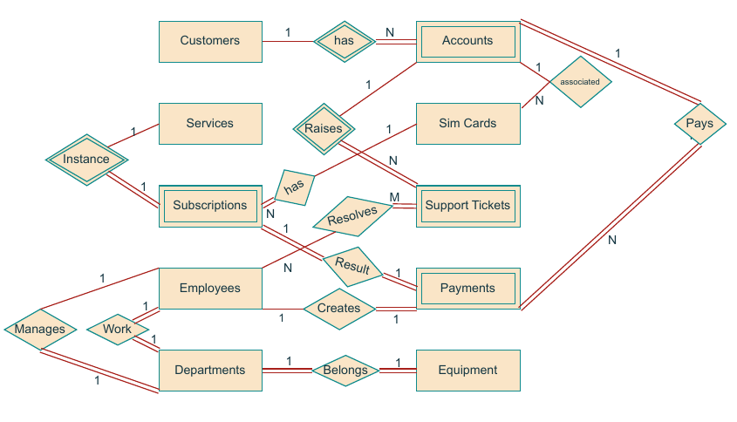
Cleo Telecom DBMS
ER Diagram

Slide 8
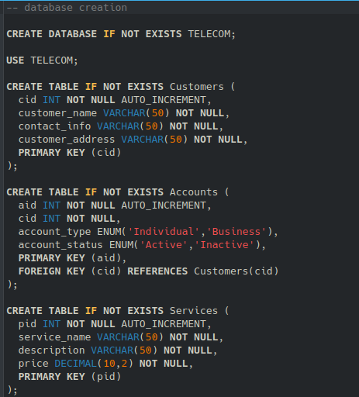
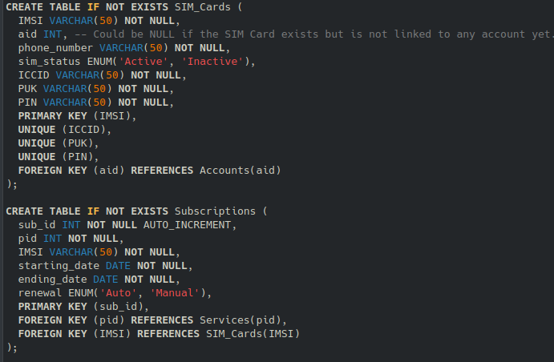
Cleo Telecom DBMS
SQL

Slide 9
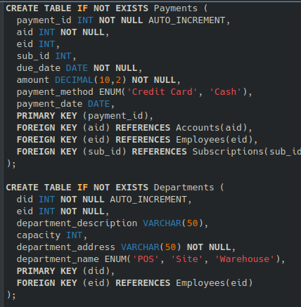
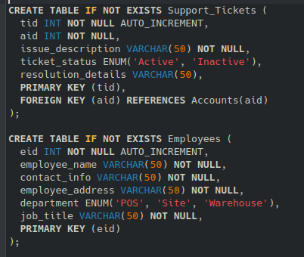
Cleo Telecom DBMS
SQL

Slide 10
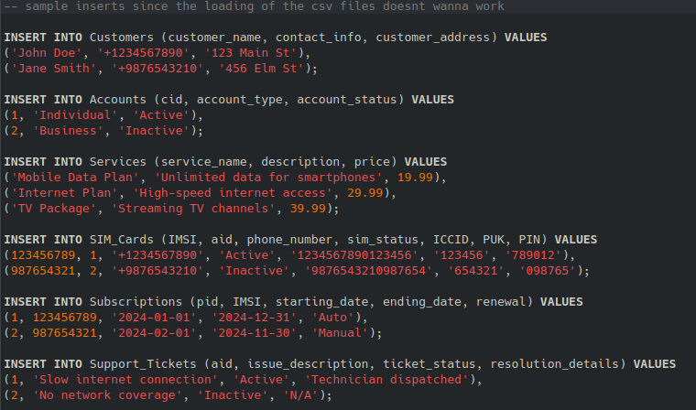
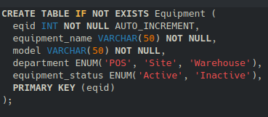
Cleo Telecom DBMS
SQL

Slide 11
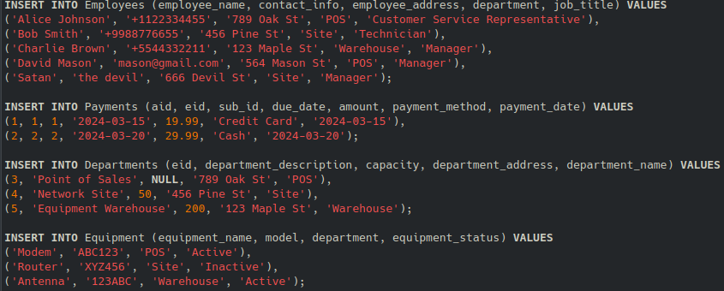
Cleo Telecom DBMS
SQL

Slide 12
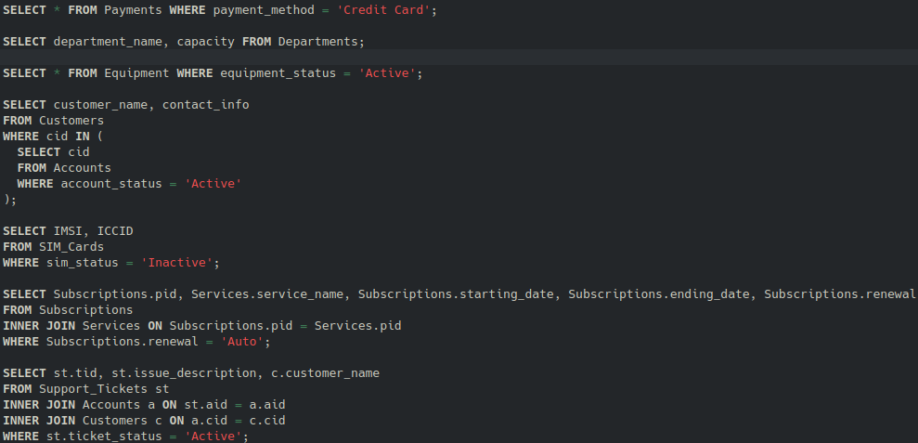
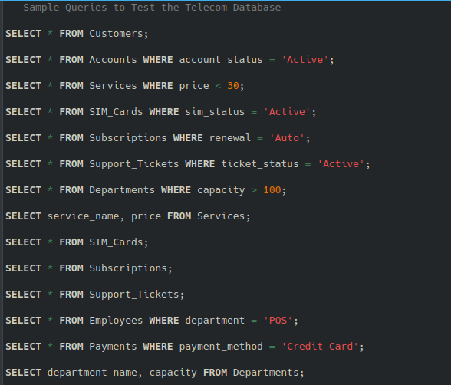
Cleo Telecom DBMS
SQL

Slide 13
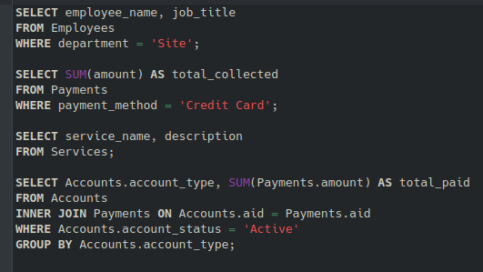
Cleo Telecom DBMS
SQL

Slide 14

Cleo Telecom DBMS
Website Features

Slide 15
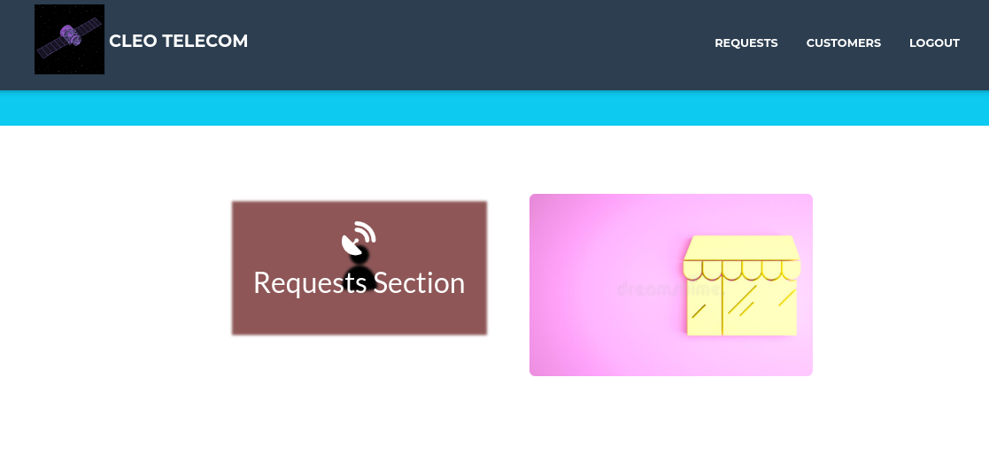
Cleo Telecom DBMS
Website Features

Slide 16
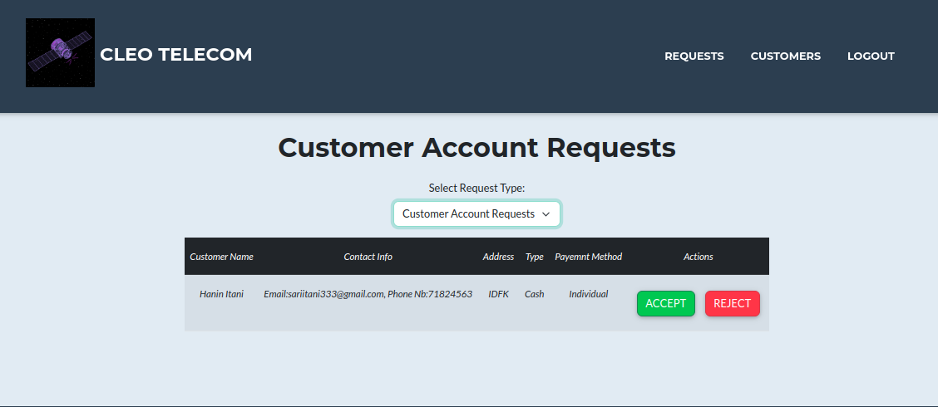
Cleo Telecom DBMS
Website Features

Slide 17
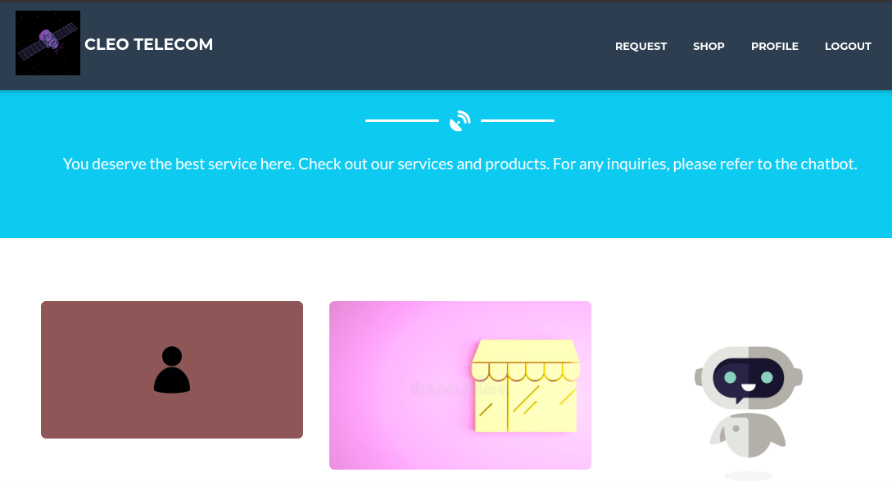
Cleo Telecom DBMS
Website Features

Slide 18

Cleo Telecom DBMS
Website Features

Slide 19
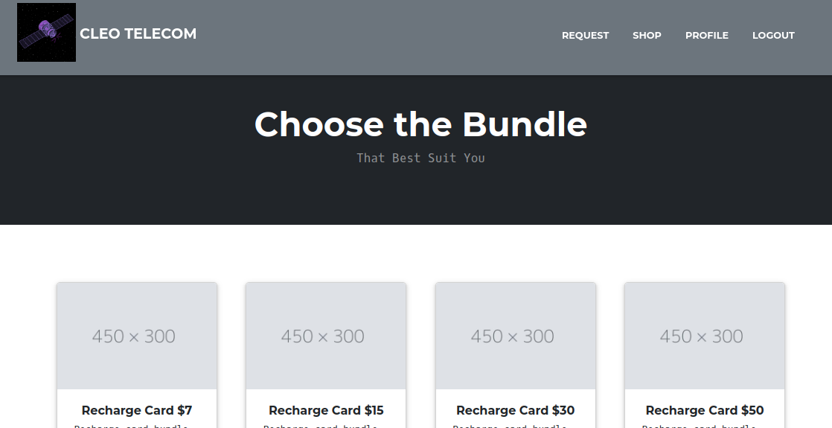
Cleo Telecom DBMS
Website Features

Slide 20
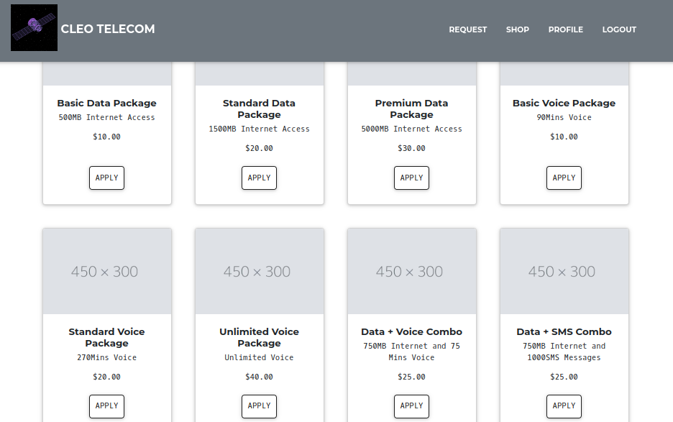
Cleo Telecom DBMS
Website Features

Slide 21
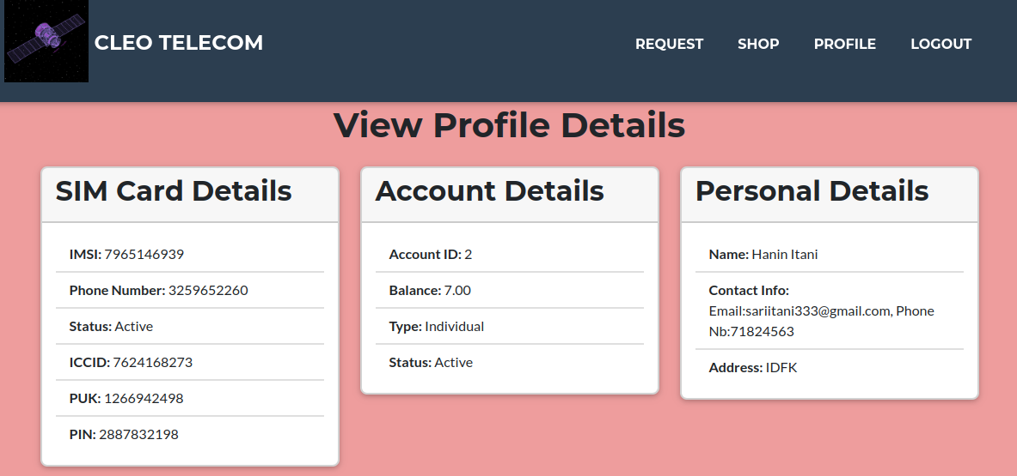
Cleo Telecom DBMS
Website Features

Slide 22
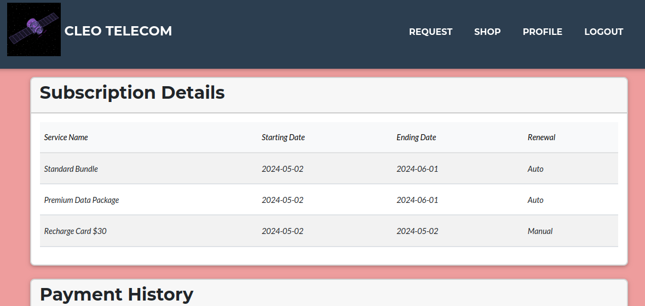
Cleo Telecom DBMS
Website Features

Slide 23
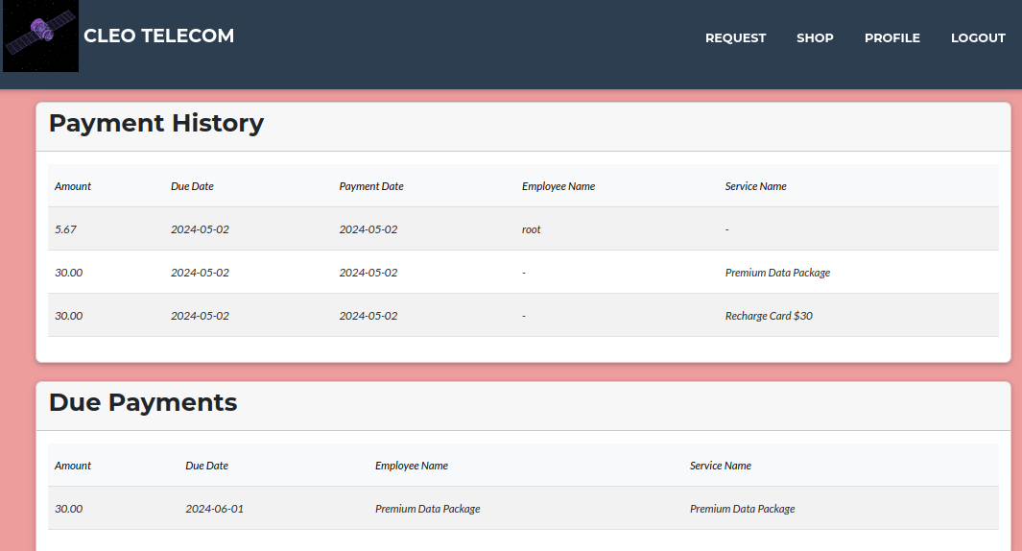
Cleo Telecom DBMS
Website Features

Slide 24
Cleo Telecom DBMS
THANK YOU!!

