Slide 1

Austin Animal Center Pet Adoptions
Project 1 July 2023
Presented by:
Sari Rojas | Jasmine Blakely | Lana Russell

Slide 2
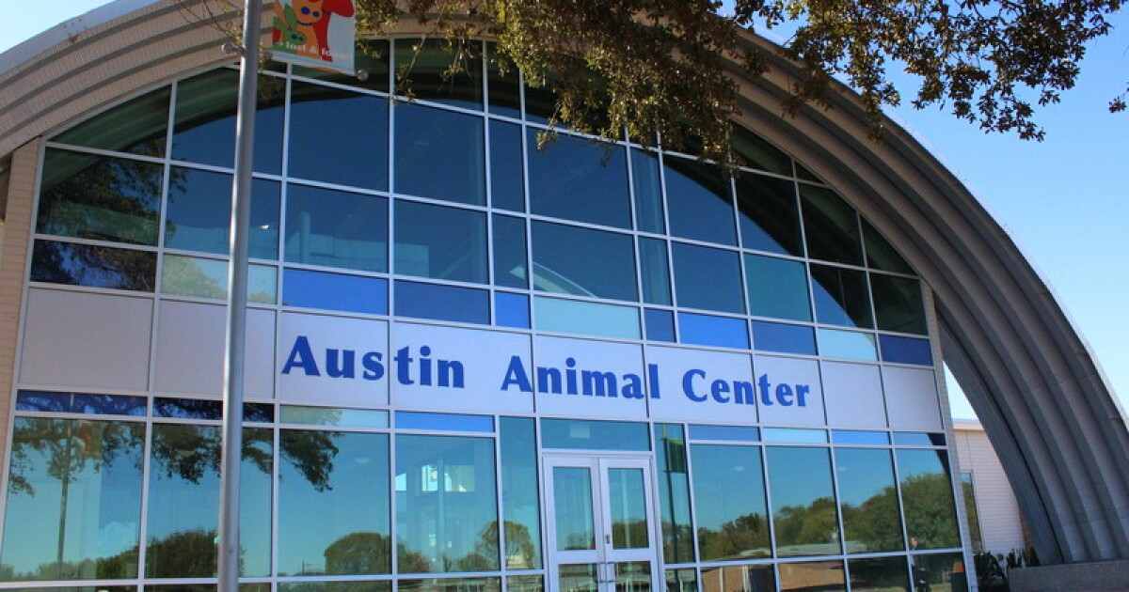
Introduction & Problem Statement
Animal shelter for the City of Austin and Travis County
Community pet services and animal care
No kill-policy
Overcrowded facilities
No longer accepting new intakes

Slide 3

Project Goal
Review 2022 public records to analyze the number of rehomed cats and dogs
Determine if there is a correlation between cat and dog adoptions based on month
Evaluate 2022 funding and programs
Assess how the Center can encourage more people to adopt a pet

Slide 4
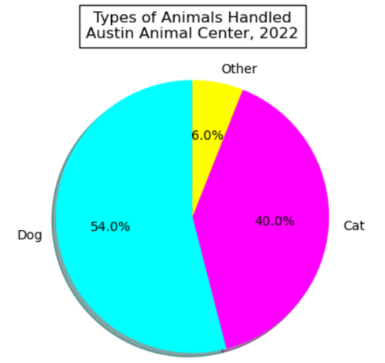

Our Process
Data source: Austin Texas open data portal
API vs CSV
Many animal types handled by the Center, including wildlife and livestock
Dataset focused on dog and cat outcomes in 2022

Slide 5
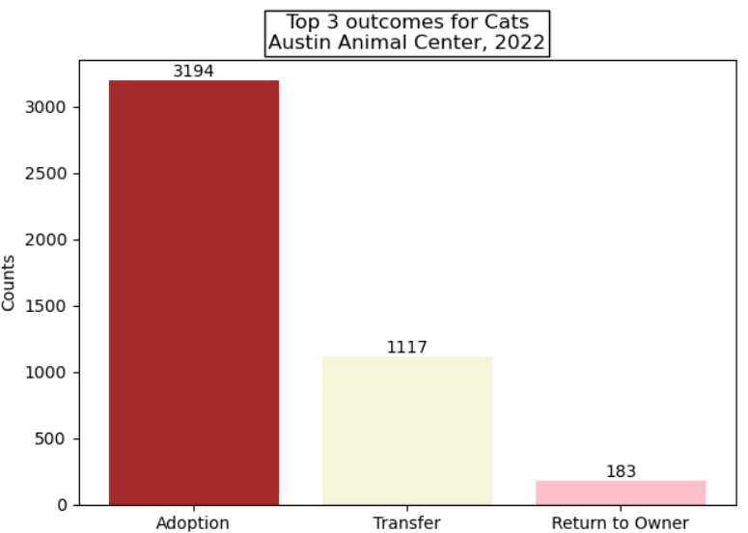
Cat Summary: Outcome Type
Numbers show most outgoing cats are adopted
A significant number are transferred to other shelters in and out of state
Some lost cats are successfully returned home

Slide 6
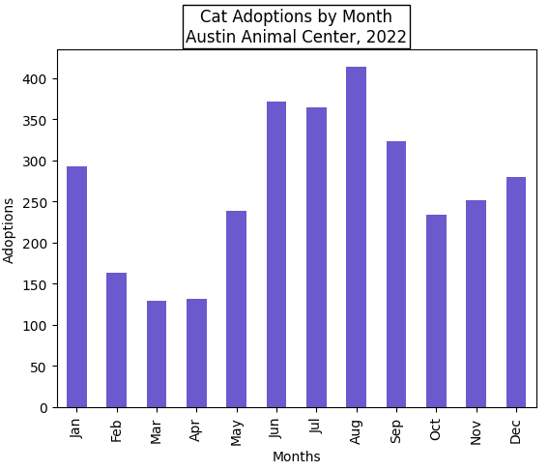
Cat Summary: Adoptions
Focusing on 2022 adoptions
Adoptions vary by season
Highest counts seen in summer
Spike coincides with “kitten season”
Adoptions drop significantly spring

Slide 7
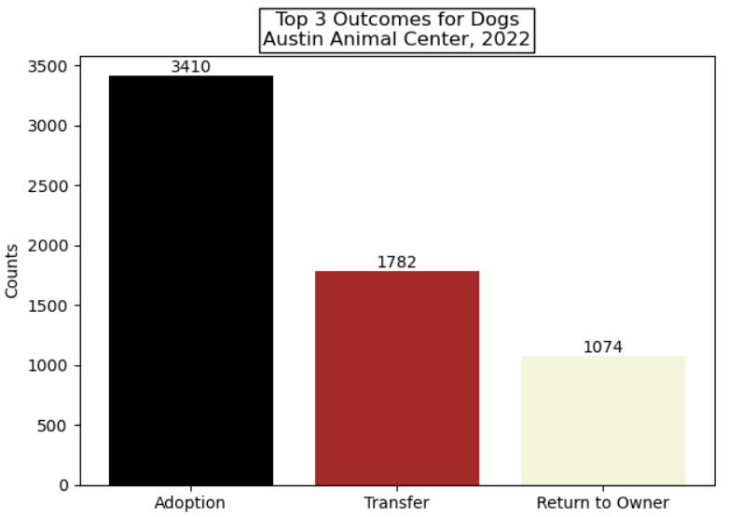
Dog Summary: Outcome Type
Numbers again show most outgoing dogs are adopted
A large number are also transferred to other shelters
Higher rate of reunification

Slide 8
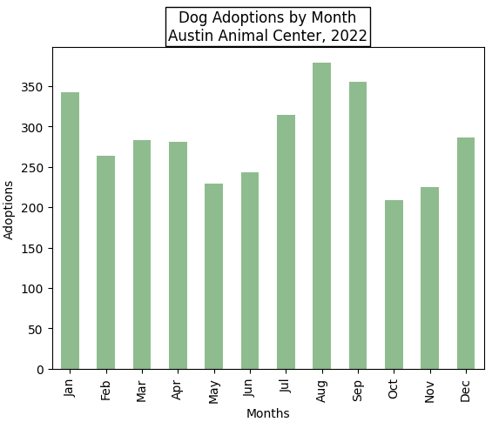
Dog Summary: Adoptions
Focusing on 2022 adoptions
Compared to cats, dog adoption counts are more stable month to month
Unlike kittens, there is no designated “puppy season”
Fewer adoptions in autumn

Slide 9
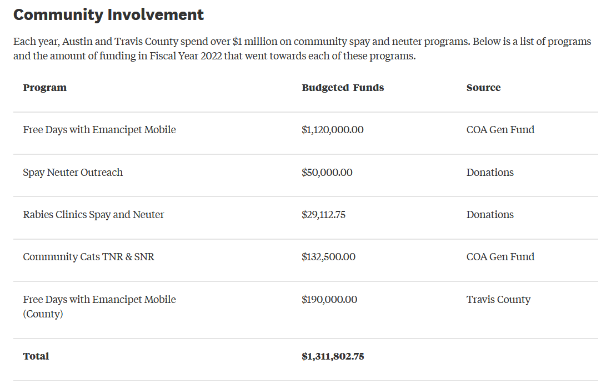

Funded Programs
Financed by taxpayers, donations, and service fees

Slide 10

Increasing Adoption Rates
Focus adoption campaigns when rates are typically lower
Proactive community outreach via Event Request Forms
Continued advertising of pet services
Live-stream adoption events

Slide 11
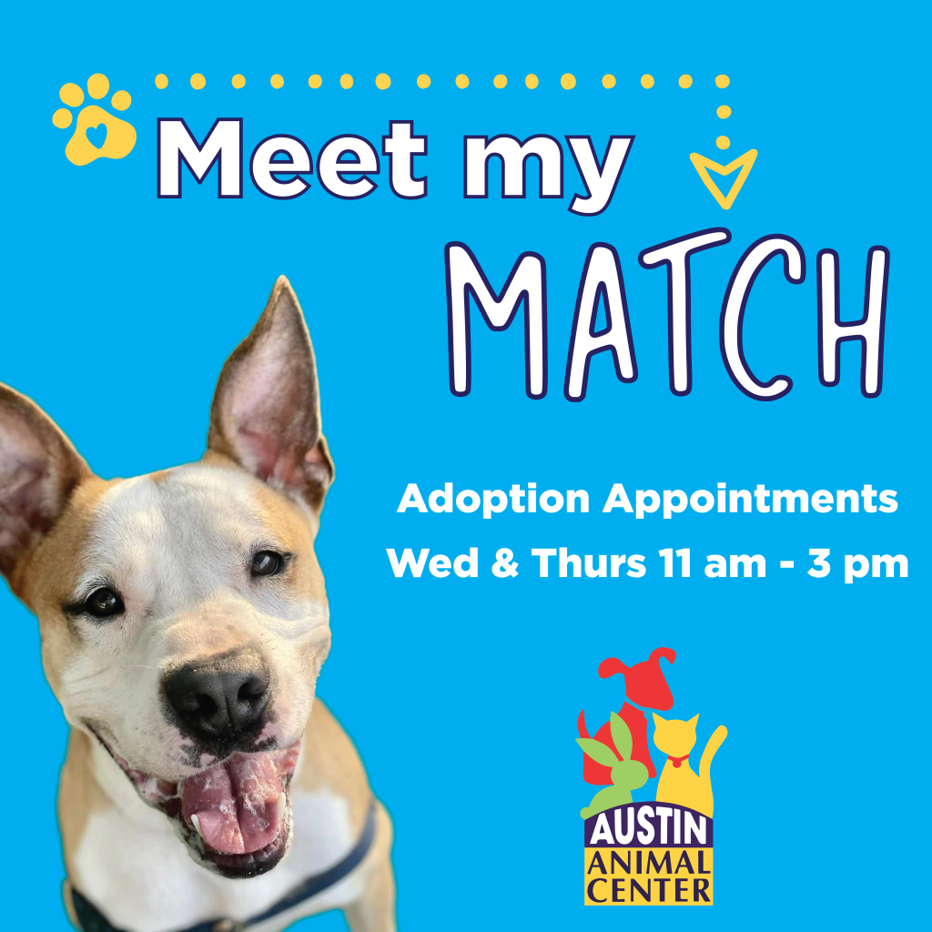
Next Steps
Audit underway
Discover new process efficiencies
Opportunity for additional staffing and satellite locations
Meet My Match pilot program
Guided selection process
Reduce/eliminate pet return rate
Identify and reunite lost pets

Slide 12
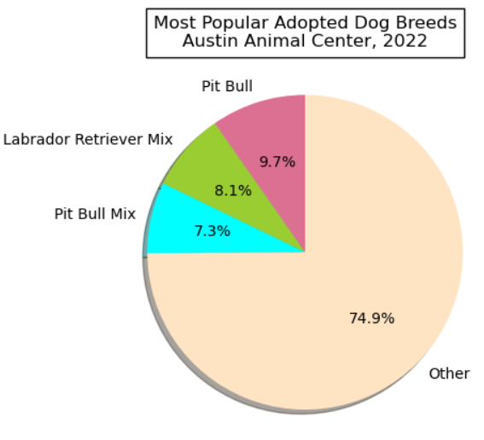
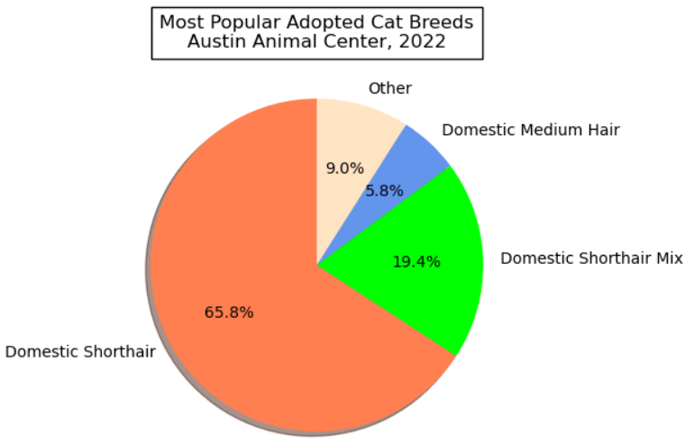
Top 3 Cat & Dog Breeds

Slide 13
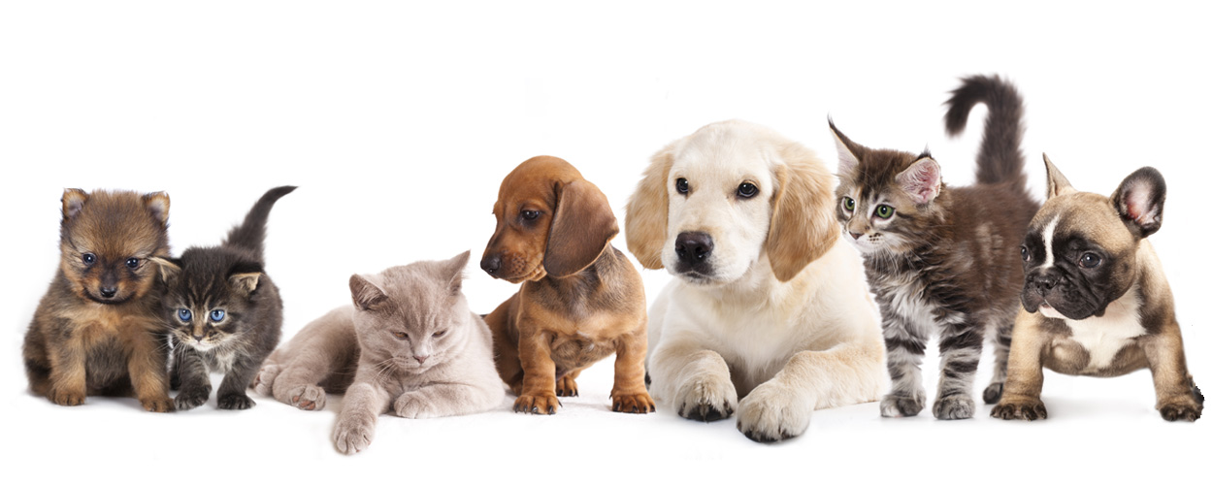
Conclusion
shortened: The findings of this project can serve as a valuable resource for animal shelters, rescue organizations, and policymakers by offering data-driven strategies that can lead to increased adoption rates, reduced shelter overcrowding, and ultimately improve the welfare of pets in the City of Austin.
Identified major causes of shelter overcrowding
Existing resources may be reallocated to target slower adoption months
Upcoming audit and pilot program results may yield additional opportunities
Data-driven strategies lead to increased adoption rates, reduced shelter overcrowding, and overall improved animal welfare

Slide 14

References
https://data.austintexas.gov/
https://www.austintexas.gov/austin-animal-center
https://www.fox7austin.com/news/overcrowding-heat-concerns-austin-animal-center-7-on-your-side
https://www.aartexas.org/2019/04/is-there-really-a-puppy-or-kitten-season/

Slide 15



