Slide 2
الفصل الثالث | شريحة البرزنتيشن
3.1 Research Methodology | Slide 10 – Research Methodology
3.2 System Architecture | Slide 11
3.2.1 Overall Framework | Slide 12 (Workflow Figure)
3.2.2 Federated Learning | Slide 13
3.2.3 Composite GAN | Slide 14
3.2.4 DeepLab | Slide 15
3.3 Dataset | Slide 16
3.4 Data Preprocessing | Slide 17
3.5 Composite GAN Augmentation | Slide 18
3.6 Feature Engineering | Slide 19
3.7 Feature Analysis | Slide 20
3.8 Federated Training Procedure | Slide 21
3.9 Experimental Design | Slide 22
Chapter 4 Results | Slides 23–30
Nabdh AI System | Slides 31–33
Conclusion & Future Work | Slides 34–35

Slide 3
Research Methodology
• Experimental and data-driven methodology
• Extension of centralized GenDeep architecture
• Federated Learning for privacy preservation
• Local ACGAN-based MRI augmentation
• DeepLab semantic segmentation
• Hierarchical cardiac feature engineering
• XGBoost, Random Forest, and TabNet classification
• FedAvg aggregation for distributed training

Slide 4
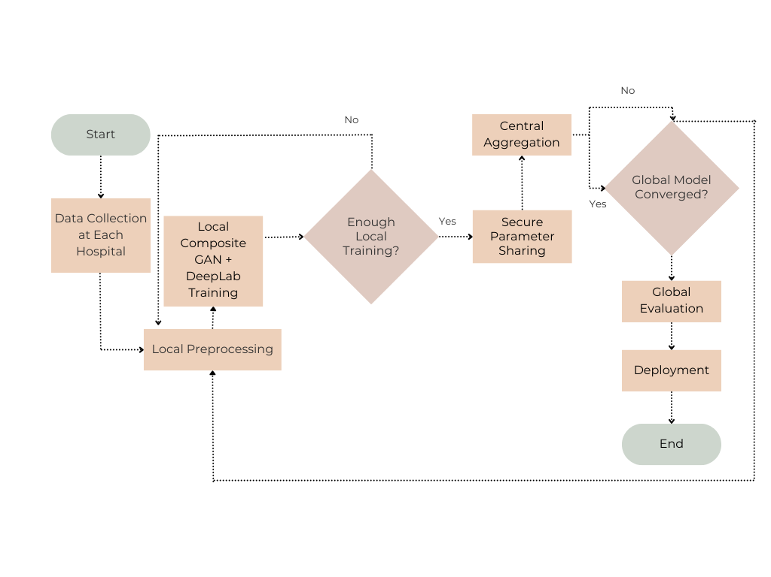

Slide 5
System Architecture
• Privacy-preserving distributed framework
• Composite GAN-based augmentation
• DeepLab semantic segmentation
• Local hospital training
• Secure parameter sharing
• Asynchronous FedAvg aggregation
• Global disease prediction model

Slide 6
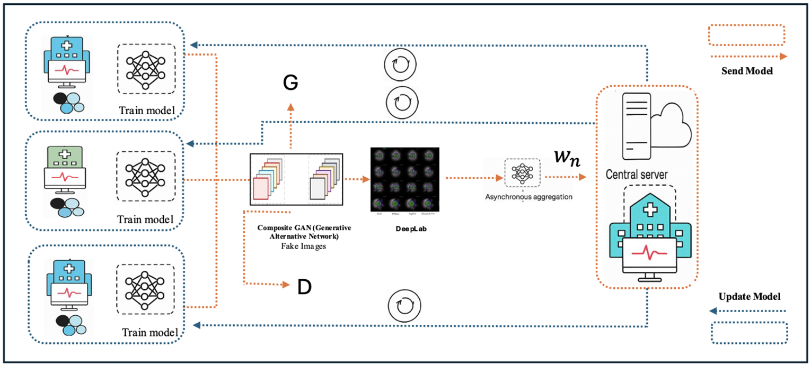

Slide 7
Overall Framework
ACDC MRI
↓
MRI Preprocessing
↓
Local ACGAN Training
↓
Synthetic MRI Generation
↓
MixedAugmentedDataset
↓
DeepLab Segmentation
↓
Slice-Level Features
↓
Patient-Level Features
↓
PCA / t-SNE / Correlation
↓
XGBoost / RF / TabNet
↓
FedAvg Aggregation
↓
Disease Prediction

Slide 8
The extracted features were analyzed and visualized to understand their distributions and relative importance. No explicit dimensionality reduction or feature elimination method was applied prior to model training.

