Slide 1




Internet Quality Predictor & Root-Cause Classifier
A proactive machine learning framework for modeling network degradation, predicting connection drops, and diagnosing underlying root causes.
Saria Nayyar
Project Lead & Developer

Slide 2


Turning Daily Frustration Into Machine Learning Insights
Instead of guessing whether buffering is caused by Wi-Fi noise, ISP throttling, or bandwidth hogs, this project collects personal telemetry data to train intelligent predictive classifiers.

Slide 3


Problem & Motivation
The Everyday Annoyance
The Data-Driven Solution
Frequent internet slowdowns and drops interrupt remote study, work, and gaming.
Automated logging of fine-grained network metrics over 1–2 full weeks.
Users lack visibility into the true failure domain (Local Wi-Fi vs. Router vs. ISP).
Supervised and unsupervised ML models trained on real, self-collected data.
Traditional troubleshooting relies on blind restarts and subjective guesswork.
Early-warning alerts and automated diagnosis of connection degradation events.

Slide 4
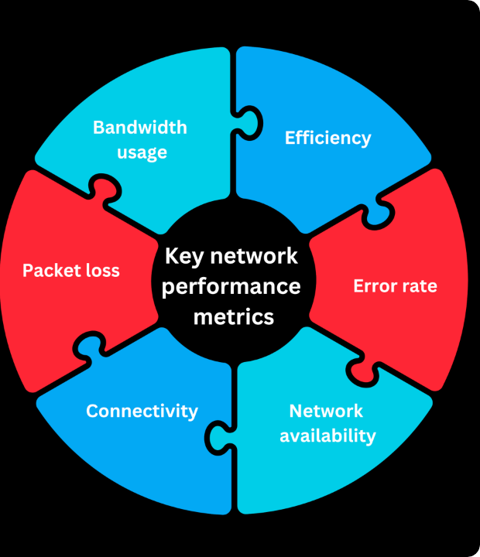
Automated Telemetry
Simulated Dataset (10 Days)
10 days of network readings every 5 minutes with three injected failure types. A local script (ping, speedtest-cli) is included to collect real data.
Tracked Telemetry Metrics
• Latency (Ping) & Jitter Dynamics
• Packet Loss Percentage
• Download & Upload Throughput
• Wi-Fi Signal Strength (RSSI)
• Number of Active Connected Devices

Slide 5






Methodology & Feature Pipeline
Preprocessing
Feature Engineering
Statistical PCA
Handles missing logs, regularizes sampling timeframes, and standardizes continuous metric scales for ML models.
Computes 10-minute rolling averages and rate-of-change delta features to capture latency trend momentum.
Applies distribution analysis for health thresholds and Principal Component Analysis to remove redundant metrics.

Slide 6

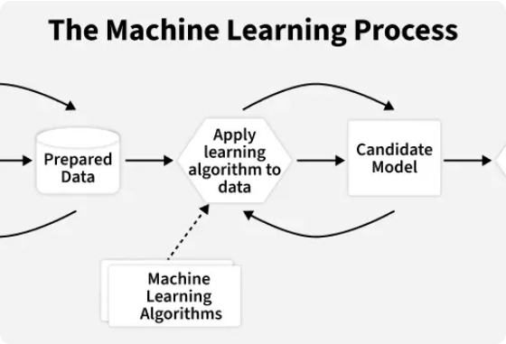
Machine Learning Architecture
Unsupervised Clustering (K-Means / DBSCAN): Clusters unlabelled time windows into distinct states like "Normal", "High Congestion", and "Interference Heavy".
Early Warning System (Logistic Regression / SVM): Binary classification predicting whether a connection will degrade in the next 5–10 minutes.
Root Cause Classifier (Decision Trees & Ensembles): Multi-class trees isolating specific failure modes to deliver actionable user guidance.

Slide 7

Target Outcomes & Metrics
System Capabilities
0.99
• Proactive Alerts: Gives users a 5–10 minute lead time before noticeable video buffer or connection loss.
• Actionable Intelligence: Directly informs whether to switch Wi-Fi bands (2.4 GHz vs 5 GHz), restart the router, or call the ISP.
Degradation Prediction Accuracy (Simulated Data)
• Low Overhead: Lightweight Python daemon running quietly in the background with negligible RAM/CPU footprint.

Slide 8
Root-Cause Diagnostic Matrix
Root Cause Category | Key Telemetry Signature | Recommended Diagnostic Action
Wi-Fi Interference | Drop in RSSI signal, spike in local jitter, stable ISP ping | Switch Wi-Fi channels or move closer to access point
ISP Congestion | Elevated external latency & packet loss, normal RSSI | Flag external ISP node congestion or regional outage
Bandwidth Overload | Maxed upload/download speeds, spike in latency | Identify high-consumption device on local LAN network
Hardware / Router Fault | Complete packet loss across local gateway, drops | Trigger automated local router reboot sequence

Slide 9




Implementation Roadmap
Phase 2: Features
Phase 4: Dashboard
Clean logs, engineer rolling trend metrics, and perform PCA dimensionality reduction.
Build real-time monitoring dashboard with background early-warning agent.
Phase 1: Telemetry
Phase 3: Modeling
Deploy Python logging scripts over 1–2 weeks to capture raw network logs.
Train & evaluate SVM, Logistic Regression, and Decision Tree classifiers.

Slide 10
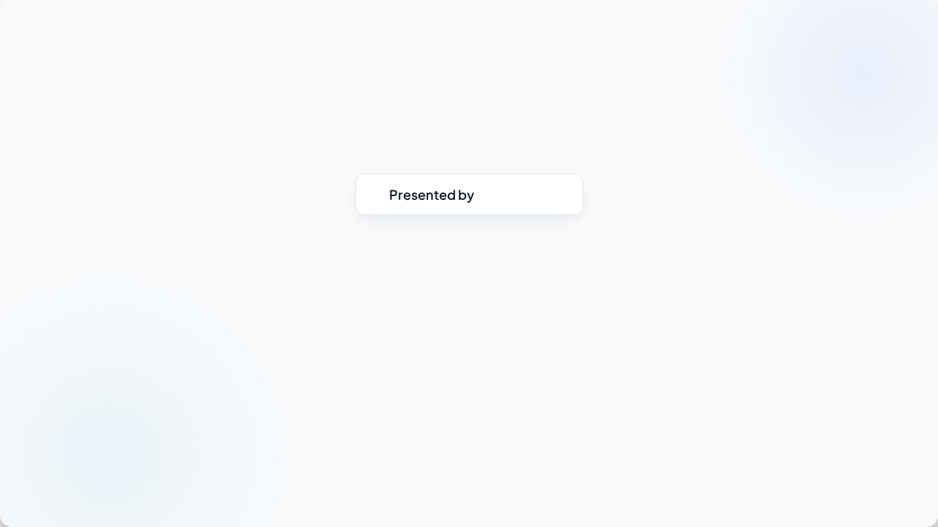
Questions & Discussion
Internet Connection Quality Predictor & Root-Cause Classifier
Saria Nayyar

Slide 11


Image Sources
https://images.surferseo.art/d9312535-a58d-424d-9430-43d7ced3a950.png
Source: www.ir.com
https://media.geeksforgeeks.org/wp-content/uploads/20251124151113659326/the_machine_learning_process.webp
Source: www.geeksforgeeks.org

