Slide 1

NBKR Institute of Science and Technology(Autonomous)
Simple Voting System in C
Team members
THALIYAKULA LIKITHA - 24KB1A05KW
THOPPANI TEJASRI - 24KB1A05LF
TUPAKULA SARIKA - 24KB1A05LN
SULLURU TEJASRI - 24KB1A05K

Slide 2

Array and Linked List Voter System in C
This presentation explores a C program implementation that combines arrays and linked lists to build a simple election voting system. It demonstrates how candidates are stored in an array, while voters for each candidate are tracked via linked lists.
We will break down the program structure, key functions, and data management techniques involved in this hybrid data structure approach, illustrating its practical application in voting systems.

Slide 3
Data Structures: Candidates Array & Voter Linked List
Candidates Array
Voter Linked List
Fixed size array holds candidate structures with ID, name, vote count, and pointer to a voter linked list.
Each candidate has a pointer to a linked list of voters who voted for them.
Supports up to 10 candidates
Dynamic size—grows as votes are added
Enables quick indexing and iteration
Nodes contain voter ID, name, and next pointer

Slide 4

Adding Candidates: Populating the Array
Function: addCandidate()
Details Stored
Stores candidate ID, name, initializes votes to zero, and voter list pointer set to NULL.
Appends a new candidate to the array if maximum capacity is not reached.
Capacity Check
Prevents adding beyond 10 candidates, ensuring array bounds safety.

Slide 5
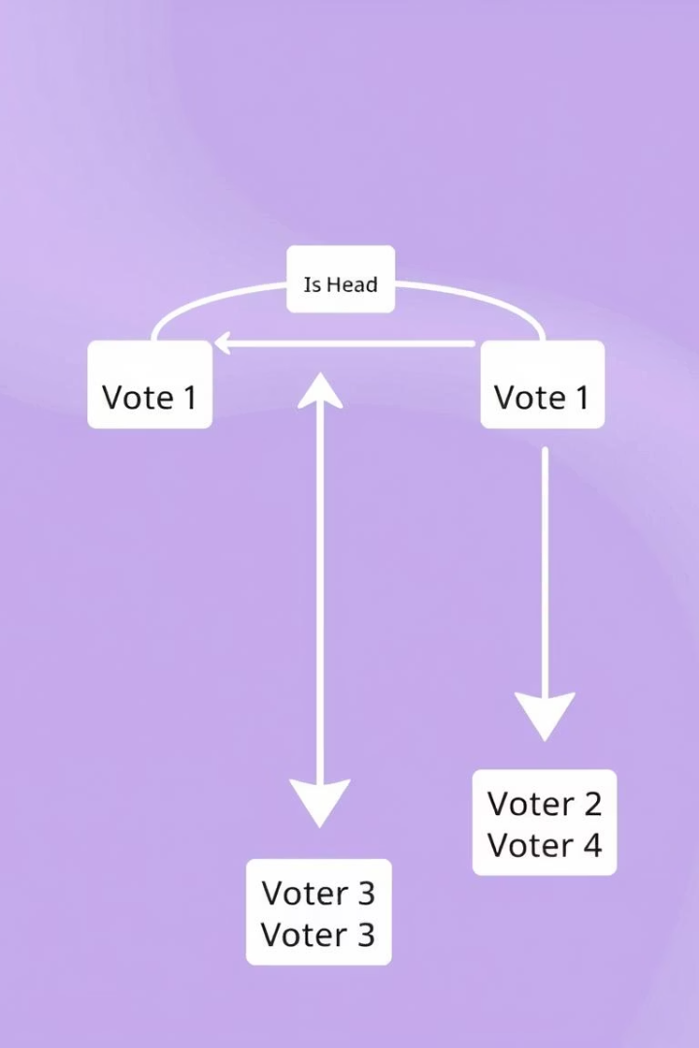
Recording Votes: Adding Voters to Linked Lists
Function: addVoter()
Linked List Insertion
Locates candidate by ID, creates new voter node, and inserts it at the beginning of the linked list.
New voter nodes point to the current head, effectively prepending to the list.
Vote Tally
The candidate's vote count is incremented upon adding a new voter.

Slide 6
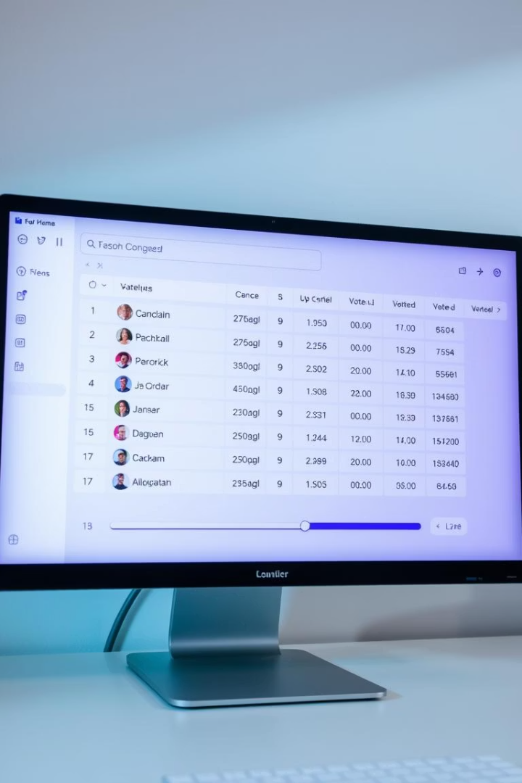
Displaying Candidates and Their Votes
displayCandidates()
Use Case
Iterates through candidates array to print ID, name, and total votes.
Provides a summary view of all candidates and current election status.
Output Format
Tabular layout showing columns for easier readability.

Slide 7
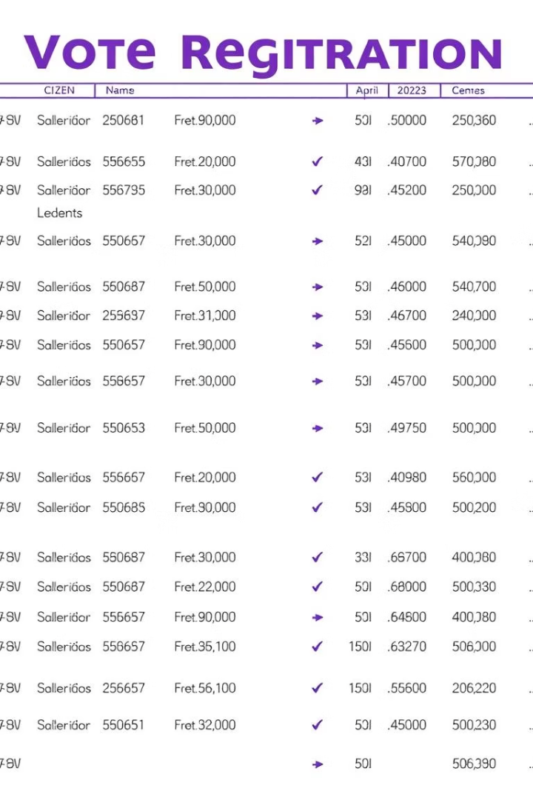
Displaying Voters for a Specific Candidate
displayVoters(candidateId)
Linked List Traversal
Starts at head pointer and iterates node by node until end of the list.
Searches for candidate by ID and traverses their linked list of voters to display voter details.
Information Displayed
Voter ID and name for each voter who voted for the candidate.

Slide 8
Main Menu & Program Flow
Interactive Menu
Input Handling
Add Candidate
Uses standard input/output functions to collect and process user choices and data entries.
Add Voter
Display Candidates
Switch-case controls the program flow based on user menu selection.
Display Voters
Exit

Slide 9

Key Takeaways and Best Practices
1
Hybrid Data Structure Design
Combining arrays for fixed-size candidate storage with linked lists for dynamic voter management allows efficient resource use and scalability.
2
Memory Management
Uses dynamic allocation for voters with careful pointer management; requires eventual freeing to prevent leaks in production.
3
User Interaction
A simple menu-driven interface provides clear workflow for adding and displaying election data effectively.
4
Applications
Concepts illustrated are foundational for building scalable systems handling dynamic data collections and real-time updates.

Slide 10
Conclusion :
This C-based simple voting system ensures secure voting through voter authentication and prevents duplicate votes. It allows candidate and voter registration, vote casting, and real-time result display. Data structures like arrays and linked lists are used effectively. The system serves as a foundational model for building more advanced election applications.

Slide 11
Thank You

