Slide 1
MACHINE JOB SCHEDULING
SPRINT-1
Muskan Allabaksh Pathan​
Sri Harshita Talari​
Renuka Gujjala​
Bhagyalakshmi Daliparthi​
Sarika Pathiputturu​
Vinitha Devalla​

Slide 2
CONTENTS
Introduction
Application solution
Workflow
Flow Of Code
Testing
Conclusion

Slide 3
INTRODUCTION
The developed application will process various files in parallel manner and reduce the time for completion of processes by dividing them into multiple small single -sequence streams called “Threads”.
In scheduling theory, the basic model assumes that all machines are continuously available for processing throughout the planning horizon.
Another motivation for the investigation of constrained machine availability arises, if we have two sets of job requirements, one set having a ﬁxed assignment to time intervals and the other being processed in the remaining free processing intervals.

Slide 4
DAY 1 TO 4
SRS- Software Requirements Specification
DESIGN- Understanding the problem and create pseudo code and DFD0 and DFD1 for the same
CODING- Developing our logic using C language
TESTING- Test our developed application using various sunny and rainy test cases

Slide 5

Application solution
Linked List

Slide 6

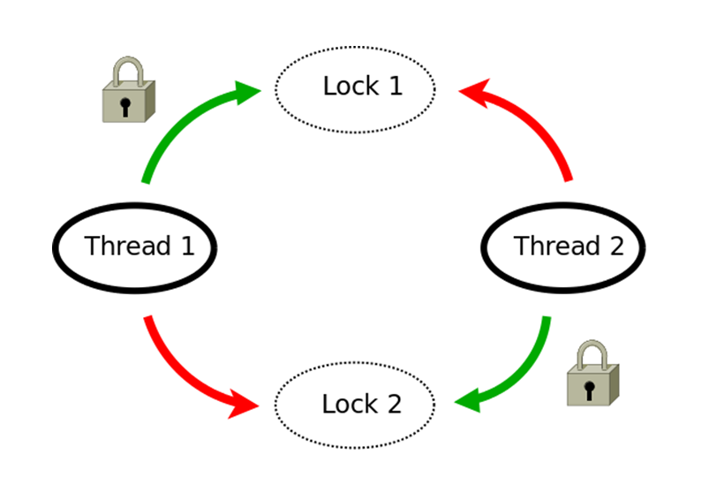
MUTEX
Mutex is a synchronization primitive that grants exclusive access to the shared resources to only one thread.
If a thread acquires a mutex, the second thread wants to acquire that mutex is suspended until the first thread release mutex.

Slide 7
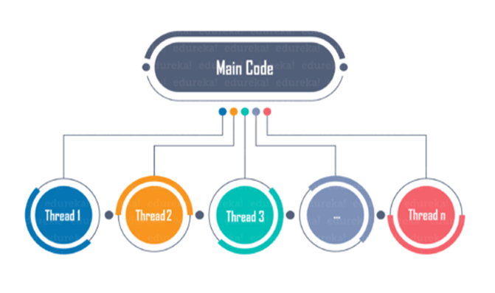
Multi-threading Multi-threading refers to the use of many threads inside a single process Each thread serves a separate function It operates concurrently

Slide 8
DATA FLOW DIGRAM
It includes data inputs and outputs, data stores, and the various subprocesses the data moves through
In these project we have:
DFD Level-0
DFD level-1
Flow Chat

Slide 9
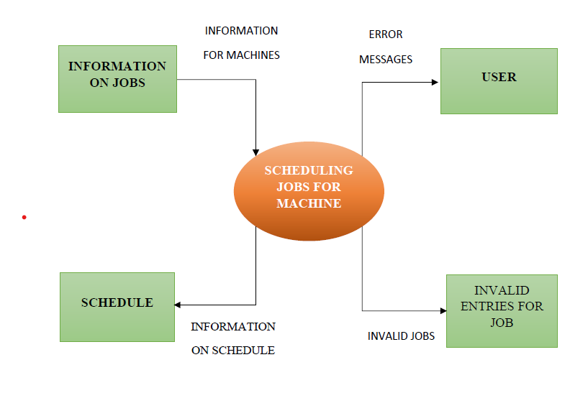
DFD Level-0

Slide 10
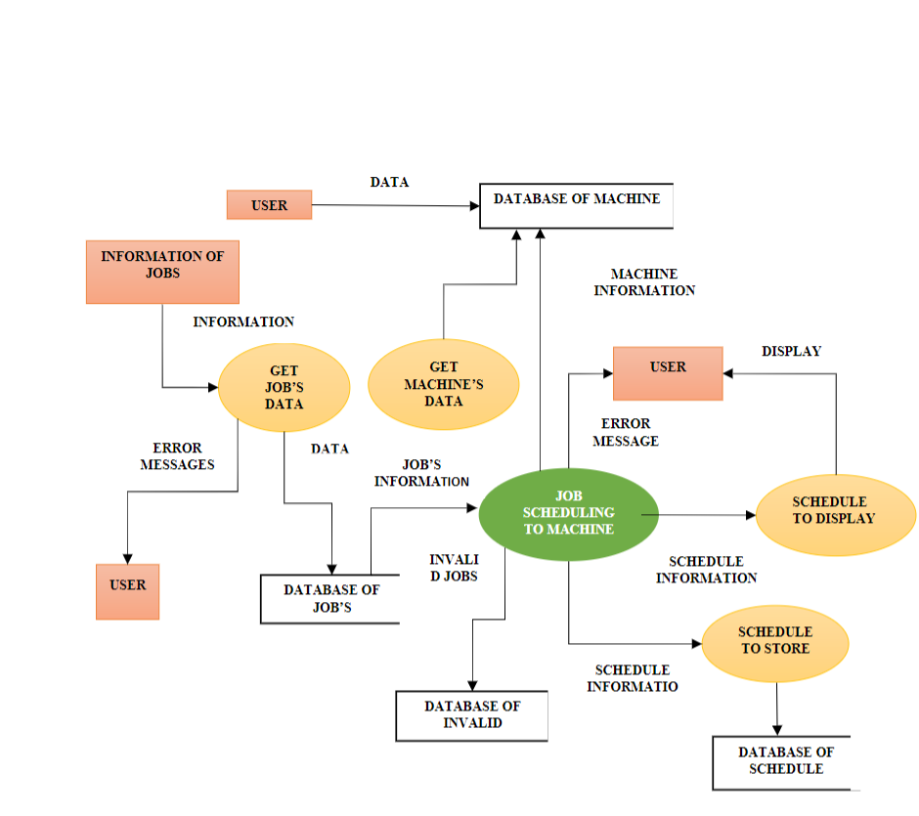
DFD level-1

Slide 11
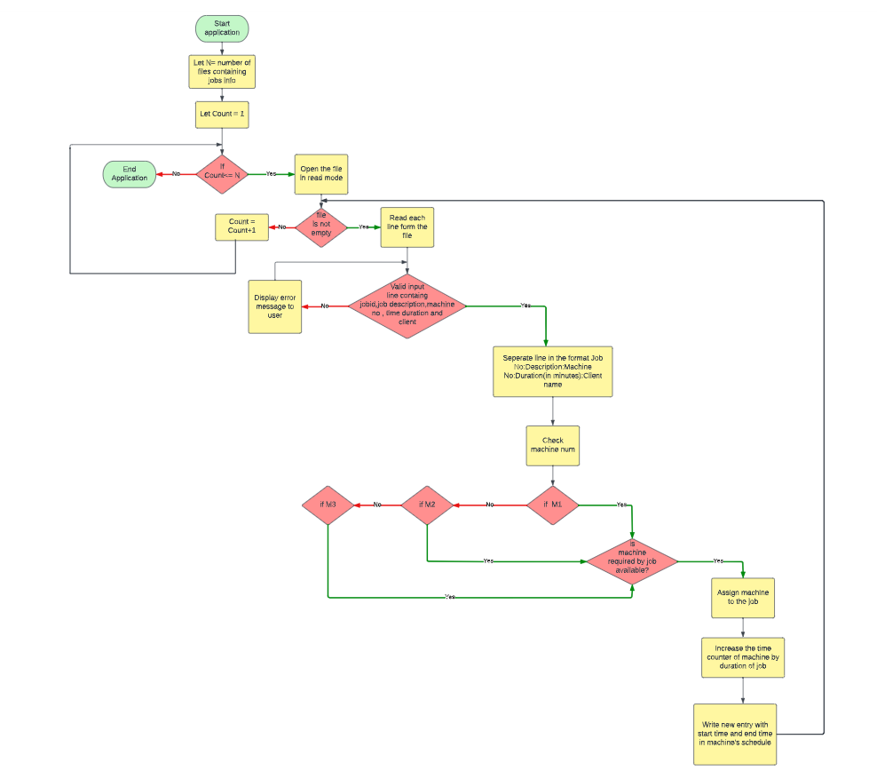
DATA FLOW DIGRAM

Slide 12
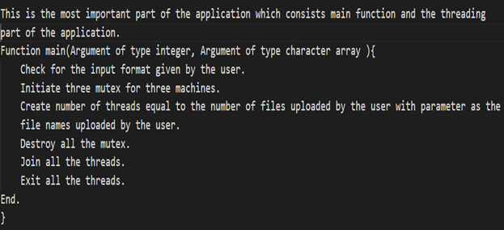
FLOW OF CODE
Main.c

Slide 13
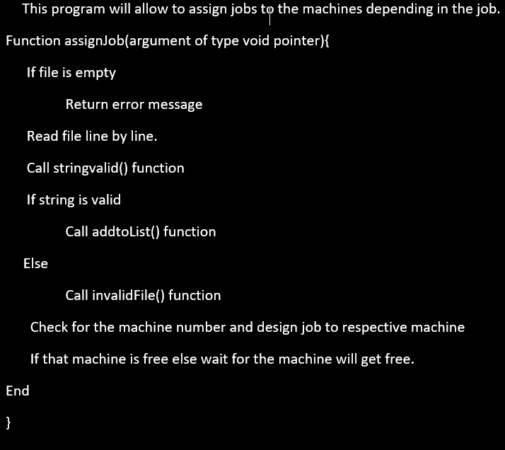
ASSIGNJOB.C

Slide 14
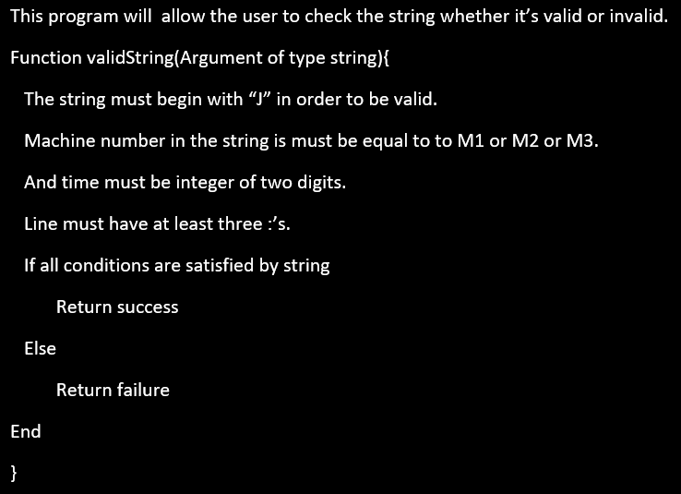
StringValid.c

Slide 15
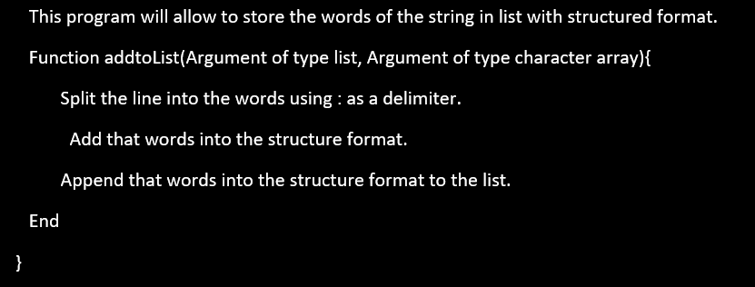
addTolist.c

Slide 16
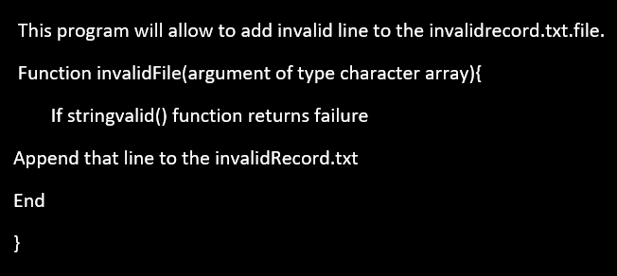
InvalidFile.c

Slide 17
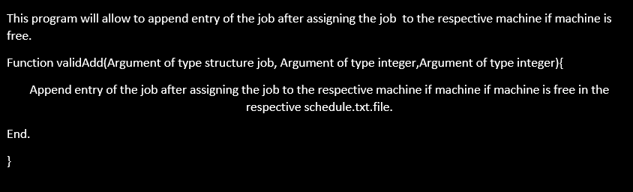
validAdd .c

Slide 18
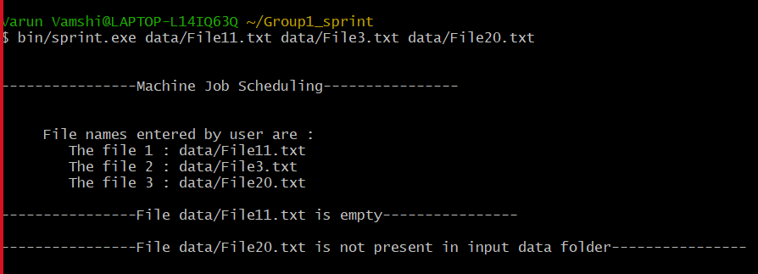
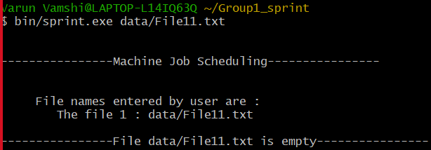
: User has provided File11.txt(which is empty). : User has provided File3.txt(which is not empty and present in the data folder). : User has provided File20.txt(which is not present in data folder).
: User has provided File11.txt(which is empty)

Slide 19
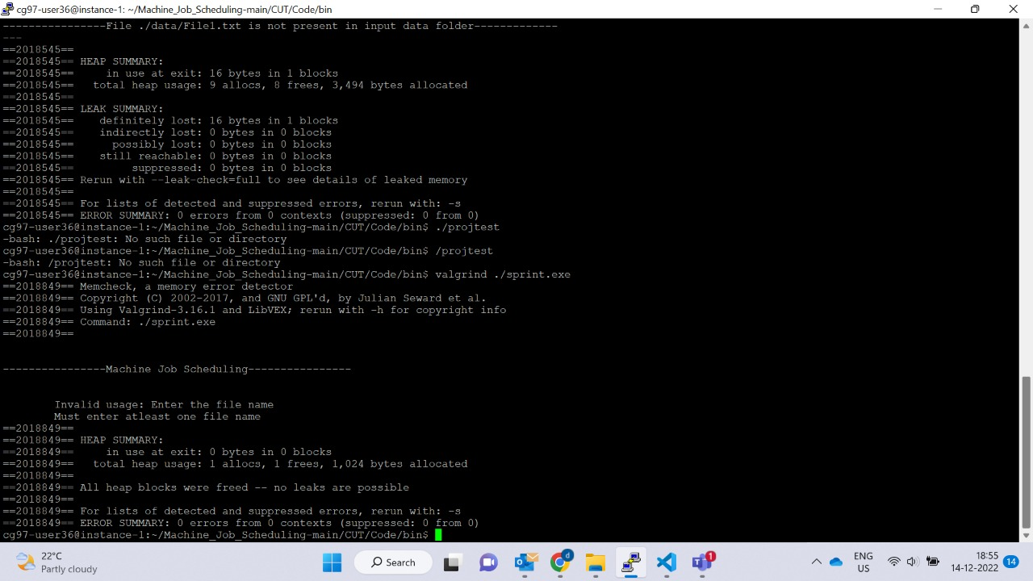
VALGRIND TEST

Slide 20
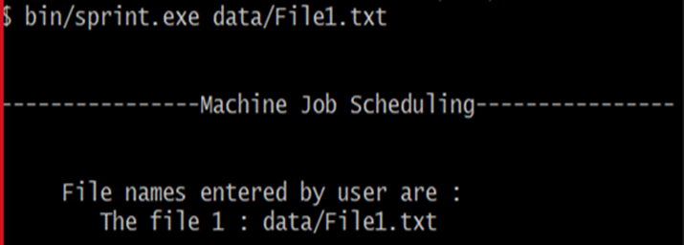

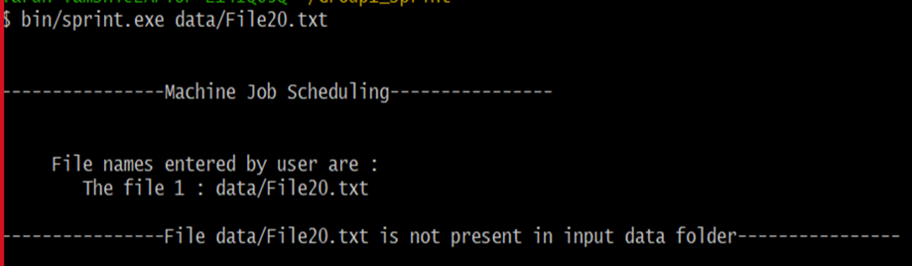

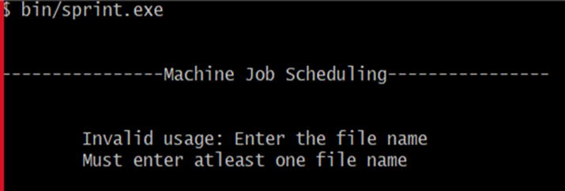

INTEGRATION TESTING
User has provided File1.txt(Which is not empty
And present in the data folder)
:User has provided File2.txt(which is not present in the data folder)
When number of arguments is less than 2, User has not provided the file

Slide 21
CONCLUSION
Successfully launched and implemented the Machine job scheduling application. This application is able to perform operations on various files parallelly and give expected results with more efficiency and less time as compared to traditional method.

Slide 22

THANK YOU

