Slide 1
MACHINE JOB SCHEDULING
Muskan Allabaksh Pathan​
Sri Harshita Talari​
Renuka Gujjala​
Bhagyalakshmi Daliparthi​
Sarika Pathiputturu​
Vinitha Devalla​
SPRINT-1

Slide 2
CONTENTS
Introduction
Application solution
Workflow
Flow Of Code
Testing
Conclusion

Slide 3
INTRODUCTION
The developed application will process various files in parallel manner and reduce the time for completion of processes by dividing them into multiple small single -sequence streams called “Threads”.

Slide 4
DAY 1 TO 4
SRS- Software Requirements Specification
DESIGN- Understanding the problem and create pseudo code and DFD0 and DFD1 for the same
CODING- Developing our logic using C language
TESTING- Test our developed application using various sunny and rainy test cases

Slide 5

Application solution
Linked List

Slide 6

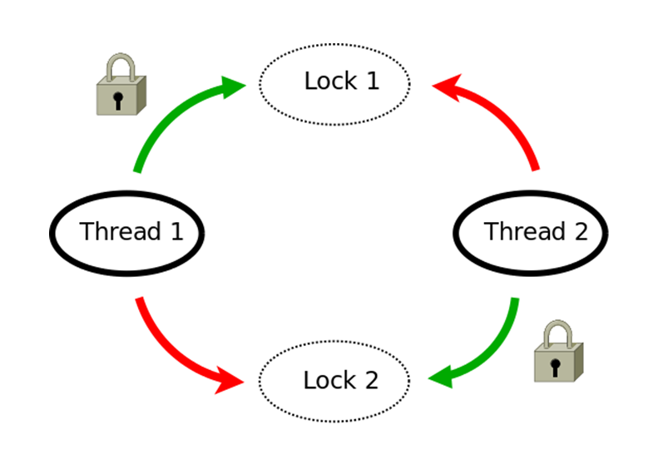
MUTEX
Mutex is a synchronization primitive that grants exclusive access to the shared resources to only one thread.
If a thread acquires a mutex,the second thread wants to acquire that mutex is suspended until the first thread release mutex.

Slide 7
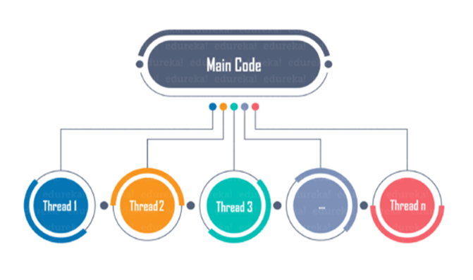
Multithreading
It refers to the use of many thread inside a single process. Each thread serves a separate function.

Slide 8
DATA FLOW DIGRAM
It includes data inputs and outputs, data stores, and the various subprocesses the data moves through
In these project we have:
DFD Level-0
DFD level-1
Flow Chat

Slide 9
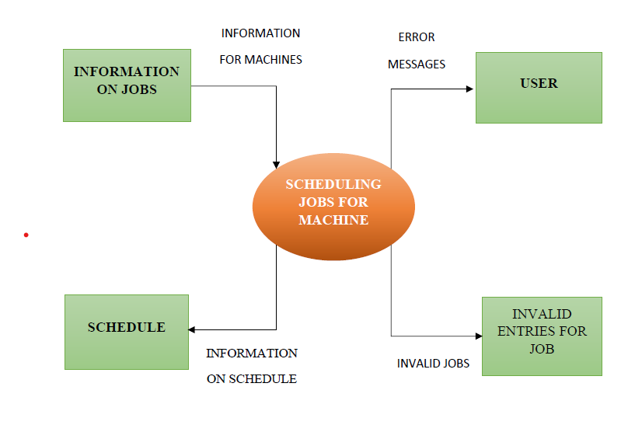
DFD Level-0

Slide 10
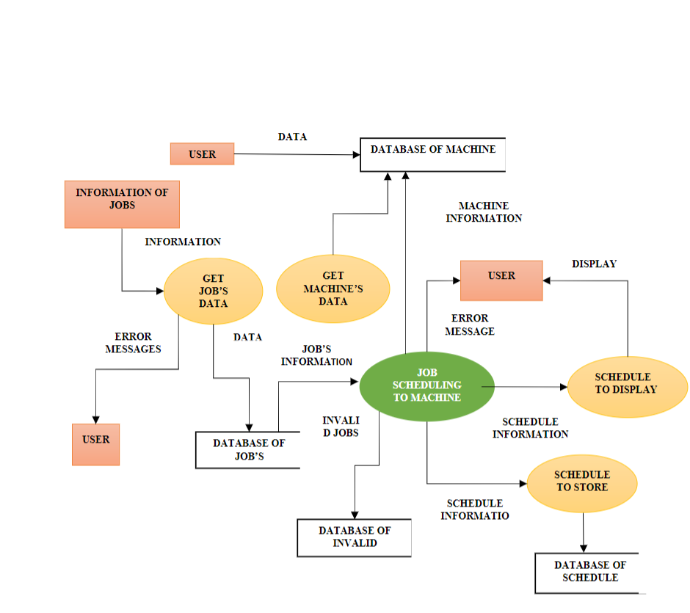
DFD level-1

Slide 11
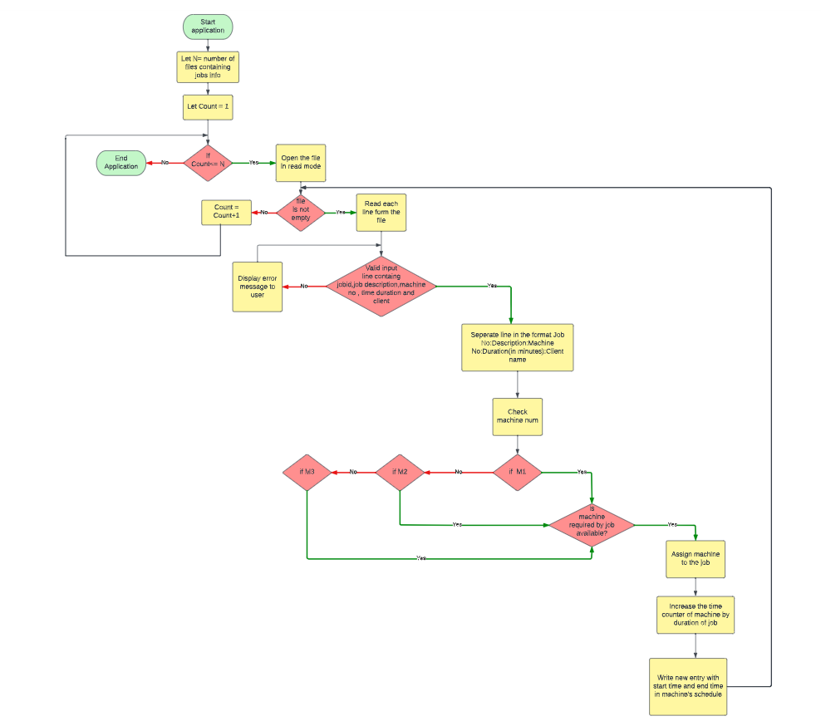
DATA FLOW DIGRAM

Slide 12
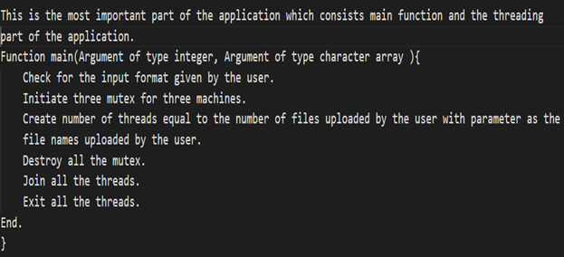
FLOW OF CODE
Main.c

Slide 13
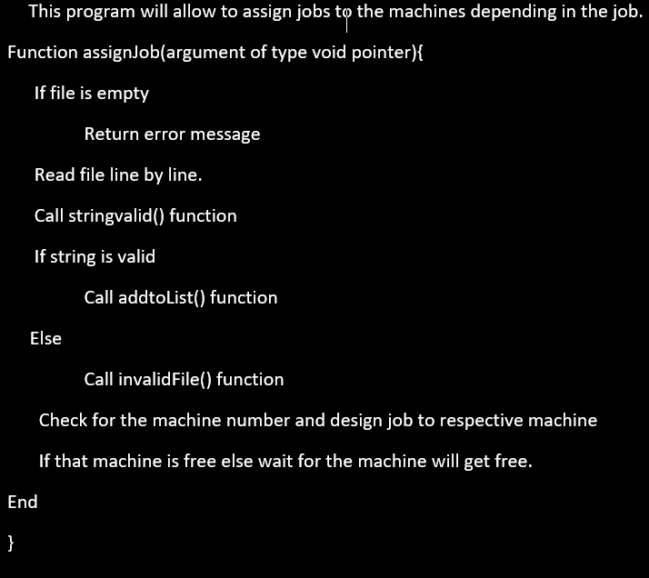
ASSIGNJOB.C

Slide 14
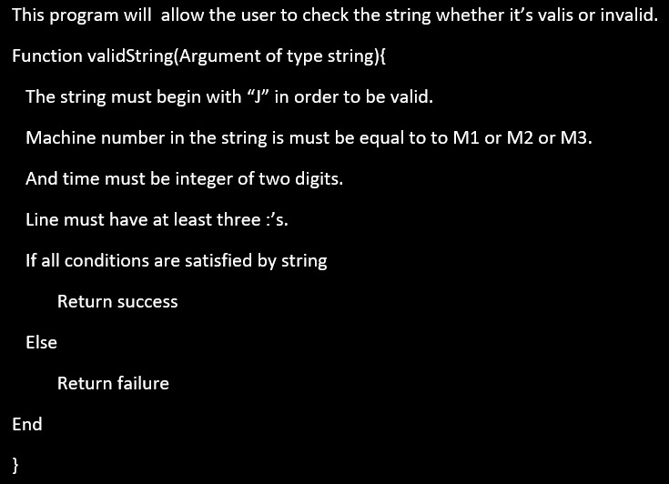
stringValid.c

Slide 15
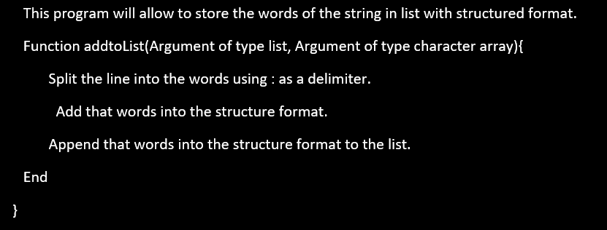
addTolist.c

Slide 16
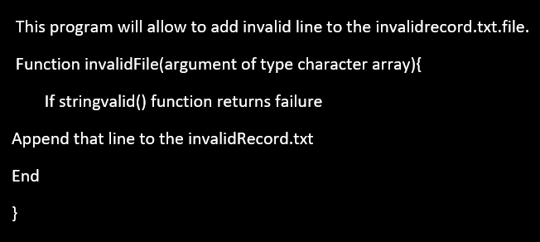
InvalidFile.c

Slide 17
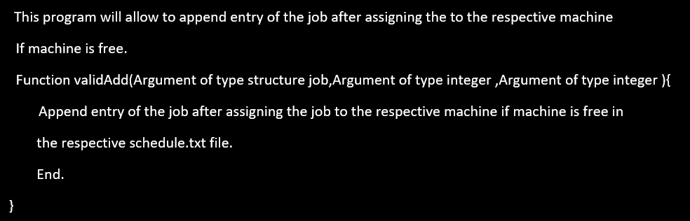
ValidFile.c

Slide 18


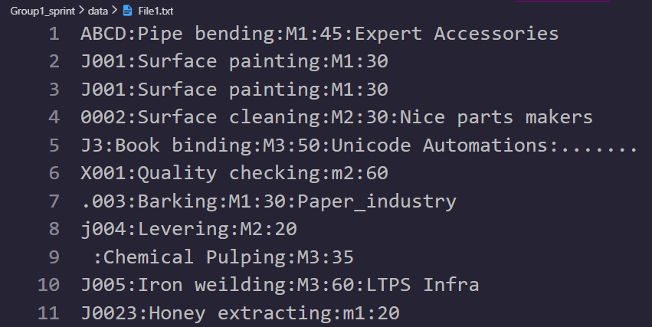
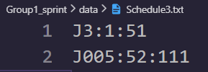
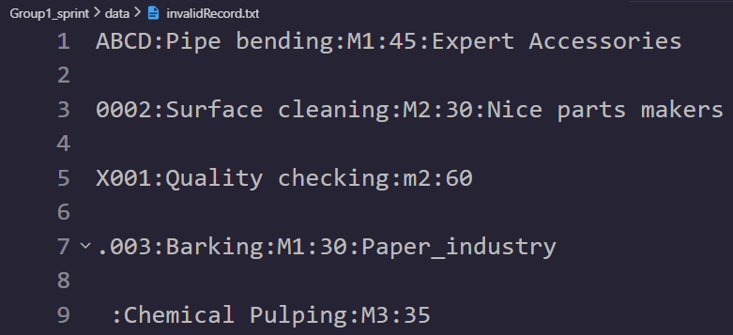
Valid Cases:
User gives the input file: bin/sprint.exe data/File1.txt
Invalid Cases:

Slide 19
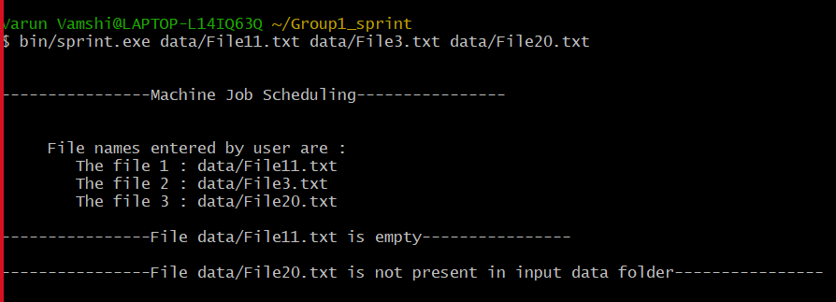
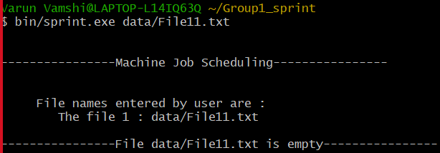
: User has provided File11.txt(which is empty). : User has provided File3.txt(which is not empty and present in the data folder). : User has provided File20.txt(which is not present in data folder).
: User has provided File11.txt(which is empty)

Slide 20
CONCLUSION
Successfully launched and implemented the Machine job scheduling application. This application is able to perform operations on various files parallelly and give expected results with more efficiency and less time as compared to traditional method.

Slide 21

THANK YOU

