Slide 1
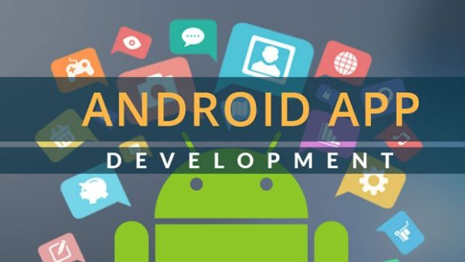
Android Application Development

Slide 2
What is Android?
Android is a touchscreen mobile operating system based on a modified version of the Linux kernel and other open source software, built primarily for smartphones and tablets.

Slide 3
Android Application Development:
Android software development is the process of creating apps for devices that run the android operating system. Using the android software development kit(SDK), Google claims that “android apps may be created in Kotlin, java, and C++ languages,” while languages are also feasible.

Slide 4
Tools required for android application development
Android studio.
ADB(android debug bridge).

Slide 5

Secure messenger app
We are here to develop an app that is named as secure messenger app.
This is a messaging app where we can chat or connect with our favorite persons.
The tool that we used to develop this, is an “android studio” where we can develop or create a design of any app.
We can use java or kotlin languages to develop these kind of apps, we have selected java language as a source

Slide 6
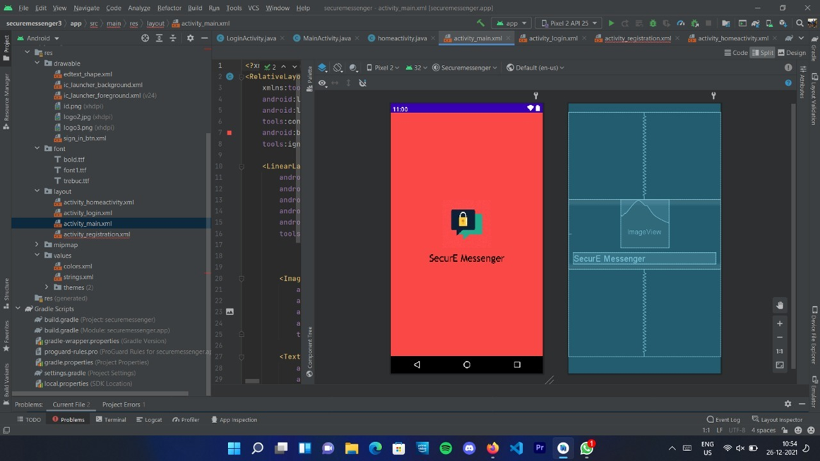
Android 1

Slide 7
Android 1
The image showed in the before slide is the 1st page that will be appeared when the app is opened.
The app is named as secure messenger.
We have selected java language as the source and created this page.

Slide 8
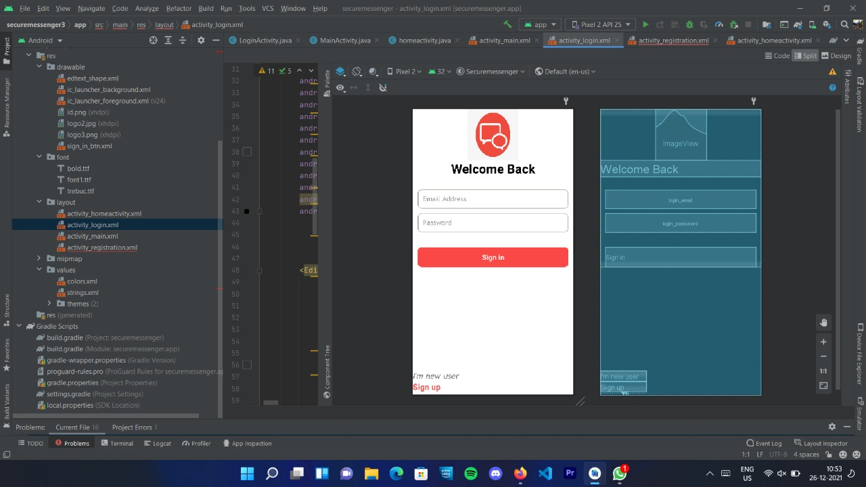
Android 2

Slide 9
Android 2
The image showed in the before slide is the 2nd page that will appear when the app is opened.
This is the sign in page.
By using the buttons option in android studio we have placed the sign in button.

Slide 10
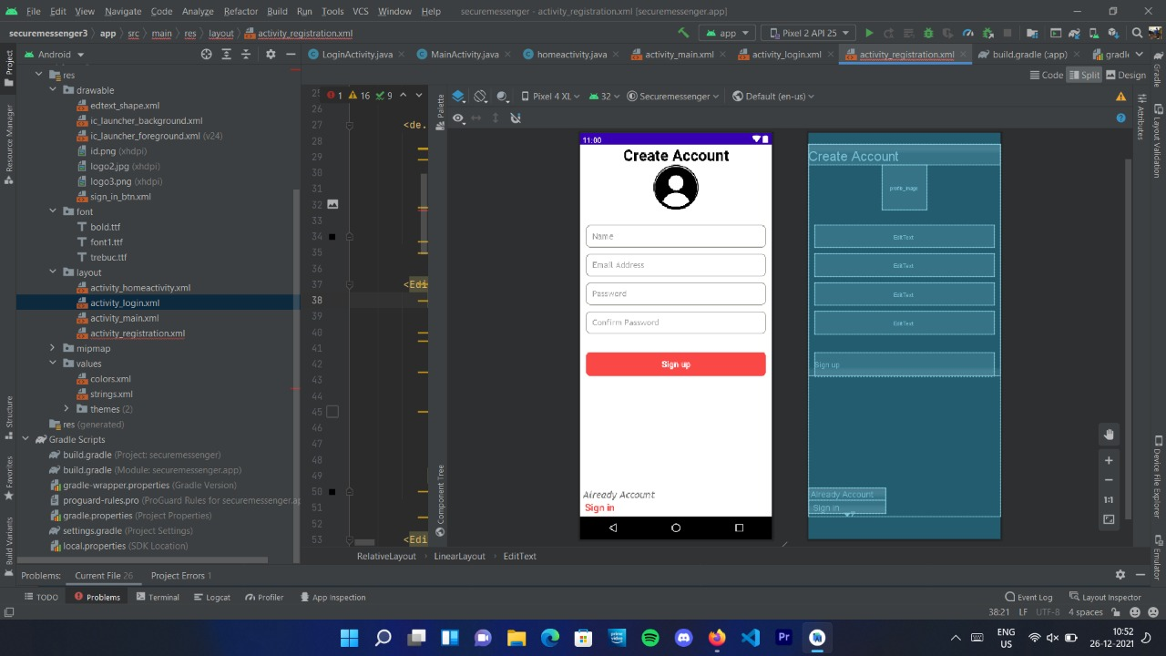
Android 3

Slide 11
Android 3
The showed in the before slide is the 3rd page that will appear when the app is opened.
This is the signup page, where we need to create an account to use the app.
with the help of android studio we developed this page.

