Slide 1
Employee Data Analysis using Excel
STUDENT NAME : SARIKA P
REGISTER NO :312209352
NAAN MUDHALVAN ID: ASUNM1353312209352
DEPARTMENT :B.COM GENERAL
COLLEGE :ANNA ADARSH COLLEGE FOR WOMEN

Slide 2
PROJECT TITLE
Employee Performance Analysis using Excel

Slide 3


AGENDA
Problem Statement
Project Overview
End Users
Our Solution and Proposition
Dataset Description
Modelling Approach
Results and Discussion
Conclusion
3/21/2024 Annual Review

Slide 4

PROBLEM STATEMENT It is about the employee performnace anaysis to know about employee situation if it has a low performnace helps to motivate the employee.

Slide 5

PROJECT OVERVIEW Analyzing the performance of the employee considering various factors like gender, performance score, ratings by using these employee data is prepared
.

Slide 6
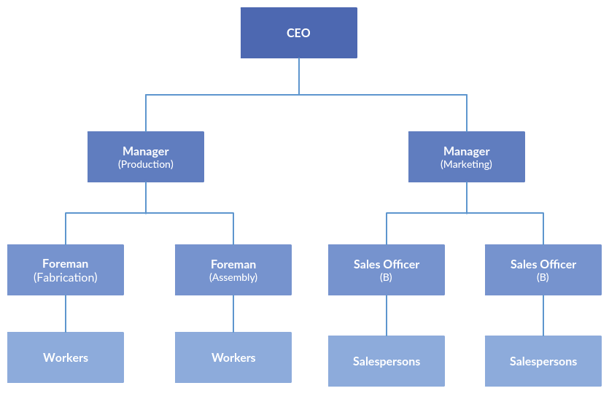

WHO ARE THE END USERS?

Slide 7

OUR SOLUTION AND ITS VALUE PROPOSITION Conditional formatting: missing Filter: remove Formula: performance Pivot: summary Graph: data visualization

Slide 8
Dataset Description EMPLOYEE= KAAGLE 26-FEATURES 9-FEATURES EMPLOYEE ID-NUM NAME-TEXT EMPLOYEE TYPE PERFORMANCE SCORE GENDER- MALE,FEMALE EMPLOYEE RATING-NUM

Slide 9

THE "WOW" IN OUR SOLUTION PERFORMANCE=IFS(Z8>=5,”VERY HIGH”,Z8>=4,”HIGH”,Z8>=3,”MED”,TRUE,”LOW”)
3/21/2024 Annual Review
9

Slide 10
MODELLING
DATA COLLECTION:
1) DOWNLOADED FROM EDUNET DASHBOARD.
2) COLLECTED EMPLOYEE PERFORMANCE SCORE.
FEATURE COLLECTION:
1) IDENTIFIED PERFORMANCE LEVEL
2) TAKEN BLANKS COLUMN
PERFORMANCE LEVEL:
1) IDENTIFIED PERFORMANCE SCORE USING FORMULA
2) IT IS DEFINED BY THE PIVOT TABLE
SUMMARY:
1)DOWNLOADED THE EMPLOYEE DATASET FROM DASHBOARD AND
DELETED THE BLANK COLUMNS.
2)CREATED PERFORMANCE LEVEL BY USING THE FORMULA
3)AND ALSO DEFINED THEM BY PIVOT TABLE.
10

Slide 11
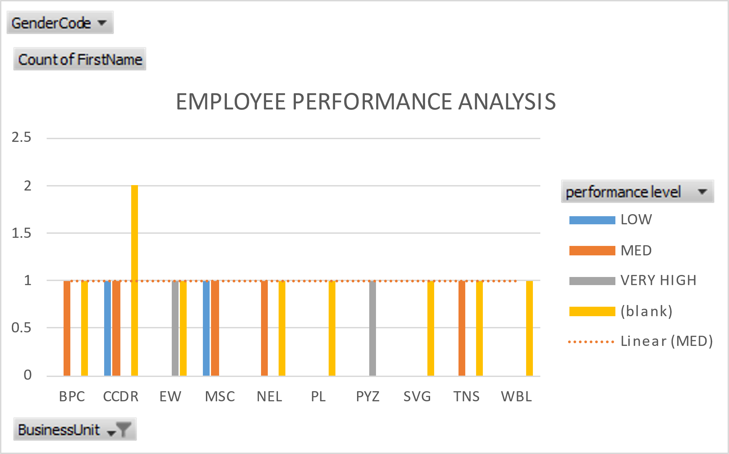
RESULTS
11

Slide 12
Conclusion In this employee dataset, we found that the employee situation by performance score, so in this dataset shows that the organization is doing well all the employees were good at their performance and some of them were needed the improvement so for those employees can give a extra task for them to develop their improvement. So, this will be the conclusion of the employee dataset by using excel.

