Slide 1
Memento Design Pattern
Sojitra Avani Parsotambhai (12008103)
Shekhada Sarika Rasikbhai (12008143)
Guide by : Ajay Parikh

Slide 2
Problem
In a GUI editor (e.g. MS Paint), we can keep making changing to drawing. Then what we do?
Solution
We can Rollback the changes with simple Commands like CTRL + Z.

Slide 3
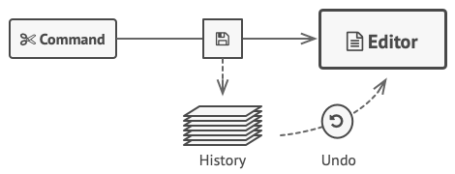
Intent
Memento pattern is used to restore state of an object to a previous state.
Without violating encapsulation, capture and externalize an object's internal state so that the object can be restored to this state later.

Slide 4
Also known as
Snapshot pattern
Motivation
It is sometimes necessary to capture the internal state of an object at some point and have the ability to restore the object to that state later in time.

Slide 5
Applicability
Use the Memento pattern:
A snapshot of an object’s state must be saved so that it can be restored later.
Use the pattern when direct access to the object’s fields/getters/setters violates its encapsulation..

Slide 6
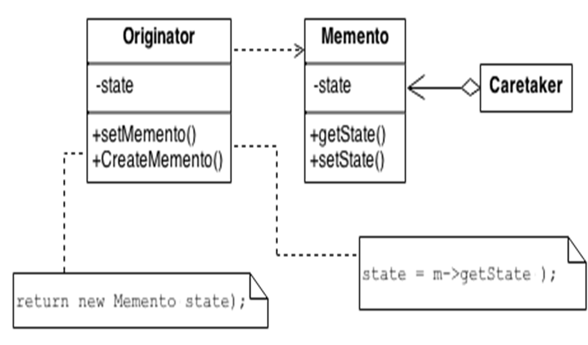
Structure

Slide 7
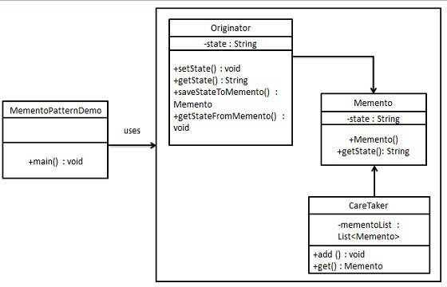
Class Diagram

Slide 8
Participants
Memento
Stores internal state of the Originator object.
a memento must be in immutable object so that no one can change it’s state once created.
the object that is going to maintain the state of originator.

Slide 9
Participants
Originator
Creates a memento containing a snapshot of its current internal state.
Uses the memento to restore its internal state.
CareTaker
Is responsible for the memento’s safekeeping.
it will hold the state of the Originator and ask to restore it when needed.

Slide 10
Collaborations
A caretaker requests a memento from an originator, holds it for a time, and passes it back to the originator.
Sometimes the caretaker won't pass the memento back to the originator, because the originator might never need to revert to an earlier state.

Slide 11
Pros and Cons
You can produce snapshots of the object’s state without violating its encapsulation.
You can simplify the originator’s code by letting the caretaker maintain the history of the originator’s state.
The app might consume lots of RAM if clients create mementos too often.
If Originator object is very huge then Memento object size will also be huge and use a lot of memory.

Slide 12
Questions
Where this pattern is used in real life?
This pattern is also known as_______.
We can restore the previous object . true/false
What is the work of originator?
Which are three class in memento pattern?

Slide 13
****-----THANK YOU -----****

