Slide 1

E-commerce (online shopping) Amazona
Group Member :
Sarika Likhar.
Prajakta Suryawanshi.
Nikhil Tekade.

Slide 2
Introduction
E-commerce definition
About our System

Slide 3
What is E-commerce
Commonly Known as Electronic Marketing.
“it Consist of Buying and selling goods and services over an electronic system such as the internet and other computer networks.”

Slide 4
Our System
Our System is an e-commerce website from where people can buy products online.
Admin monitors the activity of the users and checks the transaction.

Slide 5
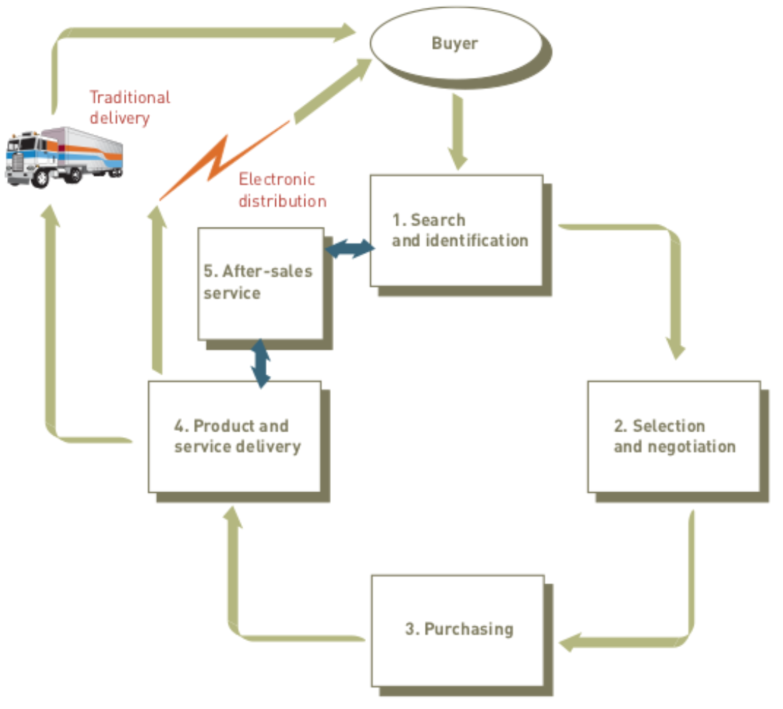
The Process of E-commerce

Slide 6
Features
Menu
Catalog Browsing
Category List.
Product List.
Catalog Management.
Product Browsing
Product review.
Related products.
Shopping Cart.
Checkout.

Slide 7
Languages :
ReactJs
NodeJs
Mongodb
Tools
Vs-code.

Slide 8
Advantage Of E-commerce
Faster buying/selling procedure, as well as easy to find products.
Buying/selling 24/7.
More reach to customers,there is no theoretical geographic limitations.
Low operational costs and better quality of services.
No need of Physical company set-ups.
Easy to start and manage a business.

Slide 9
Disadvantage Of E-commerce
Unable to examine products personally.
Not everyone is connected to the internet.
There is the possibility of credit card number theft.

Slide 10
GUI(Graphical User Interface)

Slide 11
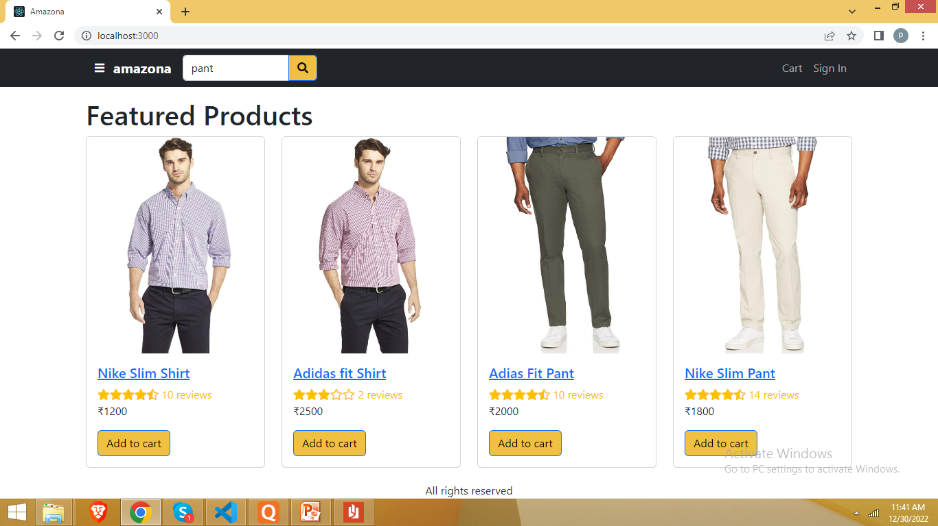
Home Screen

Slide 12
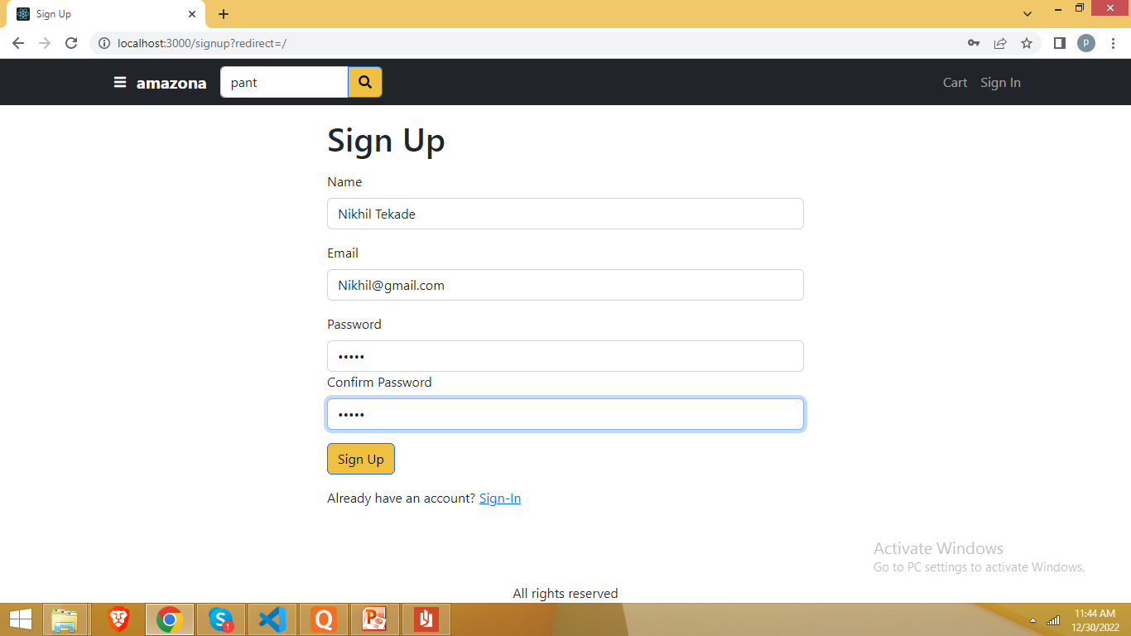
Registration

Slide 13
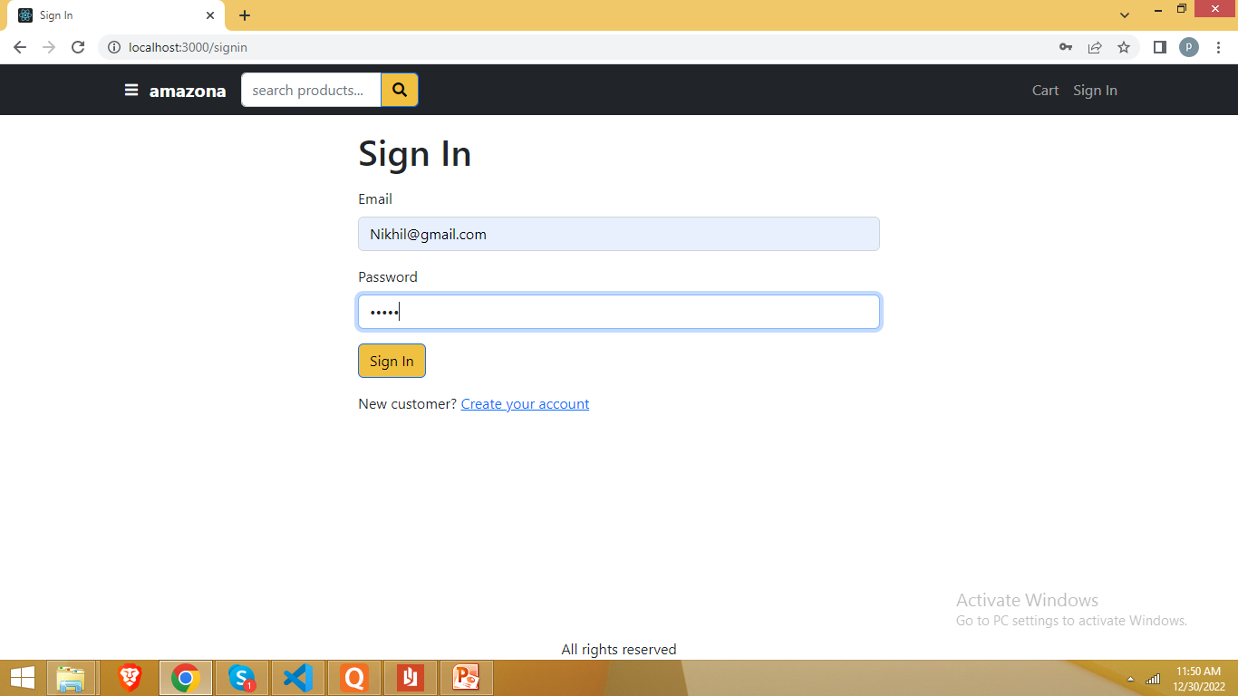
Login

Slide 14
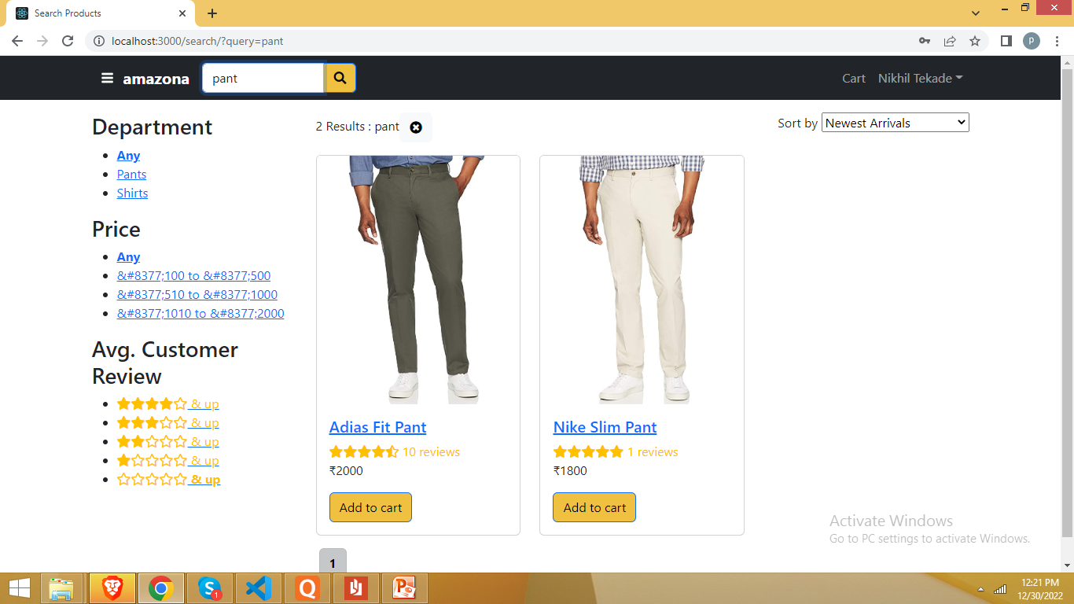
Search Product

Slide 15
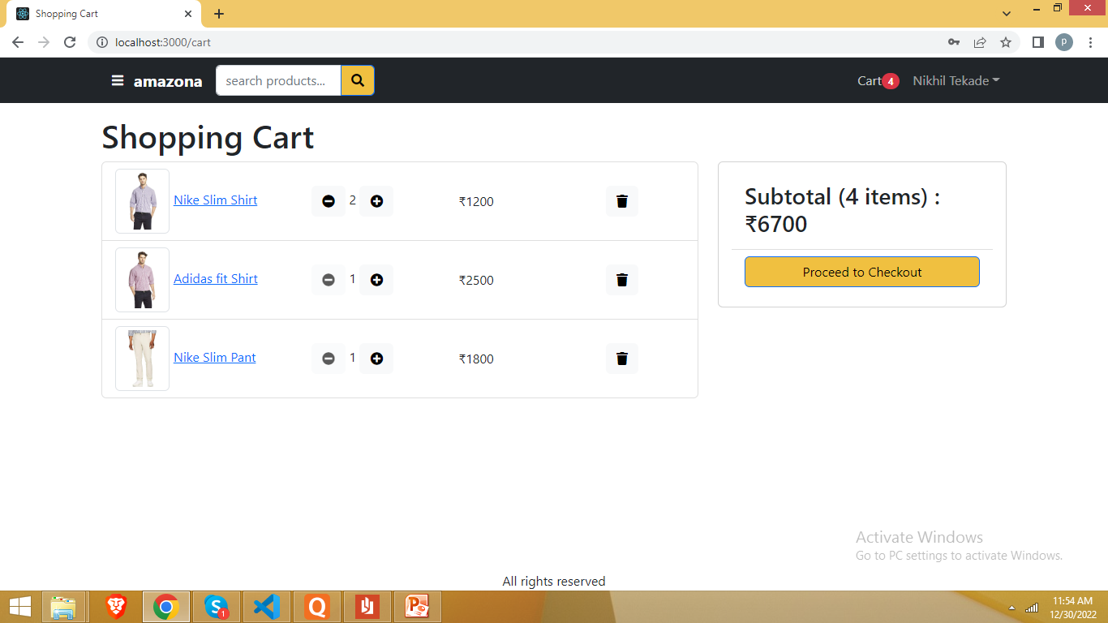
Shopping Cart

Slide 16
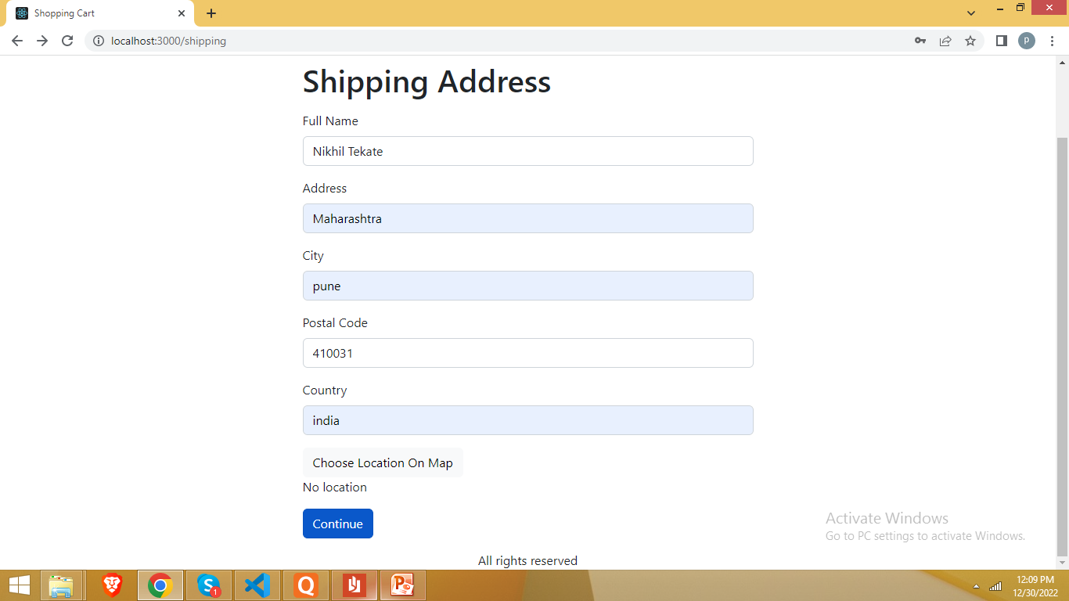
Proceed to CheckOut

Slide 17
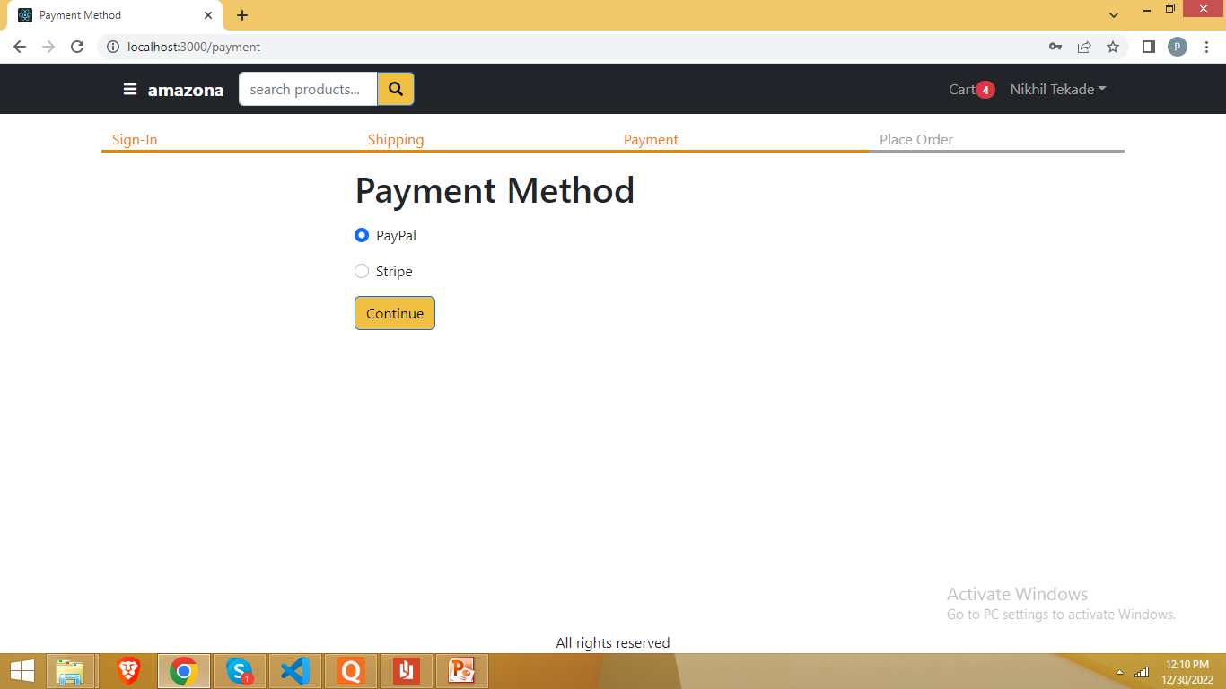
Payment Method

Slide 18
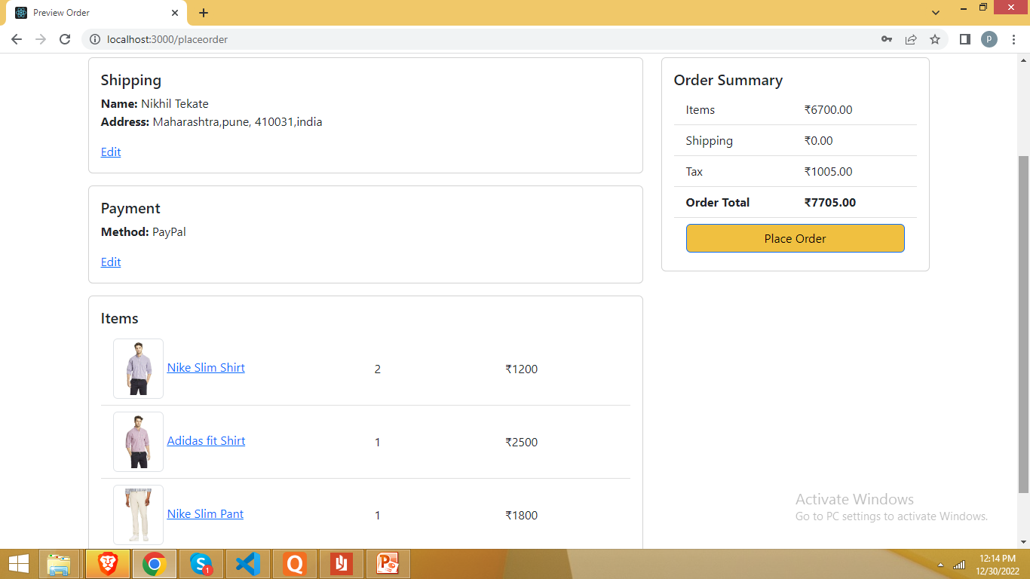
Preview Order

Slide 19
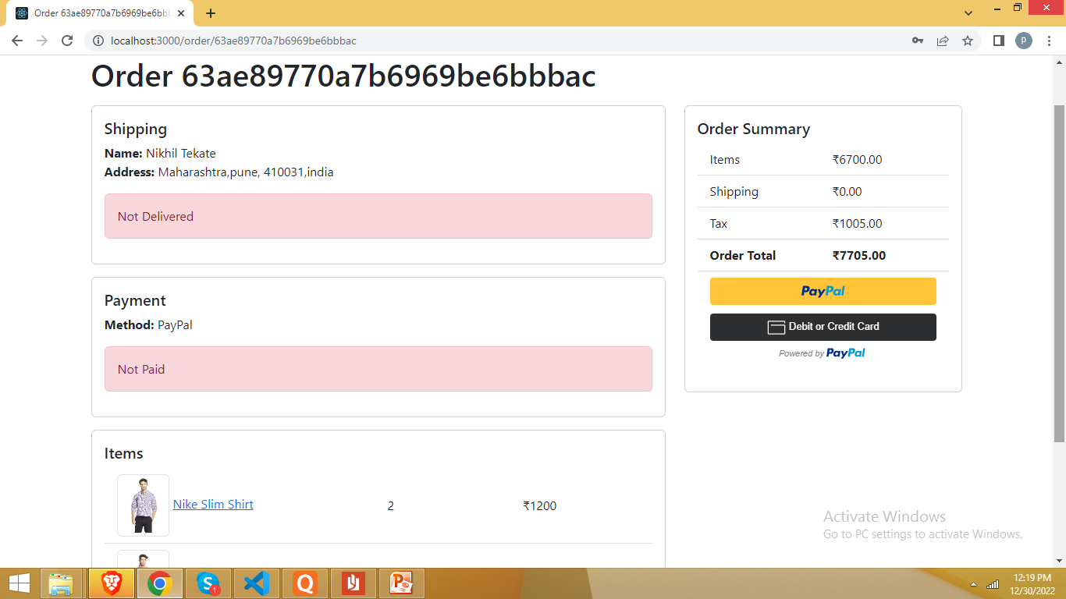
Place Order

Slide 20
Thank You

