Slide 1

WELCOME TO BIOL/STAT 2244A

Slide 2
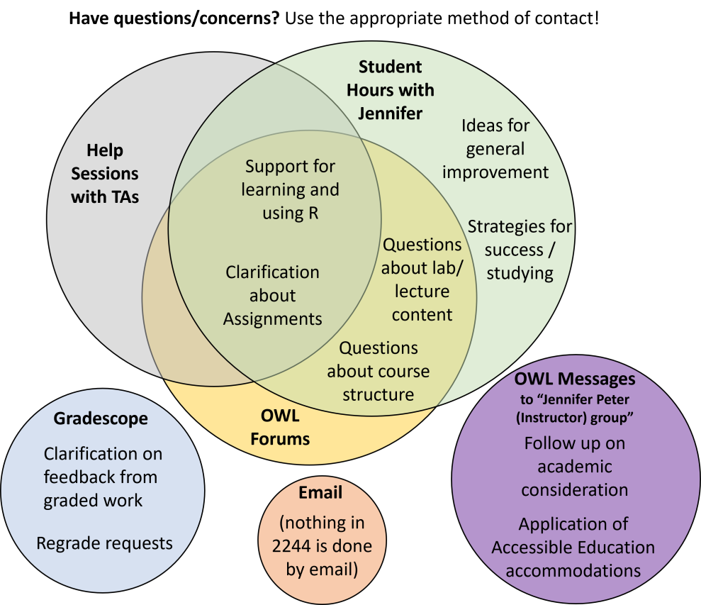
Welcome to 2244!
Jennifer Peter
Forums or “in-person” for
pretty much everything
OWL Messages for accommodations and academic considerations
Please complete the OWL Polls to determine best time(s) for help sessions

Slide 3
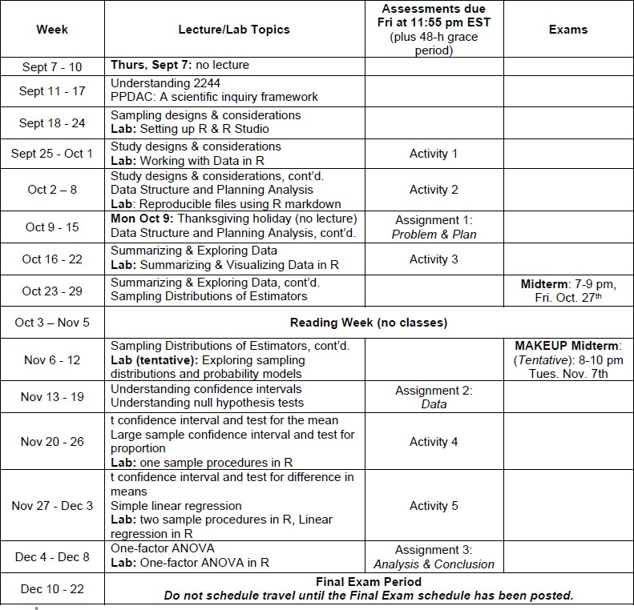
Schedule of ‘events’ (syllabus, p. 5)
all ‘work’ due by 11:55 pm EST on Fridays + 48-h grace period
make-up midterm date is confirmed
Final exam timetable should be released on Oct. 10

Slide 4
About the labs…
‘online’ and roughly weekly; complete on your own time
  weekly drop-in “R help sessions” with TAs
  questions to the Forums or talk with me
no grades associated with “doing” the lab
grading of lab ‘skills’ via Activities, Assignments,
Exams
don’t make detailed notes; don’t memorize.

Slide 5



Grade distributions (syllabus, p. 6)
Your final grade is calculated to give you the highest mark possible

Slide 6
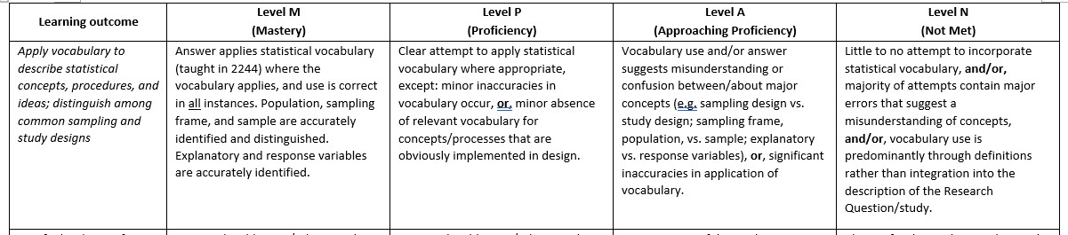
Essential Requirements
To be eligible to earn at least 50% in 2244, you must…
earn at least 20% on the Assignments (p. 7)
  complete all 3 Assignments
  earn at least 5 ‘level P’ for assignment outcomes
  earn no more than 2 ‘level N’ for assignment outcomes
earn at least 40% on Final Exam
Example: partial Assignment rubric

Slide 7
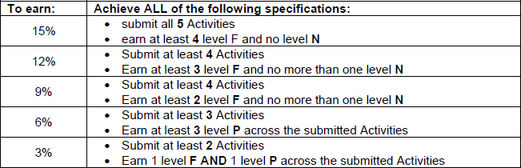
Activities (syllabus p. 8 & 9)
Short homework activities for motivation and feedback
5 Activities, mix of question types
estimate 30-60 min, on average, IF you are keeping up with the course
graded as Full credit / Partial credit / No credit

Slide 8
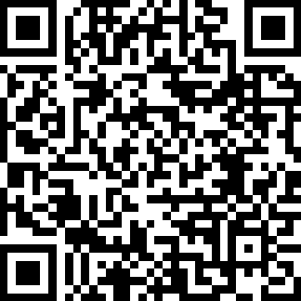
Academic considerations
Please, please, please read syllabus pp. 10-11
48-h grace period on Assignments & Activities
  no questions asked, no need to ask permission, no late penalties
  can use for as Assignments/Activities as needed
ALL OTHER requests go to Faculty Academic Counseling, such as:
midterm/final exam conflicts & absences
extensions beyond the 48-h grace period
For Science Academic Counseling:
Don’t wait for confirmation of consideration from Academic Counseling before submitting. SUBMIT when ready to the ‘Late Submissions’ on OWL Assignments.

Slide 9
Your ‘homework’
Complete the ‘polls’ on OWL by Wednesday
Review information on OWL:
  Course content/Understanding 2244
  Course content/course syllabus & AI policy
Post your questions to the OWL Forums

