Slide 1
Project Presentation
IFT 598 – Managing the Cloud
Vipul Sarin Dhruvrajsinh Parmar Roy Sofiov

Slide 2
Agenda
Project Summary
Project Environment
Getting the Data
Hadoop Workflow
Uploading data to HDFS
MapReduce Configuration and Code
Enter the Cloud
Screenshots and Output

Slide 3
Project Summary
Analyze the popularity and public visibility of the leading candidates for the Presidential election 2016, utilizing real time data from Twitter.
The analysis employed a distributed data processing system known as Apache Hadoop using several EC2 instances on Amazon Web Services
The entire project is on Github and can be accessed at https://github.com/VipulSarin/IFT_Twitter_Hadoop

Slide 4



Project Environment

Slide 5
Getting the data
Twitter provides a streaming API to stream real time twitter data.
A Python library – Tweepy was utilized to access the Streaming API and download the twitter data.
This filter is based on a list of keywords supplied in the Python code.

Slide 6
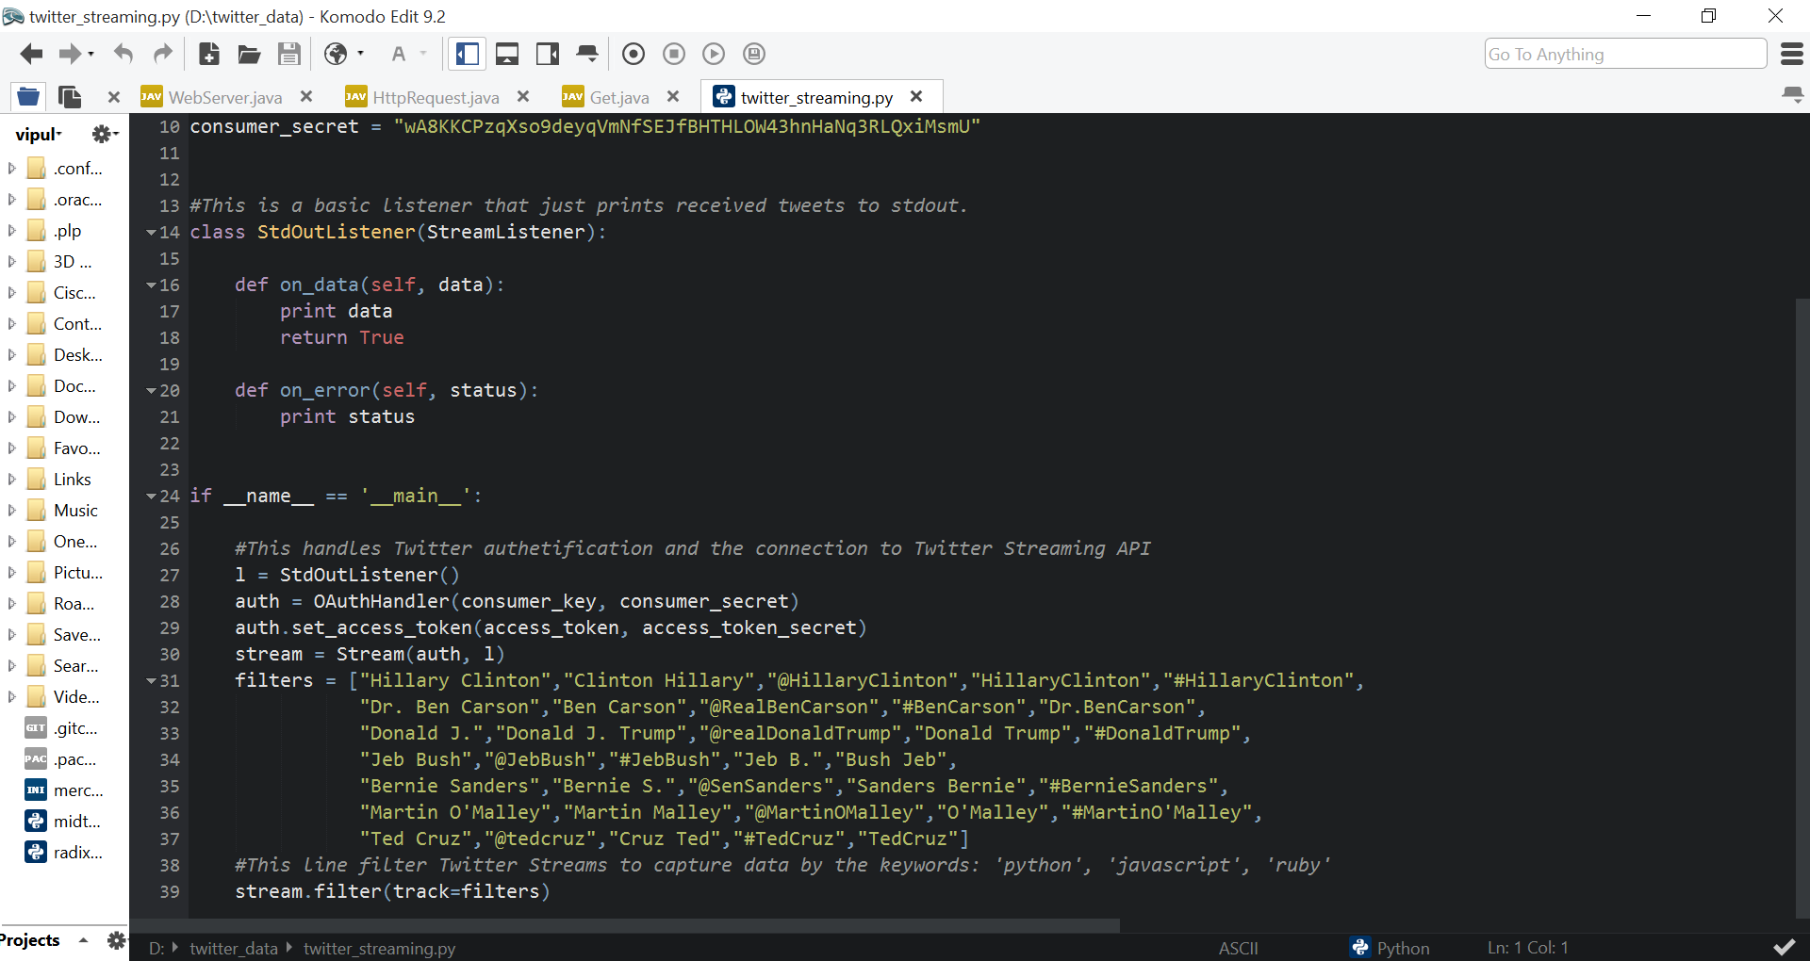
Getting the data

Slide 7
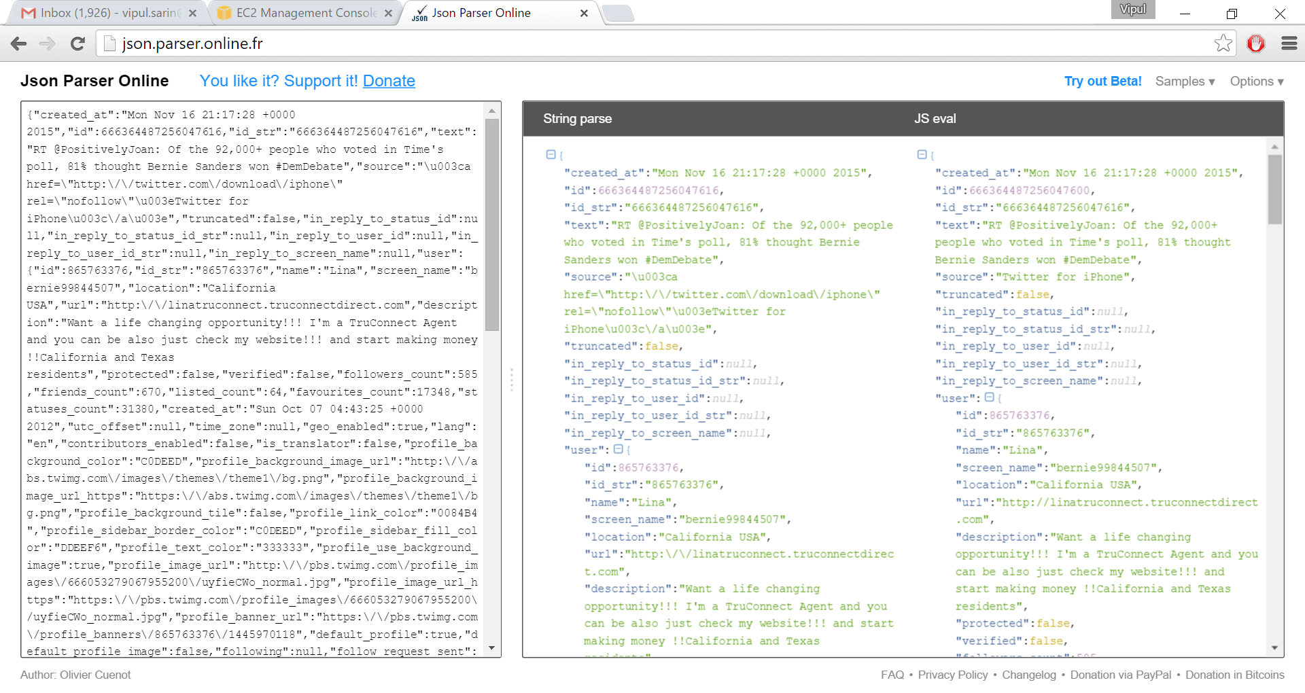
Getting the Data

Slide 8
Hadoop Workflow
HDFS Input
Mapper
Shuffle Mapper Output (Reduce by Key)
HDFS Output
Reducer

Slide 9
Uploading data to HDFS
The input file contains JSON objects for each tweet.
This file is uploaded to HDFS directory on the EC2 instances.
HDFS replicates the data (replication factor – 3) and distributes it to multiple nodes
The mapper takes as input all files present in the directory specified on the HDFS. (/project/input/*)

Slide 10
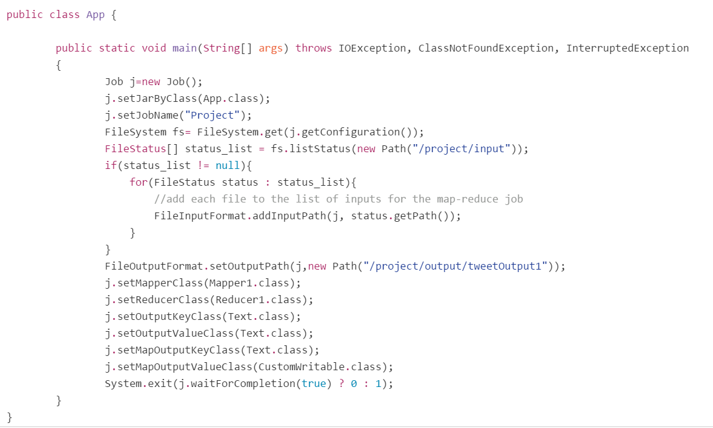
MapReduce Configuration

Slide 11
Mapper
Mapper calls the map method for each tweet object.
A Java Library -Twitter4j, is used to parse these objects.
The status string keywords are mapped against each candidate and attributes are extracted.
These are serialized using a Custom writable class and written to the output
The output is a key-value pair with the key being the candidate name and the value being the Twitter Object.

Slide 12
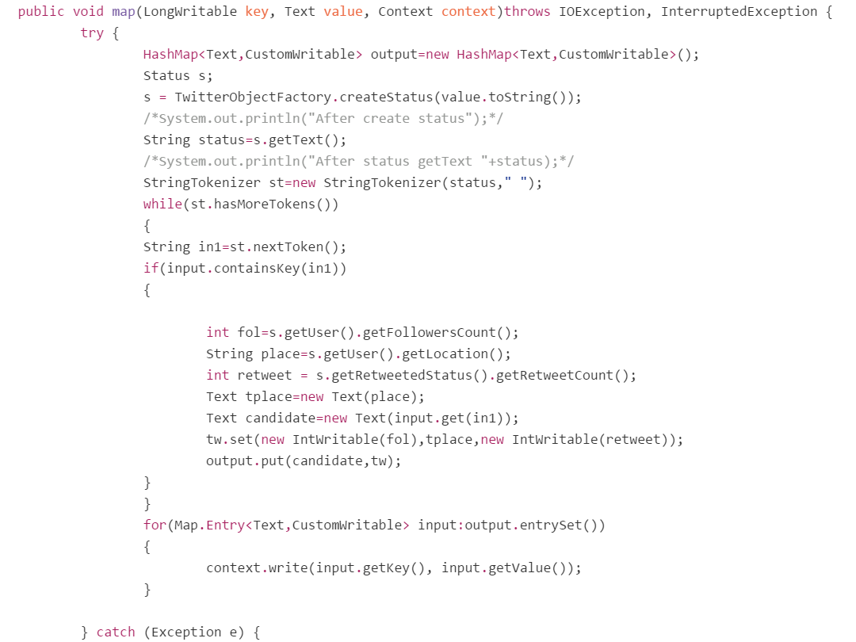
Mapper

Slide 13
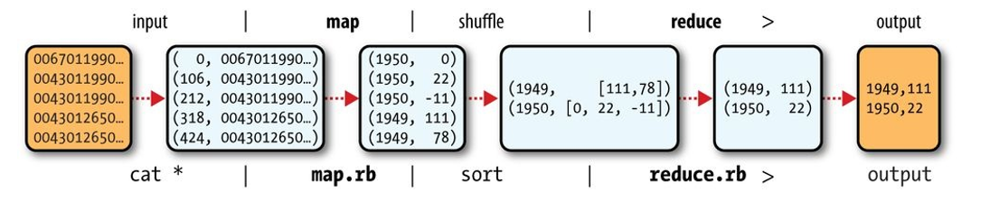
MapReduce - Shuffle

Slide 14
Reducer
Hadoop shuffles and combines the output corresponding to each key i.e. Candidate key.
Reduced reads this output and performs quantitative analysis for each attribute.
These counts are written to the output file and stored in the HDFS.

Slide 15
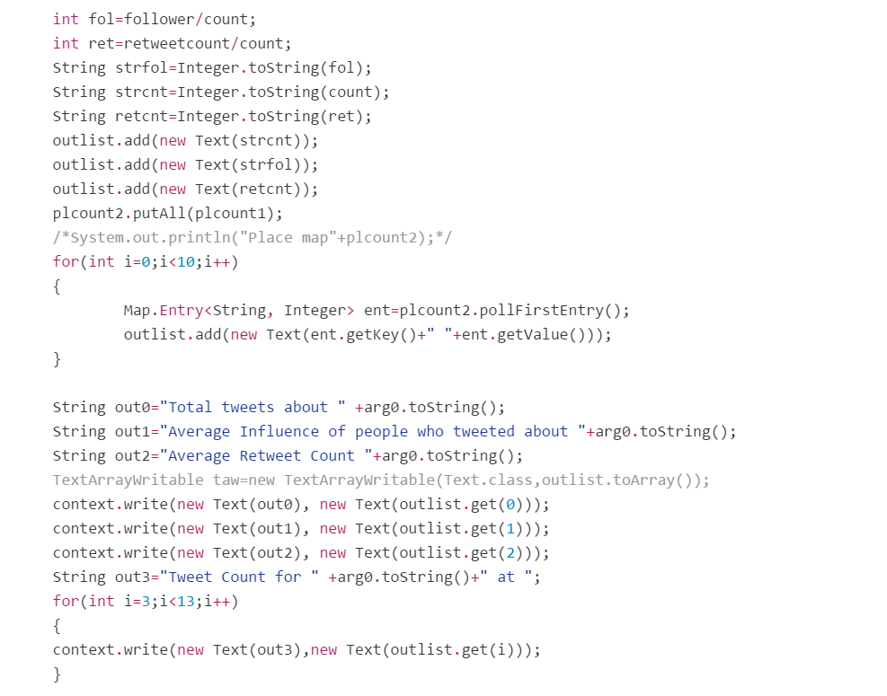
Reducer

Slide 16
Enter the Cloud
Four Amazon Web Services EC2 instances are created - t2.micro
One instance is configured as the Namenode and three others as Datanodes.
The configuration defines connections, security permissions and responsibilities for each node.

Slide 17
Infrastructure as a Service
We selected basic t2.micro instances and installed Hadoop on it.
We also configured SSH to allow connection between nodes.
Java installed on all nodes to run the MapReduce code.

Slide 18
Distributed Advantage
HDFS stores data across multiple datanodes i.e. multiple instances. This provides redundancy of data.
Mapper works on this distributed data as assigned by the Namenode.
The Namenode acts as a controller.
Thus combination of Hadoop and AWS empowers speedy processing of large chunks of data.
The system can be scaled to hundreds of nodes

Slide 19
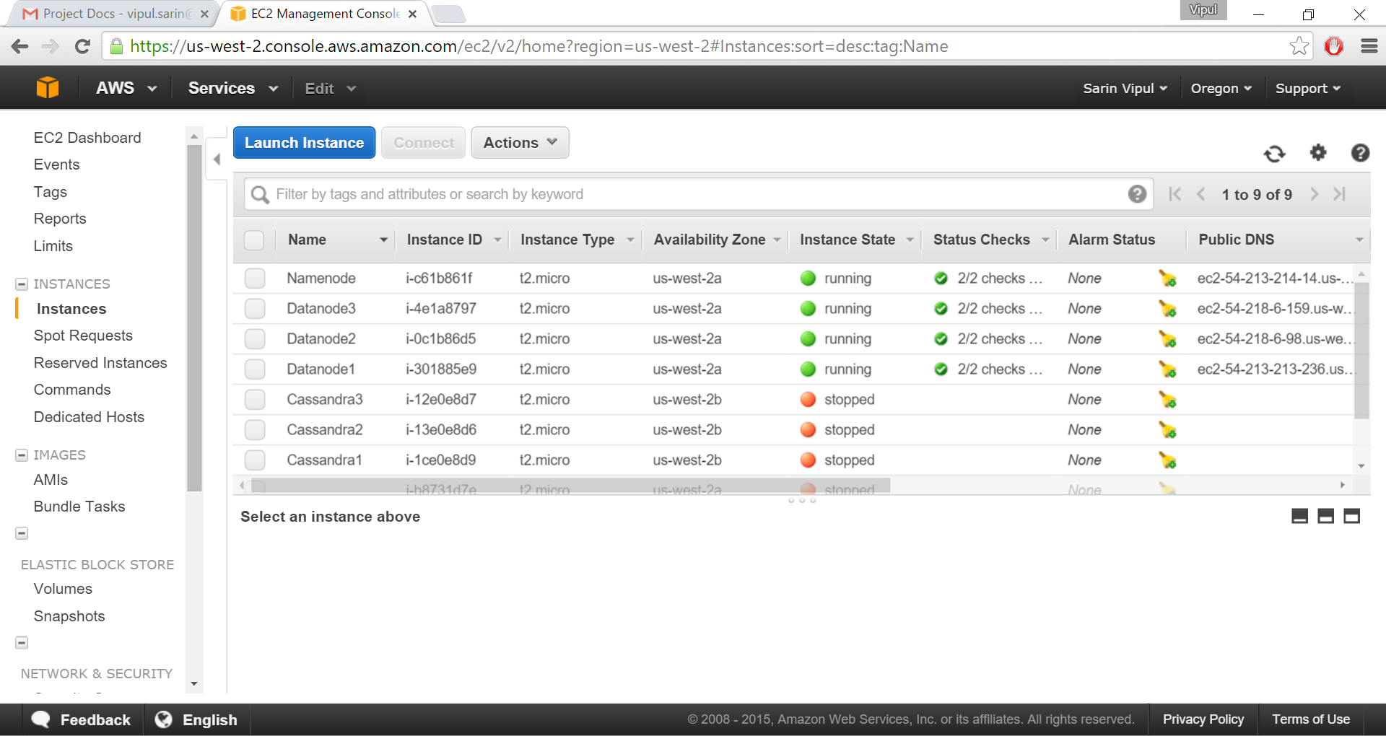
EC2 Instances

Slide 20
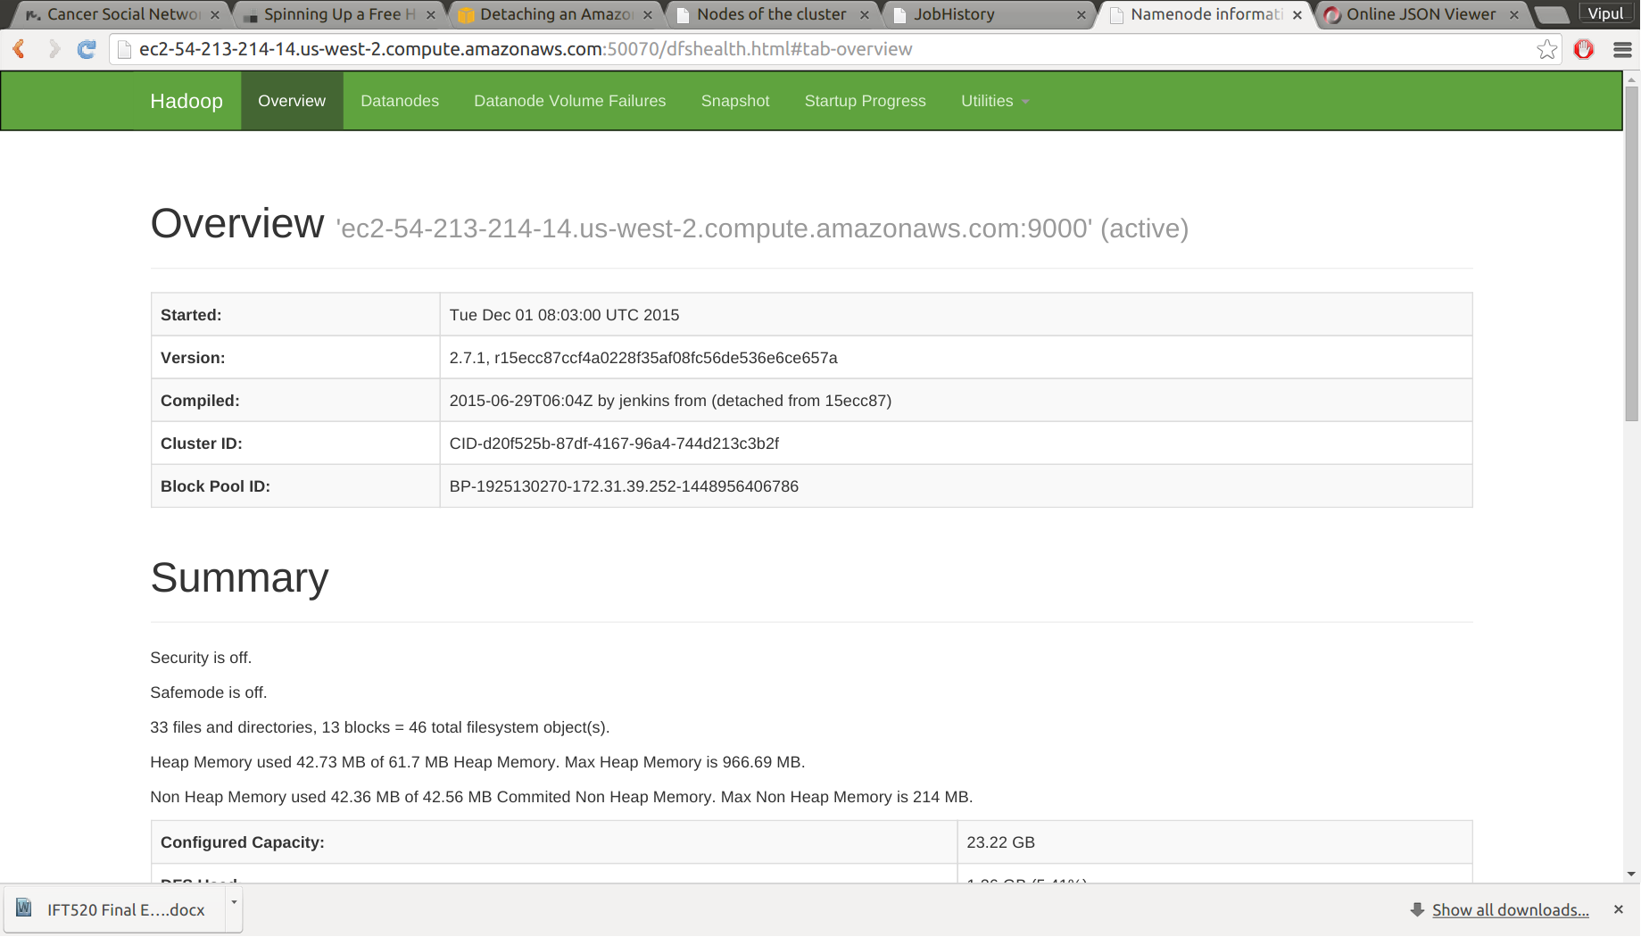
Hadoop Overview

Slide 21
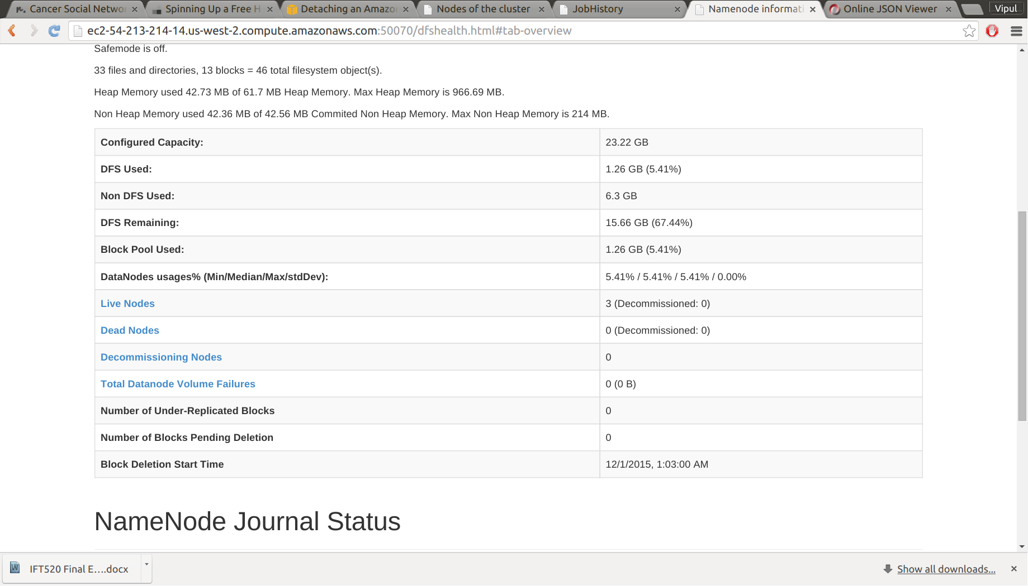
Hadoop Instance Details

Slide 22
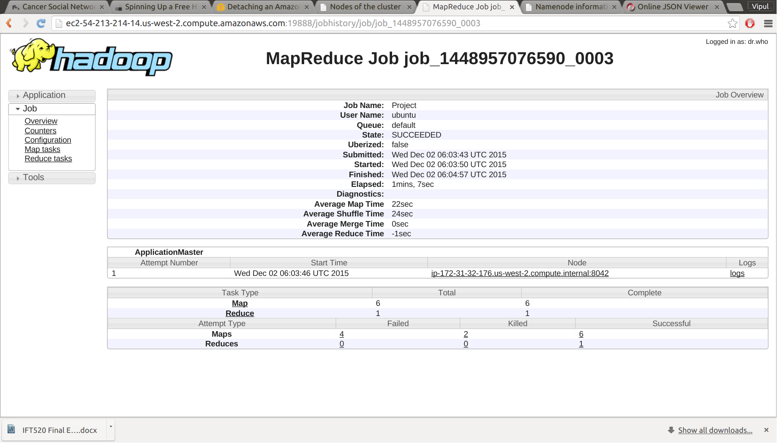
MapReduce Job

Slide 23
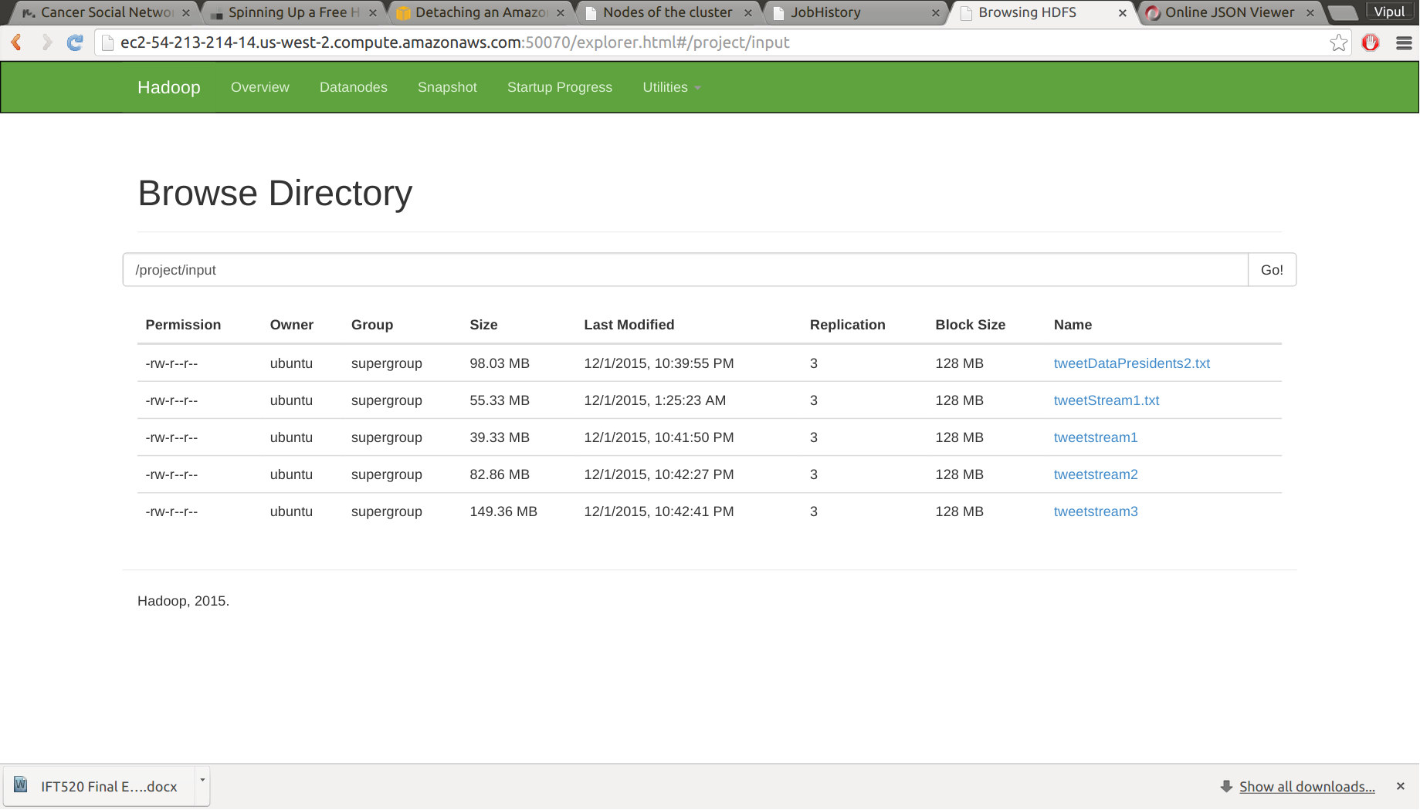
HDFS – Input Directory

Slide 24
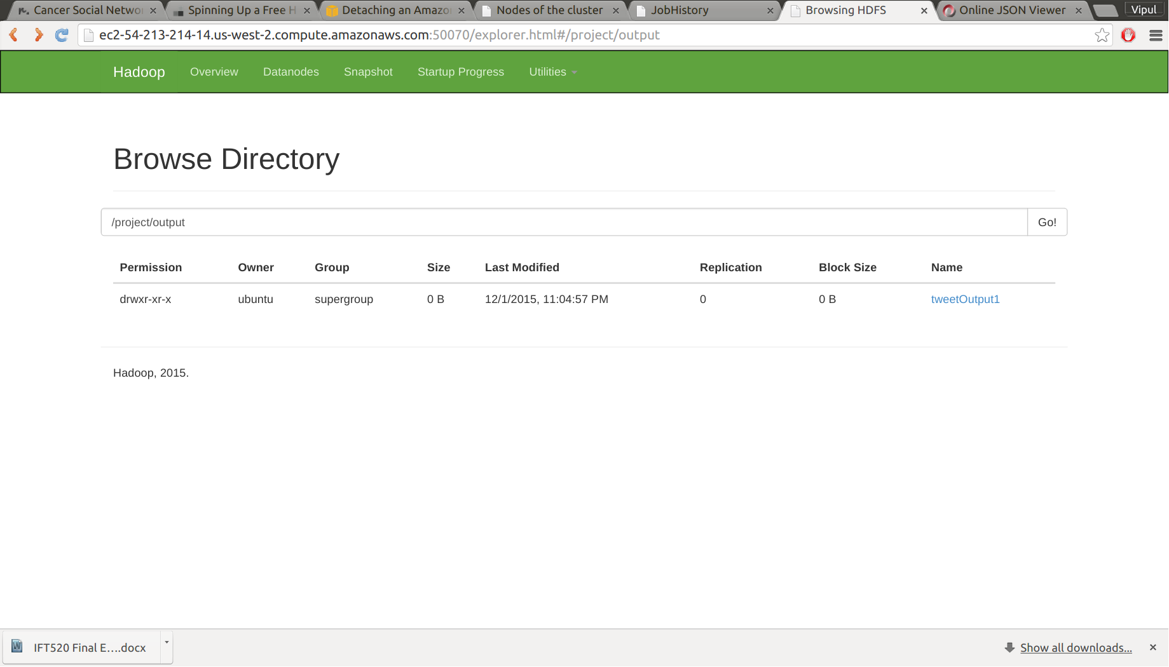
HDFS - Output Directory

Slide 25
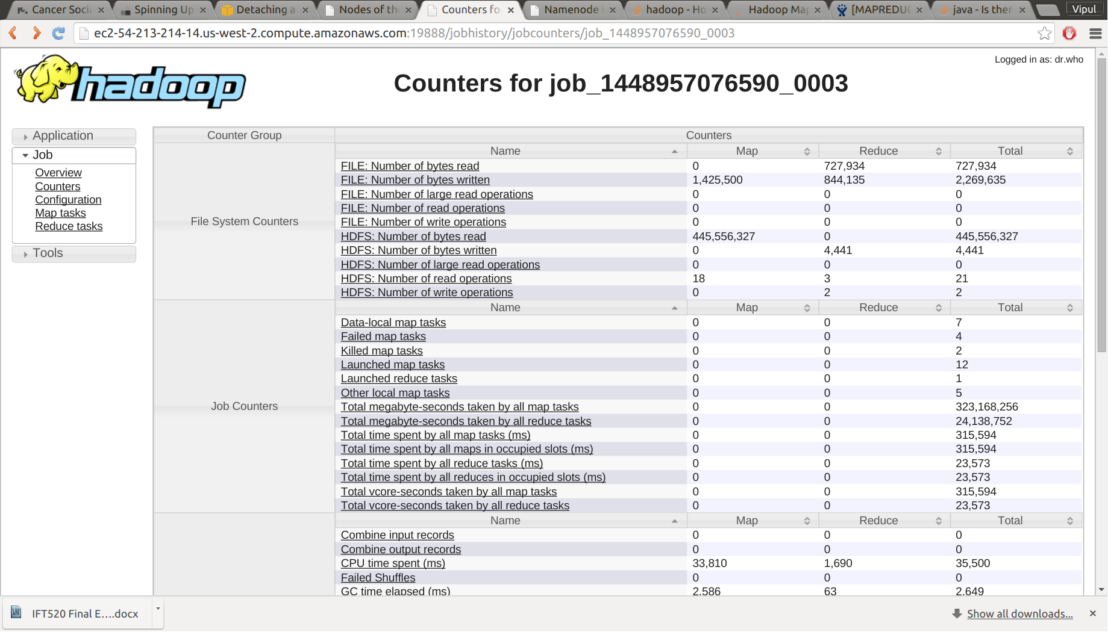
Hadoop Job Counters

Slide 26
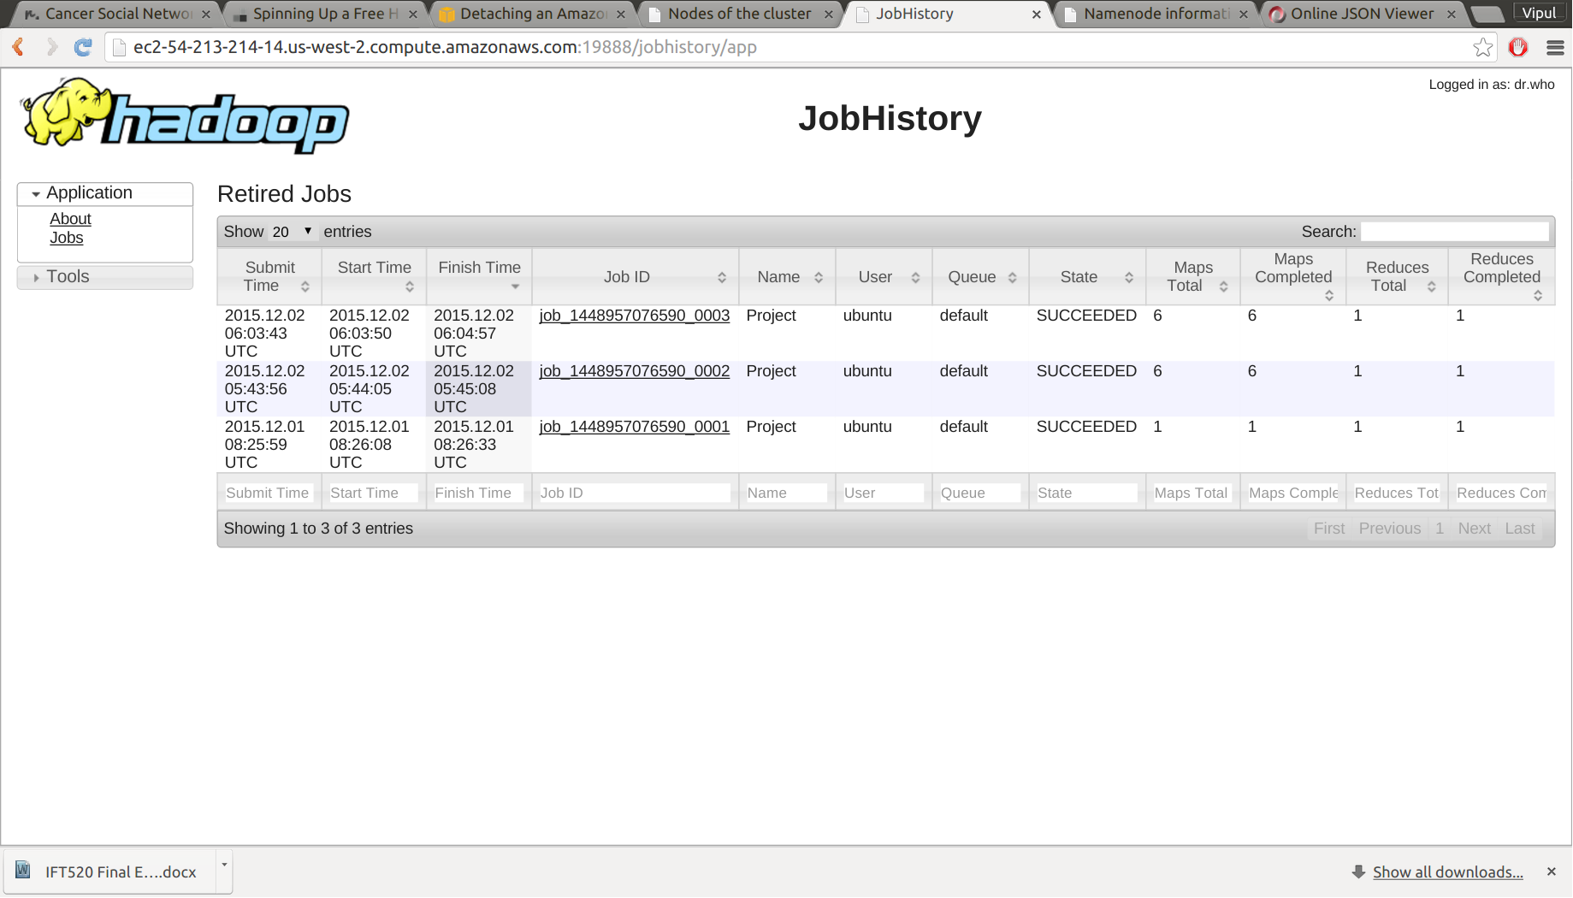
MapReduce Job History

Slide 27
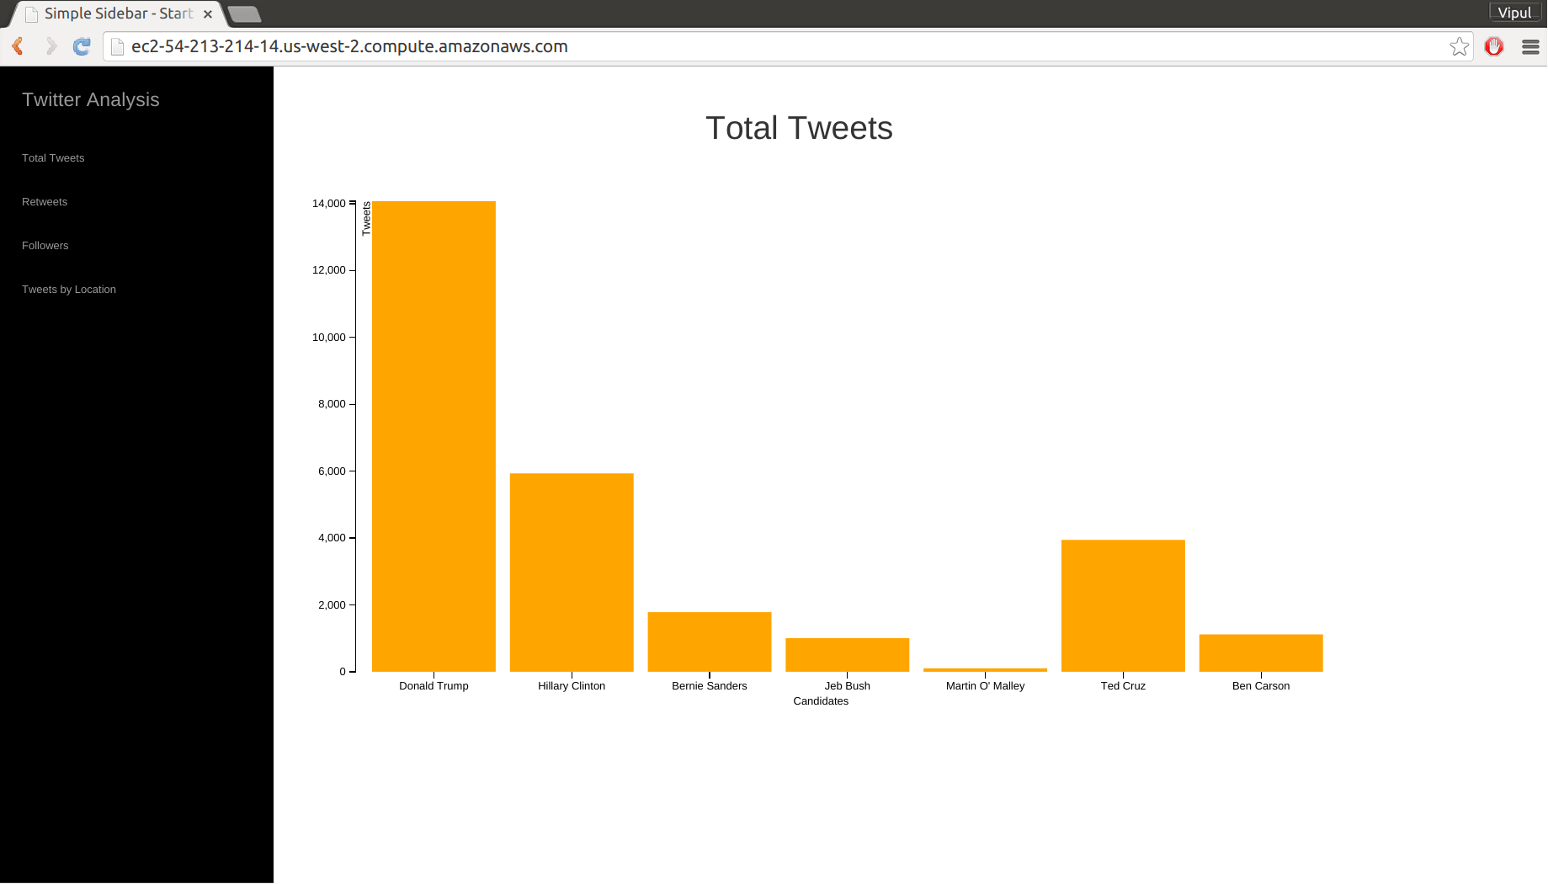
Total Tweet Count

Slide 28
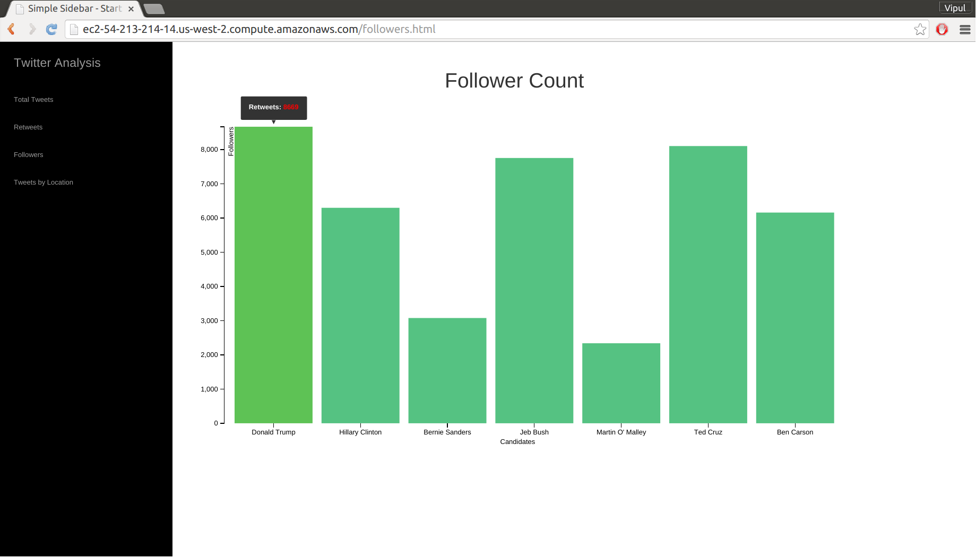
Follower Count

Slide 29
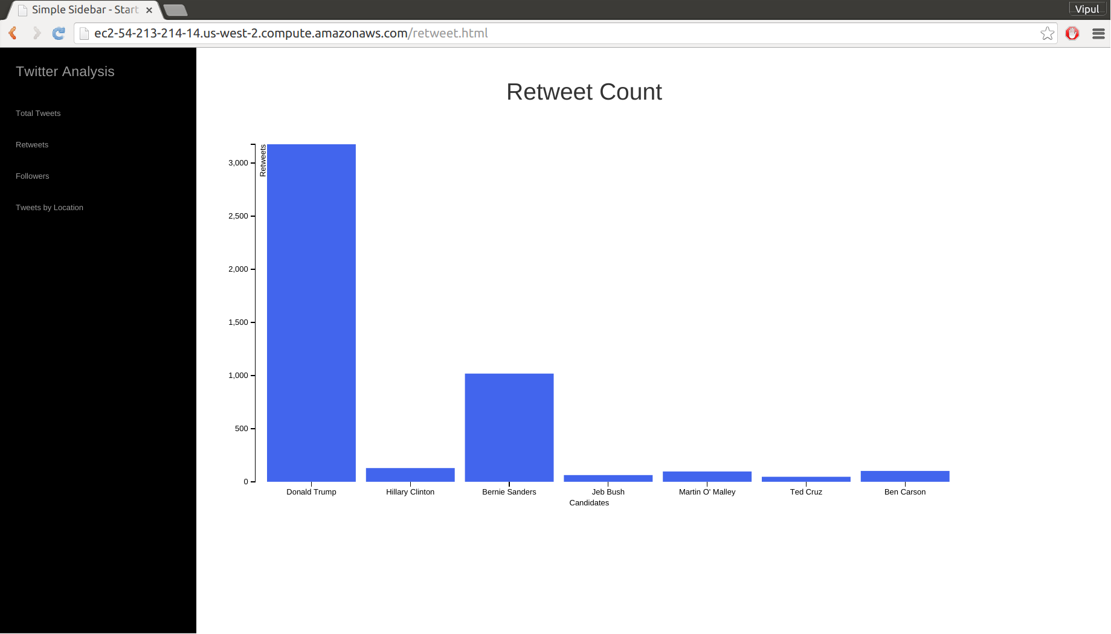
Retweet Count

Slide 30
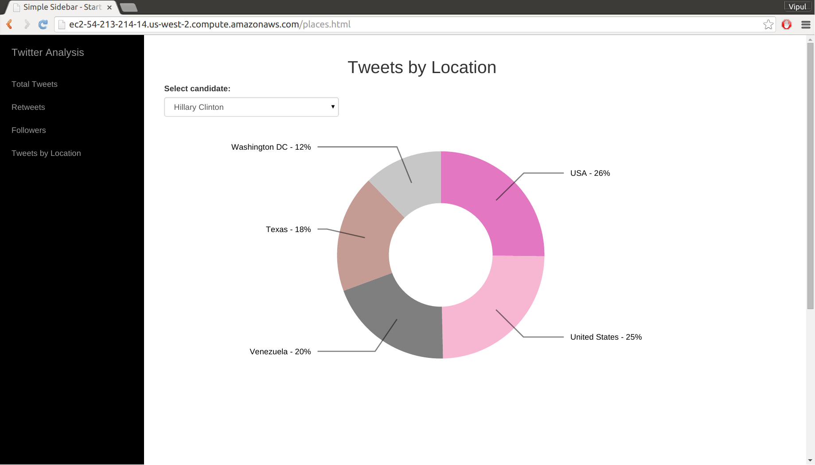
Tweets by Location

Slide 31
References
www.stackoverflow.com
Hadoop the Definitive Guide by Tom White
http://insightdataengineering.com/blog/hadoopdevops/

