Slide 1
Text Analytics Of
Women E-Clothing Reviews
SHU YANG / YUJIE CHENG / SHUANGJIE MA / CHI WANG / YIHAN BAO

Slide 2
Business Goal Analytics
What is done now to address the goal?
Text mining has emerged recently because of the digital age has resulted in a host of new information that online retailers can use to improve their marketing efforts.
Text mining solutions are used to analyze digitized text from different written sources and media platforms to identify patterns and trends on brand affinity, products preferences, consumption patterns and more.

Slide 3
Why is text analytics needed?
Almost 61% of the customers read online reviews before making a purchase decision.
What can it potentially achieve?
Find out the key features that customers care most
Building a model for sentiment analysis especially for women clothes industry
Pulling out key features the customer mentioned in both positive and negative comments.

Slide 4
Executive Summary
Customer reviews now become really valuable datasets that could let company get the feedbacks for their products and drive business growth. This project is to do text analytics of women’s E-Commerce clothing reviews to gain information from data. And this text mining method has been used in the retail industry by identifying customer purchase patterns and opinions on particular products, which we will talk about the clothing industry in our project.
This project would use Women's E-Commerce Clothing Reviews dataset to do the analysis, aiming at finding out the key features that customers care most, building a model for sentiment analysis especially for women clothes industry and pulling out key features the customer mentioned in both positive and negative comments.

Slide 5
Data Description
Data Source:
Women’s Clothing E-commerce dataset revolving around the reviews will be selected as our raw datasets from Kaggle website.
Data Size:
The datasets include 23486 rows and 10 feature variables. And Each row corresponds to a customer review. And the ten features include Clothing ID, Age, Title, Review Text, Rating, Recommended IND, Positive Feedback Count, Division Name and Class Name.
Data Type:
Categorical variable, binary variable, string variable and integer variable.

Slide 6
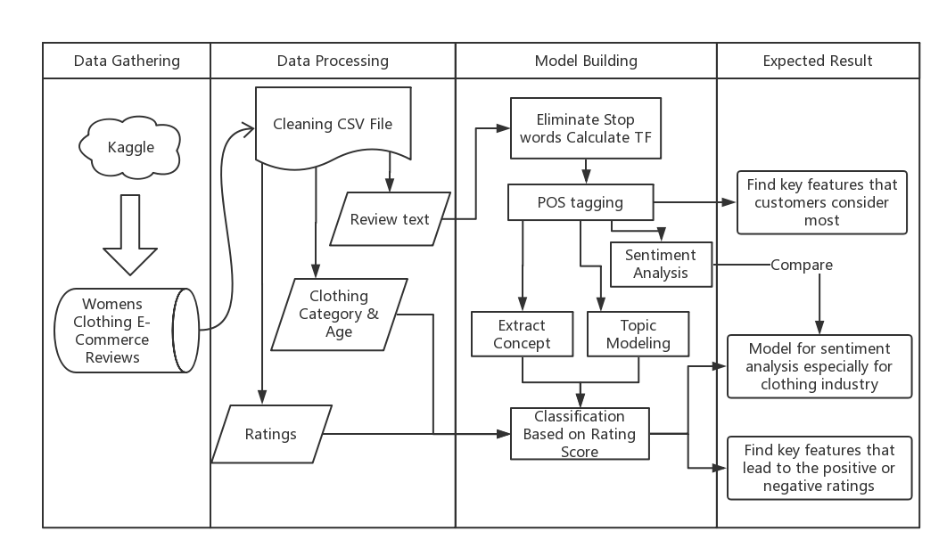
System Design

Slide 7
Word Frequency Analysis
NLTK's list of stopwords
1 | i
2 | me
3 | my
4 | myself
5 | we
6 | our
7 | ours
8 | ourselves
9 | you
10 | your
11 | yours
12 | yourself
13 | yourselves
14 | he
15 | him
16 | ……
Our list of stopwords
1 | im
2 | would
3 | one
4 | bit
5 | bought
6 | much
7 | also
8 | got
9 | think
10 | medium
11 | even
12 | get
13 | could
14 | way
15 | made
16 | ……
We remove the words that don’t make sense by twice.
Use NLTK’s list of stopwords to remove the meaningless words.
Use our own list of stopwords to remove the words that we consider useless.
Notes:
So next we would talk about the analysis. The first part of analysis we do is count word frequency. Before we do that, we remove the words that don’t make sense

Slide 8
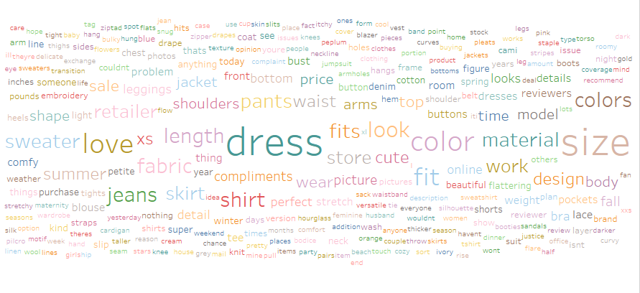
Word Frequency Analysis
[('dress', 10137),
('size', 8416),
('love', 7734),
('top', 7098),
('fit', 7040),
('like', 6886),
('wear', 6318),
('great', 5587),
('fabric', 4685),
('small', 4389),
('color', 4380),
('look', 3928),
('really', 3810),
('little', 3757),
('ordered', 3748),
('perfect', 3481),
('flattering', 3312),
('soft', 3213),
('well', 3009),
('comfortable', 2881),
('nice', 2870),
('looks', 2812),
('fits', 2790),
('back', 2787),
('cute', 2774),
('large', 2706),
('material', 2675),
('beautiful', 2640),
('length', 2538),
('shirt', 2465)]
Dress is the most frequent word that are mentioned in the reviews, this demonstrate that dresses have huge market demands.
Customers care about the overall look more, they mentioned ‘look’, ‘fit’, ‘nice’, ‘cute’, ‘beautiful’, ‘perfect’, ‘flattering’, they want the clothes look good and fits well.
Customer also care about the materials and whether is it comfortable. They mentioned ‘fabric’, ‘soft’, ‘comfortable’, ‘material’ in their reviews.

Slide 9
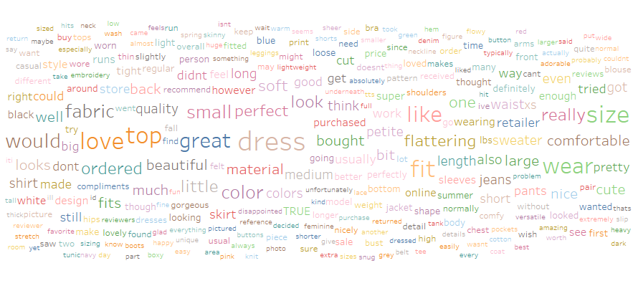
Word Frequency Analysis
[(('size', 'NN'), 8416),
(('dress', 'NN'), 8219),
(('color', 'NN'), 4183),
(('love', 'NN'), 3586),
(('fit', 'NN'), 3010),
(('look', 'NN'), 2551),
(('colors', 'NNS'), 2174),
(('jeans', 'NNS'), 2173),
(('length', 'NN'), 2053),
(('fabric', 'NN'), 2036),
(('shirt', 'NN'), 2026),
(('fits', 'NNS'), 1970),
(('material', 'NN'), 1936),
(('sweater', 'NN'), 1881),
(('pants', 'NNS'), 1774),
(('work', 'NN'), 1675),
(('store', 'NN'), 1668),
(('retailer', 'NN'), 1667),
(('skirt', 'NN'), 1535),
(('cute', 'NN'), 1457),
(('waist', 'NN'), 1422),
(('design', 'NN'), 1340),
(('summer', 'NN'), 1313),
(('top', 'NN'), 1259),
(('wear', 'NN'), 1252),
(('sale', 'NN'), 1175),
(('price', 'NN'), 1092),
(('jacket', 'NN'), 1076),
(('model', 'NN'), 1070),
(('time', 'NN'), 1047)]
The most popular types among women customers are dress, jeans, shirt, skirts, sweater, pants, skirt, jacket.
Women care about fashion and design, including color, length and waist design.
Women customers care about prices and sales. This means pricing and sale strategies are very appealing to women customers.

Slide 10
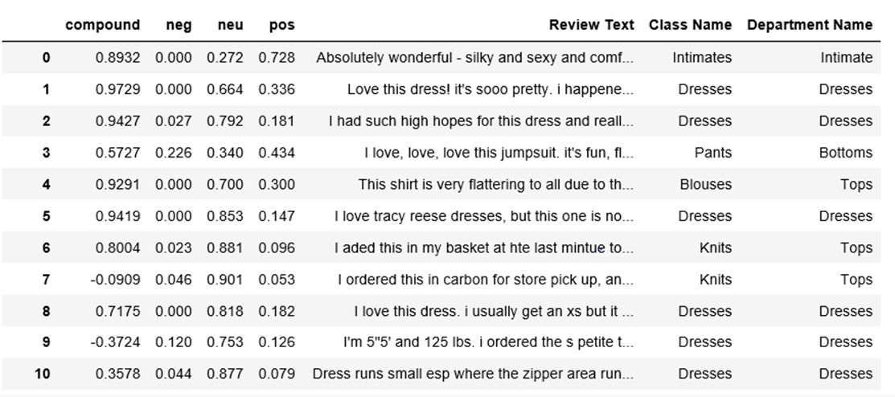
Sentiment Analysis

Slide 11
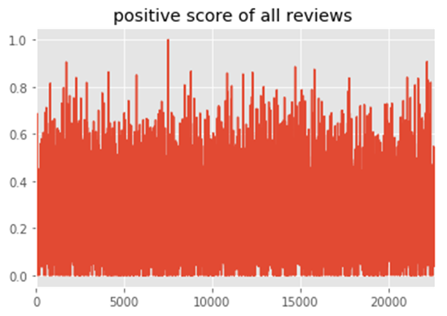
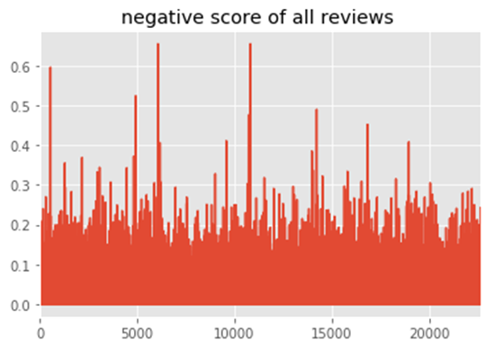

Output Visualization

Slide 12
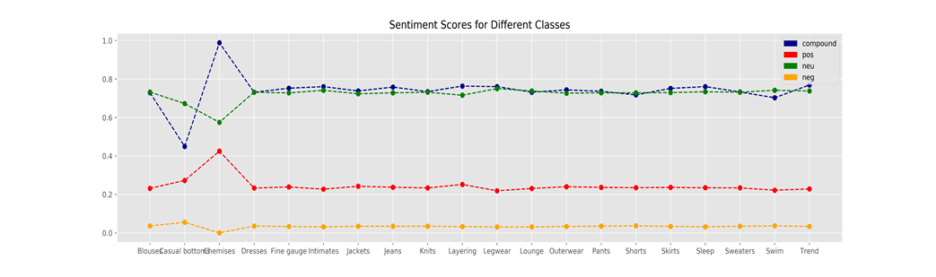
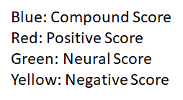
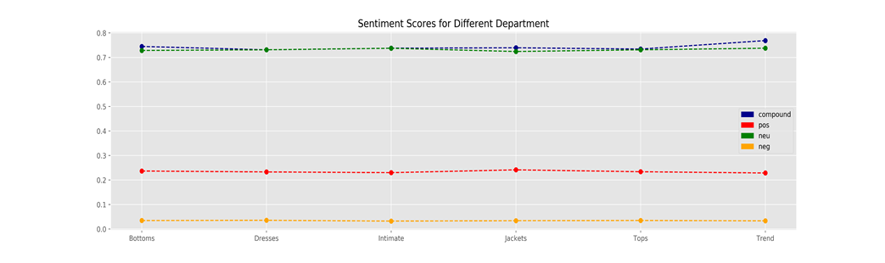
Average Sentiment Scores Visualization

Slide 13
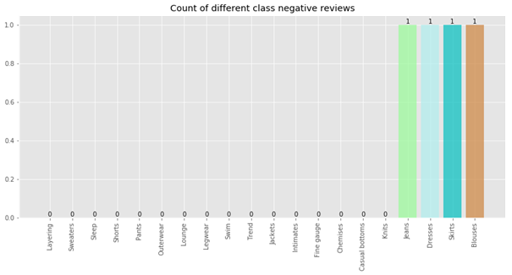
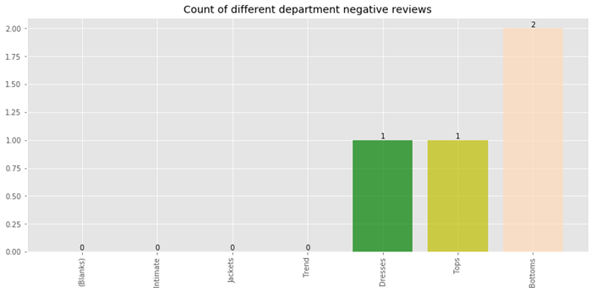
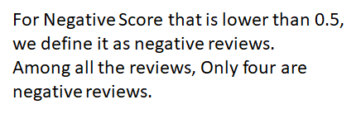
Count of Negative Reviews

Slide 14
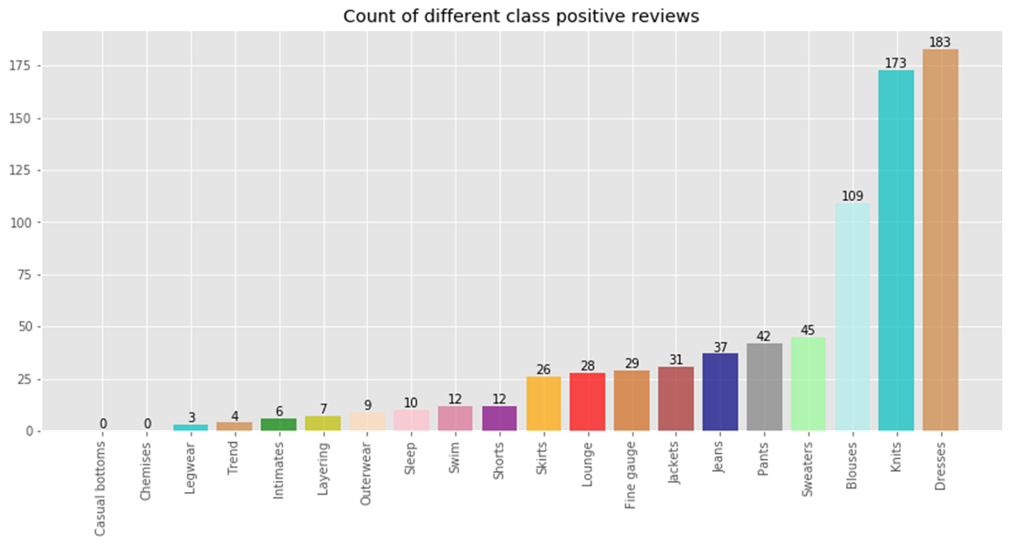
Count of Positive Reviews-Different Class

Slide 15
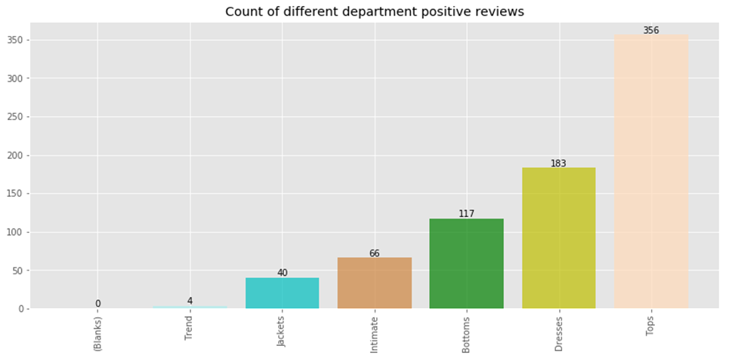
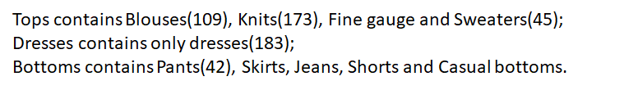
Count of Positive Reviews
–Different Department

Slide 16
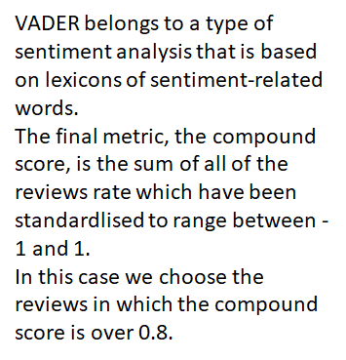
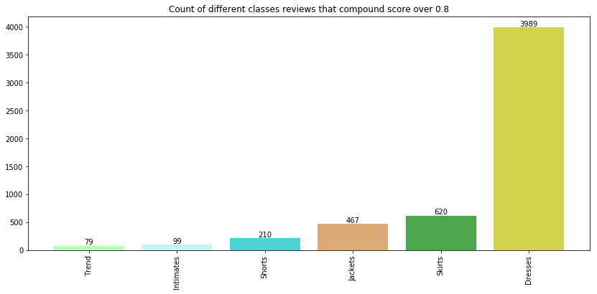
Using Vader to Do Sentiment Analysis
-Compound Score Analysis

Slide 17
SPSS Model Overview
Average Rating for the Review
rating = 5 → Positive Reviews
rating < 5 → Negative Reviews
4.2
Model Target
The first step is concept extraction. Then set the review type as the target, all concepts as the input to build models, trying to predict whether a review is positive or negative according to the concepts.
55.9% positive

Slide 18
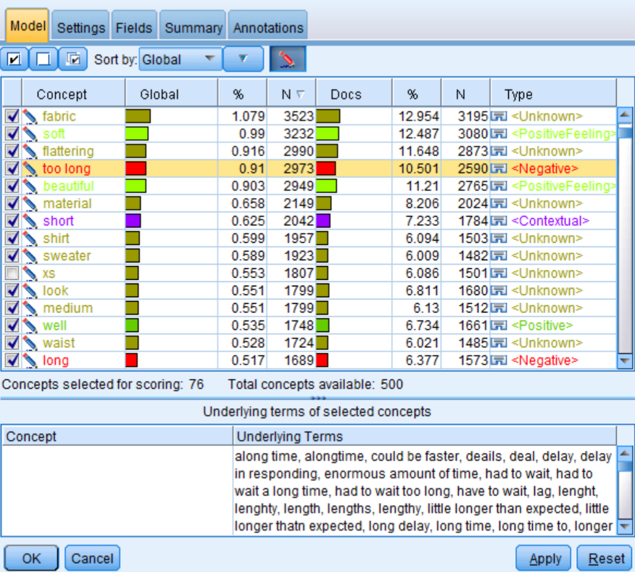
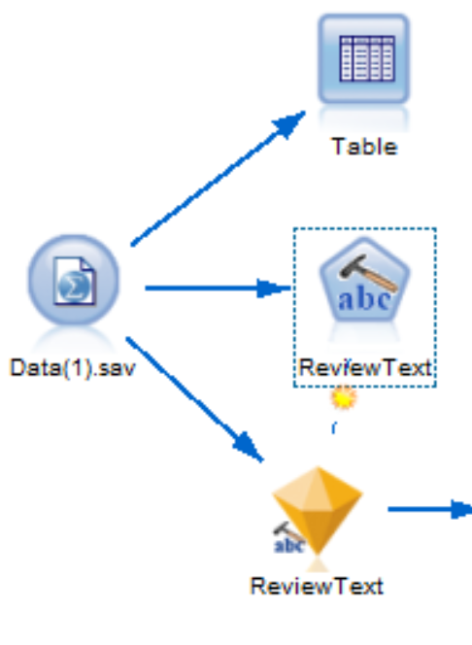
Concept Extraction
Details:
Select top 75 concepts based highest frequency
Resource Template: opinion(English)
For example, when click on the “too long” concept, we can see the underlying terms of that concept, which focuses on the long delivery time. Therefore, the type “negative” is given correctly.

Slide 19
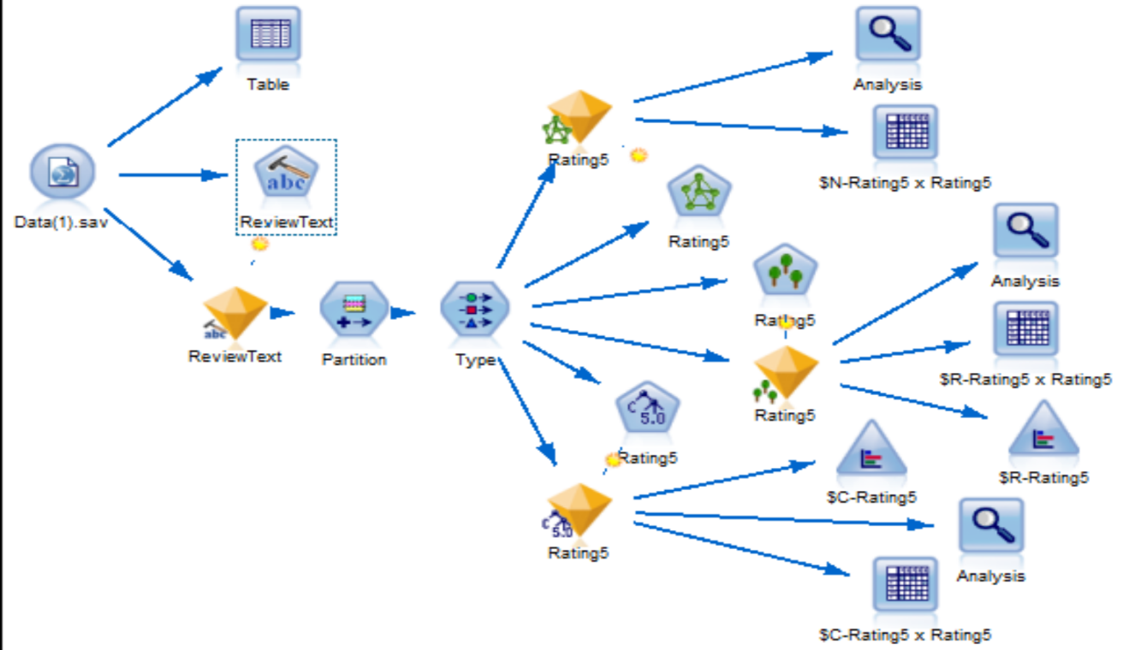
Complete Model Stream
Details:
Using the extracted concepts as the input and type of reviews as target to build models
Applied models: Neural Net work, Random Forest, Decision Tree model

Slide 20
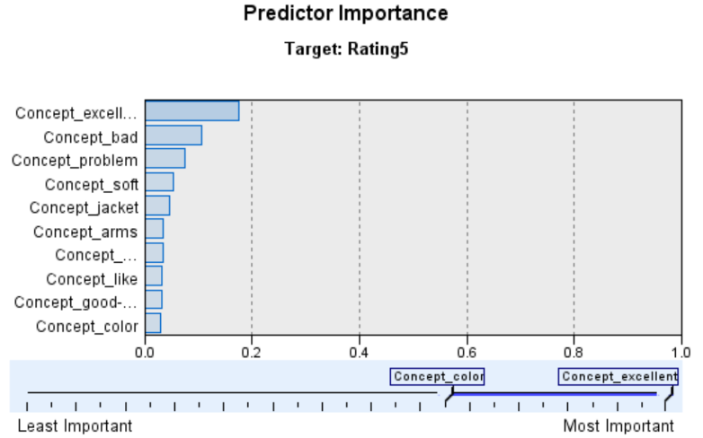
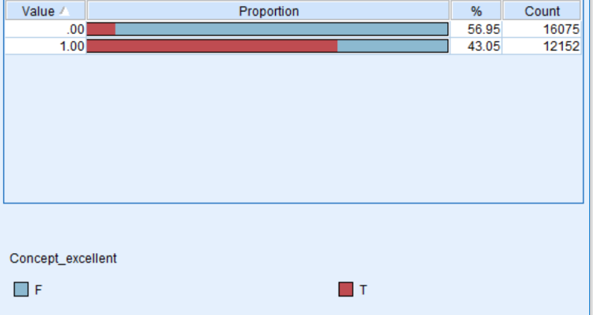
Model Results
Details:
The three classification model could give the importance for each concept.
Taking decision tree as an instance: “excellent “ concept” is the most important predictor and the second bar shows the positive reviews, whose red color shows the reviews containing “excellent”.

Slide 21
Model Evaluation
Models | Training Accuracy | Testing Accuracy
Neural Network | 71.02% | 70.58%
Random Forest | 72.85% | 70.74%
Decision Tree | 72.56% | 71.33%
Models | Accuracy for Positive | Accuracy for Negative
Neural Network | 65.22% | 75.14%
Random Forest | 73.8% | 71.04%
Decision Tree | 67.78% | 75.48%
Details:
Random Forest seems have the best performance in both predicting the negative and positive, since it have a very balanced accuracy, which is also relatively high.

Slide 22
Concept comparison
Text Mining Concept | Neural Network | Random Forest | Decision Tree
Excellent | ✓ |  | ✓
Like | ✓ |  | ✓
Appropriate
Dress |  | ✓
Size |  | ✓
Good |  | ✓
Wear |  | ✓
Color |  | ✓ | ✓
Small |  | ✓
Comfortable | ✓
Large |  | ✓
Adorable
Fabric |  | ✓
Soft |  |  | ✓
flattering
Details:
The table shows the difference of concept importance among the text mining module and classification models.
Random forest has the most similar concept importance with the text mining module and at the meanwhile it has the best performance, which implies that SPSS text mining module works well in this case.

Slide 23
Topic Modeling
K-means: decide number of clusters/ topics is 5
Number of Clusters | 3 | 4 | 5 | 6
Silhouette Coefficient | 0.016 | 0.019 | 0.029 | 0.013
Cluster 1: | Cluster 2: | Cluster 3: | Cluster 4: | Cluster 5:
top | easter | placket | 118lbs | dress
love | catalog | space | chest | love
size | hopes | section | impeccable | size
great | hoped | close | triangle | wear
fit | frumpy | mid | giant | fit

Slide 24
Topic Modeling
LSI: faster but not easy to interpret
Topic 1 | Topic 2 | Topic 3 | Topic 4 | Topic 5
'-1.000*"nan" + -0.000*"heavy" + 0.000*"coat" + -0.000*"slip" + 0.000*"pockets" + -0.000*"extremely" + 0.000*"arms" + -0.000*"leggings" + 0.000*"amazing" + 0.000*"navy"' | '0.234*"dress" + 0.186*"love" + 0.185*"size" + 0.184*"top" + 0.174*"great" + 0.157*"fit" + 0.148*"wear" + 0.145*"small" + 0.140*"like" + 0.134*"just"' | '0.703*"dress" + -0.274*"shirt" + -0.236*"jeans" + -0.209*"great" + -0.168*"sweater" + -0.145*"top" + -0.145*"soft" + -0.140*"pants" + -0.127*"cute" + 0.107*"beautiful"' | '0.385*"dress" + -0.284*"small" + 0.278*"comfortable" + 0.275*"great" + -0.237*"top" + 0.193*"love" + -0.168*"size" + -0.163*"large" + -0.161*"ordered" + -0.155*"xs"' | '0.617*"shirt" + -0.231*"sweater" + -0.229*"size" + 0.217*"dress" + 0.200*"cute" + -0.187*"pants" + -0.141*"petite" + -0.134*"small" + 0.131*"top" + -0.127*"fit"'

Slide 25
Topic Modeling
LDA: better to be interpreted and more make sense.
Topic 1 | Topic 2 | Topic 3 | Topic 4 | Topic 5
'0.030*"nan" + 0.012*"wash" + 0.011*"like" + 0.010*"dry" + 0.010*"washed" + 0.008*"top" + 0.006*"romper" + 0.006*"hand" + 0.006*"look" + 0.005*"retailer"' | '0.024*"love" + 0.020*"soft" + 0.020*"sweater" + 0.018*"wear" + 0.017*"great" + 0.016*"color" + 0.014*"shirt" + 0.014*"comfortable" + 0.014*"like" + 0.011*"super"' | '0.041*"size" + 0.028*"fit" + 0.015*"like" + 0.013*"wear" + 0.013*"pants" + 0.013*"petite" + 0.012*"jeans" + 0.012*"love" + 0.012*"ordered" + 0.011*"waist"' | '0.037*"top" + 0.021*"like" + 0.016*"just" + 0.015*"fabric" + 0.015*"love" + 0.014*"back" + 0.014*"really" + 0.013*"small" + 0.012*"look" + 0.012*"color"' | '0.060*"dress" + 0.023*"love" + 0.018*"wear" + 0.017*"great" + 0.015*"size" + 0.013*"fit" + 0.013*"perfect" + 0.011*"fits" + 0.011*"can" + 0.010*"small"'
Laundry | Top waring | Trousers size | Overviews | Good Dress

Slide 26
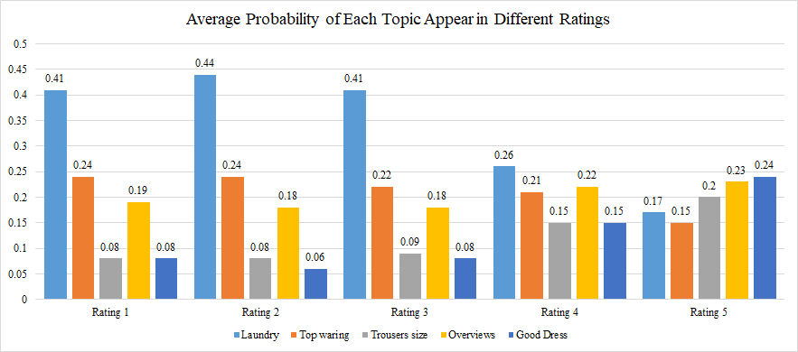
Topic Modeling
Low Ratings always come with Laundry problem

Slide 27
Topic Modeling
Topic Modeling Selection:
K-means
LSI
LDA
Logistic Regression Model:
Independent Variables: Probabilities
Dependent Variables: Rating Levels
Topic ModelingK-means
LSI
LDA
LDA:
Calculate the probabilities of each topics
Model Validation:
Accuracy: 69.15%
Cross Validation Accuracy:68.15%

Slide 28
Conclusions
Model Name | Acuracy | Business Value
Normal Sentiment Analysis | N/A | Limited
Concept Extraction Neural Network Model | 71% | Can identify which concept have significant effect on final ratings
Concept Extracion Random Forest Model | 73%
Concept Extracion Decision Tree Model | 72%
Topic Modeling Logistic Regression | 69% | Can identify what concept always come together when customers are buying clothes

Slide 29
Conclusions
Design, material, price and laundry are the four factors that customers care about most when they are buying clothes.
The most popular classes of clothes among women customers are dress, jeans, skirts, sweater, pants, skirt, jacket. And for different type, they would consider different features. We found that customers consider style, color and comfortable for tops, while they consider more about size for trousers.
Dresses, knits and Blouses are the top three among all the classes which get the positive reviews. This means these three classes are more likely to get positive reviews than other classes.
Counting the number of reviews by department, we can conclude that tops have the most positive reviews, dresses come the second and bottom come the third.

Slide 30
Future Direction
Build more accurate model by combine topic analysis and extracted concept.
Provide sentiment analysis language processing package to clothing industry to do deeper text analytics.
Develop text analytics software solutions to enable quick and self-service feedback from customers.

Slide 31
THANKS!
Any questions?

Slide 32
SlidesCarnival icons are editable shapes.
This means that you can:
Resize them without losing quality.
Change fill color and opacity.
Change line color, width and style.
Isn’t that nice? :)
Examples:

Slide 33
😉
Now you can use any emoji as an icon!
And of course it resizes without losing quality and you can change the color.
How? Follow Google instructions https://twitter.com/googledocs/status/730087240156643328
✋👆👉👍👤👦👧👨👩👪💃🏃💑❤😂😉😋😒😭👶😸🐟🍒🍔💣📌📖🔨🎃🎈🎨🏈🏰🌏🔌🔑 and many more...

