Slide 1


Slide 2


Slide 3


Slide 4
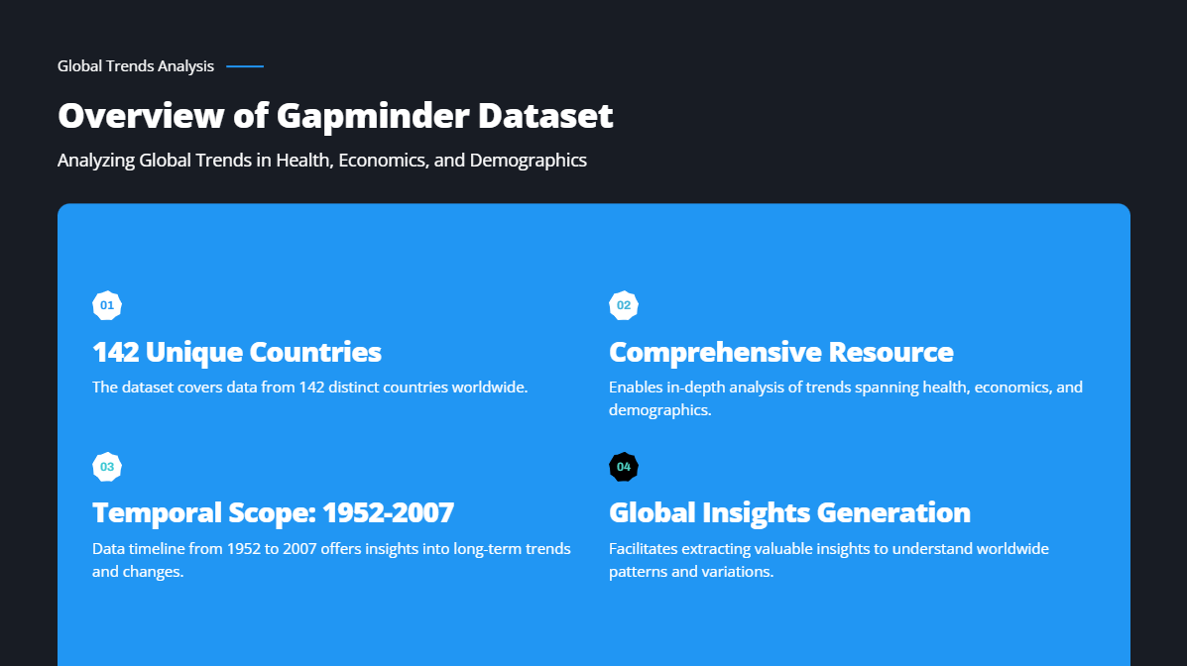

Slide 5
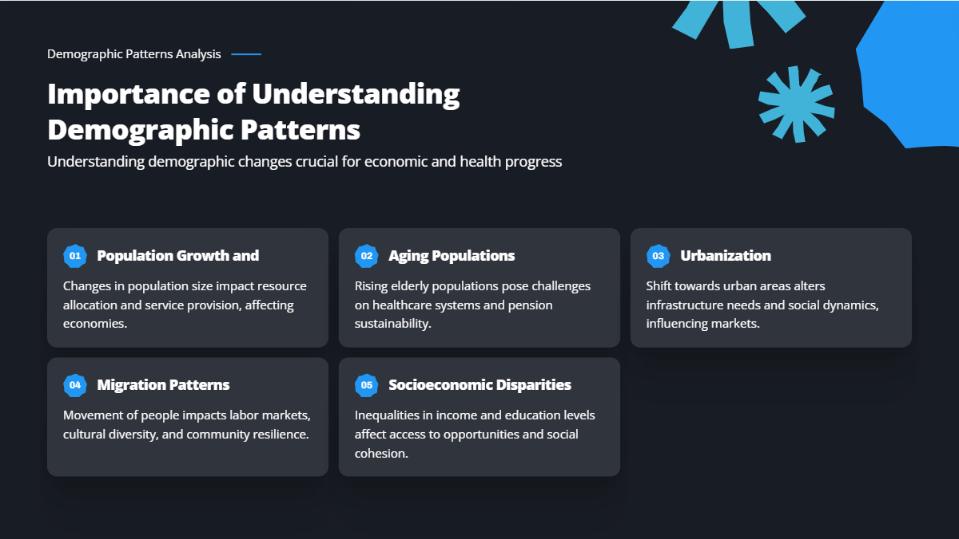

Slide 6


Slide 7
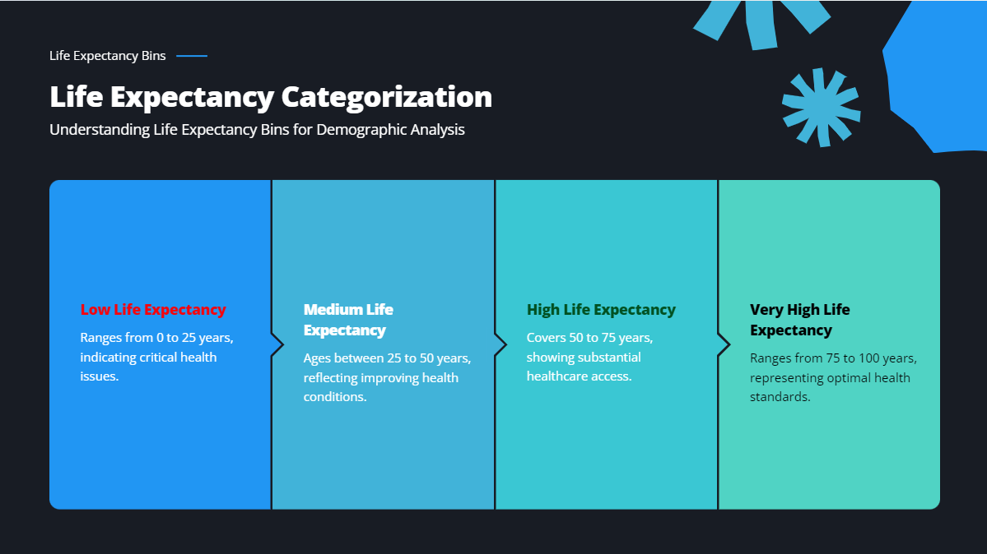

Slide 8
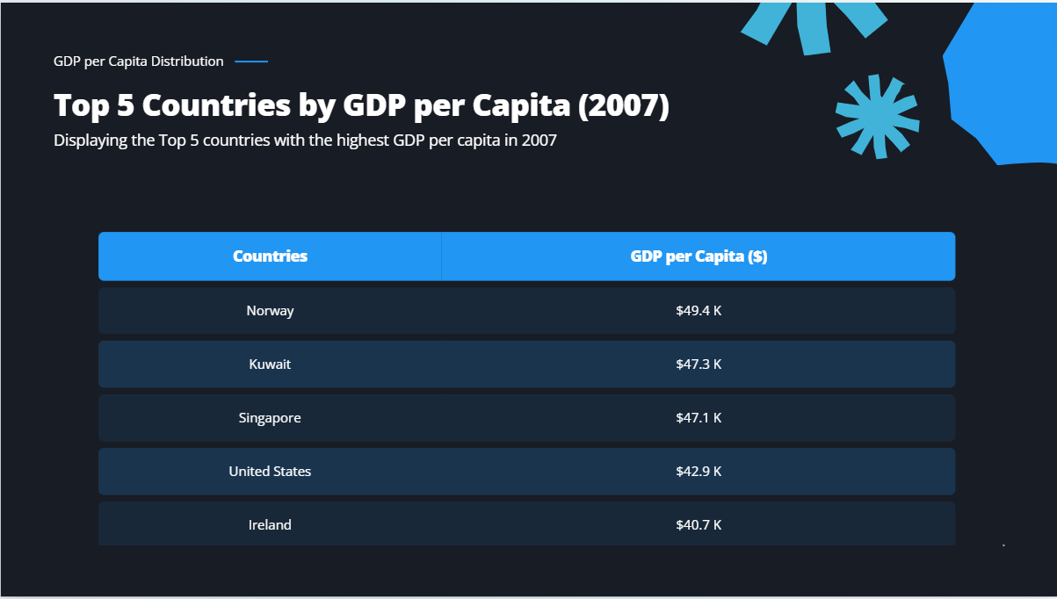

Slide 9
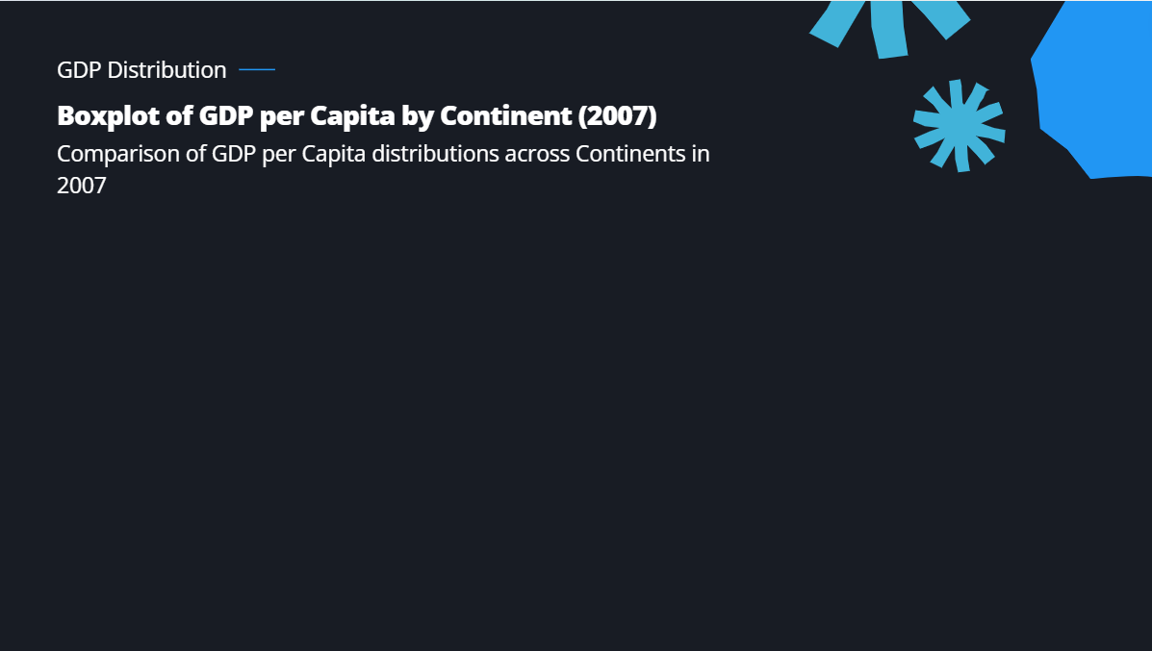
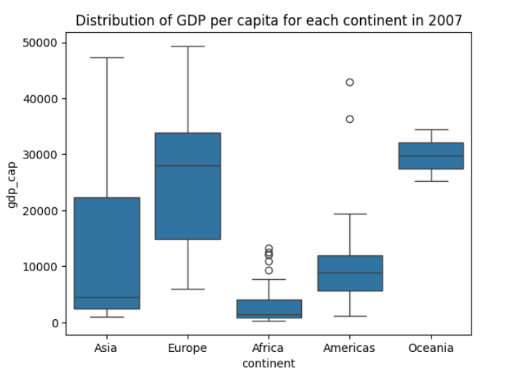
Africa shows several high outliers, possibly countries with unique economic advantages.
The Americas have a few high outliers, likely representing wealthier nations.
Europe and Oceania show no significant outliers, suggesting more uniformity in GDP per capita within these regions.
The boxplot illustrates the significant economic disparities across continents. Europe and Oceania are at the higher end of the spectrum, reflecting stronger and more consistent economic performance. In contrast, Africa shows the lowest GDP per capita with a narrow distribution, highlighting the continent's economic challenges. Asia and the Americas show more variability, indicating a mix of wealthier and less wealthy nations within these regions.

Slide 10
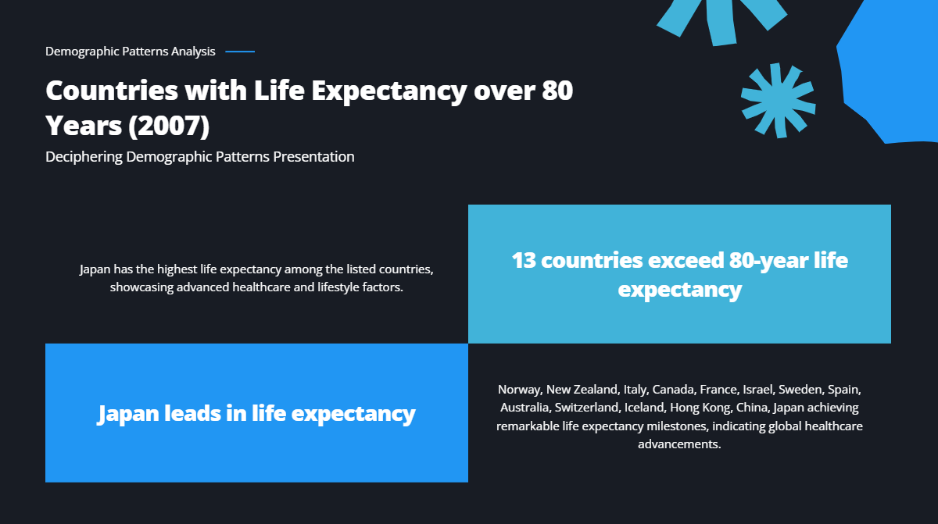

Slide 11
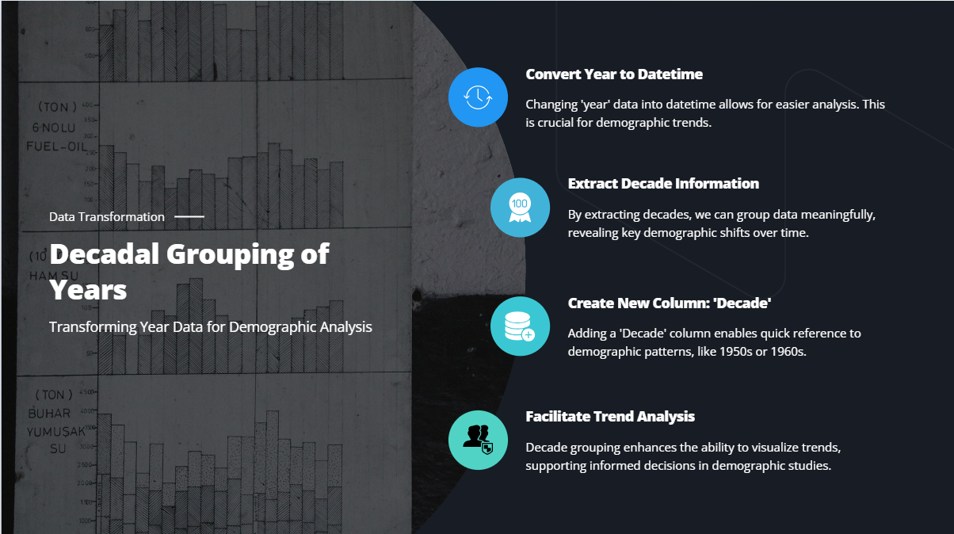

Slide 12
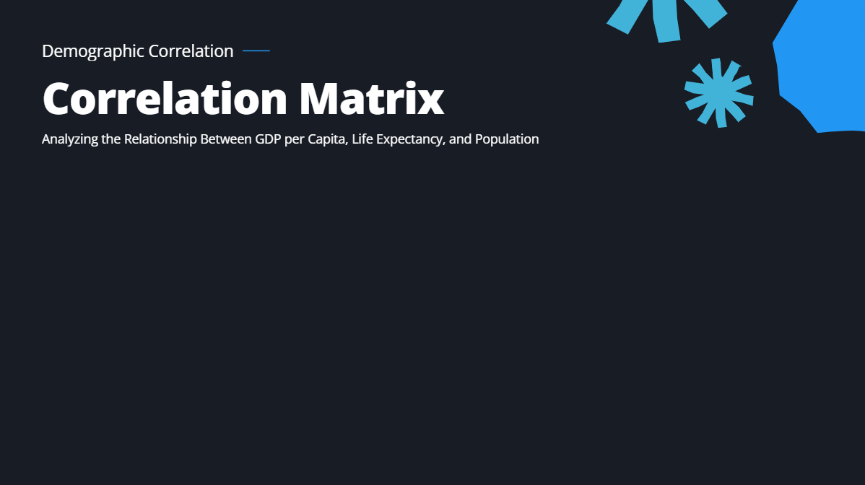
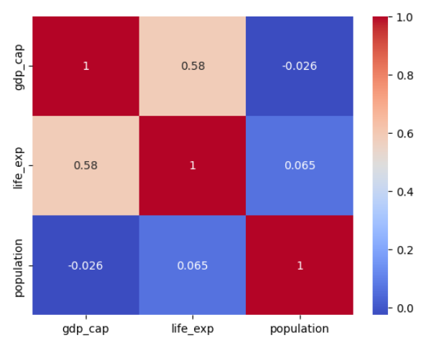
The heatmap reveals the relationships between GDP per capita, life expectancy, and population. A strong positive correlation between GDP per capita and life expectancy might indicate that wealthier countries tend to have better healthcare and living conditions, leading to longer life expectancy.

Slide 13
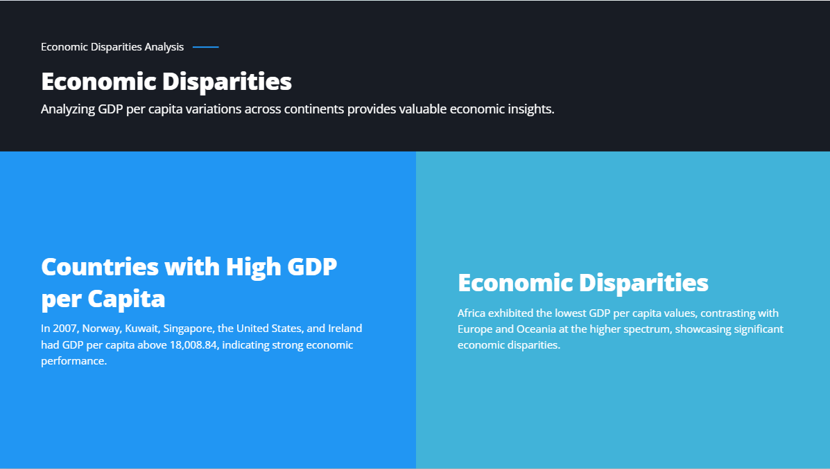

Slide 14
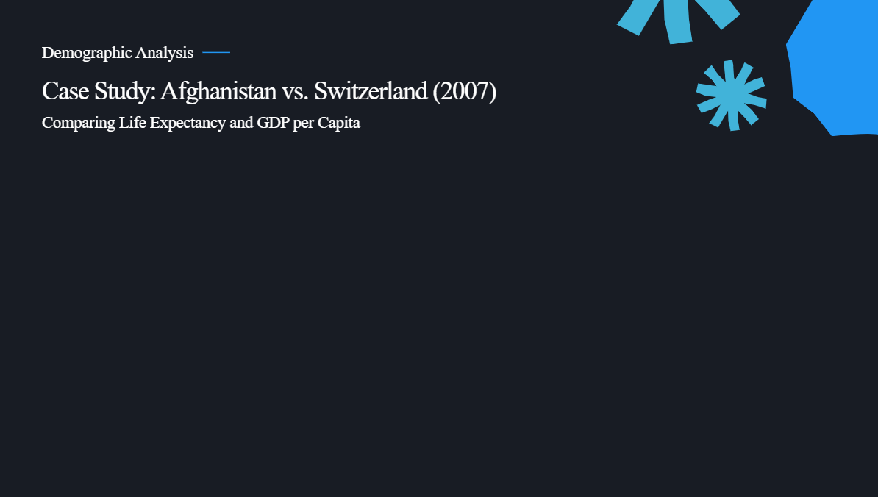
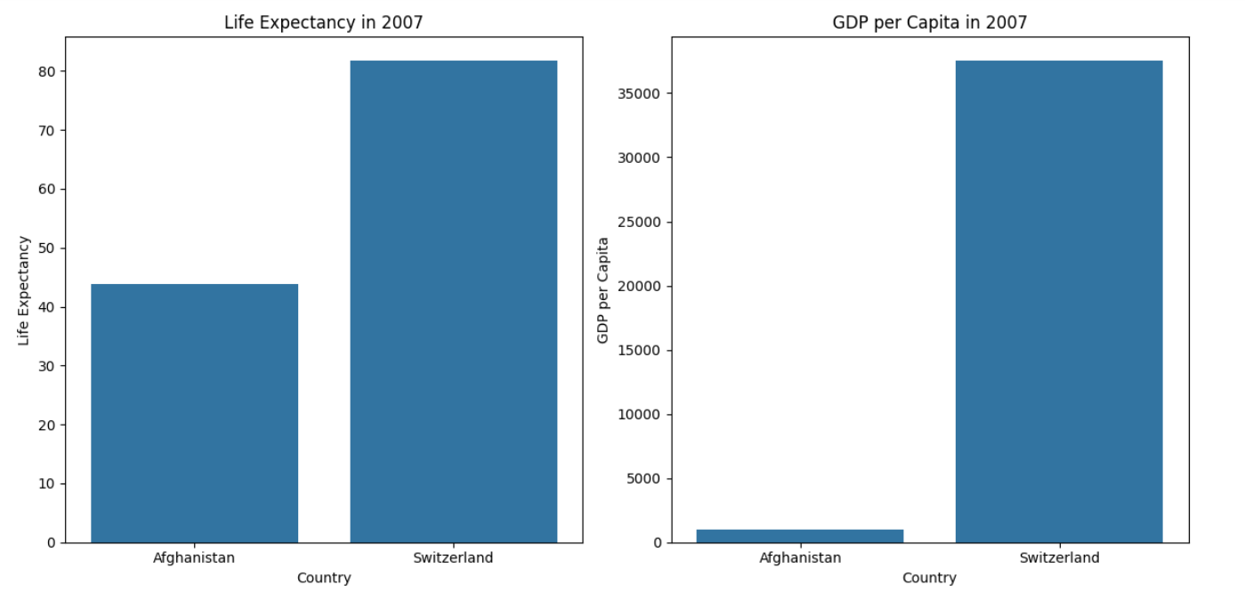

Slide 15

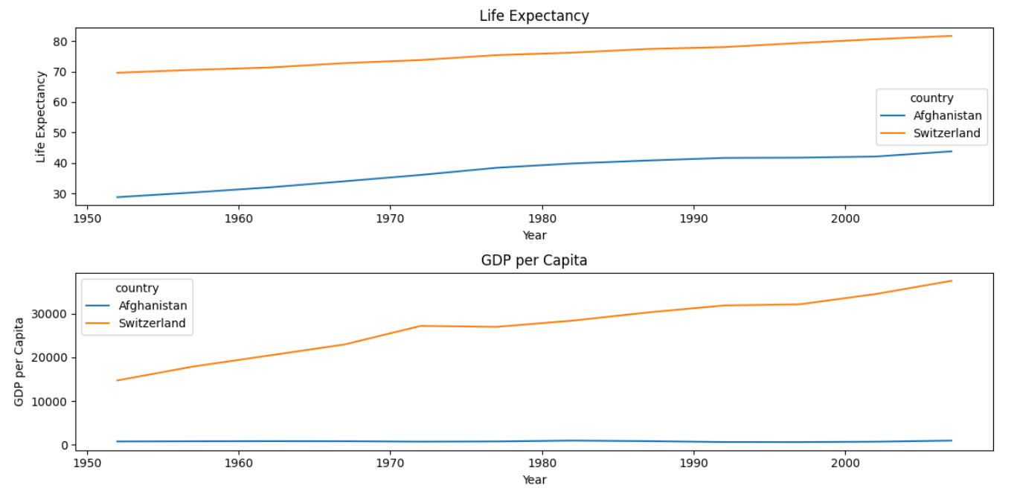
Long-term Trends: The visualisations highlight the long-term trends in life expectancy and GDP per capita, showing how stability and development policies impact these metrics over time.
In summary, the stability or instability of a country significantly influences key metrics such as life expectancy and economic development. Stable countries like Switzerland exhibit higher life expectancy and GDP per capita, while Unstable countries like Afghanistan face challenges in improving these metrics.

Slide 16
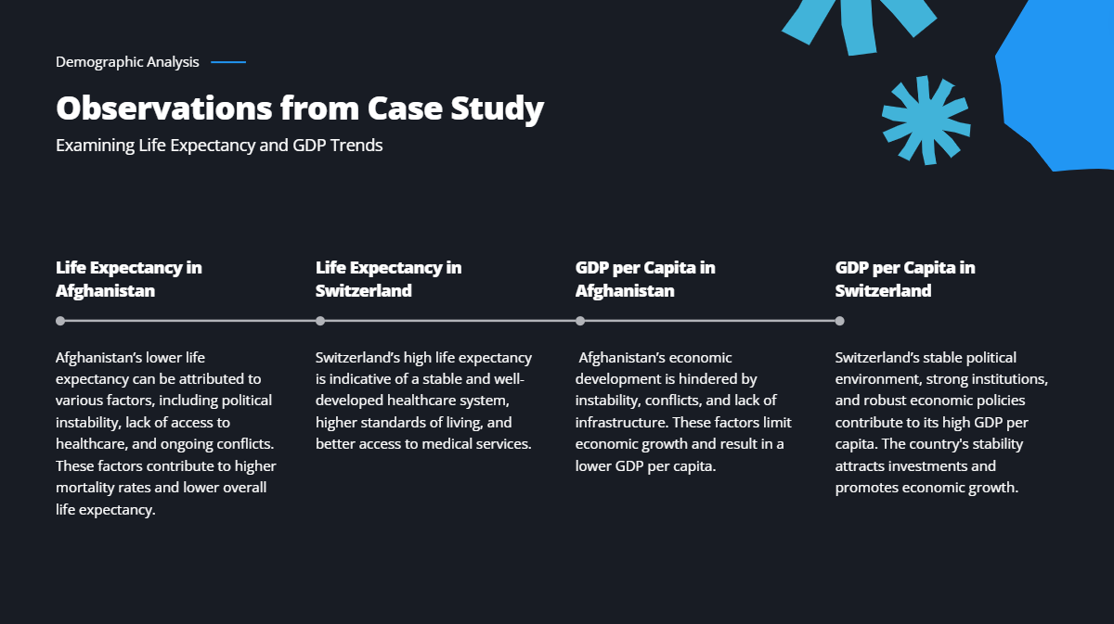

Slide 17
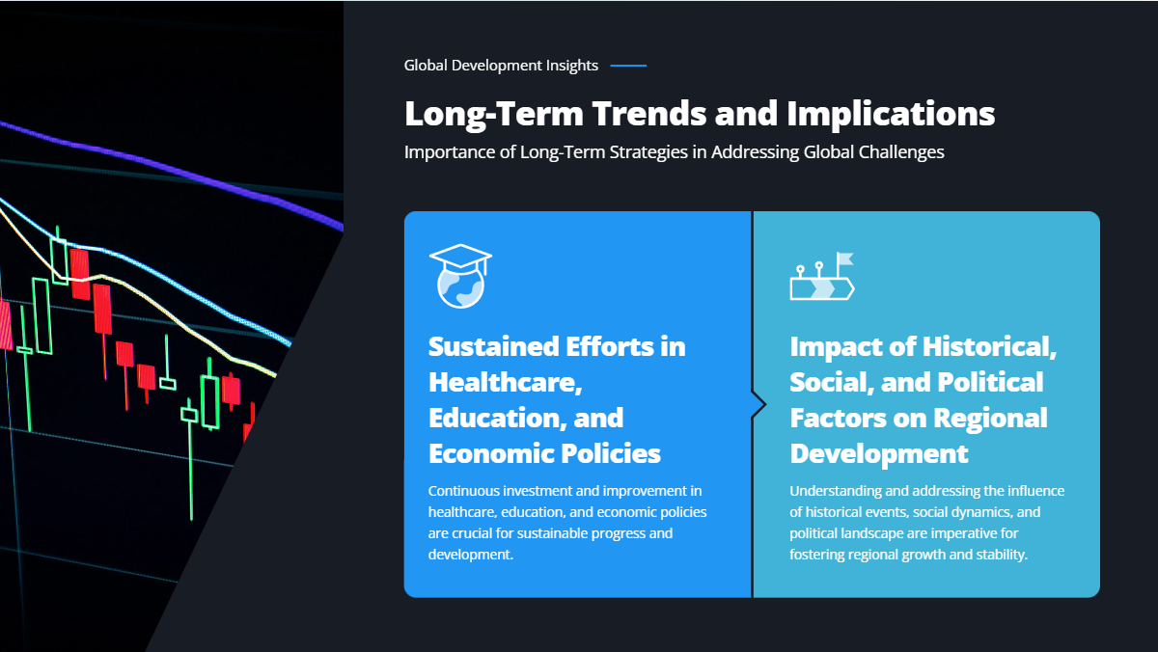

Slide 18


Slide 19
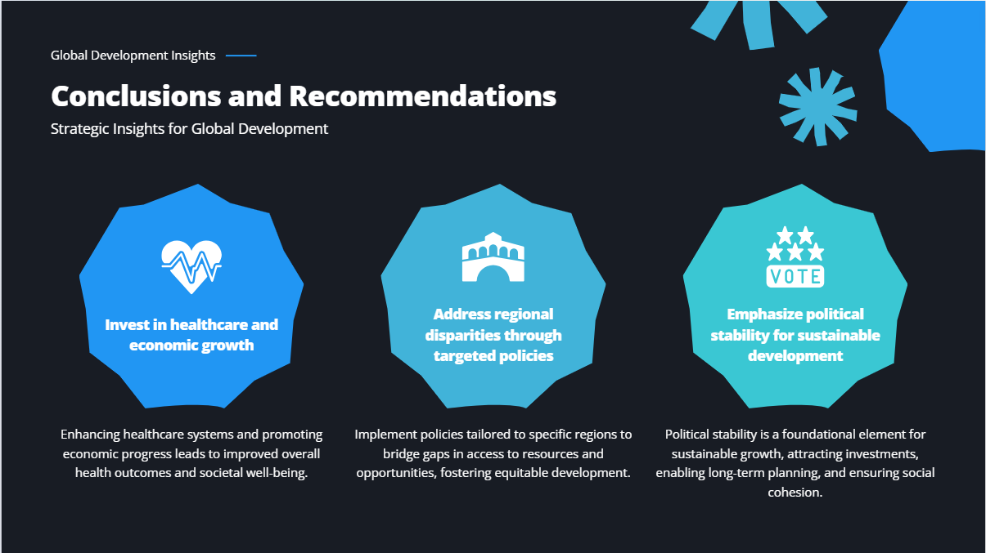

Slide 20


