Slide 1

Analyzing Hospital Dataset with Power BI Exploring Insights for Improved Healthcare Services Mukesh Saripilli

Slide 2
Problem Statement
As a consultant data analyst hired by Columbia Asia Hospital, my task is to perform data analysis to address the following objectives:
Assess the hospital's revenue generation.
Provide insights about suitable departments for new hires.
Suggest strategies for patient discounts
The hospital has asked for a report with three tabs:
Main Tab
Doctors’ Tab
Patients’ Tab

Slide 3
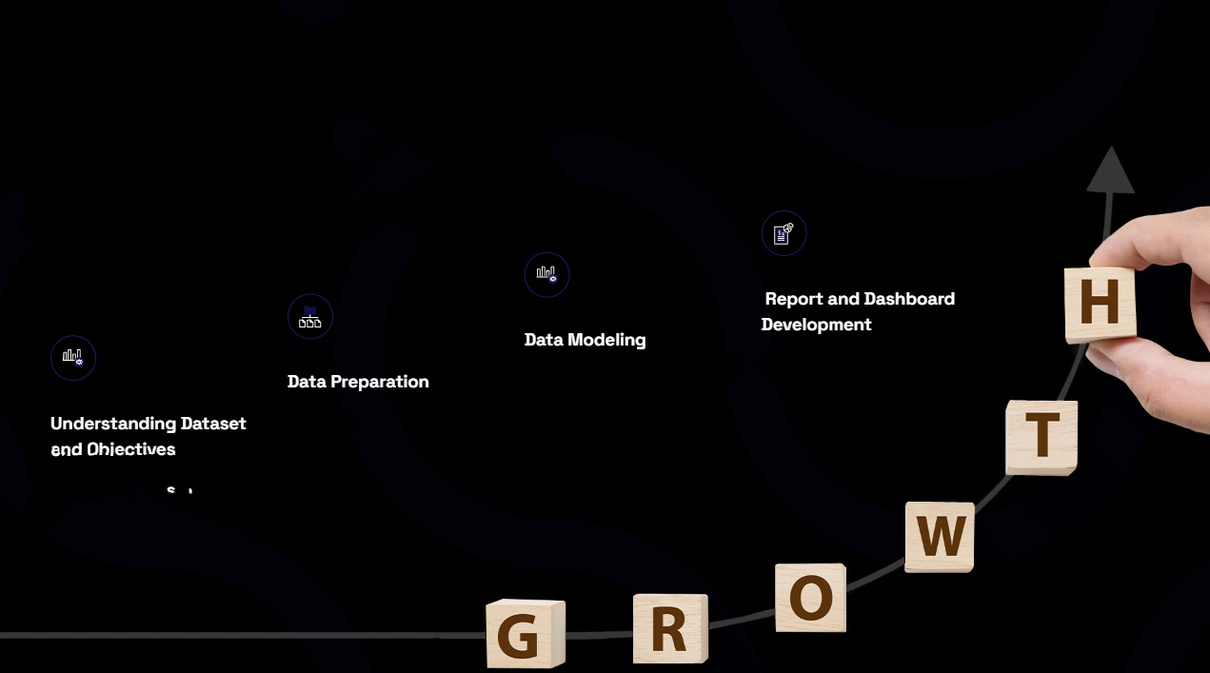
Analytical Approach
Design Reports: Create reports that visualize the data in a meaningful way, aligning with the business requirements.
Build Dashboards: Develop interactive dashboards that provide an overview of key metrics and allow for detailed exploration of data.
Add Visual Elements: Incorporate charts, graphs, tables, and other visual elements to effectively convey insights.
Effective data modeling is key to harnessing the full potential of Power BI. This involves designing the data model by establishing relationships between tables, defining measures, and creating dimensions for analysis. Implementing hierarchies, such as date hierarchies, enables detailed drill-down capabilities in reports. The data model must be optimized for performance, ensuring that queries are efficient and the data structure supports the analytical needs. A well-constructed data model serves as the backbone of the reporting and visualization process, facilitating intuitive and insightful data exploration.
Data preparation is crucial for ensuring that the dataset is clean, accurate, and ready for analysis. This process includes collecting data from various sources, cleaning it by removing duplicates, handling missing values, and correcting inaccuracies. Transforming data to the required format, creating calculated fields, and aggregating data as needed are essential steps. Integration of data from multiple sources through SQL joins and validating the accuracy of the data ensures reliability. Proper data preparation lays the groundwork for efficient and effective analysis, making sure that the data used in Power BI is of high quality.
Understanding a dataset involves comprehending its structure, variables, and the nature of the data it contains. This includes identifying the type of data (e.g., numerical, categorical), the number of observations, and any potential missing values or outliers.
The dataset's structure must be thoroughly analyzed, including identifying the tables, fields, data types, and relationships between tables

Slide 4
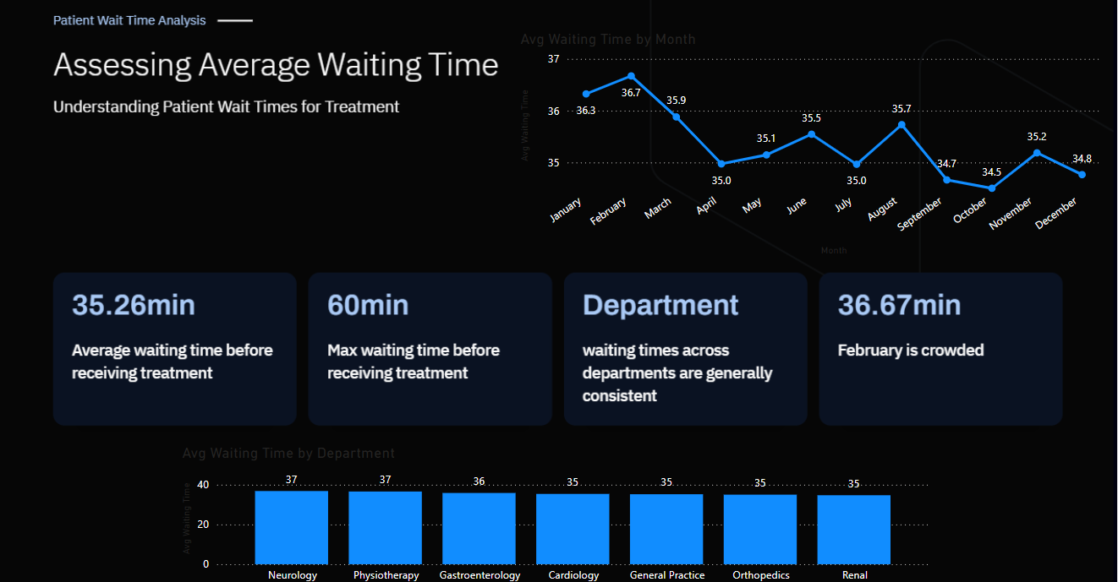

Slide 5
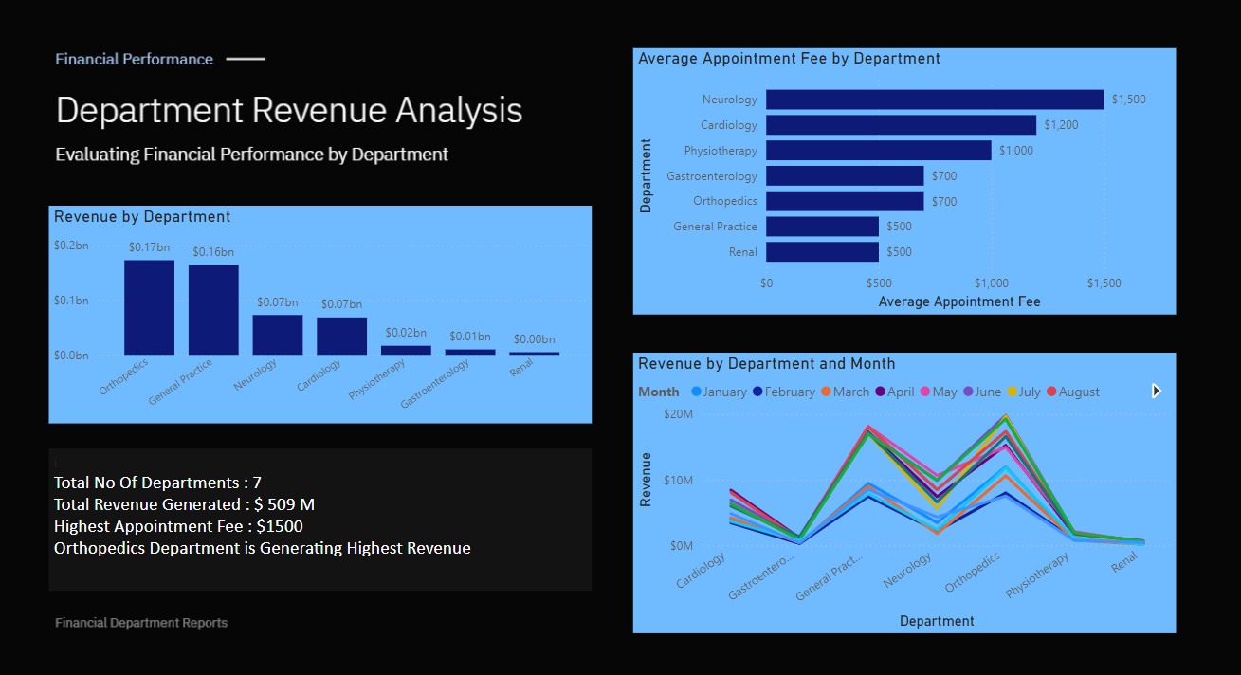

Slide 6
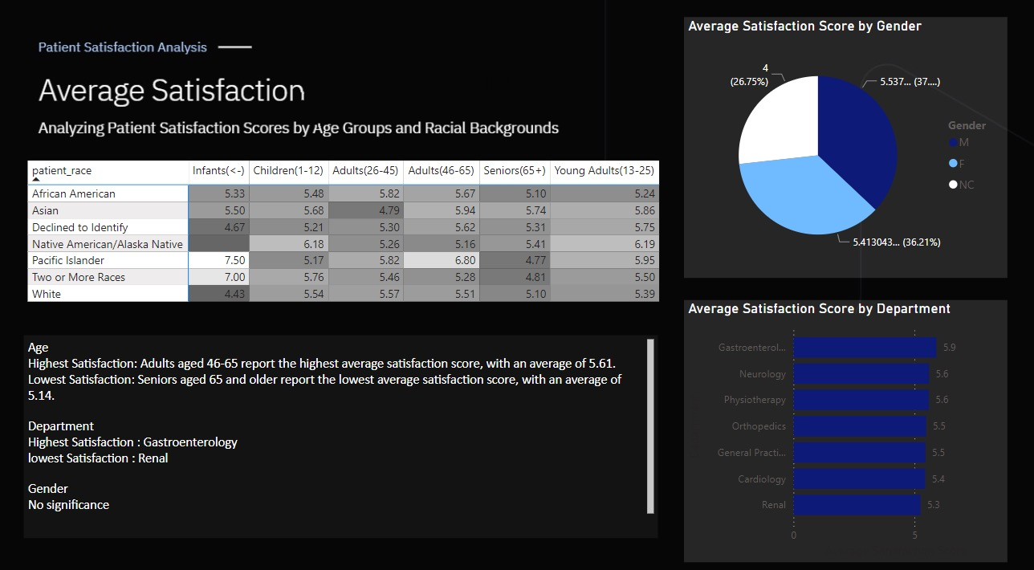

Slide 7
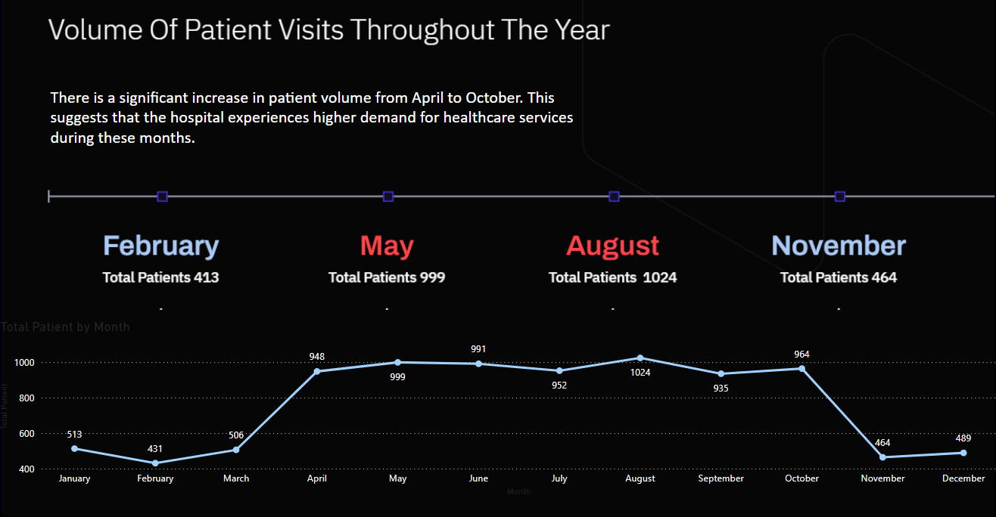

Slide 8
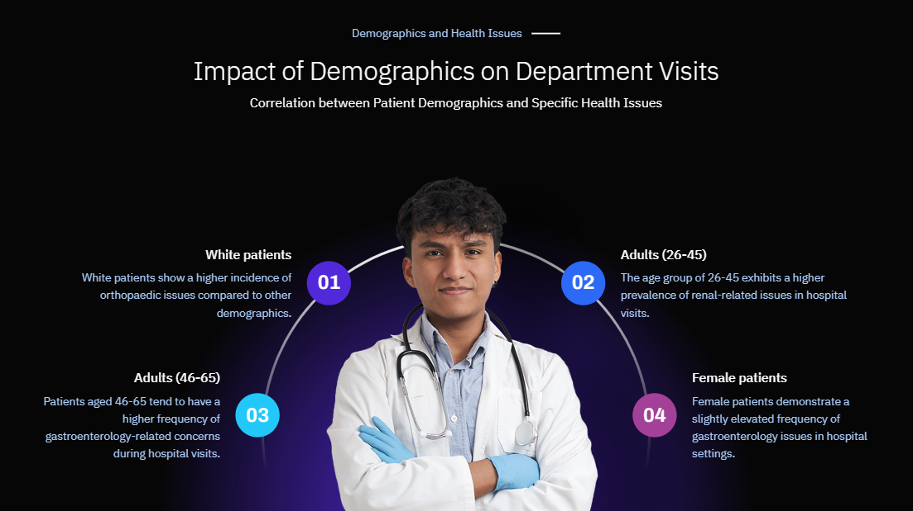

Slide 9
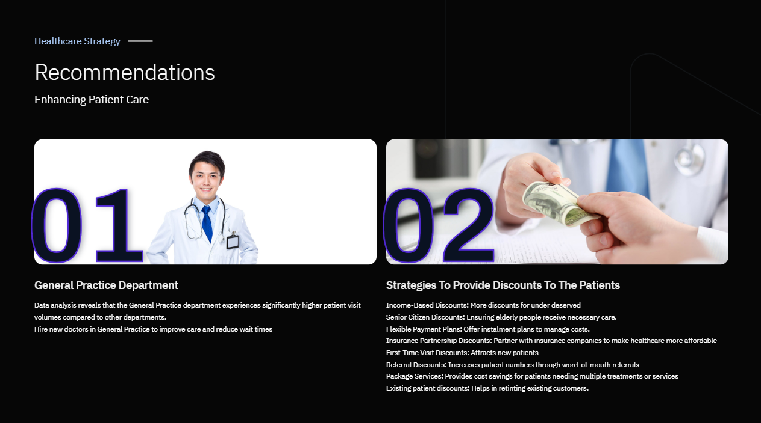

Slide 10
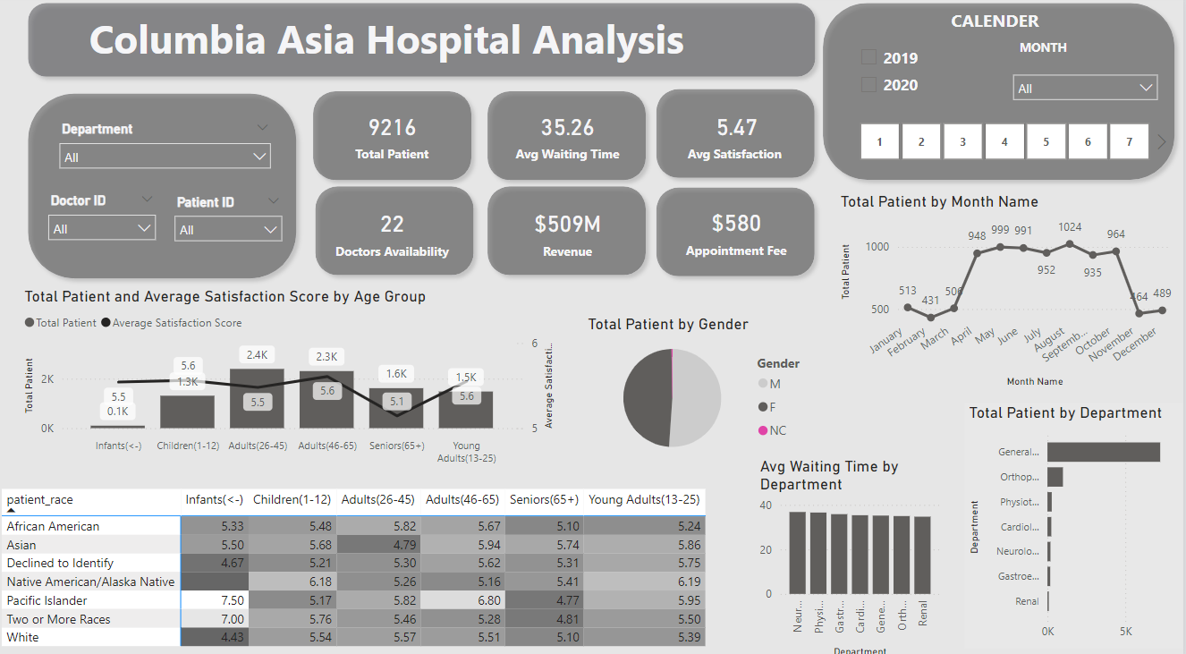

Slide 11
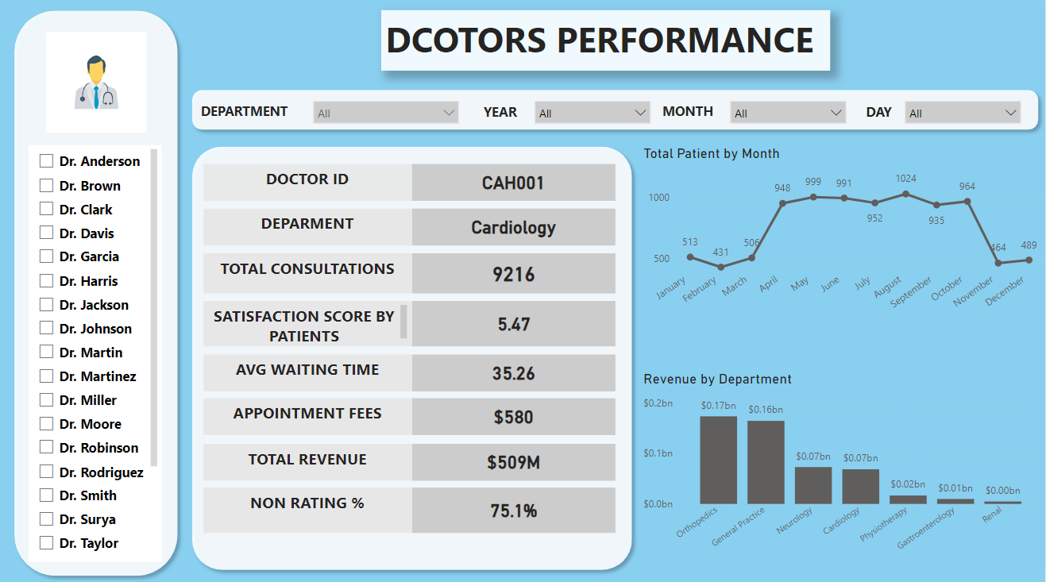

Slide 12
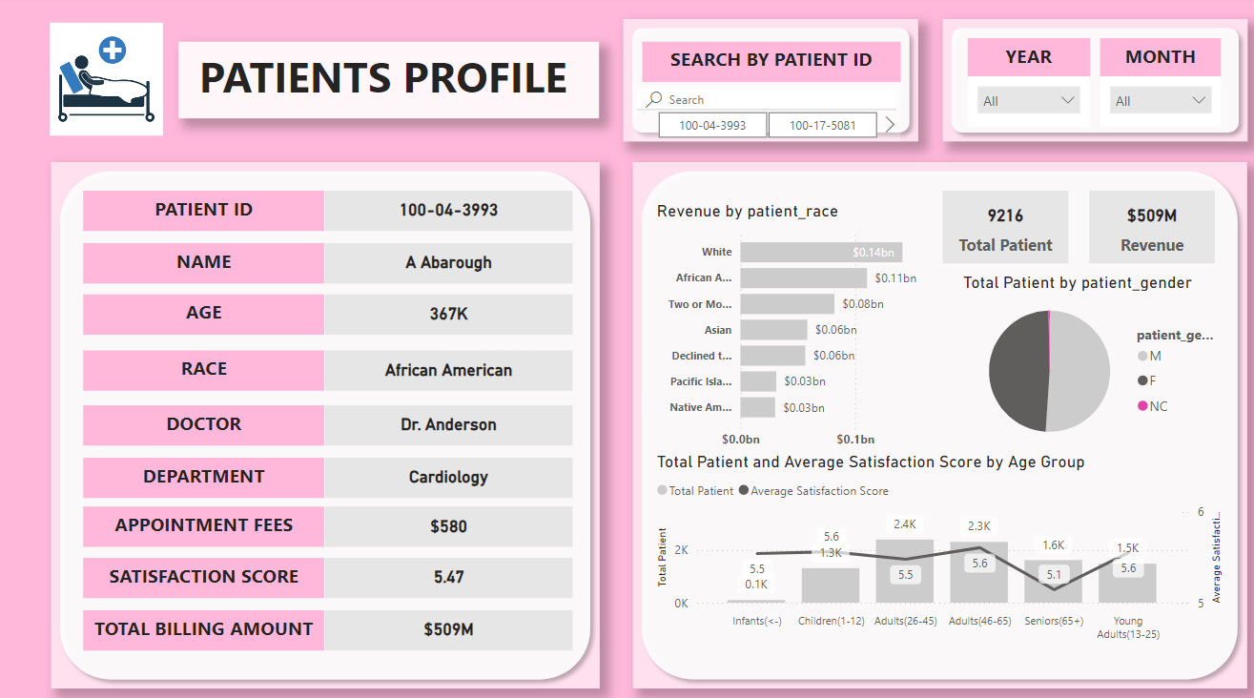

Slide 13
Conclusion
The comprehensive analysis of the hospital dataset using Power BI has yielded several critical insights that can significantly enhance the hospital's operational efficiency, patient satisfaction, and overall healthcare delivery. Proper data cleaning was crucial in ensuring accurate analysis, underscoring the importance of maintaining clean and consistent data for informed decision - making. The average waiting time before treatment is 35.26 minutes, and reducing this can improve patient satisfaction, as shorter wait times correlate with higher satisfaction scores. Analyzing visits by department and understanding revenue generation helps in strategic financial planning and resource allocation.
Patients aged 26-45 utilize healthcare services the most, indicating a need for tailored services and outreach. Different demographics exhibit varying healthcare needs and frequencies, guiding targeted health interventions. There is no significant relationship between the number of visits and patient gender. Neurology charges the highest appointment fees, guiding pricing strategies. Seasonal trends show increased patient visits from April to October, necessitating increased staffing and resources. Hiring 2-3 new doctors in General Practice is recommended to reduce wait times and improve care. While revenue data provides insights into financial inflows, a complete profitability assessment requires detailed expense analysis. Strategic discount programs can improve accessibility and equity in healthcare services. By leveraging these insights, the hospital can make informed decisions to enhance patient care, streamline operations, and improve financial performance.

