Slide 1
Predictive Modeling & Risk Scoring for Bank Customer Churn
Financial Analyst Internship Project
Prepared by: Sarita
Organization: Unified Mentor
1

Slide 2
Project Overview
BANK CUSTOMER CHURN ANALYSIS
Banks may lose customers without identifying early warning signs of customer dissatisfaction and potential churn. The objective of this project is to analyze customer data, estimate churn risk, identify key factors influencing customer exits, and support effective customer-retention strategies.
10000
Total Customers
2037
Churned Customers
7963
Retained Customers
20.37%
Churn Rate
2

Slide 3
Tools & Workflow
From data preparation to customer risk scoring
1. Data Collection – Customer dataset -10,000 records
2.Data Cleaning & Preparation – Excel and Python
3. Exploratory Data Analysis -- PivotTables and Visualizations
4. Predictive Modeling – Logistic Regression and Random Forest
5. Customer Risk Scoring – Low, Medium and High Risk
6. Business Insights & Dashboard – Power BI and Excel
3

Slide 4
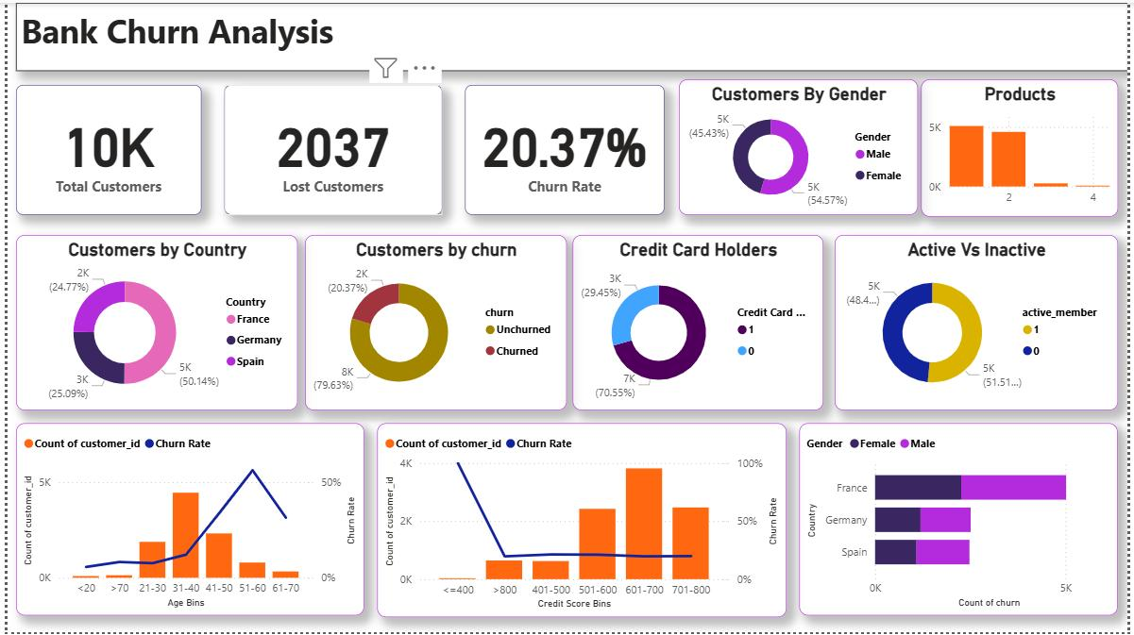
Exploratory Data Analysis
Patterns observed in the dataset
4

Slide 5
Feature Engineering
Additional variables created for modeling
Feature | Calculation | Purpose
Balance Salary Ratio | Balance / Estimated Salary | Represents balance relative to salary
Product Density | NumOfProducts ≥ 2 | Groups customers by product ownership
Engagement Product | IsActiveMember × NumOfProducts | Combines activity and product count
Age Tenure Interaction | Age × Tenure | Captures an age-tenure interaction
5

Slide 6
Model Performance
Evaluation on the 2,000-customer test set
Metric | Logistic Regression | Random Forest
Accuracy | 84.20% | 83.85%
Precision (churn) | 71.36% | 59.29%
Recall (churn) | 37.35% | 65.85%
F1 score (churn) | 49.03% | 62.40%
ROC-AUC | 83.63% | 86.16%
6

Slide 7
Random Forest was selected because it identified a higher proportion of actual churn customers, reducing the risk of missing potential customer exits. Random Forest was also identified 268 out of 407 actual churn cases. r exits.
Model Selection
Why Random Forest was selected as the leading model
65.85%
RF Recall
62.40%
RF F1 Score
86.16%
RF ROC-AUC
7

Slide 8
Top Predictive Features
Random Forest feature importance
Age
25.68%
Number of Products
14.10%
Balance
8.37%
Balance / Salary Ratio
6.97%
Age × Tenure
6.74%
.
8

Slide 9
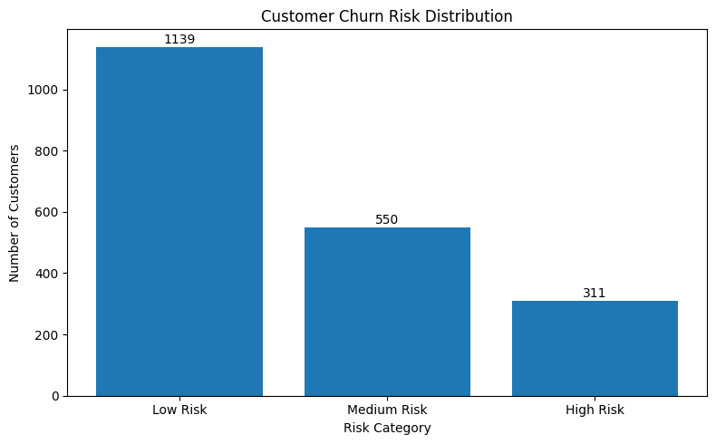
Customer Risk Scoring
Risk segmentation across all 10,000 customers
Random Forest probabilities were generated for all 10,000 records.
Project bands: Low <30%; Medium 30% to <60%; High ≥60%.
The complete customer-level risk report was exported to Excel.
Risk thresholds are initial choices and require business validation.
Full-dataset scores include training records; use held-out test results for unbiased evaluation.
9

Slide 10
Business Recommendations & Limitations
Turning model outputs into responsible action
Prioritize review of high-risk customers and consider suitable retention support.
Improve engagement with inactive customers and assess product needs.
Monitor model performance and retention campaign outcomes over time.
Validate probability calibration and risk thresholds before operational use.
Predictions are not guarantees; feature importance does not prove causation.
10

Slide 11
Thank You
I am sincerely thank you for your support. I will continue to create better value through continuous growth and innovation.
Email – sarita44532@gmail.com
11

