Slide 1
IT 7993 Capstone
Project Introduction
Spring 2021
Dr. Meng Han
Note: the projects are listed with no particular order

Slide 2
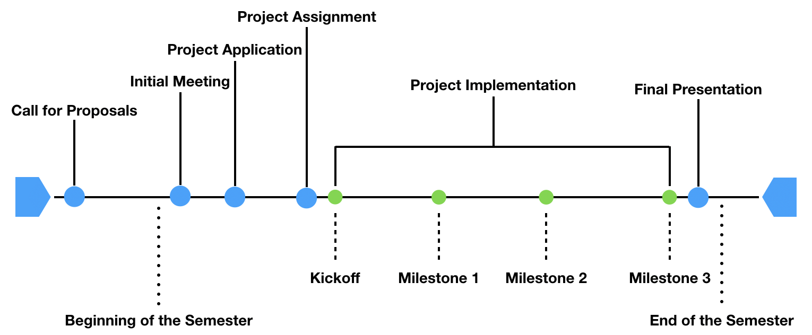

Slide 3




Slide 4
Be Professional!
Be Professional!
Be Professional!

Slide 5
Project #1 IT security solution for small business Contact: Dr. Lei Li (Director of MSIT)
ServeIT will be involved in the project by providing the sever infrastructure.
In this project, students will research and develop an IT security solution for a simulated small business. The students will experience the whole project life cycle from planning, analysis, design to implementation. Students will be perform following tasks:
1) Identify an open source e-commerce website solution and install it on a provided web server;
2) Develop a comprehensive security program to protect assigned web server such as security policy, tools can be used to monitor the network traffics and detect intrusion;
3) Conduct vulnerability analysis on the assigned web server;
4) Write a report to summarize the experience.
The server infrastructure will be provided by ServeIT.

Slide 6
Project #2 Address Linkage Key
Utilizing an algorithm provided by the United States Postal Service (USPS), create an address linkage key similar to the CASS delivery point. The solution provided will be scaled to run against full United States population datasets using Big Data technology. During this project, the students will learn valuable real-world skills:
* Professional Software Development with Python, Git, and Spark
* Software Development LifeCycles
* Data Cleansing and Hygiene
* Postal Rules and Mail Routing
Ultimately, as time permits, we will take the solution to the next level by developing a data classification model which describes and replaces one of the underlying data sources.
Sponsored by: Analytics IQ
ENTERPRISE ARCHITECT Supervision

Slide 7
Project #3 Key Professional Dataset eVestment
Our goal is to establish the one stop shop for institutional asset management distribution intelligence; the one place to go for mandates, documents, and profiles of consultants, investors, and managers with key professional contact information.
The Key Professionals dataset is aims to deliver global coverage of investor and consultant key professionals that are involved in making investment decisions, beginning with US-based firms. By end of this project, the goal is to provide coverage for the US Investors and Consultants found within eVestment platform.
The project needs students to build a Web Crawler to extract personal information from a public website. Using MySQL or any other open source relational database to organize the data and conduct a quantitative data analysis on it.
Required Skill:
Python, SQL, Database

Slide 8
Project #4 Augmented Reality Book 1
Group members in this project will develop the prototype of an Augmented Reality book using an author’s existing Intellectual Property (IP). The AR book is exploratory in nature with a focus on ideation. The existing (printed) book is used as a tracking mechanism to overlay additional, virtual content on the book. Students will create a rough story board outlining interactions with the virtual content. Once approved, technical development can begin, including the development of 3D model(s) and animations representing main characters, secondary characters, “clutter”; placeholder objects may be purchased to reduce development time. User interactions may include controlling characters in the environment, changing their facial expressions based on context, or changing behaviors based on the proximity to the camera. Narrative elements may also trigger behaviors and animations of characters. The final deliverable will be deployed to a mobile device.

Slide 9
Project #5 Augmented Reality Book 2
Group members in this project will develop the prototype of an Augmented Reality book using an author’s existing Intellectual Property (IP). The AR book is exploratory in nature with a focus on ideation. The existing (printed) book is used as a tracking mechanism to overlay additional, virtual content on the book. Students will create a rough story board outlining interactions with the virtual content. Once approved, technical development can begin, including the development of 3D model(s) and animations representing main characters, secondary characters, “clutter”; placeholder objects may be purchased to reduce development time. User interactions may include controlling characters in the environment, changing their facial expressions based on context, or changing behaviors based on the proximity to the camera. Narrative elements may also trigger behaviors and animations of characters. The final deliverable will be deployed to a mobile device.

Slide 10
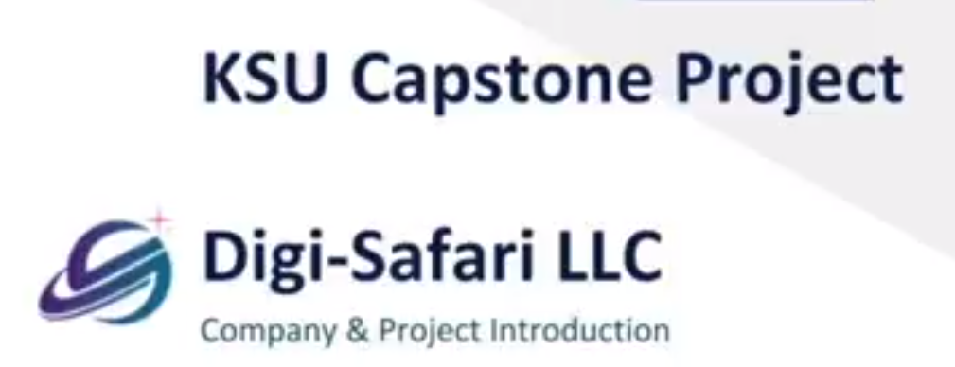
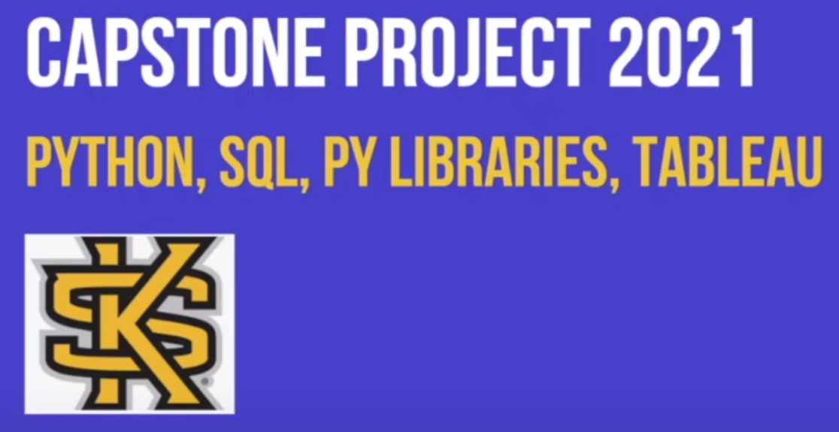
Project #6 Education Company Application
https://drive.google.com/file/d/1eBU1cjHuC9JqK_b1lwXSn4wfGo7unbwe/view
https://drive.google.com/file/d/1eBU1cjHuC9JqK_b1lwXSn4wfGo7unbwe/view?usp=sharing

Slide 11
Project #7 Analyzing Concentration Levels in Online Learning with Facial Features
This project aims to utilize webcam during an online study session to detect concentration levels of students and potentially help them improve their learning efficiency. In short, we utilize deep learning technologies to analyze students’ facial expressions, including eye movements, to detect whether the students are focusing on the contents or not. In short, the major steps in the project are as follow:
- Collect video data of yourself during an online class. These videos will not be used directly in our further study in order to protect your privacy.
- Utilize open source deep face swap technologies to replace your face with the ones of public figures. In this way, we augment our training data and also protect privacy of participants.
- Utilizing deep learning techniques (provided by the faculty sponsor) to analyze the augmented data
o You are expected to test the provided techniques and report the test results.

Slide 12
Project #8 Pose Extraction for Real-time Workout Assistant
Pose extraction refers to the process of annotating the body frame of a person in images or videos. While many current technologies can do this, each has their own advantages and disadvantages, for example, some are fast but not accurate, while some are very accurate but also computationally expensive. As we are developing a real-time smart workout assistant that utilizes pose extraction, we require a technology that is balanced in both time and precision. Furthermore, we will compare the chosen one with professional and expensive system of KinaTrax (https://www.kinatrax.com/kinatrax-motion-capture). to This project aims to determine such a technology. You are expected to:
Install different existing pose extraction technologies
Test the installed packages on different situations
Provide a report on the packages’ strengths and weaknesses
Field experiment on comparing the chosen open-source package with professional KinaTrax.
This project requires teams be able to perform some field experiments on Kennesaw campus sometime in the semester)

Slide 13
Project #9 Representation Learning for Motion Sequence
This is a part of a major project on developing a smart workout assistant. In short, the program to analyzes a user’s action sequence during exercises through camera, then queries a video of the same exercise from a professional trainer to show to the user as references. This project aims to develop a technology that converts the video of people in actions to a representation that can be used in retrieving the most similar videos with both accuracy and efficiency. You are expected to
Assist the faculty sponsor on testing different representation learning technologies (the faculty will provide the technologies)
Provide a report that compares the tested technologies’ accuracies and efficiencies.
(for this one, I have already had the data and some models, I can only think of asking the students to fine-tune the models I developed)

