Slide 1
STOCK MARKET PREDICTION USING MACHINE LEARNING TECHNIQUES
BY
SARITHA.H
PREETHI.P.S

Slide 2
DESCRIPTION
Time series analysis and forecasting is of vital signicance in stock market prediction.
Stock market forecasting involves uncovering the market trends with respect to time.
AIM
Develop new innovative approaches to foresee the stocks that result in high profits.

Slide 3
PROJECT REQUIREMENTS
Front end : html,css,java script
Back end : python 3
Database : MySQL
IDE : spyder

Slide 4
DATA SET
Yahoo finance – Historical data
Data set contains 2417 observations having 7 attributes.

Slide 5
STOCK MARKET
A “share market or equity market or a stock market'' is a public market that exists for issuing, buying and selling of stocks or shares
A Stock denotes a partial ownership in a company or an industry, with rights to share in its prots. A person, who invests in a stock or buys a stock of a company, is termed as stockholder of that company

Slide 6
INDIAN STOCK MARKET
India has two main stock exchanges as:
National Stock Exchange (NSE)
Bombay Stock Exchange (BSE)
Indian stock market has two main indicators or indexes which are as:
Nifty
Sensex

Slide 7
Machine Learning Techniques:
Multiple linear regression
Long short-term memory (LSTM) networks
Autoregressive Integrated Moving Average Model(ARIMA)

Slide 8
1. MULTIPLE LINEAR REGRESSION
It allows the analyser to consider multiple variables which affect the quantity to be predicted.
The quantity to be predicted is usually referred to as the independent variable.
The various factors which demonstrate a strong correlation with the independent variable are referred to as the dependent variables.
The measure by which the dependent variable changes due to a unit change in the independent variable is known as the regression coefficient of that independent variable

Slide 9
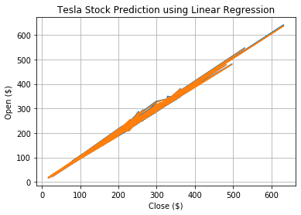
OUTPUT OF MLR

Slide 10
ERROR RATE - RMSE
The prediction error is the difference between the true value and the predicted value for an instance.
Mean Squared Error : 3.4378881758603734

Slide 11
2.ARIMA MODEL
ARIMA stands for “Auto-regressive Integrated Moving Average”
This model is also often called by the famous “Box-Jenkins model''.
AR MODEL
An “Auto regressive (AR) model'' is used to calculate the future behavior of a variable under consideration, using a linear combination of historical values of the variable.

Slide 12
MA MODEL
“Moving Average (MA) model'' uses earlier errors terms for prediction.
ARMA MODEL
“Autoregressive'' (AR) along with “moving average'' (MA).
models are used collectively to get a new unit of time series models referred as “ARMA models''

Slide 13
THANK YOU ………..

