Slide 2
Datatypes
Training
Validation
Test

Slide 3
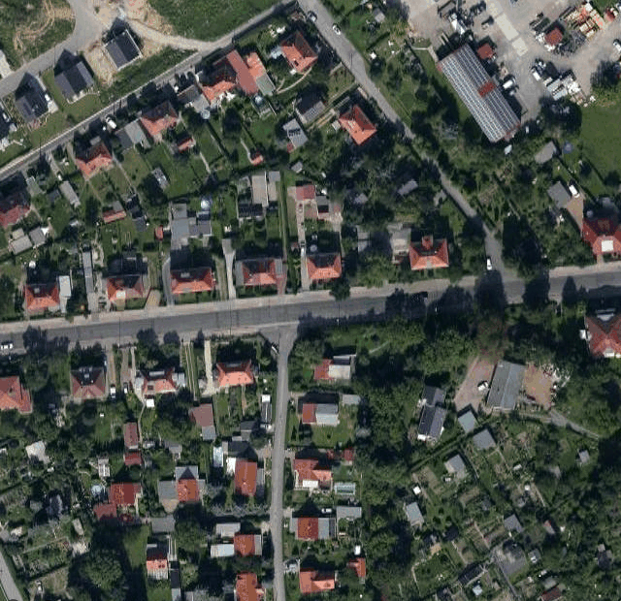


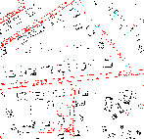
Training
Neural
network

