Slide 1
Deeplearning
Sebastian Mischke

Slide 2
Datatypes
Training
Validation
Test

Slide 3
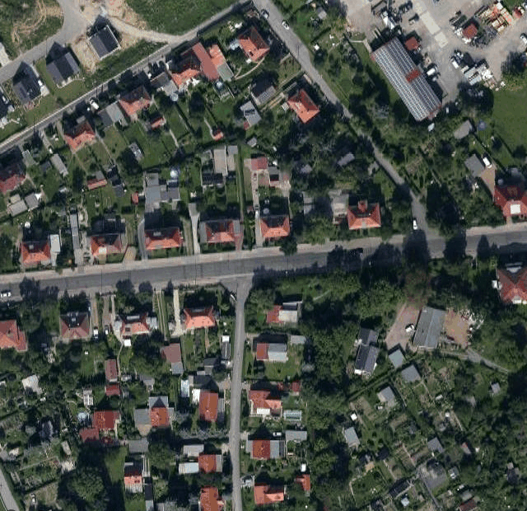


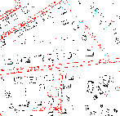
Training
Neural
network
Input
Output
Teach
Error

Slide 4
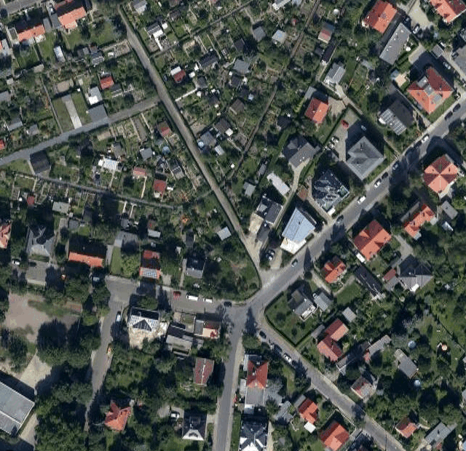
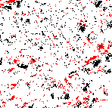

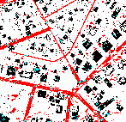
Validation
Neural
network
37%

Slide 5
Test
Neural
network

Slide 6
Subsampling

