Slide 1

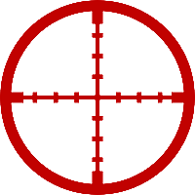
Game project: Target hunt
English presentation made by: dubecz david

Slide 2


introduction
WHAT DID THE client ASK FOR?
PLANNING
TASK ARRANGEMENT
Build-up
TESTING
FINAL WORDS

Slide 3

WHAT DID THE Client ASK FOR?
THE CLIENT REQUESTED A SIMPLE GAME, WHICH HAD TO BE ON A WORKING WEBSITE.
WE STARTED THE TASK IN THE MIDDLE OF DECEMBER IN 2023.
THE DEADLINE WAS 01/04/2024.

Slide 4
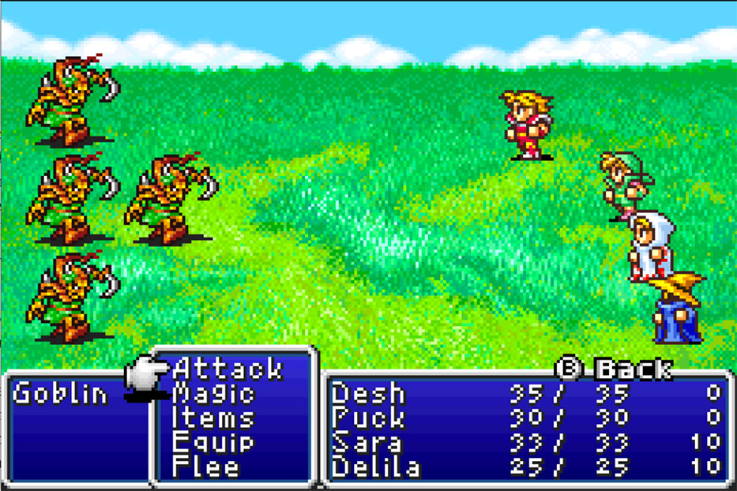
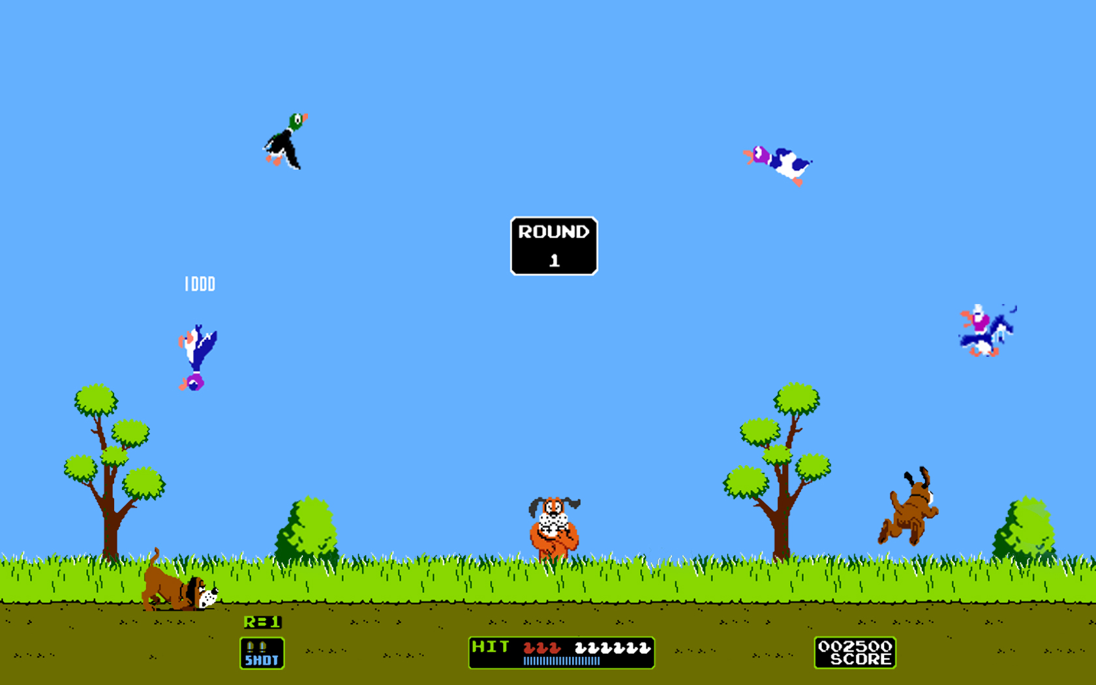

PLANNING
AT FIRST, WE WERE THINKING OF AN RPG (ROLEPLAY GAME), BUT IN THE END, THE END RESULT WAS A POINT AND CLICK TYPE OF TArGET GAME.

Slide 5



TASK ARRANGEMENT
OUR TEAM CONSISTS OF 3 PEOPLE
Javascript developer
Html developer
css developer
Rózsahegyi ákos
Sarkadi kristóf
Dubecz david

Slide 6


Task arrangement
Tools used for allocating/uploading the task:

Slide 7



Build-up
We used the following to create the game:
HTML
css
javascript

Slide 8
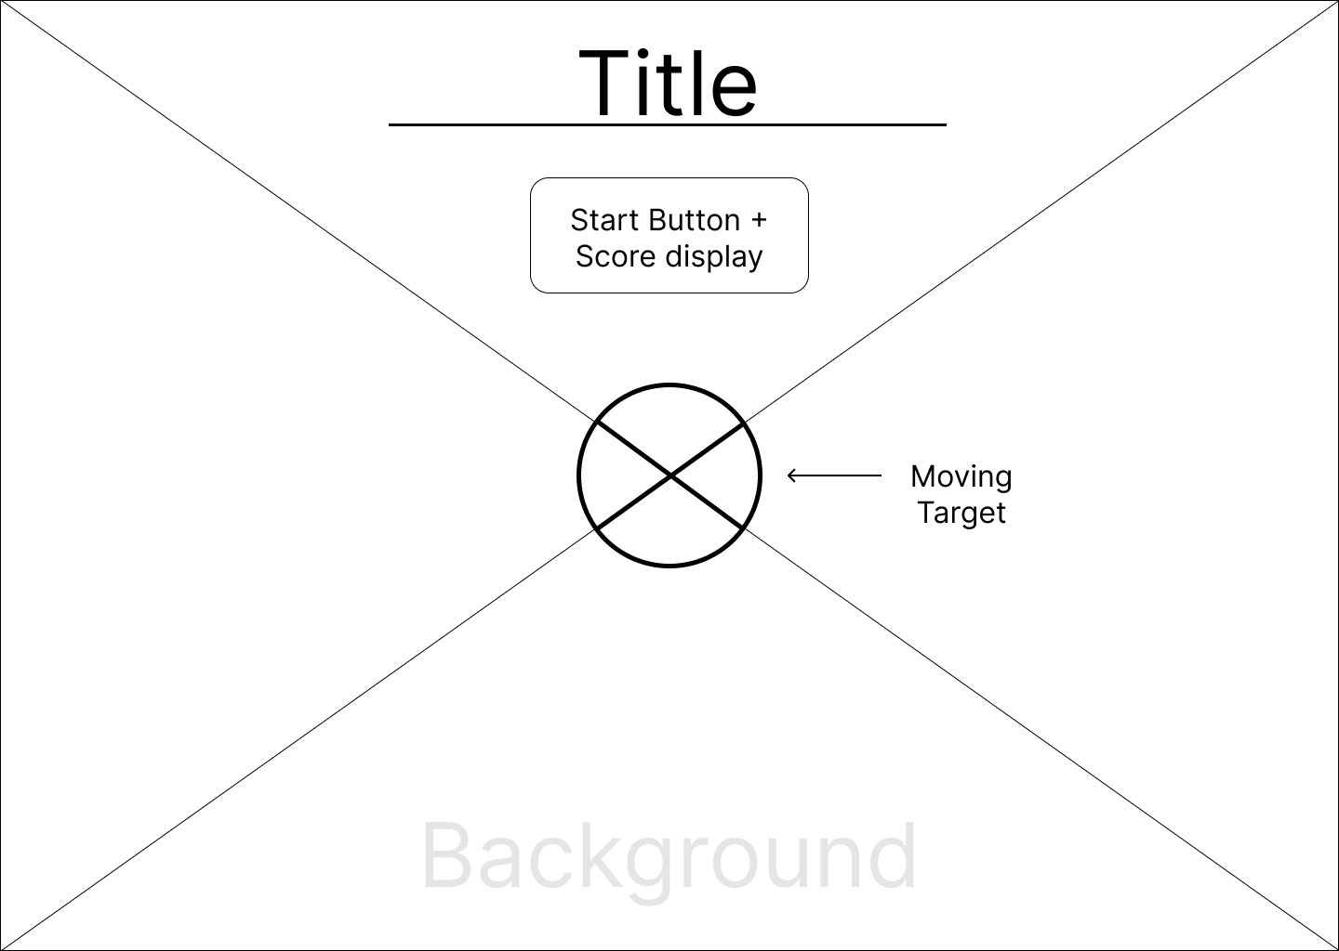
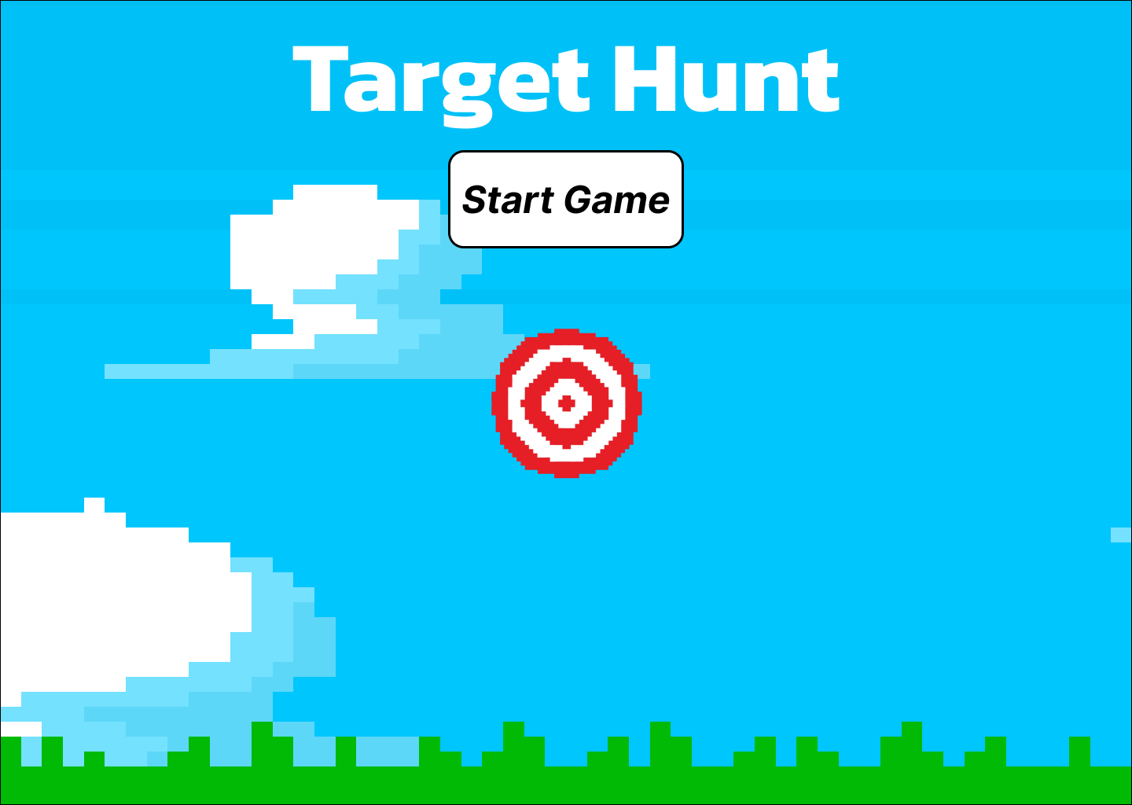
Build-up

Slide 9

Testing
In the last phases, only the tests were going, and we already sent it to the client around 01/03/2024.
While we were fixing the game, we found a bug which we left, because it made the game more interesting.

Slide 10
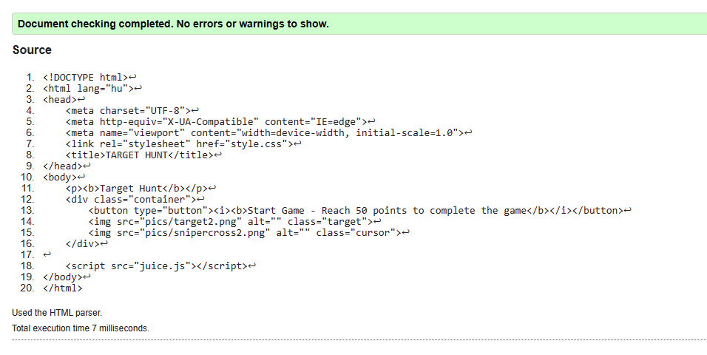
Validation was also successful

Slide 11
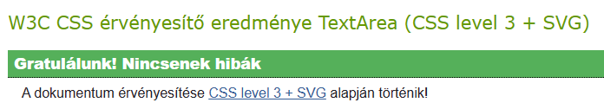
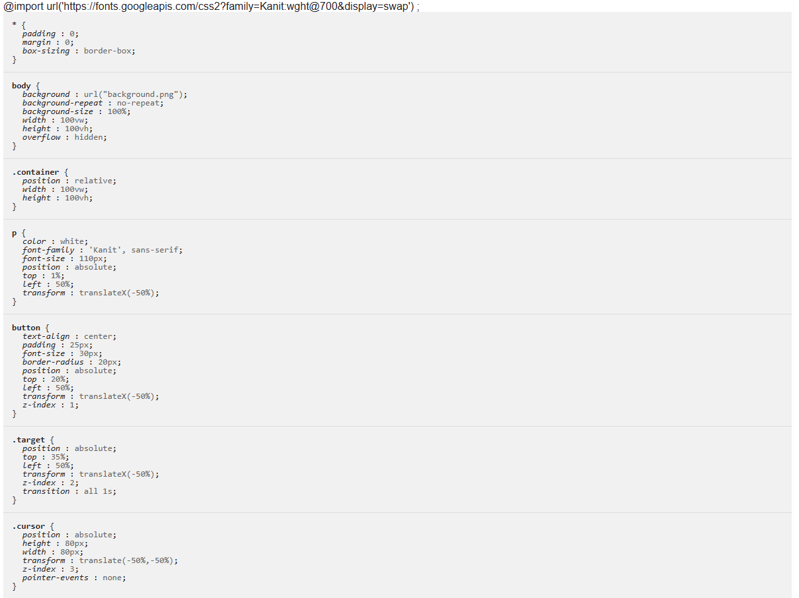

Slide 12
Final words
The game was inspired by the well known game called duck hunt .
In our game, there are no multiple targets which appears and needs to be shot, but only one that moves continuously.

Slide 13
Thank you for your attention!
Link to the game: https://sarkadikristof.github.io/jatek-project-munka/

