Slide 1
The Blue Plug
Loquen Jones, Sahil Verma
www.scu.edu
Notes:
Start with Sahil

Slide 2
The Problem & the Current Methods
Grid usage is inefficient.
Goes over peak usage daily, up to 160%
Not cost effective for both customer and supplier
The Current Solution
Use of extra generators during peak harms environment
Single grid managing load for everyone; single point for power loss
Notes:
First slide is us talking about the problem, and what’s currently out there to combat said problem. Sahil

Slide 3
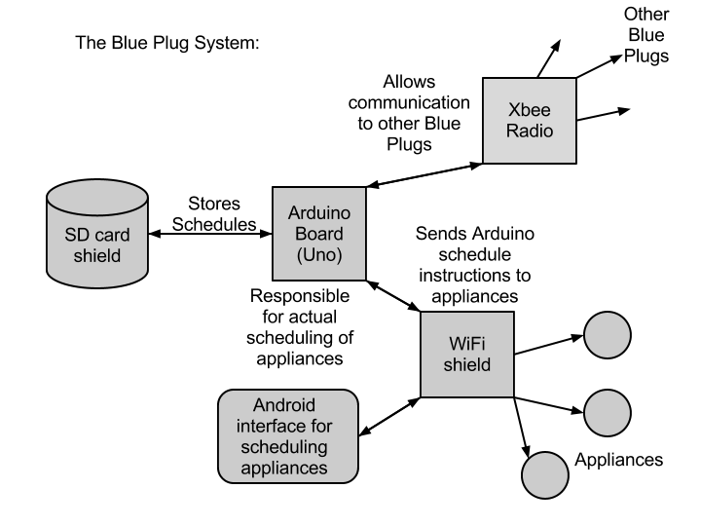
Notes:
Ok, here’s the overview of our solution. Loquen

Slide 4
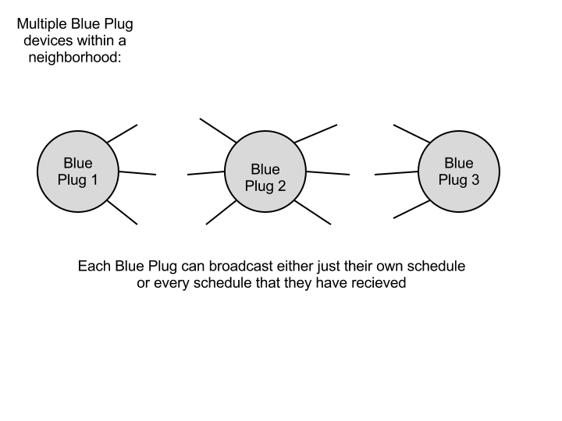
Notes:
More big picture of our stuff, including why it’s better. Loquen

Slide 5
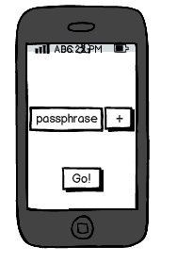
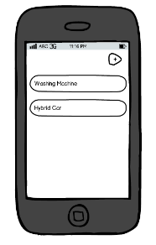
Conceptual Model
Notes:
Let’s drill down to the actual app and set up use cases. (we’ll add concept pics from eclipse!) Loquen

Slide 6
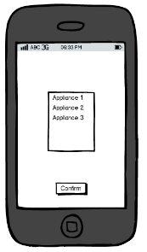
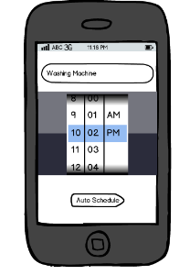
Conceptual Model (cont.)

Slide 7
Use Cases
Authenticating Users
Adding An Appliance
Setting Deadlines For Appliances
Removing Appliances From Scheduling
Scheduling Tasks (Automatically)
Viewing Schedules
Turning Appliances On Immediately
Setting Up Ad-Hoc Networks
Notes:
Now that you’ve seen what it looks like, here’s what it’ll do! Sahil

Slide 8
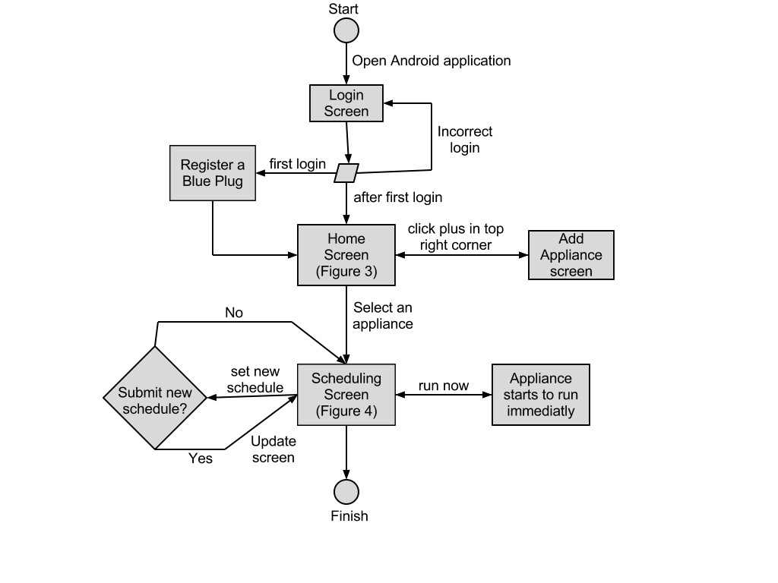
What A Typical User Will Do
Notes:
Once we’ve described the functionality (use cases), and how it flows, we’ll go over what tools will be used to build it. Loquen

Slide 9




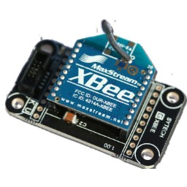
Technologies and Design Rationale
Notes:
Adding logos of technologies Sahil

Slide 10
Technologies and Design Rationale (contd.)
Android for ubiquity
Arduino is open source
Python for simple web
Notes:
Sahil

Slide 11
Project Risks
Risks | Consequence | Probability | Severity | Impact | Mitigation Strategy
Unfamiliar Tech | More Time Learning Than Building. Novice Mistakes | 0.9 | 8 | 7.2 | Ask advisors, online resources, teach ourselves.
Time | System isn’t polished, not all features added | 0.6 | 7 | 4.2 | Follow Gantt Chart, weekly meetings.
Sickness | Work on project decreased | 0.3 | 5 | 1.5 | Stay Healthy, don’t over work
Hardware Failure | Work Lost | .001 | 8 | .008 | Use Github
Notes:
Loquen

Slide 12
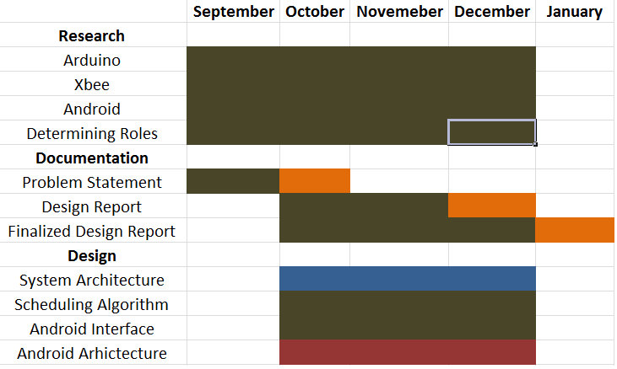
Development Timeline
Notes:
Loquen

Slide 13
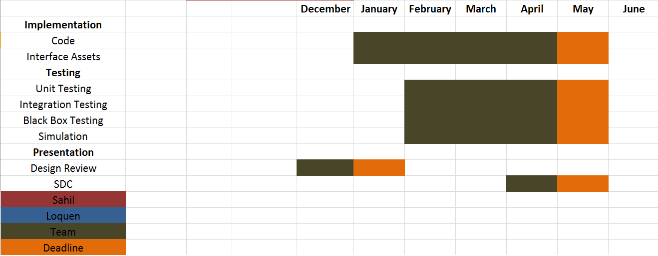
Development Timeline (cont.)
Notes:
Loquen

Slide 14
Questions?

